Slide 1
Website Compliance & Accessibility:
Tips to Protect Your City
Iowa Municipal Finance Officers Association de Novo Marketing
10/17/24

Slide 2
ABOUT US
The de Novo Team
Jen Neumann Owner & CEO
Ryan Shenefelt Account Manager, Innovation and Education Lead

Slide 3
A Brief Overview
About de Novo
Understanding Website Accessibility
The Digital ADA Approach
Best Practices & Tips
Tools to Ensure Compliance
Ongoing Commitment
Questions

Slide 4
About de Novo
Think Fresh.

Slide 5
OUR CAPABILITIES
Services
DESIGN
WEB
DIGITAL
CONTENT
STRATEGY
VIDEO

Slide 7
ABOUT US
How We Work

Slide 9
ABOUT US
Our Philosophy

Slide 10
Understanding Website Accessibility
Think Fresh.

Slide 11
Understanding Website Accessibility
What is Digital ADA Accessibility?
The practice of ensuring that people with disabilities can access and use digital content and services on an equal basis with others.
You make sure your buildings are ADA accessible…your website should be no different!

Slide 12
Understanding Website Accessibility
What Are The Rules?
Guidelines, not laws
Consequences for non-compliance
Wild West - but not as hard as it seems to make improvements and get started!

Slide 13
The Team
The Digital ADA Approach
Think Fresh.

Slide 14
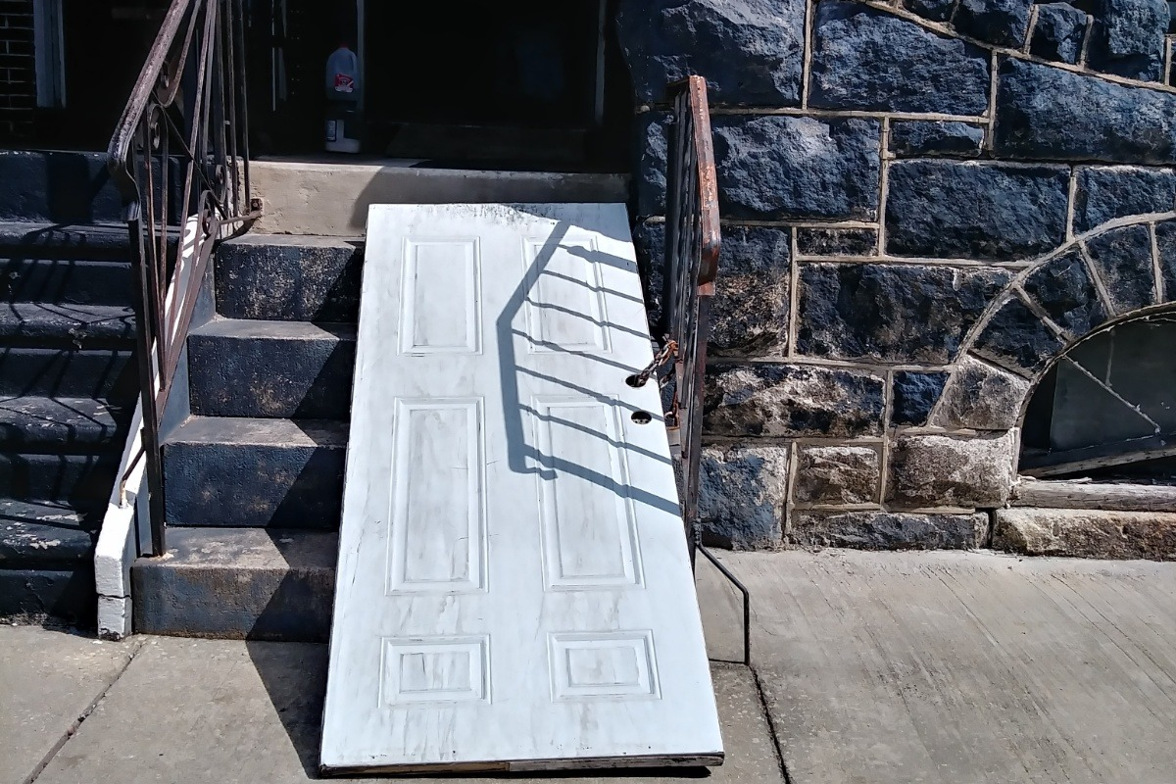
The Digital ADA Approach
Avoiding “Band-Aid” Solutions
Increase of companies offering “overlay approach”
Often notices come from those trying to sell services
Additional issues w/ screen reading software

Slide 15
The Digital ADA Approach
The “Foundation Up” Approach
Investing time and thought in the early stages of web development.
Build solutions into the foundation of your site.
Hard to “retrofit” a solution

Slide 16
Best Practices & Tips
Think Fresh.

Slide 17
Best Practices & Tips
Common Accessibility Features
HTML: H1 / H2 Tags
Newer: ARIA Tags
ALT Tags
Contrast Ratios
Text in Graphics
Forms / PDFs
Captions in Video
Transcripts

Slide 18
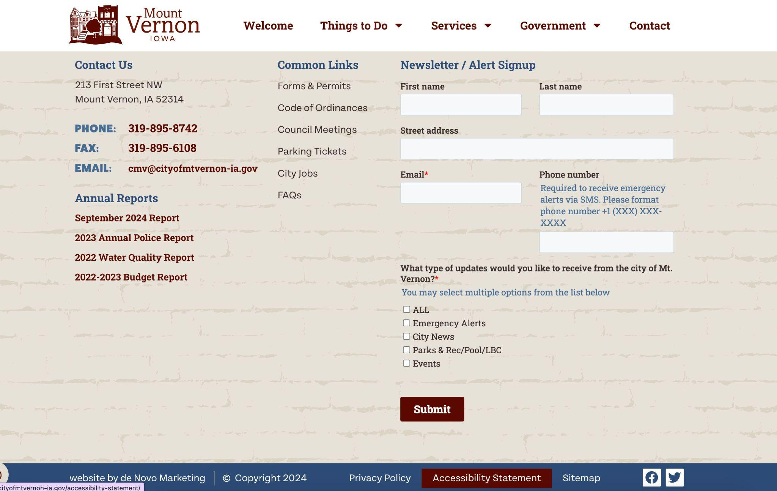
Best Practices & Tips
Accessibility Statement
Easily Located Across Site
Reflects Your Values
Shows Intention

Slide 19
Tools to Ensure Compliance
Think Fresh.

Slide 20
Tools to Ensure Compliance
How are things being reported and tracked?
WCAG Standards
Self-Check Tools
wave.webaim.org
Google Lighthouse
de Novo Audit

Slide 21
The Team
Ongoing Commitment
Think Fresh.

Slide 22
Ongoing Commitment
Responding to Concerns
Demand Letters vs. Scare Tactics
Reasonable Accommodation
Legal Consultation

Slide 23
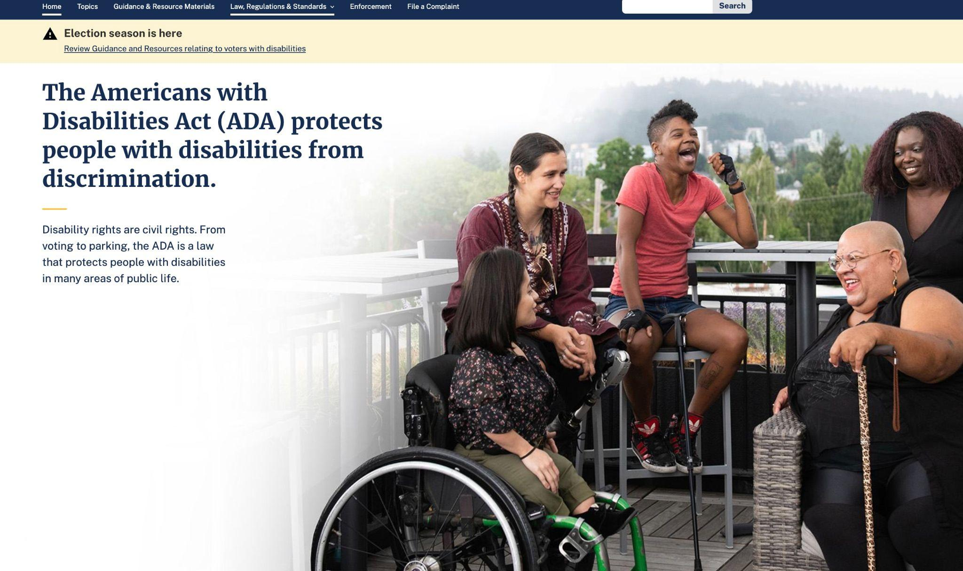
Ongoing Commitment
Future-Proofing Your Site
Constantly evolving landscape: Keep up with the news / changes to ADA guidelines
Ongoing, regular checks as new content is added or changed

Slide 24
Ongoing Commitment
Why Does It Matter?
Ensure an equitable experience for all your residents.
It’s just the right thing to do!

Slide 25
Questions?
THINKDENOVO.COM

Slide 26
Ways to Engage
Love Communications & Websites? So Do We!
Sign up for our Newsletter
Subscribe to our Podcast
Follow us on Social Media

