Slide 1

Open Meetings and Open Records Laws
GRACE HILLOCK, IOWA LEAGUE OF CITIES
Notes:
Thank IPIB, admin and communications.

Slide 2
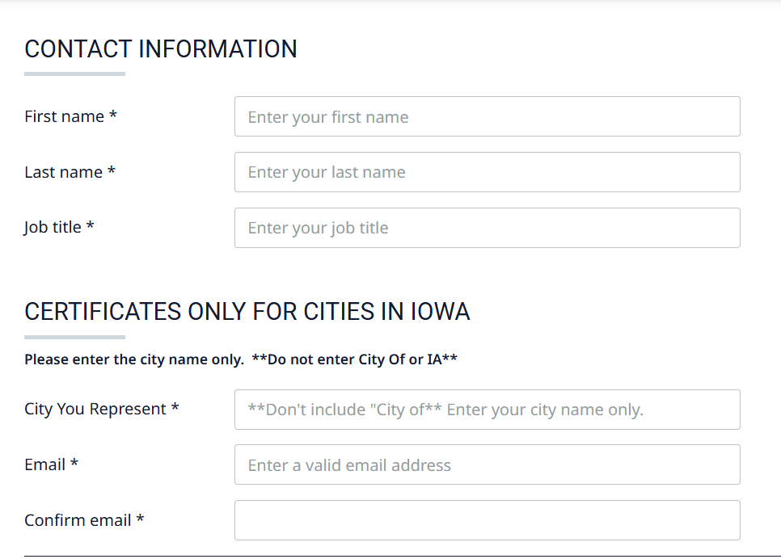
Open Meetings

Slide 3
Open Meetings
Code of Iowa Chapter 21
Open meetings and governmental bodies defined
Public notice and meeting requirements
Closed sessions
Rules of procedure and conduct
Open meetings violations

Slide 4
Intent of Open Meetings Law
Section 21.1
The law seeks to assure that the basis and rationale of governmental decisions, as well as those decisions themselves, are easily accessible to the people
Ambiguity should be resolved in favor of openness

Slide 5
Definition of Meeting
Section 21.2(2)
A gathering in person or by electronic means of a majority of members of a governmental body
May be formal or informal
Where there is deliberation or action

Slide 6
Definition of Meeting
Section 21.2(2)
Does not include gatherings of members of a governmental body for ministerial or social reasons when there is no discussion of policy
Or no intent to avoid the purposes of this chapter

Slide 7
Definition of Governmental Bodies
Section 21.2(1)
A board, council, commission or governing body created by Iowa statutes or by executive order
A board, council, commission or governing body of a political subdivision or tax supported district

Slide 8
Definition of Governmental Bodies
Section 21.2(1)
A multi-membered body created by one or more governing bodies
An advisory board, commission or task force created by executive order of a political subdivision to develop and make recommendations on public policy issues

Slide 9
Common City Governmental Bodies
City Council
City Council committees
Utility boards
Library boards
Park and Recreation boards
Planning & Zoning Commission
Board of Adjustment
Airport Commission
Many others, and committees of any of the above

Slide 10
Public Notice Requirements
Section 21.4
Meetings preceded by public notice
Posted in a “prominent place” at least 24 hours prior to meeting and provided to media who have requested notice
Time, date and place with tentative agenda
Meetings may be held without 24 hour notice for “good cause”, which must be stated in the minutes

Slide 11
Meeting Requirements
Section 21.3
Shall be held in open session unless closed sessions are expressly permitted by law
Must be held in a place and at a time reasonably accessible to the public, unless for “good cause” such a place or time is not possible (Section 21.4)

Slide 12
Meeting Requirements
Minutes – Sections 21.3 and 372.13
Governmental bodies are required to take detailed minutes of all meetings
  Must show the date, time and place; members present; any action taken
  Must show the results of each vote taken
  Minutes are public records, open to public inspection
  Must be published within 15 days according to 372.13(6) – council meetings only

Slide 13
Closed Sessions Common Uses
  Section 21.5
  Allows the use of closed sessions for specific purposes
  Common use for city councils:
    Evaluate the professional competency of an individual whose appointment, hiring, performance or discharge is being considered when necessary to prevent needless and irreparable injury to that individual's reputation and that individual requests a closed session

Slide 14
Closed Sessions Common Uses
  Section 21.5
  Common uses for city councils (con’t)
    Discuss litigation strategy with counsel
    Purchase or sale of real estate
    To avoid disclosure of specific law enforcement matters

Slide 15
Requirements for Holding a Closed Session
Section 21.5
Put the closed session on agenda
  Include the specific code section exemption
  Case name not required, if it is litigation
Affirmative vote by 2/3 of the members of the council or all members present is required
Ask your attorney whether it is lawful to go into closed session for that purpose
Council meeting minutes can include the attorney’s oral or written opinion that it is lawful

Slide 16
Additional Closed Session Requirements
Keep detailed minutes and audio recording; items must be sealed and can only be opened by court order or potentially by State Ombudsman
Discuss only relevant matters
Do not talk publicly about the closed session
Final action cannot be taken during the closed session
A governmental body can determine who attends a closed session and can exclude a member if the member’s attendance creates a conflict of interest

Slide 17
Electronic Meetings Best Practices
Select and test software
Assign meeting manager
Provide guidance/troubleshooting to council and public
Announce any special rules for participating online
Record meeting
Notes:
special rules - ex. how to participate in public forum or public hearings

Slide 18
Meeting Rules of Conduct
Section 21.7
Nothing in this chapter shall prevent a governmental body from making and enforcing reasonable rules for the conduct of its meetings to assure those meetings are orderly, and free from interference or interruption by spectators.
Section 372.13(5)
The council shall determine its own rules and maintain records of its proceedings.

Slide 19
Meeting Rules of Conduct
Setting the agenda
Discussion
Public comments
Decorum
Enforcement

Slide 20
Benefits of Council Meeting Rules
Effective, efficient meetings
Participants know how meetings are to be run (order of business, votes, discussion, etc.)
Help citizens, media and other members of public understand their role

Slide 21
Open Meetings Violations and Judicial Enforcement
Section 21.6
Any person, taxpayer or the attorney general or county attorney may seek judicial enforcement
Upon finding a violation, a court:
  Shall assess each member of the body who participated in the violation damages from $500 to $2,500 (law change in 2025)
  Shall assess each member of the body who knowingly participated in the violation damages from $5,000 to $12,500 (law change in 2025)

Slide 22
Open Meetings Violations and Judicial Enforcement
Section 21.6
Upon finding a violation, a court (con’t):
  Shall order payment of costs and attorney fees
  Shall order payment by the violating members
  Void the action taken, if the suit is brought within six months and the court makes certain findings
  Order a member removed from office if it is a second violation

Slide 23
Open Meetings Violations and Judicial Enforcement
Damages will not be assessed if a member:
  Voted against the closed session
  Believed facts indicating compliance with the law
  Relied on a court decision, attorney general’s opinion, opinion from the Iowa Public Information Board or opinion of the governmental body’s attorney
  The attorney’s opinion must be written, or if oral, included in the minutes

Slide 24
Iowa Public Information Board
Alternative means to enforce open meetings and open records laws
Complaints made to IPIB may be handled informally, through information assistance or mediation, or there may be a formal investigation of a complaint, and if probable cause is found a contested case may be prosecuted
IPIB Board may issue orders with the force of law determining whether there has been a law violation, require compliance, impose civil penalties and other remedies

Slide 25
Open Records
Code of Iowa Chapter 22
Basics and definition of records
Examination of records
Confidential records
Responding to requests, supervision and fees
Open records violations

Slide 26
Open Records Basics
Section 22.1
All governmental bodies, officials and employees are covered by Chapter 22
Each body must designate a “lawful custodian” for its records and must publicly announce who holds that responsibility

Slide 27
Public Records Defined
Section 22.1
The term “record” includes all documents, tape or other information stored or preserved in any medium of or belonging to a governmental body
It includes electronic communication such as emails, websites, social media or blogs

Slide 28
Examination of Public Records
Section 22.2
Anyone can examine, photograph or copy a public record without charge while the public record is in the physical possession of the custodian

Slide 29
When Must Records be Available?
Section 22.4
During customary office hours of the lawful custodian
If the custodian does not have customary office hours of at least 30 hours per week, such rights “…may be exercised at any time from 9:00 a.m. to noon and from 1:00 p.m. to 4:00 p.m. Monday through Friday, excluding legal holidays, unless the person exercising such right and the lawful custodian agree on a different time.”

Slide 30
Responding to a Records Request
Section 22.8
Most requests are routine and will be handled immediately or as soon as possible
However, a good faith delay is allowed to determine whether the record in question is a public record or confidential
A reasonable delay for this purpose ordinarily should not exceed 10 business days and cannot exceed 20 calendar days

Slide 31
Responding to a Records Request
Section 22.8
Record custodians should work with requesters to ensure that the correct records are released in as timely a manner as possible
Record requests do not have to be made in person; officials shall fulfill requests made in writing, by telephone or by electronic means (Section 22.3)

Slide 32
Supervision and Fees
Section 22.3
Examination and copying shall be done under the supervision of the record custodian; the custodian should not relinquish control of the records
The lawful custodian shall adopt reasonable rules to safeguard the records

Slide 33
Supervision and Fees
Section 22.3
The custodian shall provide a suitable place for the examination of records or move to a separate location, if necessary
The lawful custodian may charge a reasonable fee for the services of the custodian and for the copies (any fees should be applied uniformly)
2022 Legislation – No charge for records request that take 30 minutes or less (other than copies)

Slide 34
Supervision and Fees
Section 22.3
Fulfillment of a request may be made contingent upon payment of a fee and estimated expenses shall be communicated to the requestor
Fees cannot exceed the actual cost of providing the service and cannot include the costs of ordinary expenses such as employment benefits or those associated with the administration of the office

Slide 35
Confidential Records
Section 22.7
Over 70 types of records must be kept confidential
Other sections of the state code and federal law also contain provisions mandating confidentiality
The public records law allows the release of confidential information when “ordered by a court, by the lawful custodian of the records, or by another person duly authorized to release such information…”

Slide 36
Confidential Records
Common City Confidential Records
The work product of an attorney related to litigation by or against a public body
Peace officers’ investigative reports, except for date, time, specific location, and immediate facts and circumstances surrounding a crime or incident
Appraisal information concerning the sale or purchase of property for public purposes prior to announcement of the project

Slide 37
Confidential Records
Certain personal information such as age, race, sex, address and Social Security, home telephone numbers, reason for sick leave held in confidential personnel records of government employees
Information submitted which is not required by law and submitted from someone outside government, and the lawful custodian could reasonably believe those persons would be discouraged from submitting

Slide 38
Personnel Records
Section 22.7(11); considered public info:
The name and detailed information regarding compensation (all compensation) of an employee, including any written agreement about terms of employment
Employment dates, positions held, educational background and previous employment
The fact that the employee was discharged as the result of a disciplinary action
Records relating to the discharge of an employee, including those that resigned in lieu of termination or were demoted and documented reasons for such decisions

Slide 39
Legal Settlements
Section 22.13
After a legal dispute involving a government entity is resolved, upon request a summary must be prepared that indicates the identity of the parties involved, the nature of the dispute and terms of the settlement
This summary and the settlement agreement are public records

Slide 40
Utility Customer Account Information
  Section 388.9A
Public records of a city utility shall not be examined or copied as of right
Private customer information includes records that identify a specific customer and any record of a customer account

Slide 41
Record Retention
Some records remain permanently valuable due to their content or as required by state or federal law, but many records are of no further use once the matter has been transacted and routine audit, legal and administrative uses have been completed
Records management and best practices for retaining records can be found in the Record Retention Manual For Iowa Cities, available for free on the League’s Website

Slide 42
Open Records Violations and Judicial Enforcement
Section 22.10
A court can issue an injunction ordering a government body to comply, assess damages between $100 and $500, order payment of costs and attorney fees, and remove repeat violators from office
If a member of a governmental body knowingly participated in a violation, damages increase to $1,000-$2,500

Slide 43
Open Records Violations and Judicial Enforcement
Section 22.10
Ignorance of the law is not a defense
Damages will not be assessed against officials who voted against the violation, refused to participate in the violation, engaged in efforts to resist the violation, or relied upon a formal opinion of the attorney general, or the advice of an attorney provided in writing or memorialized in a meeting
Government officials who rely on advice from the Iowa Public Information Board are also protected

Slide 44
Resources
League materials
  Resources section (several pages on open meetings, open records, council meeting procedures, voting regulations, frequently asked questions and more)
  Open Meetings/Open Records special reports + desk reference
Iowa Public Information Board (www.ipib.iowa.gov)

Slide 45
We’re Here to Help!
Please contact us with any questions or comments
  mickeyshields@iowaleague.org
  gracehillock@iowaleague.org
  www.iowaleague.org
  (515) 244-7282

