Slide 1
Avoiding the “I Wish I’d Known That!” Moments
Avoiding the “I Wish I’d Known That” Moments
A guide for new clerks
Sara Shonrock, Community & Economic Development
Iowa State University Extension and Outreach

Slide 2

Presenter
Sara Shonrock
Assistant Director, Community & Economic Development at Iowa State University Extension & Outreach
Working with Iowa State Extension and Outreach Community & Economic Development since 2019
Primarily focusing on local and regional government needs and education.
Former Director for the Iowa Municipal Professionals Institute and Academy
Notes:
CHANGE TO YOUR INFORMATION.

Slide 3

Icebreaker
Turn to your neighbor. Introduce yourself with:
  your city
  your position
  how long you’ve been in your position
Then answer the following question:
What interested you most about your position before you took it? What concerns you most now that you have the position?
Notes:
5 minutes to talk to each other, a few minutes to share out.

Slide 4
The Reality of Municipal Professionals
Meetings • Records • Finance • Elections • Publications • Public Service
Notes:
The Code of Iowa in Section 372.13(3) requires that a city council appoint a city clerk with the following duties (from Section 380.7):
Promptly record each measure.
Where applicable, indicate whether the mayor signed, vetoed or took no action on the measure and whether the measure was passed after the mayor’s veto.
3. Publish a summary of all ordinances or the complete text of ordinances and amendments in a manner provided in Code Sections 362.3, 380.6 and 380.7. “Summary” means a narrative description of the terms and conditions of an ordinance setting forth the main points of the ordinance in a manner that informs the public in a clear and understandable way, the meaning of the ordinance and providing sufficient notice to conform to the desired conduct required by the ordinance. The description must include the title of the ordinance, an accurate and intelligible abstract or synopsis of the essential elements of the ordinance, a statement that the description is a summary, the location and normal business hours of the office where the ordinance may be inspected, when the ordinance becomes effective, and the full text of any provision imposing fines, penalties, forfeitures, fees or taxes. Legal descriptions of property must be described in full, provided that maps or charts may be substituted for legal descriptions when they contain sufficient detail to clearly define the area with which the ordinance is concerned. If it is necessary to use technical or legal terms not generally familiar to the public, the narrative description should include definitions.
4. Authenticate all measures, except motions, with his or her signature and certify the time and manner of publication if any. The clerk’s certification is presumptive evidence of the facts stated therein.
5. Maintain for public use copies of all effective ordinances and codes. One of the largest duties of the clerk is to record and publish the minutes of each city council meeting (Code Section 372.13(6)). The council minutes should include: • Signatures of the mayor and city clerk in accordance with Code Section 380.7. • Proper notice preceding the meeting required by Code Section 21.4 (tentative agenda). • Information sufficient to indicate the vote of each member present as required by Code Section 21.3. • Documentation of the passage of ordinances, amendments or resolutions by a majority vote of all the members of the council in accordance with Code Section 380.4 (not just those in attendance). • Documentation that the council followed proper proceedings for closed sessions (Code Section 21.5). 1) The session was closed by affirmative roll call vote of at least two-thirds of the members. 2) The specific exemption under Code Section 21.5 was identified and documented. 3) Final action was taken in open session. 19Chapter 2 | Role of Clerk • Delivered for publication (or posted depending on population size) within 15 days of the meeting in accordance with Code Section 372.13(6) and includes: 1) Total disbursements from each fund. 2) A list of all claims allowed (including the reason for the claim). 3) A summary of all receipts. 4) A summary of ordinances or amendments adopted.

Slide 5
The Ultimate Municipal Juggler
Information hub for residents, staff, & elected officials
Master calendar keeper, official custodian of records, and deadline tracker
Juggler of meetings, elections, licenses, budgets, & public requests
Asked to do the impossible…preferably by 4:30p.m.
Question for you:
  What task takes up more of your time than people realize?
Notes:
Slido: What task takes more of your time than people realize?

Slide 6
Federal, State, and Local Law Overviews
Federal Requirements
Fair Labor Standards Act
Family & Medical Leave Act (FMLA)
State Requirements
State Laws & Mandates (Iowa Code)
Job Duties
Local Requirements
Local Policies & Ordinances
Federal Grants
Accounting Methods/Reports
Open Meetings/Open Records
Ordinances
Resolutions
Motions

Slide 7
Before a Council Meeting
Agendas
  Public Hearings should offer the specifics of public hearings (guidelines, time limits)
  ​
  Title & Heading should be comparable to council minutes in format ​
    Should state it’s an agenda​
    Name the municipality​
    Show date/time/place​
  Council Procedures ​
    Consult your council procedures for specific details​
Notes:
Agenda development varies but the roll of the agenda is to outline the overall discussions and actions by the council. There is not right or wrong way to develop an agenda but everyone in the community should understand how items get added to the agenda.
Council Procedures will have items like when the agenda must be submitted by the City Administration, as well as things like the order of business for the agenda, and when the closing of agenda items takes place before a meeting (for exa

Slide 8
Agenda Requirements
Agendas with minimal information such as “approval of old minutes, old business, new business” would not be sufficient, nor would using the same agenda for meeting after meeting. The information on the agenda must be reasonably sufficient to alert interested people as to the subject matter to be considered.
Minimum requirements include:
    Time, date, location, and tentative agenda.
    The tentative agenda can be subject to change under certain circumstances.
    The law allows discussion and action on emergency items,
          but if action can reasonably be deferred to a later meeting, it should be.
  The agenda must specifically state any issues the board intends to discuss in open or in closed sessions.
  HF2490 CHANGE:
      An agenda that had been previously posted may be amended by posting a revised agenda not less than 24 hours prior to the meeting, marked with the word “AMENDED,” and identifying the amended provisions. The government body must provide notice of the amended agenda in the same manner required for the original agenda, discussed above.
Notes:
Iowa Code Subsection 21.4(1) outlines the minimum requirements for public notice of a meeting: the time, date, and place of each meeting, and the tentative agenda of the meeting, “in a manner reasonably calculated to apprise the public of that information.” The Iowa Supreme Court provided clarification on how public bodies must handle agendas, notices, and discussions in the decision KCOB/KLVN v Jasper Co Board of Supervisors (1991),. The Supreme Court stated that a sufficient meeting must provide enough information to notify readers as to the subject matter to be considered. The Court also stated that the standard for compliance was “substantial” rather than “absolute.” In this case, A media company sued the Jasper County Board of Supervisors for allegedly violating Iowa’s Open Meetings Law (Chapter 21).
The Key takeaways were that:
1. Tentative Agendas Are Allowed and can be modified during meetings. Discussing items not listed is permitted if not done to intentionally mislead the public.
2. Notice Must Be Reasonable, Not Exhaustive-The law requires reasonable notice, not detailed descriptions of every item and prior public discussion or awareness can support the adequacy of notice.
3.Emergency or Unexpected Items- Items may be added during meetings if they arise unexpectedly or require urgent action but If action can wait, it should be deferred to a future meeting with proper notice.
4.Intent Matters- Violations require intent to conceal or mislead and Innocent omissions or agenda changes are not automatically violations.
5.Transparency Is the Goal-The law aims to ensure public access and awareness, not to restrict flexibility in governance.
Effective July 1, 2026- An agenda that had been previously posted may be amended by posting a revised agenda not less than 24 hours prior to the meeting, marked with the word “AMENDED,” and identifying the amended provisions. The government body must provide notice of the amended agenda in the same manner required for the original agenda, discussed above.

Slide 9
Standard Agenda
Call to Order and Opening Ceremony such as Pledge of Allegiance
Adoption of the Agenda
Reading and Approval of Minutes
Reports
Unfinished Business
New Business
Announce-ments
Adjourn
For public bodies, public hearings and public comment periods are integrated
Notes:
For public bodies, public hearings and public comment periods are integrated. Public hearings will need to have the details listed in the agenda as will public comment periods. You will want to list the details for any public hearing or comment period in the agenda. While there is no specific place that public comment and public hearing information belongs on the agenda, they are most often seen at the beginning after you adopt the agenda or after any reports to the council. Your Council Procedures and rules of order will help you find what works best.

Slide 10
Public Notice (21.4)
Includes time, date, location, and tentative agenda
In a prominent place
Notice of the meeting must be sent to any news organization or member of the public requesting it
except in an emergency or other good cause, which must be stated in the minutes
This will generally be handled by staff
HF2490: Notice must be posted in a designated, conspicuous location that is always visible
Posted at least 24 hours in advance
Notice must be posted on the primary internet site owned or maintained and regularly updated by the governmental body
Notes:
Before any public meeting you must give notice at least 24 hours in advance.
Notice must be posted in a prominent, conspicuous location visible always, such as governmental buildings, glass doors which the notice can be seen 24 hours a day, prominent bulletin boards etc. Notice must also be On the primary internet site owned or maintained and regularly updated by the governmental body, or on another primary internet presence moderated by the governmental body.
E-mail a copy to members of the public who request it.
Where proper notice is not given, the nature of the good cause must be stated in the minutes. This is rare and usually applies to emergency situations.
New and starting July 1, 2026, HF 2490 modifies Iowa Code section 21.4 relating to public meeting notice requirements. Public notices for open meetings must now be posted:
1. In a prominent and conspicuous place that is annually designated for such purposes by the governmental body, in a manner such that the notice is visible at all times; and
2. On the primary internet site owned or maintained and regularly updated by the governmental body, or on another primary internet presence moderated by the governmental body.
Notice to news media that have requested notice continues to be required.

Slide 11

Discussions on Agendas
Review a sample agenda and identify missing items or posting concerns.
This Photo by Unknown Author is licensed under CC BY-SA

Slide 12



Public Comment Policies
Legal Framework (Iowa Code Ch. 21)
Standard Decorum & Guidelines
Forum & Comment Types
• Right to Observe
• Mandatory Hearings
• 24-Hour Notice
• Speaker Sign-Up
• Time Limits
• Podium Protocol
• Agenda Item Input: Targeted remarks delivered immediately before the council discusses and votes on a listed item.
• Open Citizen Forum: Dedicated general comment period (start/end of meeting) for topics not on the official agenda.
• Local Autonomy: Each municipality adopts its own standing rules of order (e.g., Ames, Ankeny).
Notes:
Legal Framework:
• Right to Observe: The Iowa Open Meetings Act guarantees public observation, not an automatic speaking right.
• Mandatory Hearings: Public input is legally required only for formal public hearings (taxation, rezoning, ordinances).
• 24-Hour Notice: Agendas must be publicly posted at City Hall / online at least 24 hours in advance.
Standard Decorum:
Speaker Sign-Up: Most cities require registering via a speaker card or digital kiosk prior to call to order.
• Time Limits: Typically 3 to 5 minutes per speaker to ensure equitable participation.
• Podium Protocol: Speakers must state their name/address at the microphone; personal attacks are strictly prohibited.

Slide 13
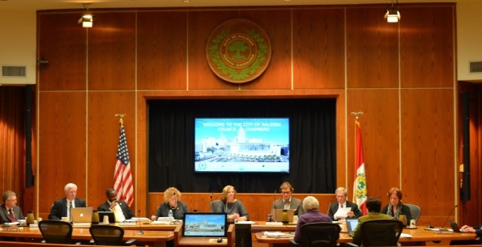


Meeting Decorum
This Photo by Unknown Author is licensed under CC BY-SA-NC
This Photo by Unknown Author is licensed under CC BY-SA
This Photo by Unknown Author is licensed under CC BY
Meeting Foundations
Professional Conduct
Ethics & Accountability
Open Meetings Compliance (Chapter 21)
Quorum
• Rules of Procedure
• Council Decorum
• Ethics & Standards
• Public Trust
Notes:
Column 1: Meeting Foundations (Quorum & Open Meetings)
"Every council meeting begins with the basics of legal governance. A quorum is the minimum number of members required for the council to conduct business and take official action. Without a quorum, discussion may occur in limited circumstances, but votes and official decisions generally cannot. Council members should also understand open meetings requirements, including providing proper notice, posting agendas, and conducting public business openly. These requirements are not simply procedural hurdles; they help ensure transparency, accountability, and public confidence in local government."
Column 2: Professional Conduct (Rules & Decorum)
"Rules of procedure help meetings run efficiently and fairly. Members should follow adopted rules, stay focused on the agenda, seek recognition before speaking, and direct comments through the chair when appropriate. Good decorum means listening respectfully, avoiding interruptions, and debating issues rather than personalities. Disagreement is a normal and healthy part of governing, but it should remain professional and civil. The goal is not always agreement, but productive discussion that allows the council to make informed decisions."
Column 3: Ethics & Accountability (Ethics, Standards, and Public Trust)
"Council members are entrusted with serving the public interest. Ethical conduct requires avoiding conflicts of interest, complying with applicable laws and policies, and making decisions based on what is best for the community. Members should treat staff, fellow officials, and the public with respect, even during difficult conversations. Every action taken by a council member reflects on the credibility of the governing body. By demonstrating integrity, fairness, and accountability, councils build and maintain the public's trust."
Closing Transition "Strong councils rely on all three areas working together: legal compliance through quorum and open meetings requirements, professional conduct through rules and decorum, and ethical leadership through accountability and integrity. When these elements are present, meetings are more effective and public trust is strengthened
Question for discussion: What is the most challenging public meeting situation you’ve dealt with? Take 5 minutes and talk about your craziest meeting experience.

Slide 14
Closed Sessions
Pass a motion by a vote of two-thirds of members
State in the minutes the reason for the closed session
Keep minutes during the closed session with details of all discussions, persons present, and actions taken
Record audio or video of the closed session, and retain for at least one year after the date of the meeting
Discuss only what is on the agenda
Vote on the issue discussed in the public session
Requirements for Closed Sessions
Closed sessions will only happen for specific reasons
Requirements
  There are 12 specific reasons that a meeting is allowed to go into closed session. These are listed in Ch. 21.5
Notes:
City attorney should be there.

Slide 15
Minutes, Resolutions & Ordinances
Minutes document discussion/action; resolutions act; ordinances create law.

Slide 16
Custodian of Records
Custodian of records
Key Responsibilities
Most often the City Clerk is the designated custodian.
Iowa Code Chapter 22 covers Open Records
Receive & respond to records requests
Locate and provide access to records
Protect confidential records
Fees
Supervision
Fees can be charged for the fulfillment of requests
Can’t charge fees for ordinary expenses
Provide space for supervision of copying or photographing in onsite
Cannot require the request to be in-person
Response to Requests
Best Practices
Response to routine requests should be immediate
Good faith delays can be allowed
Define what is public, private, or a mix
Create processes for records requests and confidential records
Notes:
FEES:
The custodian can charge fees for the fulfillment of requests provided those fees do not exceed the actual costs of providing the service and cannot include ordinary expenses like employee benefits, electricity, etc. A lawful custodian should not charge a requester for legal services used to determine whether the records requested contain confidential information. ​
The lawful custodian should only charge the requester for the actual time an attorney spends redacting or reviewing confidential information.
SUPERVISION:
Per House File 2490, starting July 1, 2026, custodians must fulfill requests received in writing, by telephone, or electronically, while also establishing that records taking less than thirty minutes to produce should generally be provided at no cost beyond copying fees, and that actual costs for services should be clearly communicated and reasonable, excluding ordinary operational expense
RESPONSE TIME:
Chapter 22 is silent as to the time for response to a records request. ​
Based on our review of section 22.8(4)(d), we believe it is not intended to impose an absolute twenty-day deadline on a government entity to find and produce requested public records, no matter how voluminous the request. Horsfield Materials, Inc. v. City of Dyersville, 834 N.W.2d 444 (Iowa 2013).​
If a request is routine, work to provide it immediately or as soon as possible.​
A good faith delay is allowed to determine whether the record in question is a public record or confidential. (Section 22.8(4))​
A reasonable delay for this purpose ordinarily should not exceed 10 business days and cannot exceed 20 calendar days. ​
Record custodians should communicate with requesters to ensure that the correct records are released in as timely a manner as possible and any issues are discussed.​
But, several Supreme Court decisions have raised specifically fact questions regarding “unreasonable delay.” See Belin, Kirkwood Institute, and Teig
BEST PRACTICES:
It is strongly encouraged that agencies create written policies that:
Define the nature and extent of personally identifiable information collected by the agency
Describe which records are public, confidential, or a mixture
Delineate procedures for handling records requests
Create a process for the subject of a confidential record to grant permission to release that record to a third party
Create a process for the subject of a public record to review that record and have additions, dissents, or objections entered into that record, unless otherwise prohibited

Slide 17
Minutes
Publication requirements
Minutes Must Include
Requirements for publication are listed in Iowa Code 372.13(6)
Minutes must be published within 15 days of the meeting. For communities under 200, you may opt to publish but it is not required.
Publish accounts payable and revenue and expenditures by fund.
  date, time, and place
  members present, who presided (mayor/mayor pro tem)
  Actions taken
  Results of each vote taken
Notes:
After the council meeting, clerks are required by law to publish or post the meeting minutes within 15 days. The publication requirement for minutes is the same as the requirement for notices discussed previously in this chapter. Cities with populations under 200 can post minutes in three designated places as specified by ordinance. Cities with populations over 200 must publish minutes in a newspaper of general circulation. Meeting minutes must include the actions of the council and the votes of each council member. Some cities include more information than the minimum required by law, and the amount of information to include is typically determined by city practice.

Slide 18
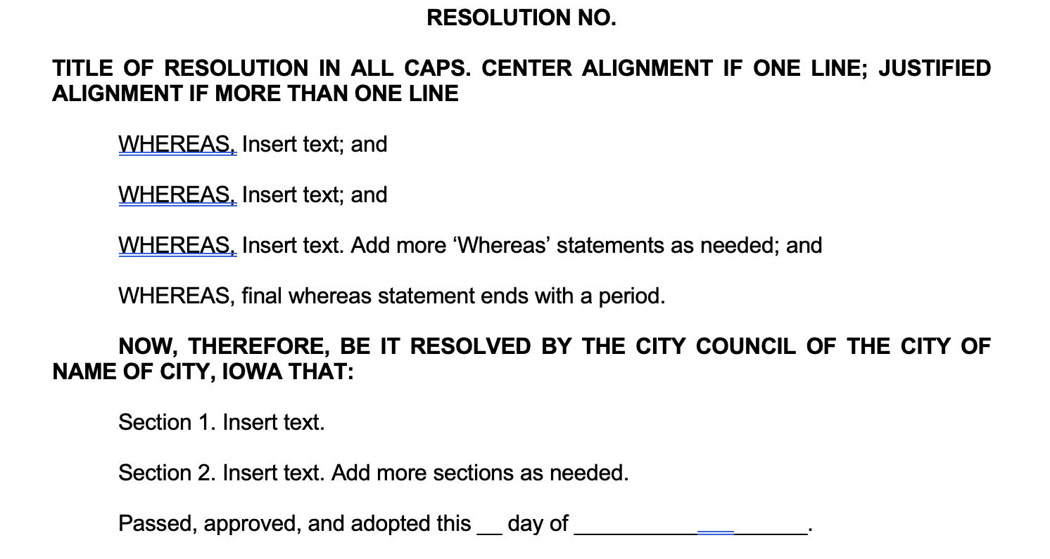
Resolutions
A formal expression of policy, opinion or intent
Examples include setting wages, establishing council rules, adopting the annual budget, approving a scholarship application for MPI
Can be passed by a majority at one meeting
Notes:
Resolutions are required: 1. For approval of subdivision plats per Iowa Code Section 354.8; 2. For approval of the sale of city property per Iowa Code Section 364.7; 3. For approval of contacts to construct public improvements per Iowa Code Section 26.10 4. For expenditure in excess of $100,000 on a public improvement project 5. For acceptance of a public improvement or facility upon its completion per Iowa Code Section380.4 6. For adoption or amendment of the annual budget per Iowa Code Sections 24.2A, 384.16 and 384.18 7. Fund transfers 8. City officials wages, salaries and benefits 9. Depository Resolution 10. Resolution of Necessity (Bonds and Urban Renewal Districts) 11. Special Assessments 12. Street Finance Report approval 13. Contracts and agreements, including 28E agreements 14. Employment policies/handbooks
*Talk about depository resolutions and why they are necessary.

Slide 19
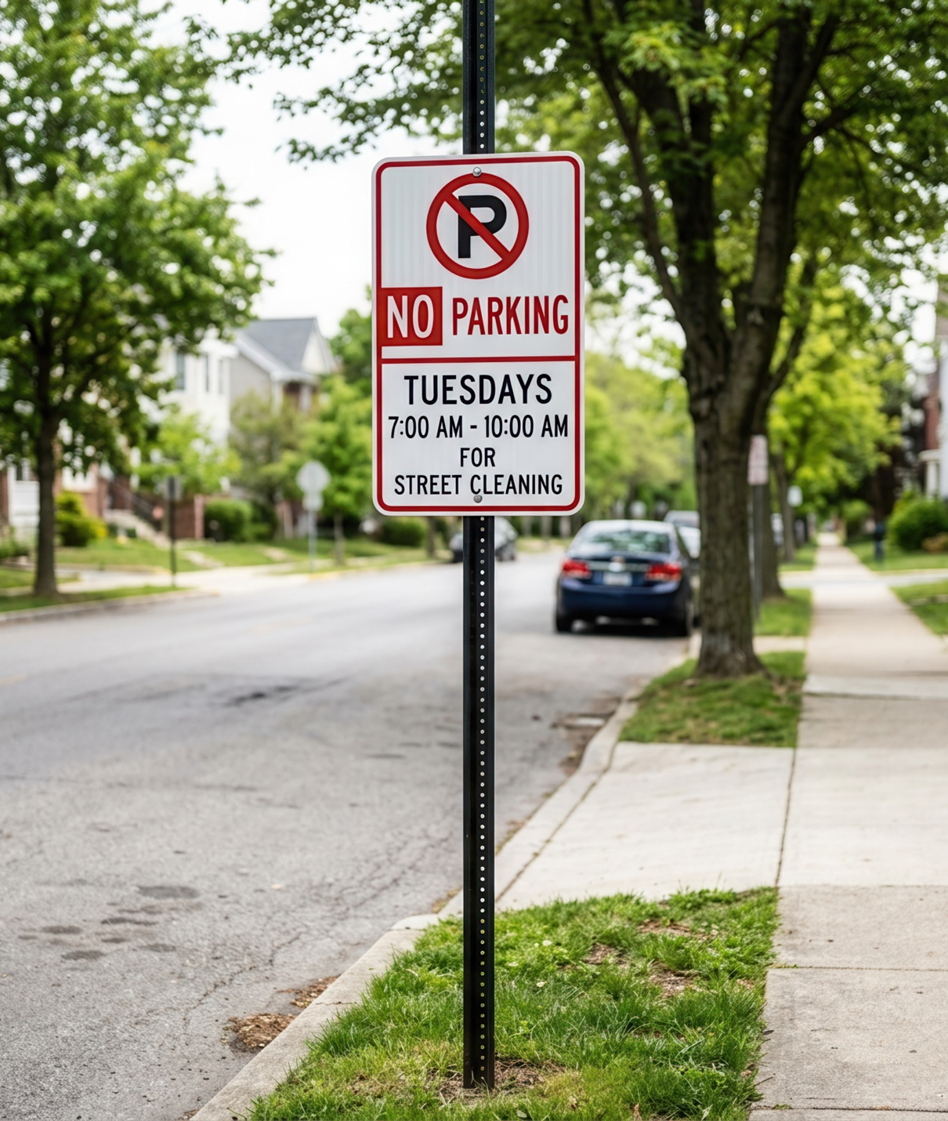
Ordinances
City law that is permanent
Covers broad rules such as zoning, utility rates, and public offenses
Passed by a majority at three separate readings/council meetings
  Councils can waive the requirement by approval of ¾ of the council.
Annual Codification
  Index if no codification available

Slide 20

Records Request Scenario
Resident requests all emails about a project. What steps would you take?

Slide 21
Notary Responsibilities
Many city clerks are also notaries for their city.
Role is to prevent fraud by witnessing signing of documentation.
Always require a Driver’s License or ID to provide identity
Keep a Journal of Notarial Acts
  Vital legal protection
  Fraud prevention
  Resolves lost documents
  Permanent chronological records of transactions

Slide 22
Annual Audit/Examination
All Iowa cities are subject to financial oversight requirements. The type of review depends primarily on the size of the city and the budgeted expenditures.
City Size / Budget | Requirement
Population over 2,000 | Annual Audit
Population 2,000 or less and $1M+ budgeted expenditures for 2 consecutive years | Annual Examination
Population 2,000 or less and under $1M budgeted expenditures | Periodic Examination (at least once every 8 years)
Required audits must be completed within 9 months after the end of the fiscal year (March 31), unless an extension is granted by the State Auditor
Notes:
Cities not required to have an annual audit are always able to have an audit conducted on their own initiative.

Slide 23
Annual Audit/Examination
🗂 Before the Audit
Ensure financial information is complete, organized, and accessible.
Maintain accurate financial records throughout the year
Retain supporting documentation for revenues, expenditures, payroll, and contracts
Ensure annual financial reports are prepared and submitted timely
Monitor compliance with state reporting requirements
🤝 During the Audit or Examination
Assign primary point of contact for the auditor.
Coordinate requests for records and supporting documents
Answer questions about city financial processes
Assist staff and elected officials in gathering information
Track requests and deadlines to keep the process moving
✅ After the Audit
Audit reports are only valuable if findings are addressed.
Review findings and recommendations with city officials
Help develop corrective action plans
Monitor progress on unresolved findings
Maintain records of actions taken for future reviews

Slide 24
Internal Audit Committees
Provides independent review and oversight over your city’s reporting process, internal controls, and independent auditors.
Committee should be formally established by resolution or a part of a financial management policy.
Members should have or be able to receive a high understanding of governmental budgeting, accounting, and the reporting and auditing requirements.
Council member(s) should be a part of it.
Notes:
Purpose
Provides independent oversight of the city's financial reporting, internal controls, and audit process.
Typically includes council members and may be established by resolution or city financial policy.
Membership
At least one council member should serve on the committee.
Members should understand budgeting, financial reporting, and audit requirements.
Staff such as the clerk or finance director support the committee but should not be members.
Key Responsibilities
Review financial reports, invoices, bank statements, and internal controls.
Assist with selecting audit/examination services and reviewing auditor recommendations.
Meet with auditors and discuss financial statements and findings.
Provide a confidential process for reporting accounting concerns.
Report to the city council annually on committee activities.
Clerk Connection
The clerk is often the committee's primary staff resource, providing records, financial information, and support throughout the audit or examination process.

Slide 25
Annual & Recurring Reporting
Budget
Due by April 30th of each year
2 Public hearing notices needed (not fewer than 4 days & not more than 20 days before the public hearing
Must enter max tax levy by March 5 at 4pm in the DOM website
Street Finance Reports
The SFR is released in mid-July and due on December 1st for all cities in the State of Iowa.
It is a summary of all revenues and expenses that are related to roads, streets, bridges, etc., for the previous FY.
Instructions, including a step-by-step book and training videos, are available on the INSTRUCTIONS link located on the left side of the SFR page and can be accessed without logging in.
Annual Financial Report
Must be filed by December 1 of each year
Report provides a summary of the fiscal year ending on June 30
Must be filed electronically with the Iowa Department of Management
Notes:
Budget:
The budget must be filed by April 30 and is preceded by two public hearings/notices as required by the state code. Code Section 384.16(3) requires that the public hearing notice is published (or posted for those cities 200 or less in population) not fewer than 4 days before and not more than 20 days before the public hearing. Additionally, a copy of the detailed budget must be available at least 20 days before it is certi­fied but not fewer than 10 days before the public hearing
In 2023, the legislature added an additional step that requires cities to hold a hearing on its proposed property tax amounts and taxpayer statements. This must be done after March 20th and prior to the final annual budget hearing/adoption.
SHARE A RESOURCE THAT REALLY HELPED YOU WHEN YOU STARTED AS A NEW CLERK WITH THESE REPORTS. IF YOU ARE A NEW CLERK: WHAT REPORTING REQUIREMENT IS CAUSING YOU THE MOST STRESS?

Slide 26
Clerk Resources
Who to call and where to go

Slide 27
Resources
Local & State Resources
League of Cities Resources
City Code
State Code
Iowa Department of Management
Iowa Department of Revenue
League Calendar
League Weekly
Records Retention Manual
City Clerk Handbook
Mentorship Program
IMFOA Resources
Iowa State Extension & Outreach
ClerkNet
Membership
Regional Clerk Groups
Certification Dashboard
Grant writing
Strategic Planning and Goal Setting
Critical Governance
Planning & Zoning

Slide 28




Training and Development
Iowa State Extension & Outreach
Iowa Municipal Finance Officers Association
League of Cities
Iowa DOT
Iowa Municipal Professionals Institute/Academy
Grant writing
Goal Setting/Strategic Planning
Planning & Zoning
IMFOA Conference
Certification
League Conference
Small Cities
Clerk Office Hours
Budget Workshops
Street Finance Reports

Slide 29


Certification Requirements
Iowa State Extension & Outreach
League of Cities
Iowa Municipal Finance Officers Association
Iowa Municipal Professionals Institute/Academy
Grant writing
Goal Setting/Strategic Planning
Planning & Zoning
League Conference
Small Cities
Clerk Office Hours
Budget Workshops
IMFOA Conferences
April and October
Clerk & Finance Officer Certification
Recertification

Slide 30

Evaluation Slide

Slide 31


Slide 32
Who Do You Call?
Build your network:
  League,
  IMFOA,
  County and state auditor
  Your city attorney,
  IDOT
  Iowa State Extension & Outreach
  Mentors

Slide 33
One thing learned, one action item, one remaining question.
Wrap Up

