Slide 1
Municipal Professionals Institute & Academy Overview
Understanding the Process
April 11, 2025

Slide 2
Overview
Municipal Professionals Institute Information
Municipal Professionals Academy Information

Slide 3
Municipal Professionals Institute
Beginner courses that are designed to help municipal professionals with their day-to-day duties.
Pathway to being certified as a municipal clerk or finance officer
Fees are $16 per credit hour
Do not need to be taken in any order and are on your schedule
Target audience: City clerks, finance officers, administrators, utility clerks, elected officials, etc.
Lovingly known as ”clerk school”
A credit hour is equal to an hour of class. So a 4 hour class is worth 4 credits

Slide 4
Institute Classes
Courses take places three times per year
February virtual classes over three days (1st or 2nd week of February)
June is in person classes over 4 days (June 9-12, 2025)
October is virtual classes over 3 days (October 1-3, 2025)

Slide 5
Page 2 of the Municipal Professionals Institute Brochure

Slide 6
Important Institute Information
Classes cannot be duplicated during your certification credit period
Courses take place once a year, virtual classes are live and not recorded.
If your goal in taking Institute classes is to get certified, you will need to take classes in each session

Slide 7
Municipal Professionals Academy
Offers advanced educational information on a variety of topics that are vital parts of your positions
You do not have to be certified to attend, nor do you have to have completed the Institute
Cost to attend is $250 and is worth 16 credit hours for attending the entire Academy.
For recertification purposes, this is an easy way to get your credits each year! .

Slide 8
Academy Courses for 2025
Academy will be June 9-11, 2025
Breakout sessions include:
Strategic Planning for your Community
Public Art
Council Procedures

Slide 9
Items & Dates
Sweatshirt registration closes May 14, 2025
Academy
Registration closes June 1, 2025
Clifton Strengths registration closes May 14th to get books out to attendees as well as the strengths evaluation
Institute
Registration closes June 1, 2025
Difficult Discussions and Group Dynamics have class size limits

Slide 10
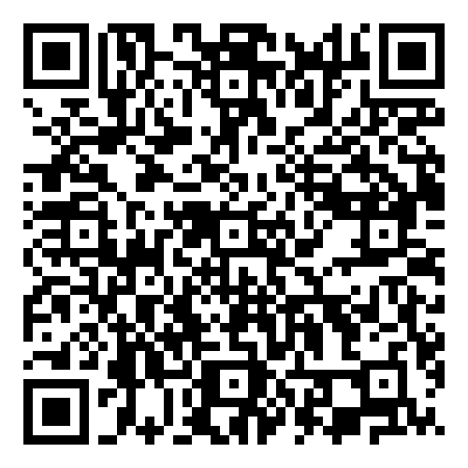
Registration Information
You will need to know your IMFOA ID. This is imperative to getting your credit, so please do not enter any number into the IMFOA registration information.
Gateway link to reserve rooms directly to the MPI/MPA Block
Sweatshirts will be in three different colors this year to choose from:
Black and Gold
Red and Gold
Black and Silver
There will be a social hour on Monday, June 9th for both Institute and Academy attendees from 5:15-6:30.
MPA Registration Code

Slide 11
Certification Highlights
Certification is provided by IMFOA. The Institute and Academy is strictly the educational component.
Which certification you pursue is based on your title and your goals.
Course hours must be within 8 years of applying for initial certification. Otherwise, they expire and must be retaken.

Slide 12
Recertification Highlights
Recertification requires 15 contact hours of continuing education per year
Courses can only be used once per certifying period, however Institute classes can be used towards recertification purposes after a certain time has passed from initial certification.

Slide 13
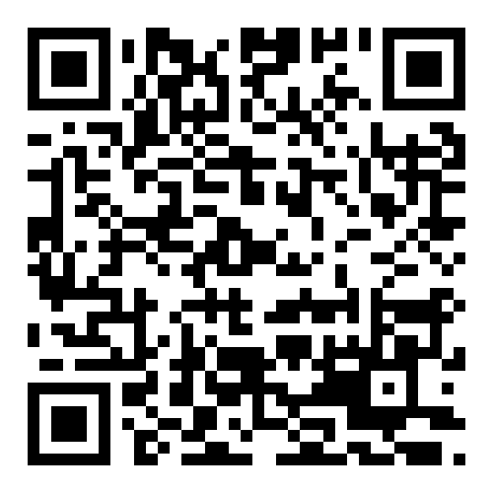
More Information
Come be our friend on Facebook!

Slide 14
Sara Shonrock
Institute Director, Municipal Professionals Institute & Academy
https://www.extension.iastate.edu/communities/municipal-professionals-institute-mpi

