Slide 1
License Administration Portal
April 16, 2026

Slide 2
Disclaimer
Please be advised that the information in this presentation contains informal opinions and are only applicable to the factual situations referenced and to the statutes in existence as of the date of this presentation.
The Iowa Department of Revenue may take a contrary position in the future to what is stated today. Any oral or written guidance or opinion given by Department personnel not pursuant to a Petition for Declaratory Order under Iowa Administrative Code 701—4.7 is not binding upon the Department.

Slide 3
Agenda
Gaining and managing access
Emails and web messages
Reviewing and approving/denying applications
Dramshop insurance endorsements
Fee distributions
Assisting customers
Q&A

Slide 4
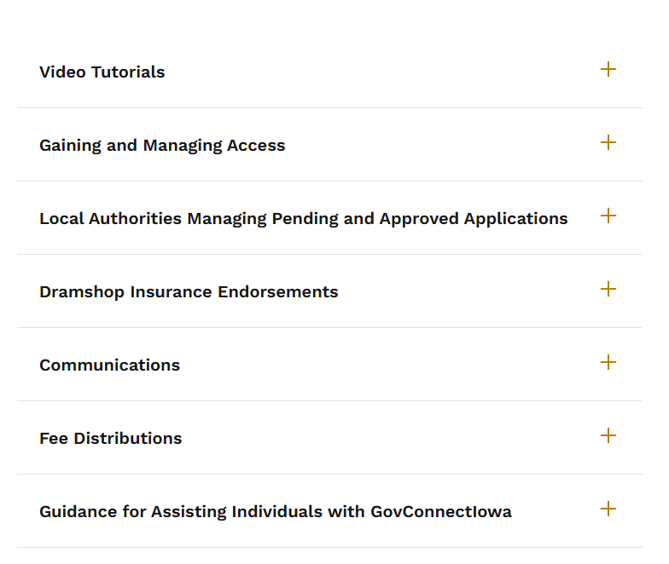
License Administration Portal Help - Website Update
New web page launched February 2026
Answers common questions and offers step-by-step instructions on navigating the portal
How to get there: revenue.iowa.gov >
Resources > GovConnectIowa Help >
License Administration Portal Help

Slide 5
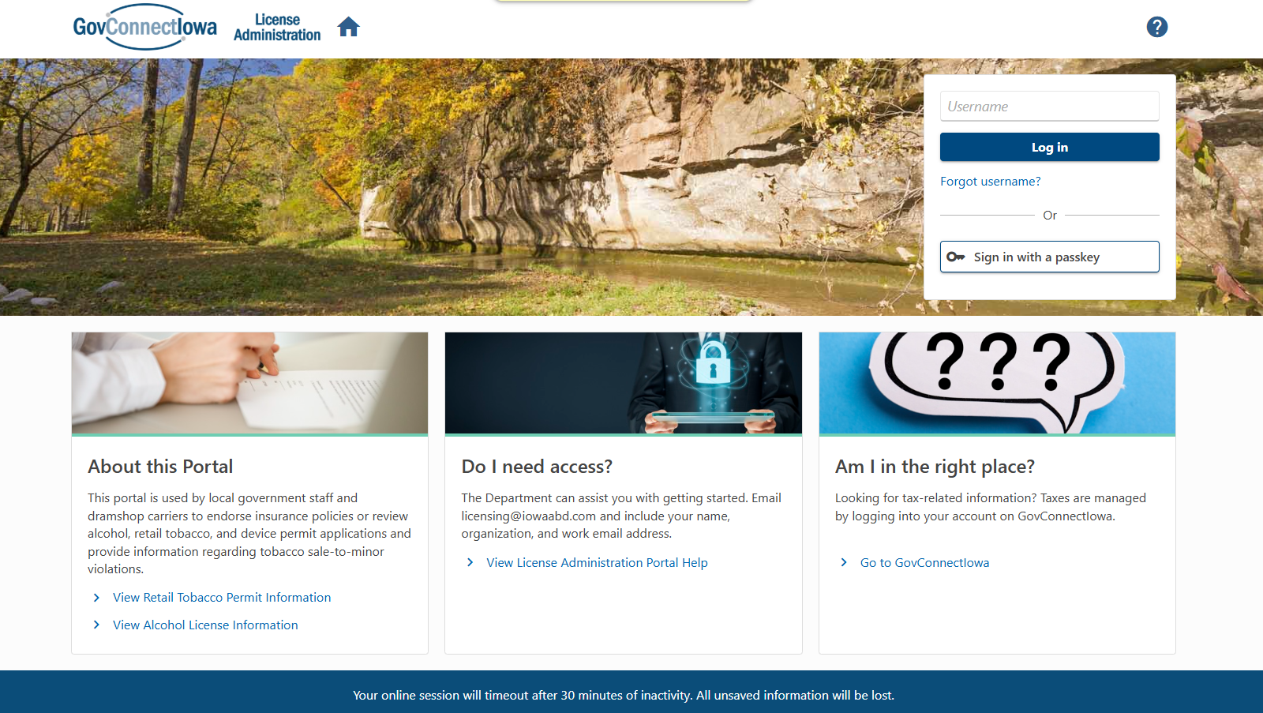
1
2
3
4
Notes:
1 - Can take them directly to help page or “View Support ID” feature
2 - Forget your username or password? You can receive it on your own without calling or emailing us. If the information you provided matches our records, you will receive a link to reset your password.
3 - You can get directly to the new web page by clicking the “View License Administration Portal Help” - available logged in too
4 - There’s an inactivity timer for security purposes. If you leave the screen for 30 minutes, it’ll refresh automatically so save your info as you go.

Slide 6
Access

Slide 7
Gaining Access
Local Authority Users: Send an email to licensing@iowaabd.com from your verified government city or county email address with the following information:
Your name
The city or county you require access to
Any other helpful information
If you already use GovConnectIowa, please provide your existing username.

Slide 8
Gaining Access
Dramshop Carriers: Send an email to licensing@iowaabd.com with a signed document on company letterhead including:
Authorized representatives (full name, company phone, and email).
Underwriting companies each representative is authorized to verify.
Date and signature of an underwriting manager or supervisor.
Note: Only alcohol licensing staff can create a dramshop user ID.

Slide 9
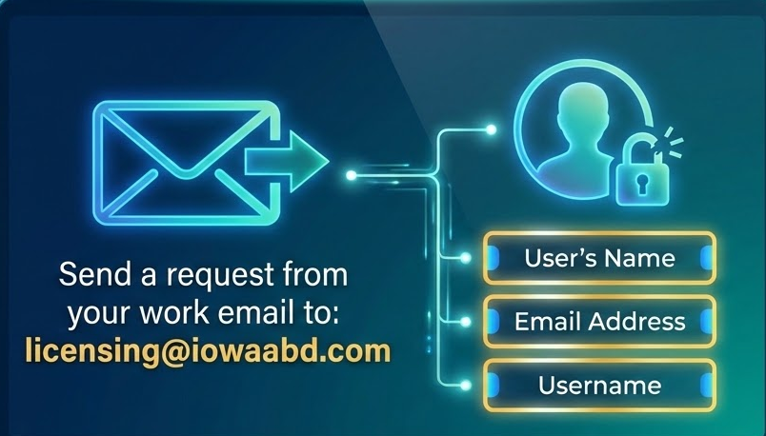
Managing or Revoking Access to Others

Slide 10
Using Multiple Usernames? Let us know
If you use multiple portals (GovConnectIowa, Debt Administration Portal, License Administration Portal), you only need one username and password.
To consolidate existing usernames, email us the following:
Usernames for all portals
Preferred username moving forward

Slide 11
Communications

Slide 12
Communications - Types of Messages
Emails:
Sent to notify you of new web messages
Go to all registered web logons
Web Messages:
Located in the License Administration Portal
Visible to anyone logging into the portal with city/county access for your local authority
Notes:
Briefly discuss the difference and what the local authority can expect to see. Emails will tell them they have a web message. Web messages will be in their portal.

Slide 13
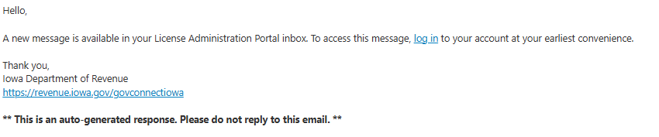
What Emails Look Like
Emails come from no-reply@govconnect.iowa.gov

Slide 14
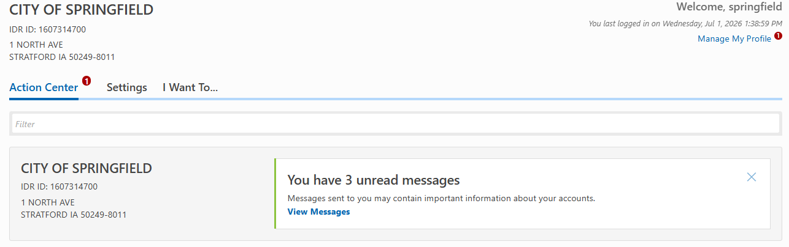
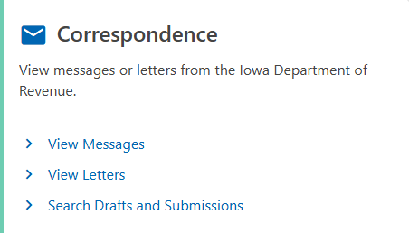
Web Messages - How to Find Them
Once Logged in, go to Action Center or I Want To… tabs for messages:
Notes:
Example of where they can find their web messages.

Slide 15
Types of Messages - Emails
Subject of Emails
Notification that you have a web message
Notification of a license cancellation
Notification of a license suspension
If you are getting too many emails, please let us know.

Slide 16
Types of Messages - Web Notices
Updates to Applications: New, Renewal, and Amendment
Renewal Notices (70, 10, and 1 day)
Submitted to Dramshop for endorsement
Awaiting Local Authority review
Submitted to IDR for Internal Review
Approved, denied, suspended, canceled, or revoked
License Timely Filed Status
Automatic Renewals:
Successful Enrollment in the Program
Ineligible for Auto Renewal
Upcoming Auto Renewal (70 day notification)
License Successfully Renewed under Auto Renewal
Unenrolled from Auto Renewal Program

Slide 17
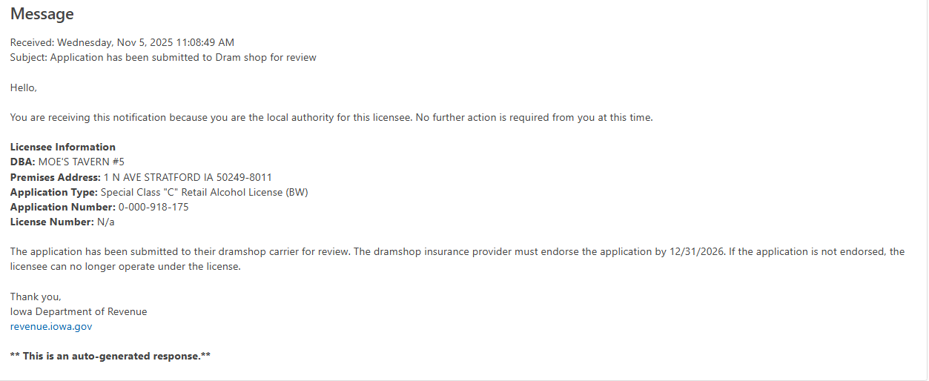
Sample Web Message

Slide 18
Upcoming Enhancements
Manage Access - managing user access on your own
Chatbot - answering your most common questions
Send a Message - message us without leaving the portal

Slide 19
Reviewing Applications

Slide 20
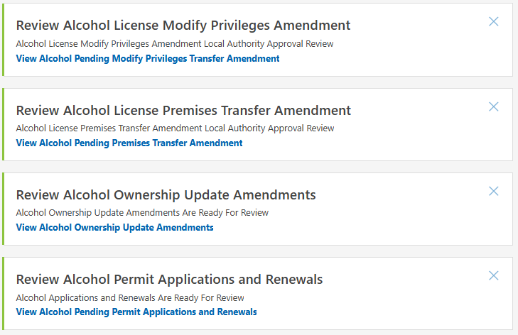
Reviewing Applications - Action Center View
Notes:
Example of main Action Center page once they are logged into their portal

Slide 21
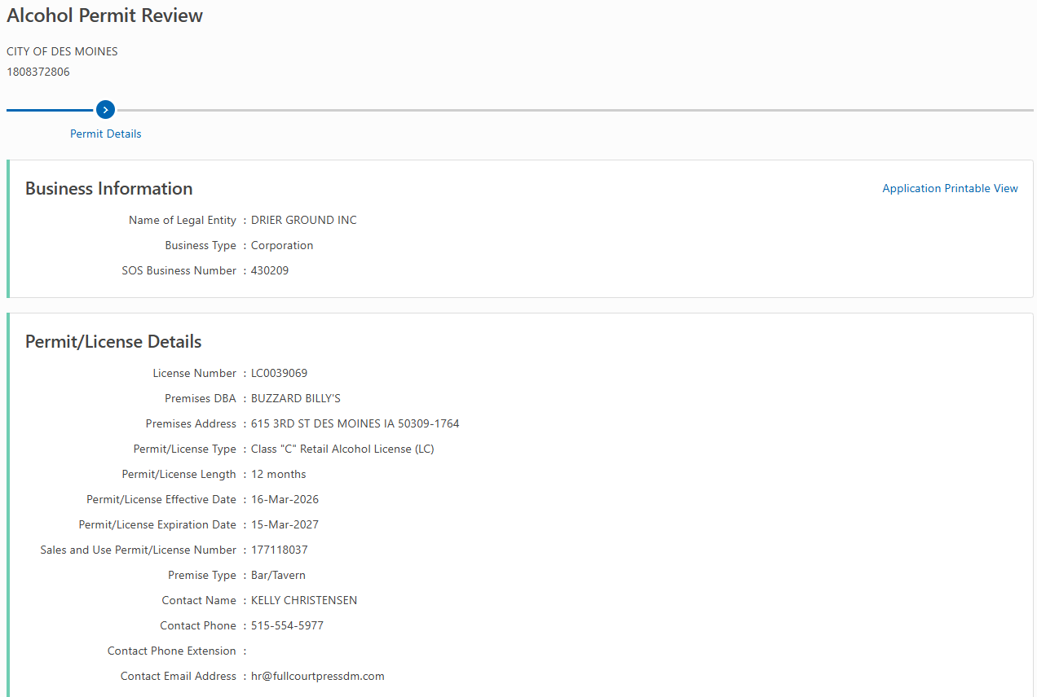
Review Walkthrough - Renewal Example - Pg 1
Notes:
1st page of what a renewal will look like. I will briefly discuss what is here.

Slide 22
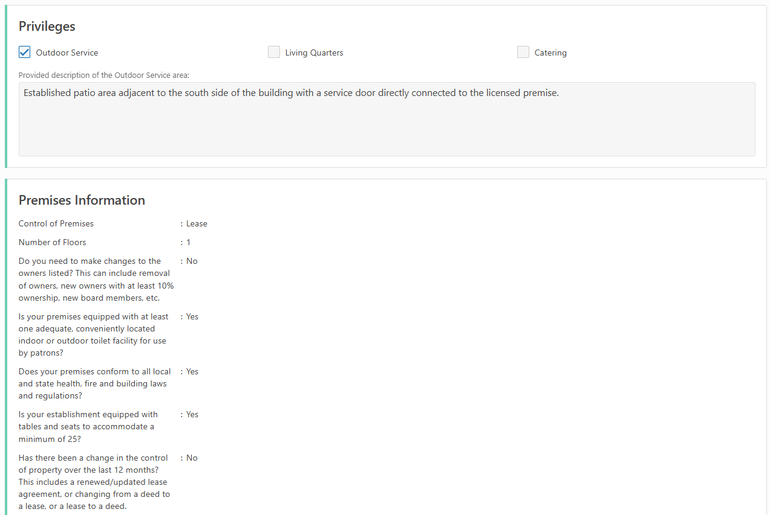
Review Walkthrough - Renewal Example - Pg 2
Notes:
2nd page of what a renewal will look like. I will briefly discuss what is here. I will draw attention to the outdoor service privilege.

Slide 23
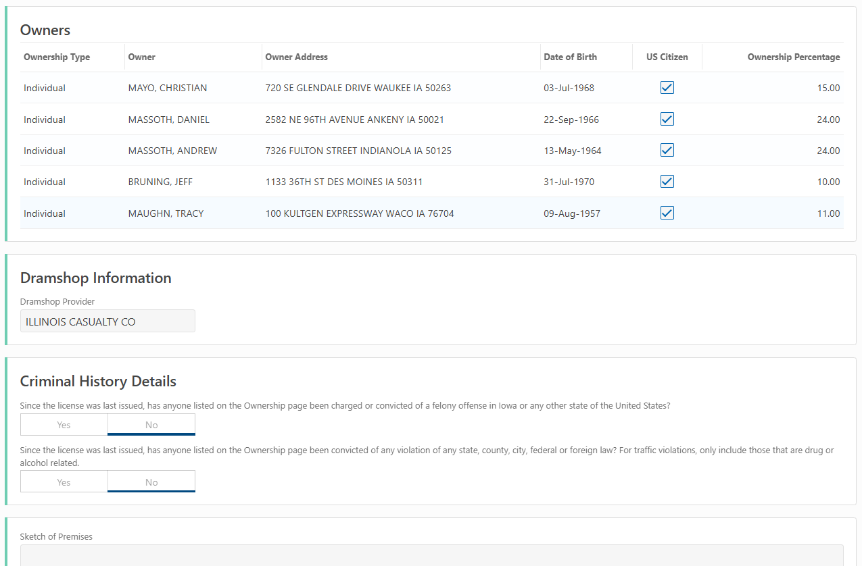
Review Walkthrough - Renewal Example - Pg 3
Notes:
3rd page of what a renewal will look like. I will briefly discuss what is here.

Slide 24
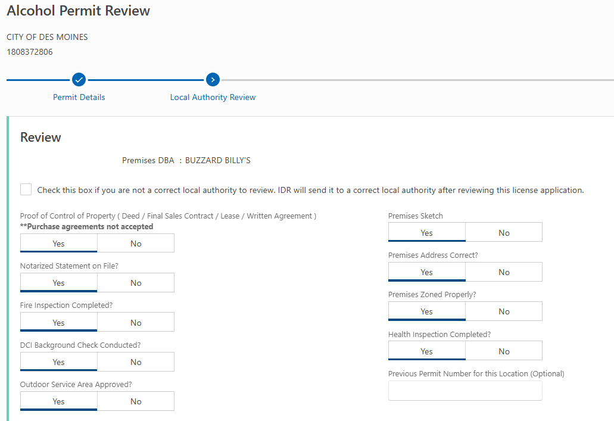
Review Walkthrough - Renewal Example - Pg 4
Notes:
4th page of what a renewal will look like. I will briefly discuss what is here. I will highlight the Outdoor Service question.

Slide 25
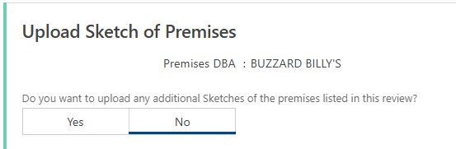
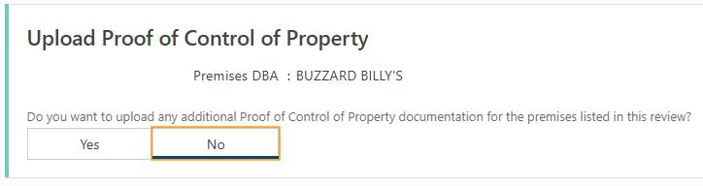
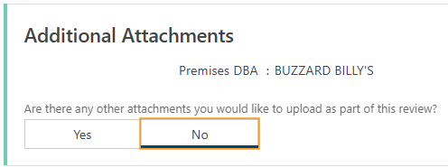
Review Walkthrough - Renewal Example - Pg 5
Notes:
Emphasize the addition of additional docs. Discuss adding additional information to the review case.

Slide 26
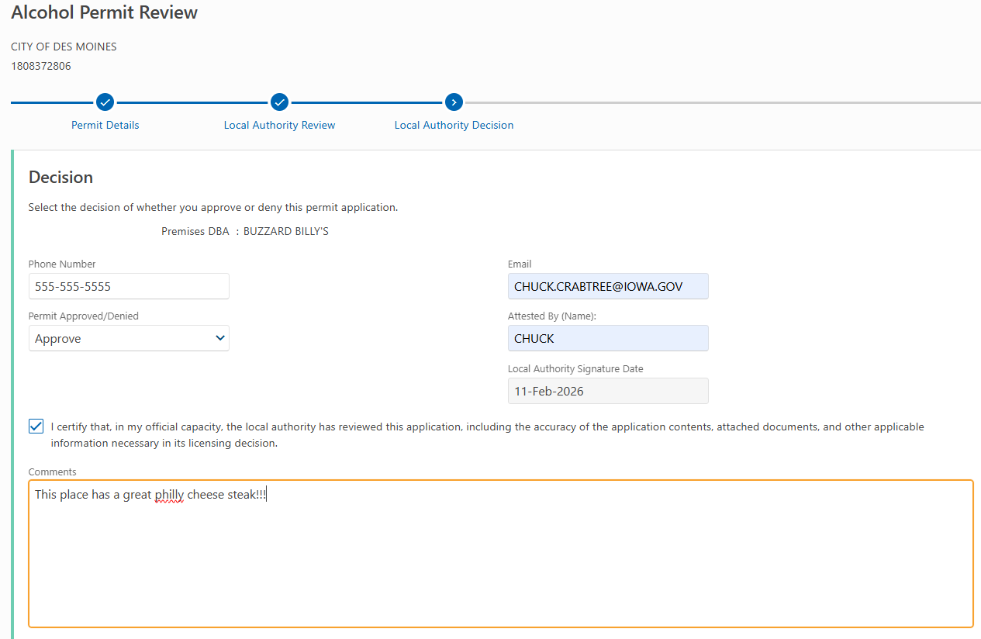
Review Walkthrough - Renewal Example - Pg 6
Notes:
5th page of what a renewal decision page will look like. I will briefly discuss what is here.

Slide 27
Additional Information Required
Requesting Additional Information from the Licensee:
Keep the application status as “Local Authority Review.”
Local Authorities are unable to change the application status to “Additional Information Required.”
Request any necessary additional information outside of the License Administration Portal (e.g., via email or phone calls).
Upload any supplemental documents to the application.
Notes:
Discuss how to stage the case when requesting additional information from the licensee and how to request additional information. Emphasis on adding additional information to the review case.

Slide 28
Printing the Application
Application Printable View

Slide 29
Timely Filed Renewal Applications
What does “Timely Filed” mean?
A Renewal application is “Timely Filed” when it is in either “Local Authority Review” or “Internal Review” stage AND it is past the expiration date of the license.
A renewal that is not “Timely Filed” will be automatically canceled 1 day after the expiration date. The licensee will have to apply for a new license.
Notes:
Discuss Timely Filed and how it now works in the LA portal. Highlight the implications of not achieving Timely Filed.
Timely Filed is not an option for LA. Timely Filed is assigned automatically.

Slide 30
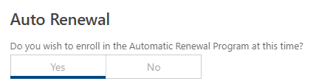
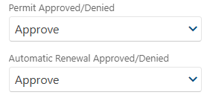
Outdoor Service and Auto Renewal Review
Outdoor Service
You still have the option to deny the outdoor service while approving the rest of the application.
Auto-Renewal Program (LE only)
The review page indicates if the applicant desires to enroll in the auto-renewal program.
After you "Approve" the application, you will be prompted with the option to "Approve/Deny" enrollment in the auto-renewal program.
Notes:
Brief discuss on how to approve/deny outdoor service and auto renewals but still being able to approve the application.

Slide 31
Ownership Updates
Changes to the Process:
A single ownership update will now apply to all licenses and applications associated with a business.
Local Authorities will only see one ownership update per business, regardless of how many licenses (even at different locations) that business holds.
All impacted licenses will be listed in your "Ownership Update Review" case.
Notes:
Discuss changes to the ownership update process. Emphasis on one approval/local authority, even if there are many licenses involved.

Slide 32
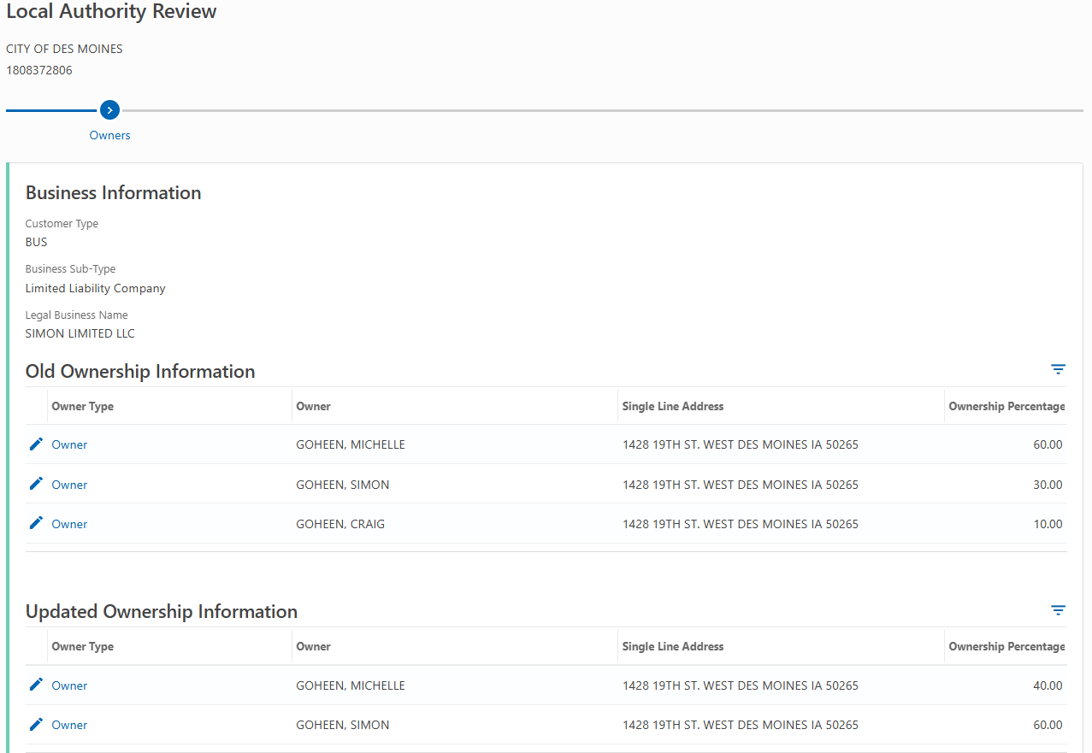
Ownership Updates - Example pg 1
Notes:
Example of ownership update review process. Discuss where to see details about owners

Slide 33
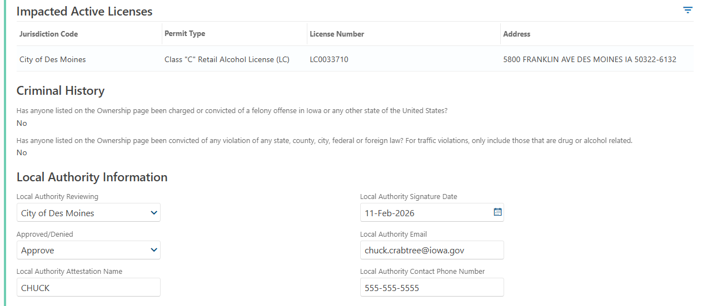
Ownership Updates - Example pg 2
Notes:
Emphasize Impacted Licenses and restate, one ownership update case per LA and that all impacted licenses will be listed here.

Slide 34
Dramshop Insurance

Slide 35
Dramshop Insurance Endorsements
To meet “Timely Filed” requirements, a renewal application must receive endorsement from the dramshop carrier before the license expiration date to avoid cancellation.
Dramshop carriers’ representatives have the option to:
Endorse - This option is used when a policy exists for the alcohol license.
Unable to Verify Dramshop Policy - This option is used when a dramshop carrier does not carry a dramshop policy for an applicant.

Slide 36
Reminders for Dramshop Carriers
Dramshop policies must cover the entire license term. If a policy is anticipated to lapse mid-term, a new policy can be submitted via the "Manage Dramshop Policy" link.
The portal does not support dramshop policy cancellations. Send cancellations and corresponding reinstatements to licensing@iowaabd.com.
Dramshop carrier representatives will not receive notifications for new policy reviews. Representatives must log into the License Administration Portal and monitor the Action Center for any review activity.

Slide 37
Fee Distributions

Slide 38
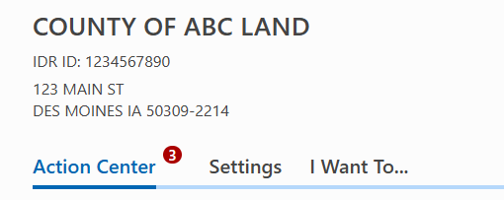
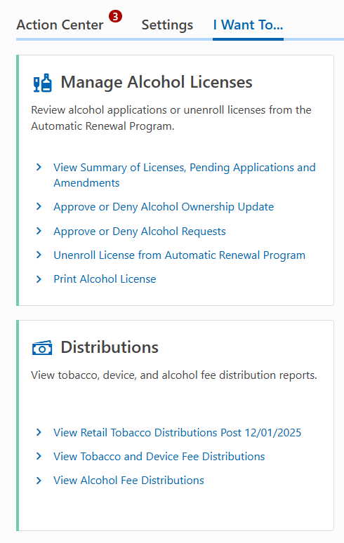
Viewing Fees Sent To Your Jurisdiction
All payment, refund, and disbursement related questions should go to the accounting department.

Slide 39
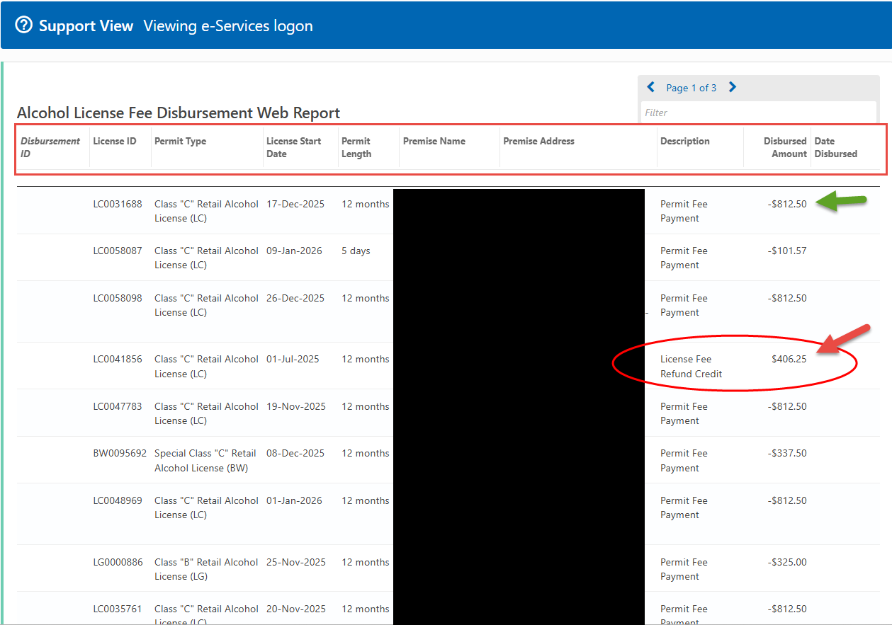
Alcohol Fee Distribution Report

Slide 40
Available Guidance

Slide 41
Local Authorities
Website: revenue.iowa.gov > Resources > GovConnectIowa Help > License Administration Portal Help
Email:
  Alcohol: licensing@iowaabd.com
  Tobacco: iapledge@iowaabd.com
  Accounting: accounting@iowaabd.com
Phone:
  Portal navigation: 515-281-3114
  Alcohol: 515-281-7400, option 1
  Tobacco: 515-281-7400, option 4

Slide 42
License Holders
revenue.iowa.gov/govconnectiowa
They can:
  Call us at (515) 281-3114
  Email us at idr@iowa.gov
  Send us a message on GovConnectIowa
  Watch step-by-step video tutorials on YouTube channel

Slide 43
Ways to Stay Connected
Subscribe to GovDelivery updates
Attend webinars
Follow us on social media

Slide 44
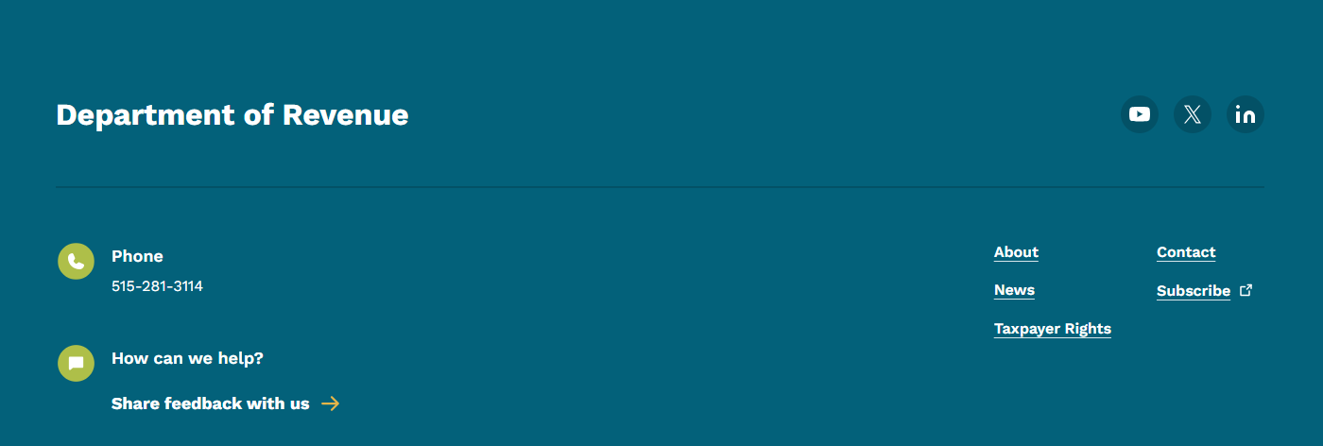
Subscribe to Updates
revenue.iowa.gov

Slide 45
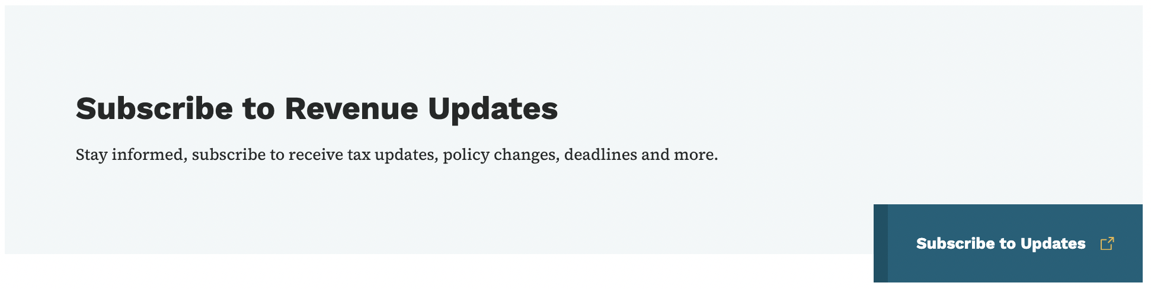
Subscribe to Updates
Electronic Filing
Economic, Fiscal, and
Statistical Information
Topics Include:
Newsroom
Tax Information
Law & Policy Updates
GovConnectIowa

Slide 46
Live Q&A

