Slide 1
League Legislative Update
2024 IMFOA Fall Conference

Slide 2
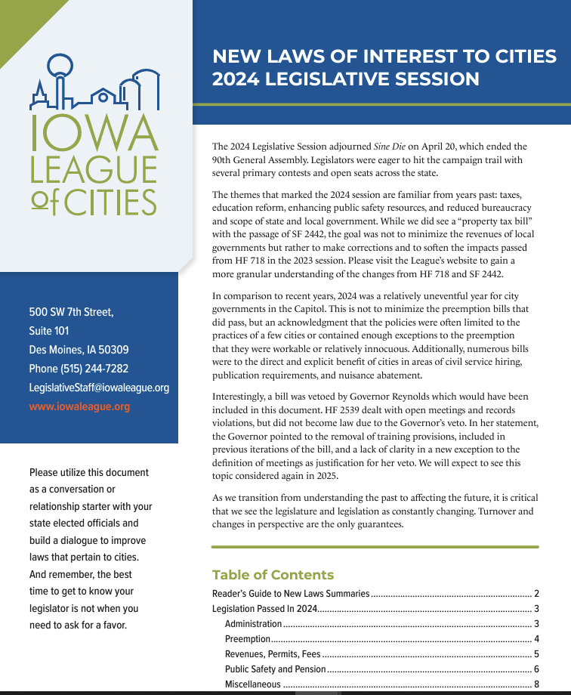
Recap of 2024 Legislative Session
2024 New Laws of Interest (https://iowaleague.org/wp-content/uploads/2024NewLaws.pdf)
Full rundown of laws important to cities

Slide 3
Recap of 2024 Legislative Session
SF2331 | Publication Changes
Newspaper requirements (Chapter 618)
If a newspaper has a website, it must post public notices to it for free
Display a link to the statewide public notice site (still in development)
No fees for proof of publication (question over charges for affidavits)
If a newspaper “refuses to publish”, a city may post a notice to its website, the county website and statewide website

Slide 4
Recap of 2024 Legislative Session
SF2331 | Publication Changes (continued)
Newspapers must now publish notices within certain timeframes
Daily newspapers must publish within 72 hours
Weekly newspapers must publish within 48 hours of next scheduled publication

Slide 5
Recap of 2024 Legislative Session
SF2385 | State Boards/Commissions Reorganization
Reduces state agencies/reorganizes structure
Included provision that alters Section 21.8 and use of electronic meetings for governmental bodies
Removes the standard for using an electronic meeting only when in-person meeting is “impossible or impractical”
However, mandates the use of an electronic meeting if a member of governmental body requests ones

Slide 6
Recap of 2024 Legislative Session
HF2398 | Public Official Bonds/Insurance
Clarifies that cities can obtain an insurance policy in lieu of a bond as required in Chapter 64 (which requires the mayor and those with the ability to disburse public funds to be bonded)
Most cities already do something similar via a “blanket bond”, typically through their liability provider

Slide 7
Recap of 2024 Legislative Session
SF2096 | Gender Balance Boards/Commissions
Removes requirement for local governments to make a “good faith effort” to achieve gender balance on appointed boards/commissions
HF2388 | Residential Façade Preemption
Preempts a local government from passing or administering an ordinance that would prohibit or limit the use of a specific cladding or finish materials on facade restrictions that are more stringent than the State Building Code

Slide 8
Recap of 2024 Legislative Session
SF455 | Topsoil and Construction Site Permits
Preempts a city from regulating topsoil requirements at construction sites in a more restrictive manner than found in the National Pollutant Discharge Elimination System (NPDES) General Permit #2
Allows for more stringent restrictions on topsoil requirements so long as the local government pays for the difference in cost of study, engineering, and implementation of the more stringent standards

Slide 9
Recap of 2024 Legislative Session
HF2681 | Automated Traffic Enforcement (ATE)
Cities must now obtain a permit from the IDOT to operate an ATE
Existing cities/ATEs may apply for a permit to continue operations
Moratorium on new ATEs through 2025

Slide 10
Recap of 2024 Legislative Session
SF2442 | Property Tax Omnibus
Focus this year was on technical changes
Property Tax Notification Statement now has a deadline of March 5 (instead of March 15); still to be submitted to the IDOM
Alters the Property Tax Notification Statement form
Added new category for the Consolidated General Fund Levy reduction system
2.75-3.99% growth

