Slide 1
Debt, Law Changes, & Reporting
IMFOA Fall 2026
Ted Nellesen
State and Local Budgets Division
October 21, 2026

Slide 2
Debt Reporting & AFR/Budget Changes

Slide 3
Recent Debt Issuance Changes
HF718
  County & City Bond Issuance Report - COI 8.5(16)
  DOM is to file a report with the General Assembly annually by January 15 including:
    The use of each bond issuance procedure
      General corporate purpose
        Voted
        Non-voted
      Essential corporate purpose
    Amount of each type of debt issued

Slide 4
Recent Debt Issuance Changes
HF718
  Enhanced debt reporting – COI 384.22(1)
  A requirement to increase the amount of debt reporting on city & county AFRs
  Beginning with FY 2024-2025:
    List of all outstanding “bonds, notes, or other obligations”
    Amount of issue
    Purpose of issue
    Method of approval
    Ties to other debts issued for the same purpose

Slide 5
Debt Reporting Requirement
Requirement to increase the amount of debt reporting on city & county AFRs
  Began with FY 2024-2025:
    List of all outstanding “bonds, notes, or other obligations”
    Amount of issue
    Purpose of the issuance
    Method of approval
    Ties to other debts

Slide 6
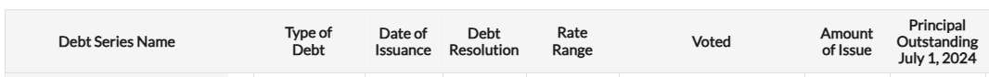
Debt Reporting Requirement
Voted
  Select the approval method which was required under Code of Iowa 331 or 384 for the type of debt issued from the dropdown
    Voted: Debt was required to be approved by a vote of the citizens
    No Vote – Essential GO: GO debt was approved by as an essential corporate purpose, which does not have a debt requirement.
    No Vote – Below Threshold: GO debt was below threshold of principal issued over which a citizen vote would be required
    No Vote – Non-GO: Debt is not a general obligation

Slide 7
Implementation
New page added to the AFR
COUNTY DEBT DETAIL and CITY DEBT DETAIL
  Similar to the Long-Term Debt pages of the budget form
  Requires a few extra pieces of debt information
    Rate range
    Method of approval – Voted
    Tied to other debt?
    Purpose of the debt issue – what was it used for?

Slide 8
DOM Debt Database System
Attempt to remove yearly work & uncertainty
  Debts on a set schedule and do not change often
  Helps provide continuity for staff turnover
  Provides local governments & County Auditors with a repository for GO debt documents
Data integration
  Automatically fill in budget and AFR for debt reporting
  Working toward integration in other reports
    Will provide an output for filling out the Outstanding Obligations Report

Slide 9
DOM Debt Database System
AFR – Starting FY 25/26
  Will fill in the City or County Debt Detail page completely
Budget – Starting FY 27/28
  Fills in the LT Debt page completely
  Changes to debt will have to go through the database first
    Similar to AFR changes in the budget

Slide 10
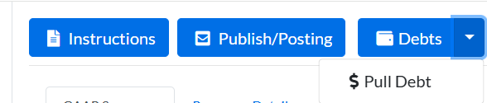
DOM Debt Database System
System will require that users fill in basic information about the debts from the resolutions approving the debt which are on file
Entries will remain editable
One time lift, then only updated as resolutions
are changed
Once your debt is entered, you click the following button to pull it into your AFR/budget

Slide 11

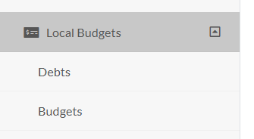
DOM Debt Database System
Debt Database accessible through the AFR or Budget form using the Debts Button
OR access the Debt Database via the option on the lefthand navigation under Local Budgets

Slide 12
DOM Debt Database System
The “Debts” button has two functions:
  Access the Debt Database
  Pull the data from the Debt Database into your budget and AFR using the dropdown arrow

Slide 13
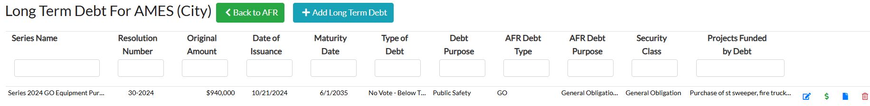
DOM Debt Database System
Enter all Debt using the “+ Add Long Term Debt” button for each obligation.

Slide 14
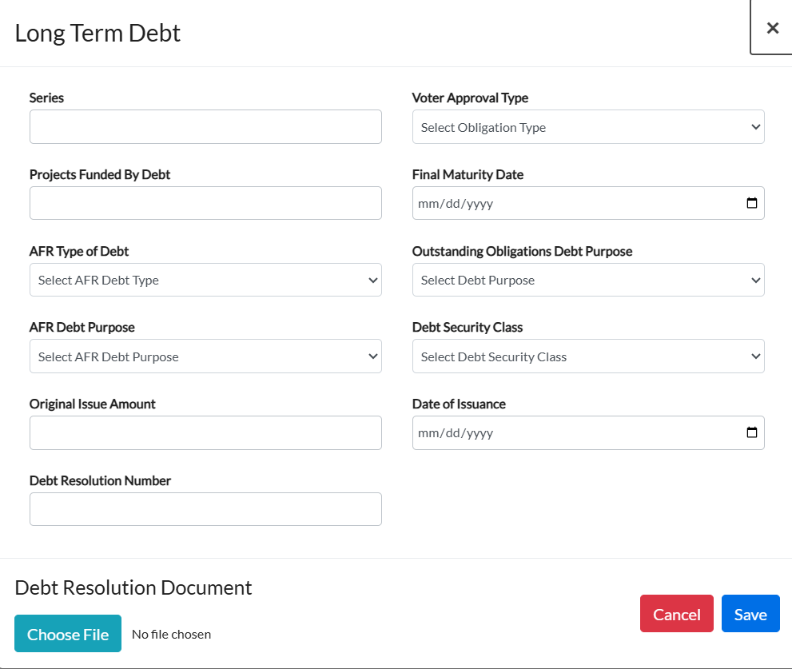
DOM Debt Database System
The initial information to populate after selecting “+ Add Long Term Debt” button is a new window with several fields to identify the type of debt and collect basic information about the obligation.

Slide 15
Debt Database – General Information
Enter a trackable debt name (Year issued + repayment source + main project borrowed for)
Enter a description of project(s) funded by the debt – 150-character limit
Select the debt repayment source from the debt resolution; will flow the debt balance to the correct Other P10 column
Select the AFR-based purpose of the debt; will flow the debt information to the correct Other P10 line
Enter the amount originally borrowed
Enter the resolution number of the issuing resolution

Slide 16
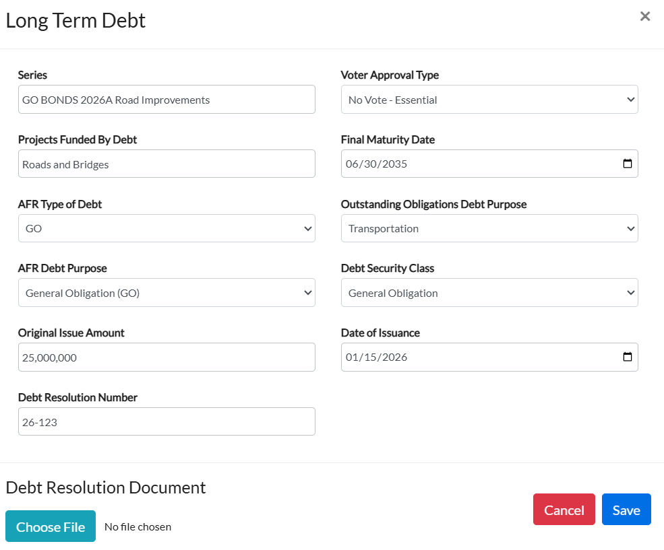

Slide 17
Debt Database – General Information
Select the level of citizen vote on the debt
Enter the date of the final payment on the debt schedule
Select the debt repayment source from the debt resolution; based on the Outstanding Obligations Report
Select the purpose of the debt; based on the Outstanding Obligations Report
Enter the date debt was issued

Slide 19
Debt Database – General Information
Click to find and upload the issuing resolution for this debt
Click to save the entered debt information

Slide 20

Debt Database – Editing Controls
You can add more debts or edit the information about the debts using the buttons:
Edit the name, Debt Purpose, Obligation Type, Maturity Date, and Amount of Issue using the edit icon
Use the trash can icon to delete the debt series
Use the documents icon to upload the adopted debt resolution
Edit annual payments using the dollar sign

Slide 21

Debt Database – Payment Information
After inputting the required information about the debt, the annual payment amounts from your long-term debt schedule/resolution of payments can be entered using the dollar sign:

Slide 22
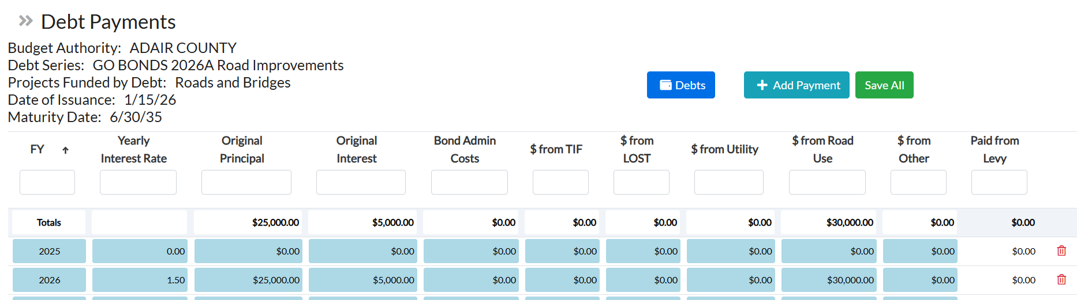
Debt Database – Payment Information
Payment information will be entered by fiscal year from current date through end of debt payment term

Slide 23
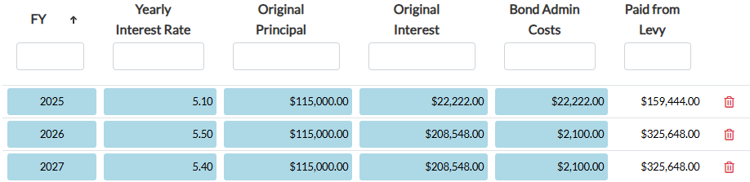
Debt Database – Payment Information
You will have to fill out payment information for the reminder fiscal years of the obligations:

Slide 24
Debt Database – Payment Information
Spots are provided to enter the amount of payment that will come from sources other than property tax
  Optional use
  Will remain editable year-to-year
  Will flow through to budget LT Debt, but can then be edited on the LT Debt page
    Does not populate to the AFR

Slide 25
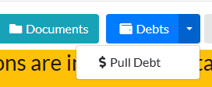
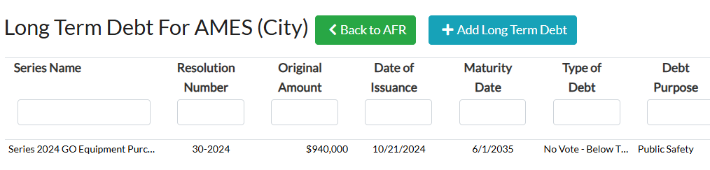
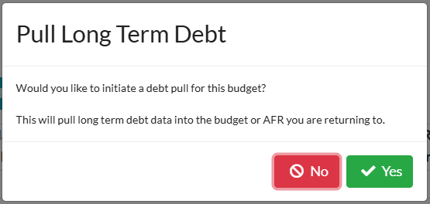
Debt Database – Payment Information
To populate your Long-Term Debt
Schedule Tab you will need to use
the dropdown of the “Debts” button
and select “$ Pull Debt”
You can also populate the data by clicking on the button to get back to the AFR and the button to pull the updated data.

Slide 26
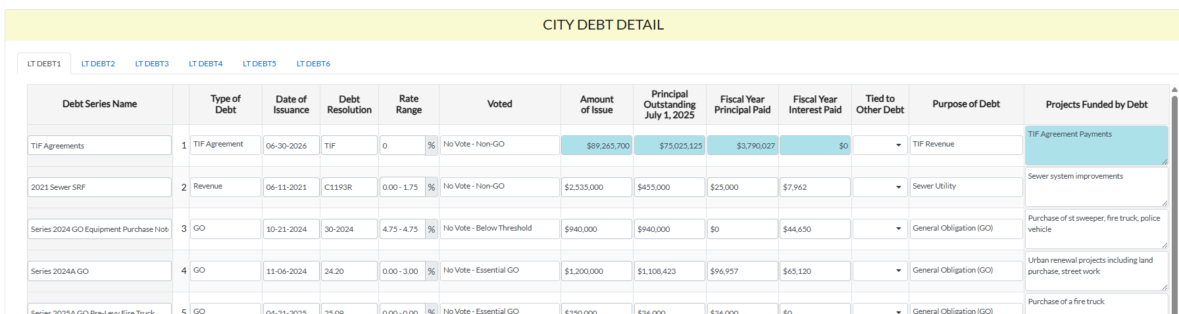
Debt Database – Payment Information
Information populates to line 2 and below on the debt detail pages.

Slide 27
Debt Detail Page – TIF Agreements
All TIF rebate / development agreement information must still be entered into line 1 of the debt detail pages manually
TIF rebates / agreements
  Aggregate totals onto one line
  Amount of issue is the total of the original not to exceed amounts
  Principal outstanding is the not to exceed minus amount paid to beginning of the fiscal year being reported

Slide 28
Urban Renewal Changes
SF2496 & SF2472

Slide 29
SF2496 – EMS Levies & TIF
Senate File 2496 excludes EMS levies from being diverted to TIF revenue
  Levies specifically related to providing ambulance and emergency medical service no longer included in the net TIF consolidated rate
    422D Countywide EMS levy
    357F Unincorporated EMS levy
    357G City EMS levy
  Change took effect immediately (May 2, 2026) and applied to the FY 2026-2027 budgets which were already submitted
    Required DOM to update rates for FY 2026-2027 budgets

Slide 30
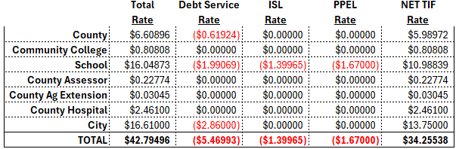
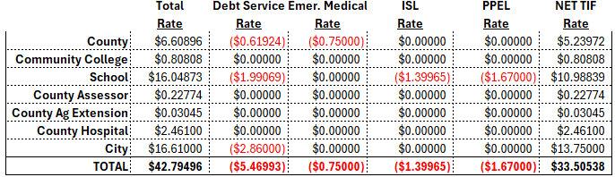
SF2496 – EMS Levies & TIF
Net TIF prior to SF2496
Net TIF after SF2496

Slide 31
TIF Sunsets
SF2472 created a sunset for ALL TIF ordinances passed after May 18, 2026
  Includes slum and blight designated URAs, which were previously perpetual
  TIF ordinances passed after 5/18/2026 are limited to 24-years (1 + 23 years) of revenue collection
  TIF ordinances passed on or after 1/1/2027 are limited to 24-years of revenue collection and are not allowed to divert the school foundation levy
    Currently $5.40 of the school levy
    Schools may voluntarily allow the foundation levy
    to be captured in TIF revenue

Slide 32
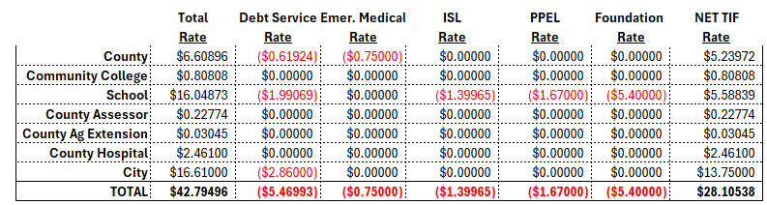
SF2472 Div. XIII – UR TIF Rates
Net TIF prior to SF2472
Net TIF after SF2472

Slide 33
TIF Sunsets
TIF Areas / TIF Taxing districts now have a statutory sunset
  Economic Development (regular)
    Before 5/18/2026 - 20 years after the first year (21 years)
    After 5/18/2026 - Existing TIF ord. areas will finish out on their current schedule. New TIF ord. areas - 23 years after the first year (24 years)
  Residential Economic Development
    Before 5/18/2026 - 10 years after the first year (11 years), with possible 3-year or 5-year extension
    After 5/18/2026 – Code section struck by SF2472; now treated same as regular economic development - 23 years after
    the first year (24 years)

Slide 34
TIF Sunsets
TIF Areas / TIF Taxing districts now have a statutory sunset
  Slum and Blight
    Before 5/18/2026
      PERPETUAL, ends at discretion of when the URA / TIF authority believes they achieved the plan’s goals
    After 5/18/2026
      Existing perpetuals will continue to be perpetual, but after 20 years from May 18, 2026 (end of FY2046) will be limited to 60% of the available TIF and will no longer be allowed to divert the school foundation levy
      Existing slum/blight TIF areas which have not yet been certified will be limited to full collection for 21 years, and then will be limited to 60% of available TIF revenue and
      cannot divert school foundation levy

Slide 35
SF2472 Div. XIII – LMI Requirements
Code of Iowa 403.22
  Required projects receiving TIF to build housing in a residential economic development urban renewal to include assistance to low and moderate income (LMI) housing.
    Projects not meeting this requirement had to certify a separate amount to be used for LMI assistance projects throughout the city.
  SF2472 strikes COI 403.22 in its entirety.
    Dollars currently being held in balance for LMI project must be used for LMI projects.
    Dollars certified but not yet collected for LMI may be decertified and no longer need to be collected.
    No LMI requirement on future residential UR/TIF projects.

Slide 36
Valuation Changes
SF2472

Slide 37
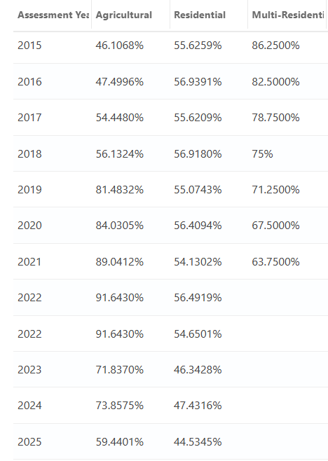
SF2472 Div. VIII - Multiresidential
Multiresidential Class Returns in FY29 (NO CHANGE FOR UPCOMING FY28)
  Reinstates multiresidential as a property class for the 2027 assessment year (FY29)
  Ties the multiresidential assessment limitation to the residential assessment limitation
    FY29 - residential rollback percentage plus 3%
    FY30 and after – residential rollback percent plus 6% (not to exceed 100%)
  Example using the last two years assessment limitations:
50.4316%
50.5345%

Slide 38
SF2472 Div. XX – Homestead Exemptions
Homestead Credit Phase Out
  An exemption is a reduction in the value of the property that a taxpayer pays taxes on. A credit is a direct reduction of the tax amount.
    Regular homestead credit ends (more on this later).
    Disabled Veteran Credit remains.
Homestead Exemptions
  Sets the FY28 exemption at 10% of taxable value, no less than 5,500 and no more than 20,000
  Elderly homestead exemption remains in place at 6,500
  Increases the max homestead exemption by a cumulative adjustment factor calculated by IDR
    Factor is 100% in AY2026 and then tied to an
    inflationary factor each year after

Slide 39
SF2472 Div. XX – Homestead Exemptions
Homestead exemption is calculated on taxable valuation
Taxable Valuation Calculation steps:
  Assessment limitation
    Assessed value x assessment limitation percentage (rollback) = Net Taxable #1
  Homestead Exemption
    Net Taxable #1 – (Net Taxable #1 X 10%) (min. 5,500, max 20,000) = Net Taxable #2
  Elderly Homestead Exemption
    Net Taxable #2 – 6,500 (if applicable) = Net Taxable #3
  Military Exemption
    Net Taxable #3 – 4,000 (if applicable) = Taxable
    Value

Slide 40
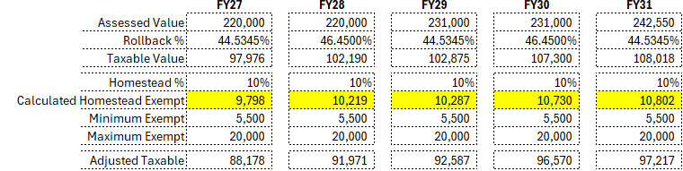
SF2472 Div. XX – Homestead Exemptions
Homestead Exemption Example:
  Statewide average homestead example

Slide 41
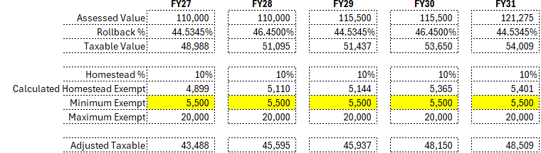
SF2472 Div. XX – Homestead Exemptions
Homestead Exemption Example:
  Minimum exempt example:

Slide 42
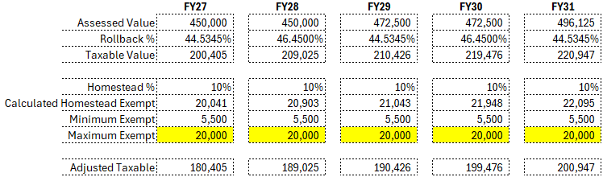
SF2472 Div. XX – Homestead Exemptions
Homestead Exemption Example:
  Maximum exempt example:

Slide 43
SF2472 Div. II – New Valuation
Defines “New Valuation” - AY2026 (FY28)
  Codifies how it was defined in AY2025 valuation submission
    New Construction
    Additions and Improvements
    Boundary Adjustments
    Does NOT mean expired exemptions
    Does NOT mean TIF released/ended
Used in calculation of city general fund levy (CGFL)

Slide 44
Budget Changes
SF2472

Slide 45
SF2472 Div. XX – Homestead Replacement
Homestead Credit Phase Out
  An exemption is a reduction in the value of the property that a taxpayer pays taxes on. A credit is a direct reduction of the tax amount.
    Regular homestead credit ends. Disabled Veteran Credit remains.
    Phases out the homestead credit replacement by a 1/3 each year over three years
      FY28 – 2/3 of FY27 payment
      FY29 – 1/3 of FY27 payment
      FY30 & after – No further credit payments
  No longer counted as property tax, must be counted as a replacement payment.
    New chart of accounts number will be necessary.

Slide 46
SF2472 Div. XXIV – Two Tier Payments
First 150,000 of assessed commercial or industrial value receives the residential assessment limitation percentage. Remaining value above 150,000 receives 90% assessment limitation.
  Two-tier business property replacement payment in place to bridge the gap created by assessment limitation change.
  Payments received each fall and spring, along with regular property tax payments
FY27 payments will be the last payments received.
Assessment limitation process will remain in place after payments end.

Slide 47
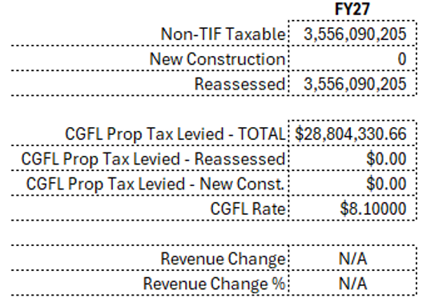
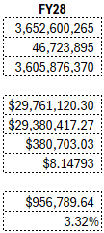
SF2472 Div. II & III – Property Tax
Sets a 2% plus new construction levy limitation on the General Fund levy (CGFL) for Cities
Calculation method:
  CGFL rate =
  1000 X ((Current FY Request X 1.02) / non-TIF taxable value)
X 1.02

Slide 48
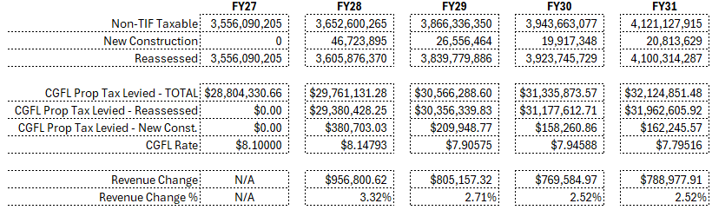
SF2472 Div. II & III – Property Tax
An example:

Slide 49
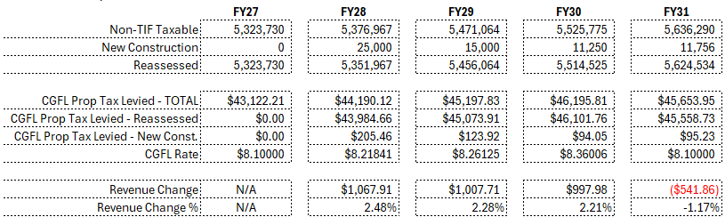
SF2472 Div. II & III – Property Tax
Low growth example:

Slide 50
SF2472 Div. II & III – Property Tax
Does not limit currently non-limited rates
  Insurance, support of local EMC, employee benefits, debt
Makes $8.10 city General rate hard limit beginning in FY31
  Lesser of $8.10 limit or 2% growth
  FY28 – FY30, there is no rate cap on the CGFL
    Rates can grow as necessary to capture 2% revenue growth until FY31

Slide 51
SF2472 Div. II & III – Property Tax
Caps local government rate limited levies to 2% growth
  Includes rate limited city levies except:
    CGFL
    SSMIDs
  Does not limit non-limited rates
    Insurance
    Support of local EMC
    Employee benefits
    Debt service
Allows for new voter approved rates and usage of previously unused limited rate levies
  Allowed to use levies at max rate cap in
  first year.

Slide 52
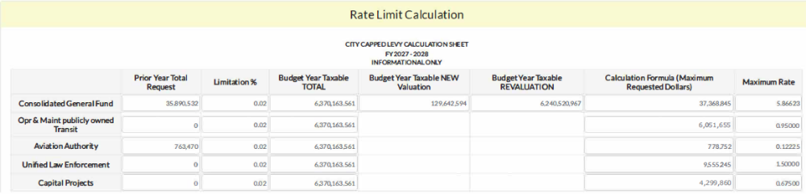
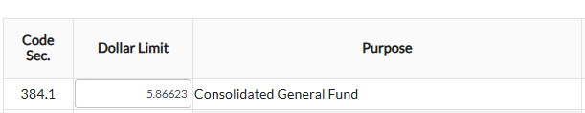
SF2472 Div. II & III – Property Tax

Slide 53
SF2472 Div. III – GO Debt Limitation
General Obligation Debt Issuance Prohibition
  As of July 1, 2026 GO debts cannot be issued “for the purpose of funding the general operations of the governmental entity or otherwise use proceeds from the sale of bonds or issuance of other indebtedness to fund general operations.”
  “General Operations” defined as:
    “Services or activities generally funded from the governmental entity’s general fund, which are necessary for the operation of the governmental entity, including salaries and benefits, or which are for the health and welfare of the governmental entity’s citizens or primarily intended to benefit all residents of the governmental entity, but excluding direct and indirect capital expenditures properly allocable under the Internal Revenue Code, as defined in section 422.3, if the governmental entity were a taxpayer, capital leases, and services financed by statutory funds other than a
    debt service fund.”

Slide 54
SF2472 Div. XI – General Fund Reserves
Beginning with FY2028 budget
Prescribes the use of GASB Fund Balance designations
  https://iowaleague.org/resource/gasb-54-fund-balance-classifications/
Requires governmental entities to budget no more than a 35% ending general fund balance (% of total expenditures) as Unassigned
  Unassigned – Any balance in the general fund that has not been given classification. The general fund should be the only fund that reports a positive unassigned fund balance amount.
Requires an audit of such entity to report the governmental entities’ reasons for exceeding the budgeted fund balance in the actual year if applicable.

Slide 55
SF2472 Div. XI – General Fund Reserves
Nonspendable – Amounts legally/contractually required to be maintained intact
Restricted – Use is restricted due to external imposition by creditors (debt covenants), grantors, contributors, or laws/regulations of other governments
Committed – Amounts that can only be used for specific purposes pursuant to constraints imposed by formal action of the government’s highest level of decision-making authority
Assigned – Amounts that are constrained by the government’s intent to be used for specific purposes, but are neither restricted nor committed.

Slide 56
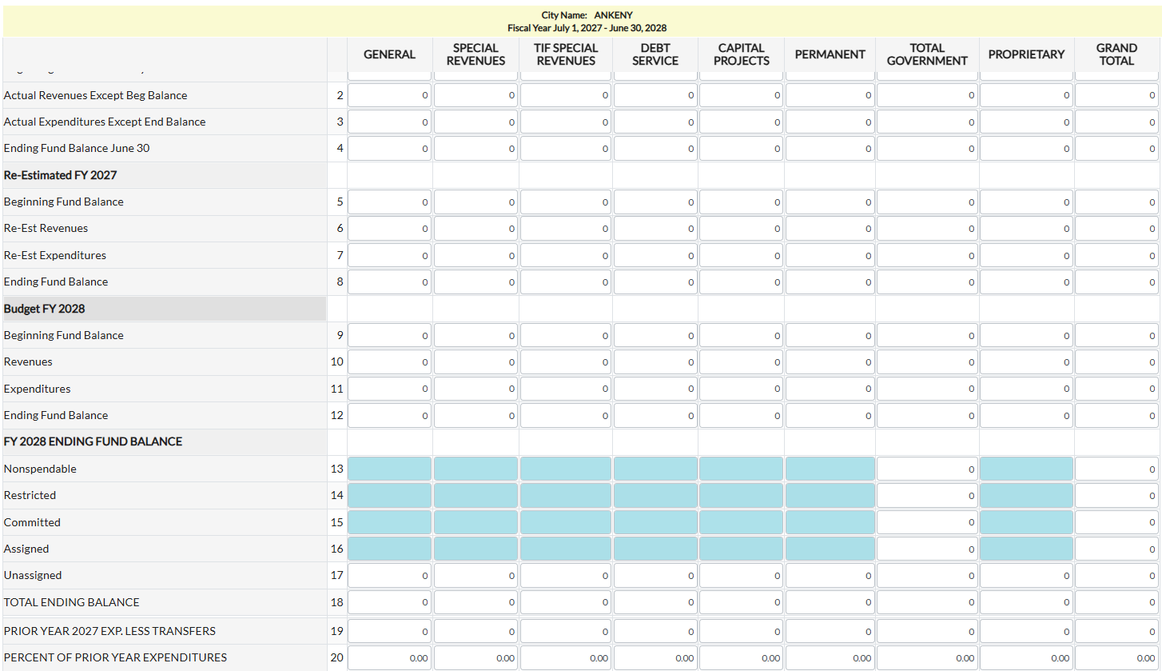
SF2472 Div. XI – General Fund Reserves
Fund Balance Summary

Slide 57
SF2472 Div. XXIII & XXVI – Misc. Levies
28M Transit District Property Tax Change
  Sets a 3% revenue limitation on the total (sum of all members) property tax levied for transit districts
    Non-28M transit levy (non-DART) is governed by 2% hard cap on rate limited levies
EMA Funding Change
  Sets a 3% revenue limitation on the total (sum of all
  members) property tax levied for support of EMA

Slide 58
SF2472 Div. XXI – Budget Notice Mailing
Requires county auditors to send individualized statements regarding specific impact to a taxpayer.
  Same date requirements
    March 5 – Data must be in DOM system
    March 15 – Notices must be mailed / available online
Eliminates the calculation of an effective tax rate, general property example
  Single page with meeting and proposed rate information
Requires DOM to consult with ISAC and League of Cities on the format of the statement
Allows the statement to be posted on the County Auditor’s web site in lieu of mailing

Slide 59
Budget Process Review
Changes have occurred, but process remains the same
  Budget system will still be opened in December
  Taxable valuation is still to be filed to DOM by January 1
  Proposed property tax rates/revenues & property tax hearing information must be in DOM budget system by March 5 @ 4PM
    Proposed Tax Notice page completed and notice proposed in system (“Propose Tax Notice” button)
  Budget statements mailed/posted electronically by March 15
  Notice of both the property tax hearing and the budget hearing must be published/posted 4/20 days prior to hearing – NO OVERLAP
  Budgets due April 30

Slide 60
Questions?
Ted Nellesen
ted.nellesen@dom.iowa.gov
(515) 281-3705

