Slide 1
IMFOA Funding Seminar
Developing a Municipal Funding Strategy in Partnership with USDA
Dee Fischer, USDA Iowa Rural Development
Gene Gettys, JEO Consulting Group
Erin Pingel, JEO Consulting Group

Slide 2
Welcome!
A little about who we are…
…and why we’re here.

Slide 3
Today’s Topics
Funding Strategy
Project Phasing
Key Programs
USDA Coordination
Q&A

Slide 4

And, what about you?

Slide 5

Why having a funding strategy matters
Increasing competition
Need for early planning
Alignment with priorities
Coordination improves outcomes

Slide 6
The infrastructure funding landscape in Iowa
IEDA
DNR
SRF
Federal + state alignment
Rural priorities
Funding trends

Slide 7
What makes projects competitive
Clear scope
Aligned priorities
Strong narrative
Project readiness

Slide 8

Funding by Project Phase
Study / PER / Evaluation
Design
Construction
Sequencing matters
Coordination needed

Slide 9
Planning & Vision
Scope definition
Community input
Cost estimates
Implementation roadmap

Slide 10

Stacking & Sequencing Funding
Layer funding sources
Time applications
Leverage awards

Slide 11
USDA Rural Development
Community Development Block Grant (IEDA)
SRF (IFA/DNR)
WTFAP (DNR)
CAT (IEDA)
Local / private match
Key Programs for Iowa Communities

Slide 12
Financial Readiness
Match planning
Rate impacts
Affordability

Slide 13
Risk Management
Common pitfalls
Delays
Documentation issues

Slide 14
From Strategy to Implementation
Moving to execution
Setting up delivery
Coordination drives success

Slide 15
Importance of Coordination
Align stakeholders
01
Set roles early
02
Prevent delays
03

Slide 16

Are you still with us?

Slide 17
Together, America Prospers
Iowa Municipal Finance Officers Association
Dee Fischer, Area Director
April 16, 2026

Slide 18
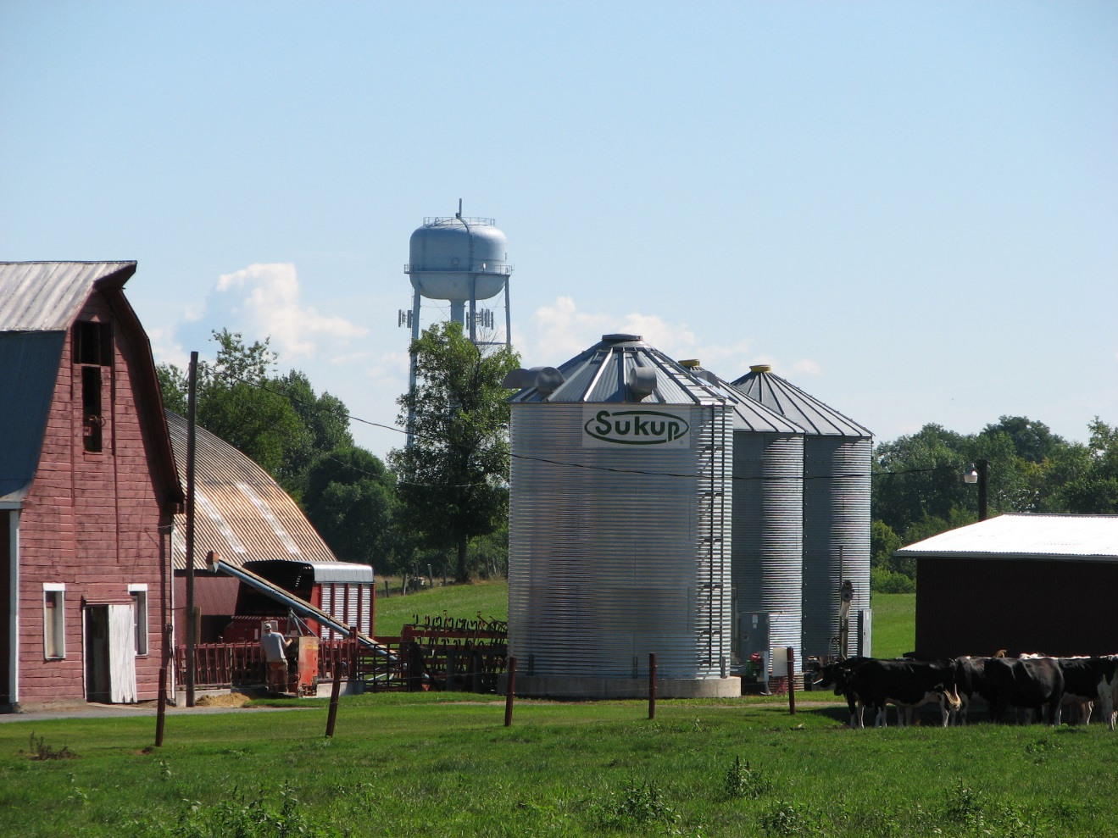
USDA Rural Development: Infrastructure and Services for Rural America
80+ years serving rural America
Federal programs delivered locally in rural areas
Built on strong partnerships

Slide 19
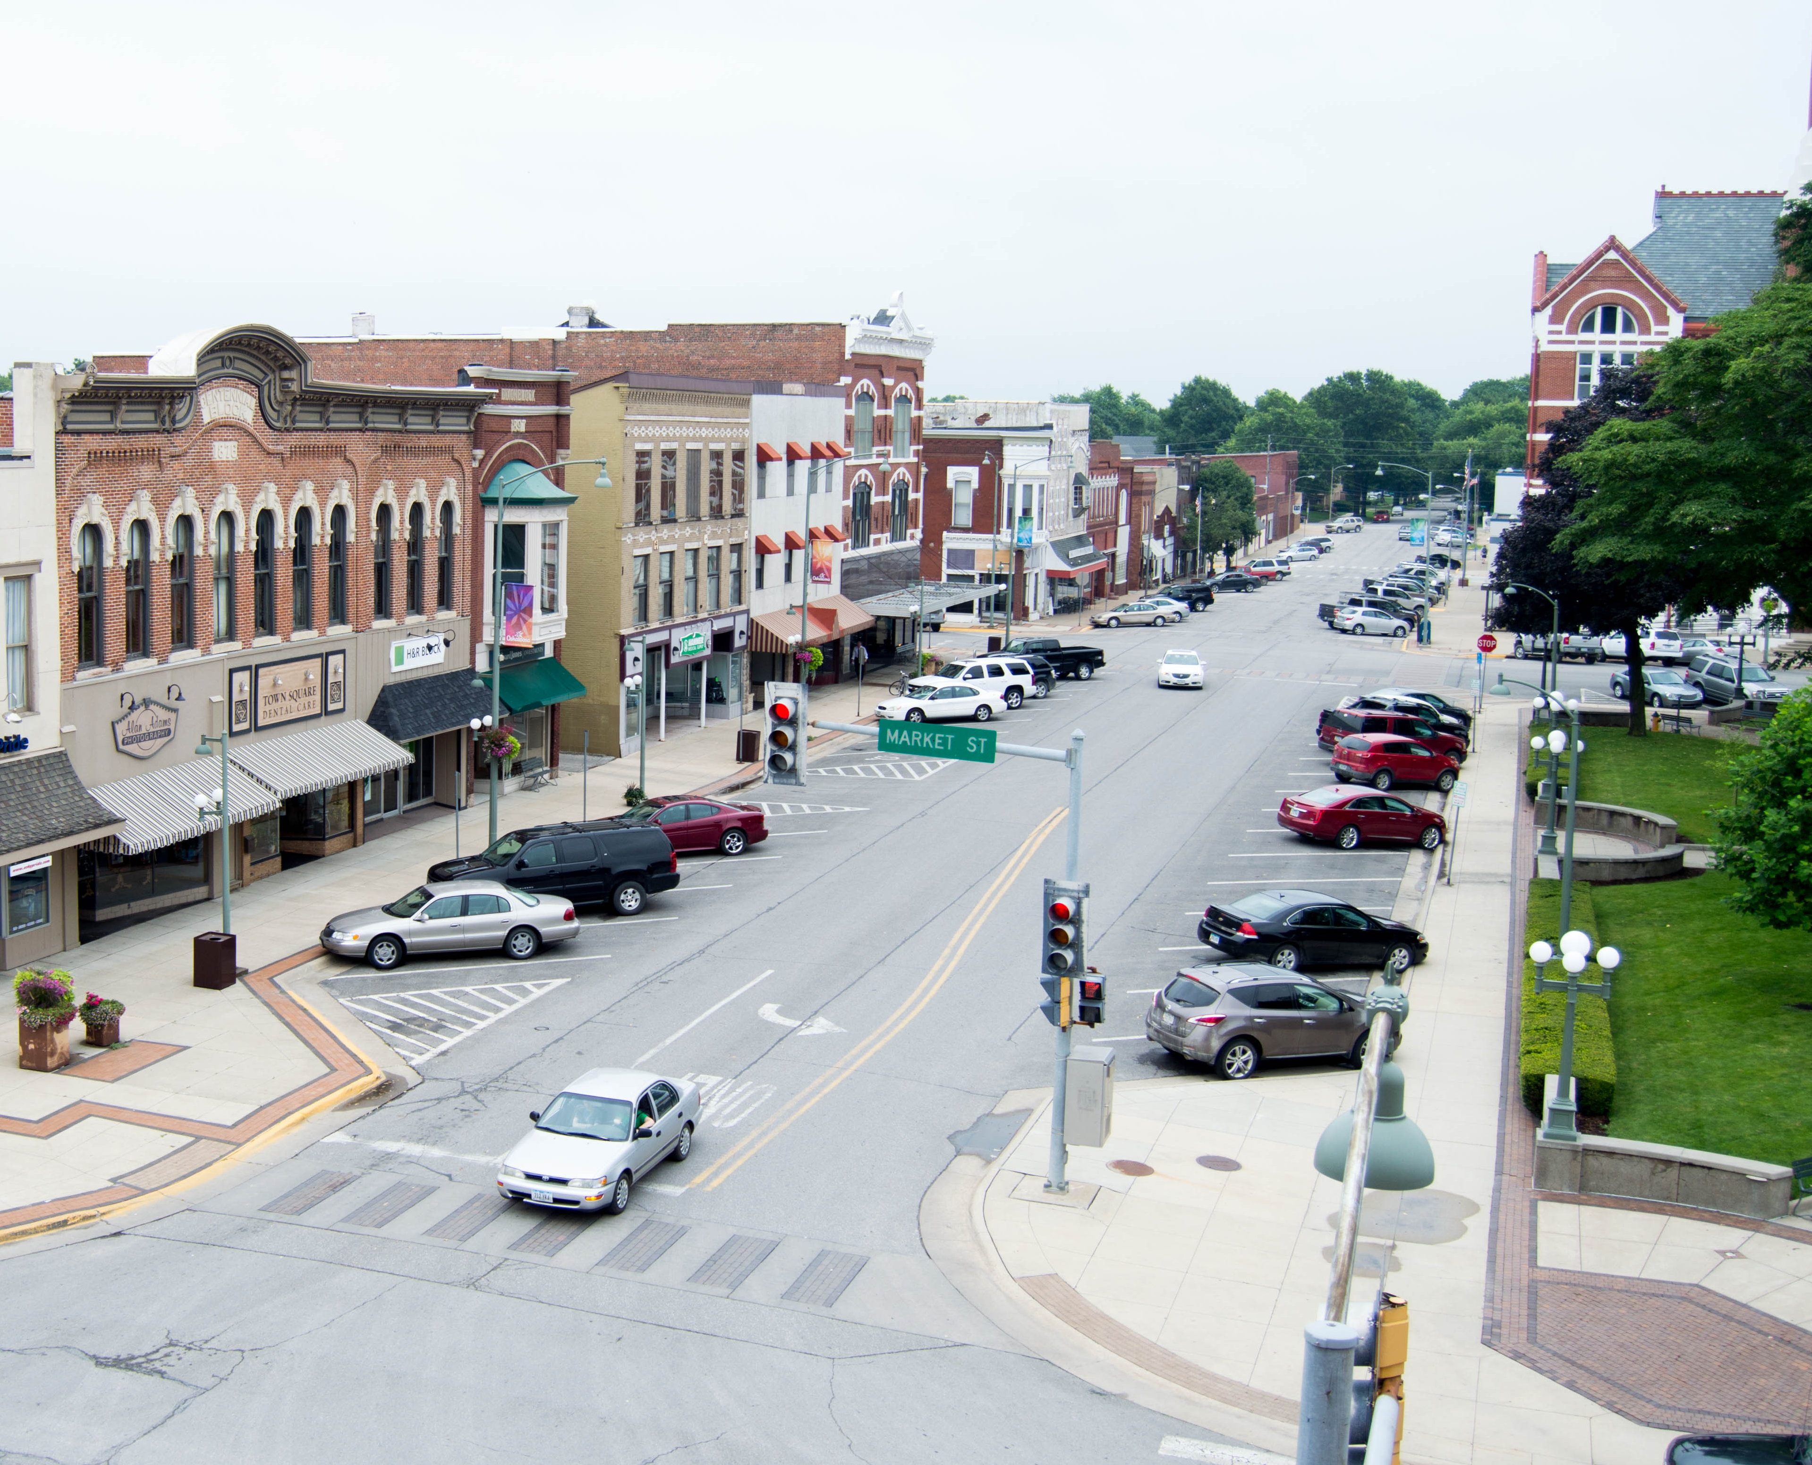
USDA Rural Development in Iowa
$619 million invested in Iowa in 2025
Job creation and economic development
Improvements to critical infrastructure
Upgrades to essential community facilities
Housing opportunities
70+ programs
Downtown Oskaloosa, Iowa
Notes:
We have over 50 programs to help support rural America. This is a view of Oskaloosa, Iowa. Business and academic entities located there have been the recipient of USDA RD grants and loans.
$740 million invested in Iowa in 2022
Job creation and economic development
Improvements to critical infrastructure
Upgrades to essential community facilities
Housing opportunities
50+ programs

Slide 20
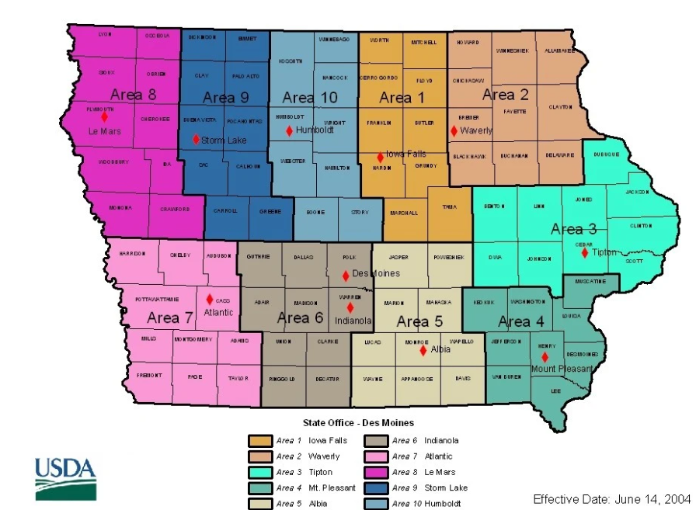
USDA Rural Development - Iowa
Notes:
We have over 50 programs to help support rural America. This is a view of Oskaloosa, Iowa. Business and academic entities located there have been the recipient of USDA RD grants and loans.
$740 million invested in Iowa in 2022
Job creation and economic development
Improvements to critical infrastructure
Upgrades to essential community facilities
Housing opportunities
50+ programs

Slide 21
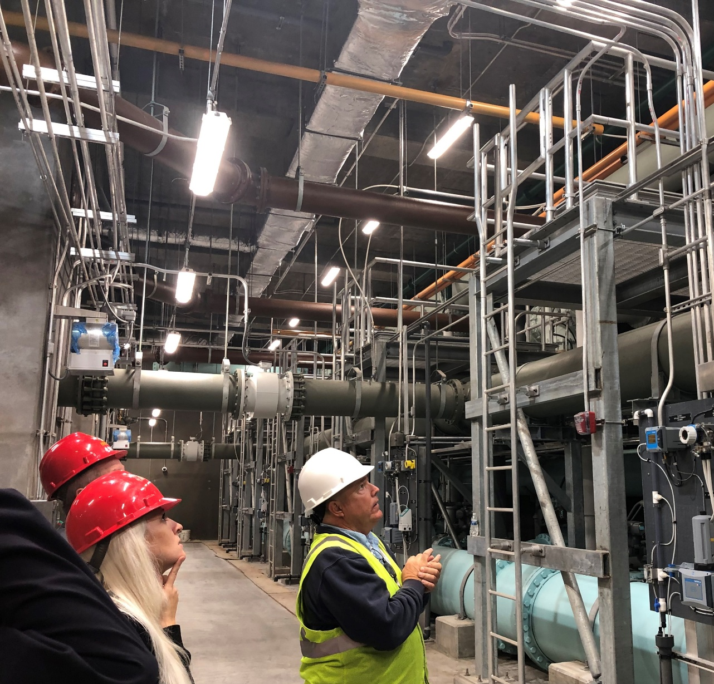
Water & Environmental Programs
WHO IS ELIGIBLE FOR ASSISTANCE?
Public Bodies such as cities, counties, special districts
Indian Tribes
Non-Profit Organizations
Serves communities with a population of 10,000 or less.
987 eligible communities in Iowa

Slide 22
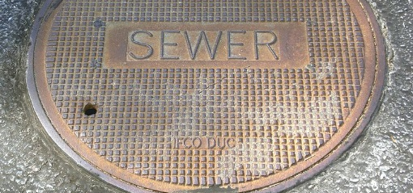
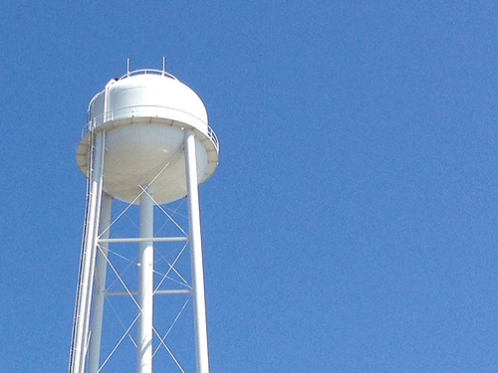
Water & Environmental Programs
Priorities include:
Provide financial assistance for water, wastewater, storm water and solid waste projects
Serving the most financially needy communities
Correcting health and sanitary issues
Leveraging funds from other sources
– reasonable user fees for

Slide 23
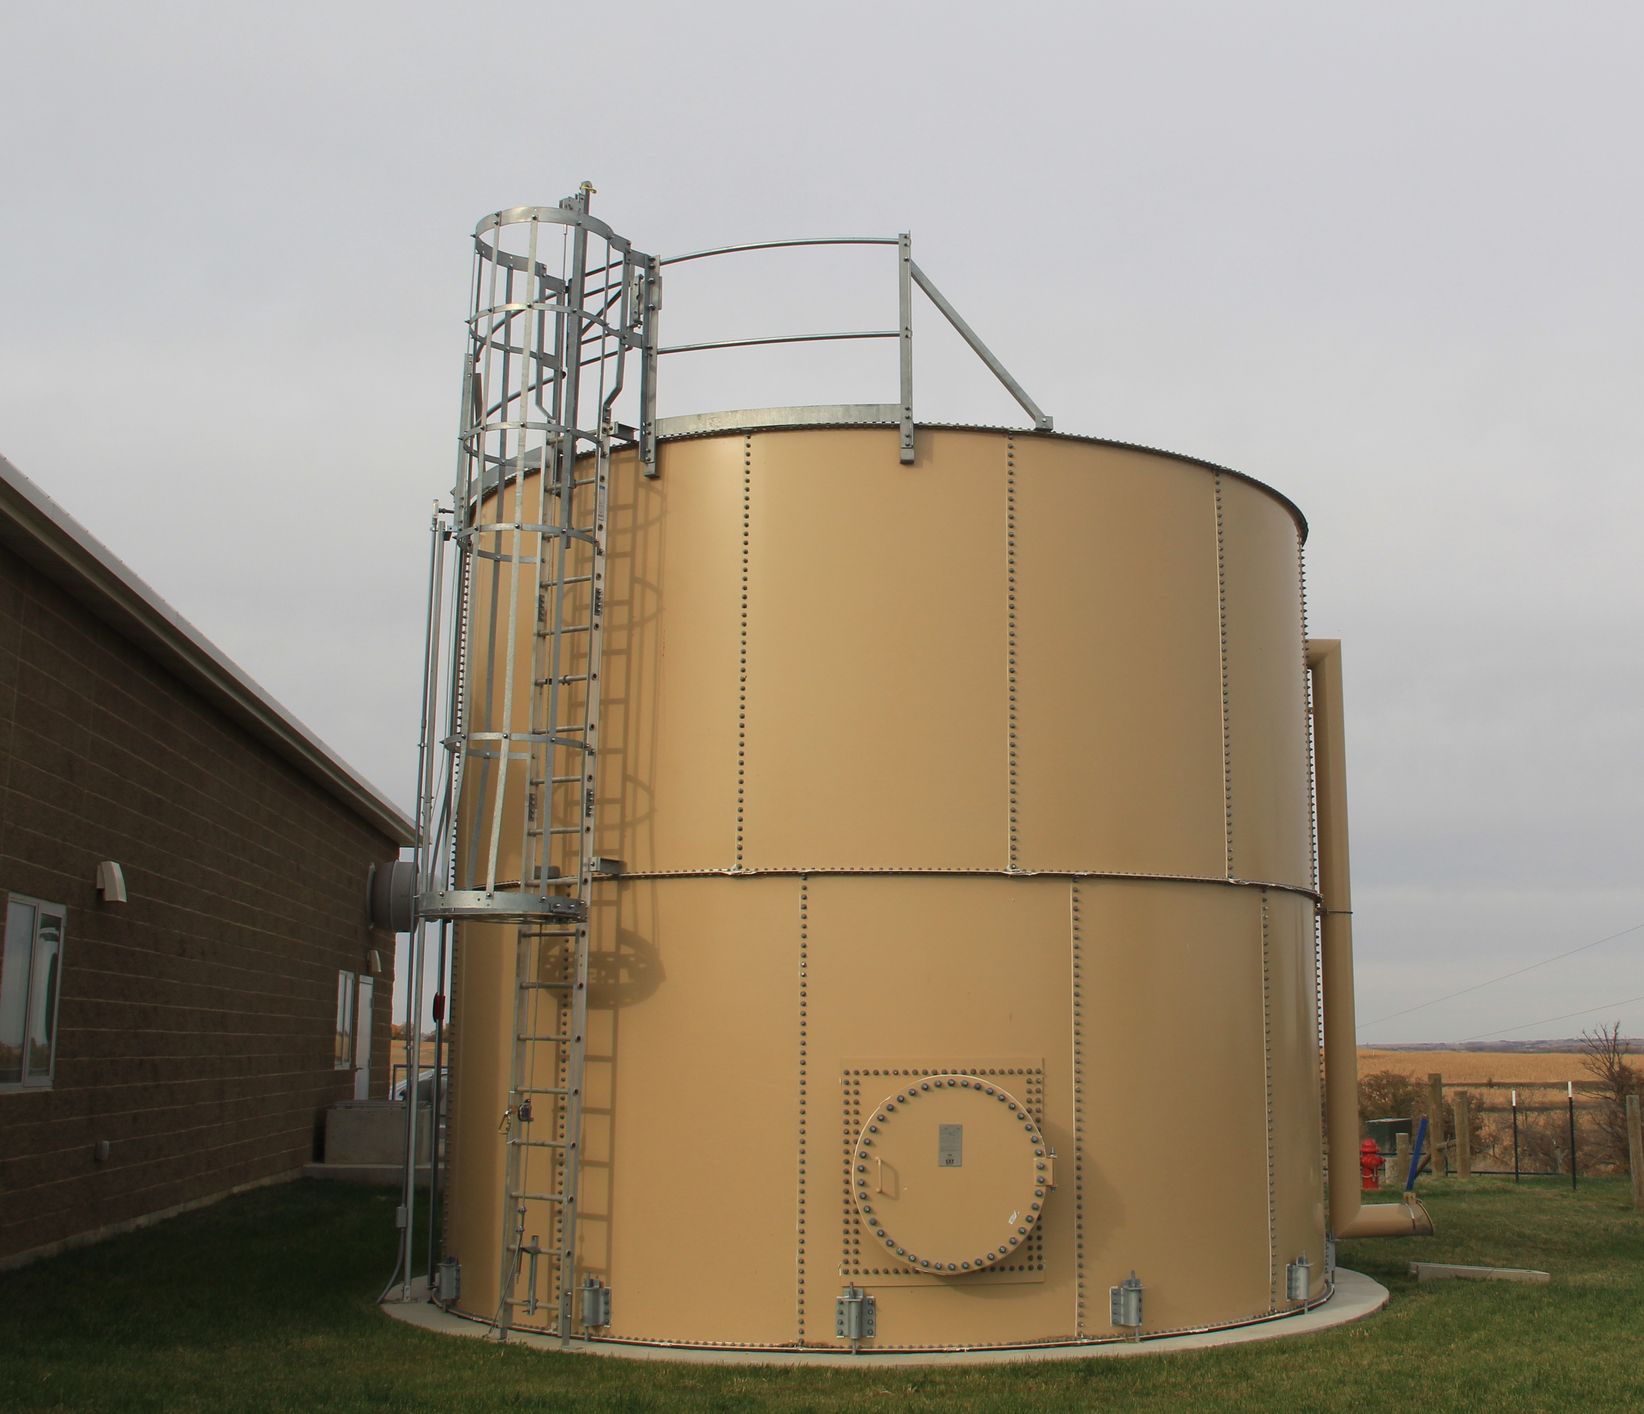
Water & Environmental Programs
WHAT ARE ELIGIBLE PROJECTS?
Costs to Acquire, Construct, Repair, Modify, Expand or Improve:
Water Systems
Sanitary Sewer Systems
Solid Waste Disposal
Storm Wastewater Disposal
Related Costs include:
Legal Fees
Engineering Fees
Land Acquisition
Water Rights

Slide 24
Water & Environmental Programs
DIRECT LOAN TERMS
Maximum loan amount based on financial feasibility
Long term, fixed interest rates.
40-Year maximum term
Security
Public Bodies: Pledge of Facility Revenue
Non-Profit: Note, Mortgage, Pledge & Security Agreement

Slide 25
Direct Loan Interest Rates
Current Rates (effective until June 30, 2026)
Poverty 2.875%
Intermediate 3.75%
Market 4.75%
Interest rate offered is based on Median Household Income (MHI) and if the project is correcting health or sanitary issues
Grant assistance may be considered in the agency underwriting process and is based on financial need
No application or servicing fees
Applications accepted year round
City Attorney and Bond Counsel engagement

Slide 26

Water & Environmental Programs
Application process
RD Apply
Preliminary Engineering Report
Environmental
Report

Slide 27
Water and Waste Disposal Projects Technical Assistance Grants
Special Evaluation Assistance for Rural Communities and Households (SEARCH) and Predevelopment and Planning Grants (PPG)
Technical Assistance for Application Development, Predevelopment Costs
Financial and Feasibilities Studies
Engineering Analysis
Environmental Reports
SEARCH – 100% grant; population <2,500
-Maximum SEARCH Grant $30,000
PPG – 75% grant; population <10,000
-Maximum PPG $60,000
Median Household Income (MHI) must be less than $55,808 and lack the financial resources to cover project predevelopment costs

Slide 28
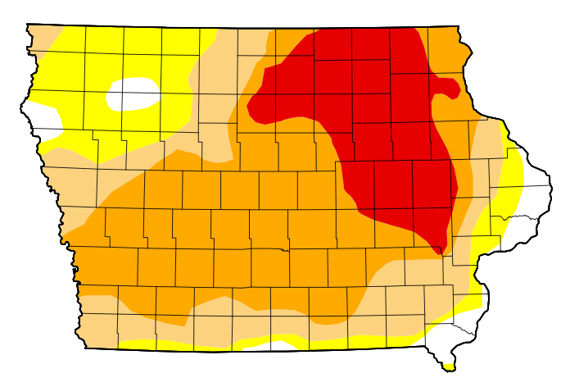
Emergency Community Water Assistance Grants (ECWAG)
Helps rural communities prepare or recover from an emergency threat to safe, reliable drinking water
Events include but not limited to:
Drought, Floods, Earthquake, Tornadoes
Disease Outbreak, Chemical Spills, PFAS
Water transmission line - grants up to $150,000
Water source - grants up to $1,000,000
Can be combined with our loan program
Median Household Income must be less than $69,760

Slide 29
Water & Environmental Programs
GUARANTEED WATER & WASTE LOANS
Population 50,000 residents or less
Lender Driven Program
Loan made by a commercial lender
80% Guarantee by the Government
Reduces risk to the lender
Rates and terms are negotiated between the lender and borrower
No maximum loan amount
Combine with WEP direct loan to ensure project feasibility
1% Guaranteed Fee of guaranteed amount

Slide 30
Water & Environmental Programs -Sustainable Systems
Facility Revenue is adequate to cover:
Operating & Maintenance Expenses
Debt Service
Debt Service Reserve Transfers
Short-Lived Asset needs of the utility (pumps, controls, tower painting, etc.)
Reserves for future capital improvements
Rate Studies and Technical Assistance:
Iowa Rural Water Association https://www.iowaruralwater.org
Midwest Assistance Program https://www.map-inc.org/services

Slide 31
Full Listing of Water and Waste Disposal Programs https://www.rd.usda.gov/programs-services/all-programs/water-environmental-programs

Slide 32
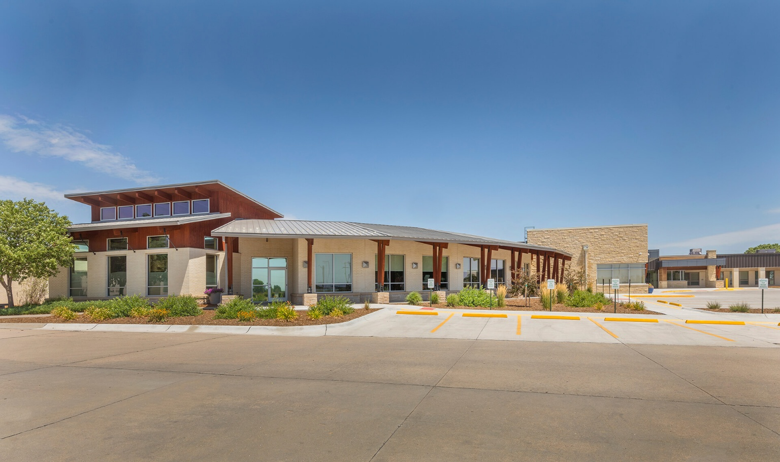
Community Facilities Loans
WHO IS ELIGIBLE FOR ASSISTANCE?
Public Bodies
Cities
Counties
Special districts
Indian Tribes
Non-Profit Organizations
Serves communities with a population of 20,000 or less

Slide 33
Community Facilities Loans
Types of Projects:
Hospitals & Clinics Fire Stations & Emergency Vehicles
Child Care Facilities Streets & Bridges
Airports Nursing and Assisted Living Facilities
City Hall Community Centers
Rates and Terms:
Up to a 40-year term, also determined by Iowa Code
Fixed interest rate – currently ranges from 4.50% to 4.75%
Loan amount – based on scope of the project and financial feasibility
Security:
Public Bodies – General Obligation or Revenue Secured Indebtedness
Non-Profits – Note, Pledge & Security Agreement, Appraisal, & Mortgage

Slide 34

Community Facilities Grants
VERY limited grant funds in 2026
Grants generally <$50,000, typically used for equipment purchases
Grants are based on need and median household income
Highly competitive national program – best scoring projects are Public Safety and Healthcare

Slide 35

Iowa Community Programs Contact Information:
Community Programs
iowacommunityprograms@usda.gov
Phone 515-284-4669
210 Walnut Street, Room 873, Des Moines, IA 50309
USDA is an equal opportunity provider, employer, and lender.

Slide 36
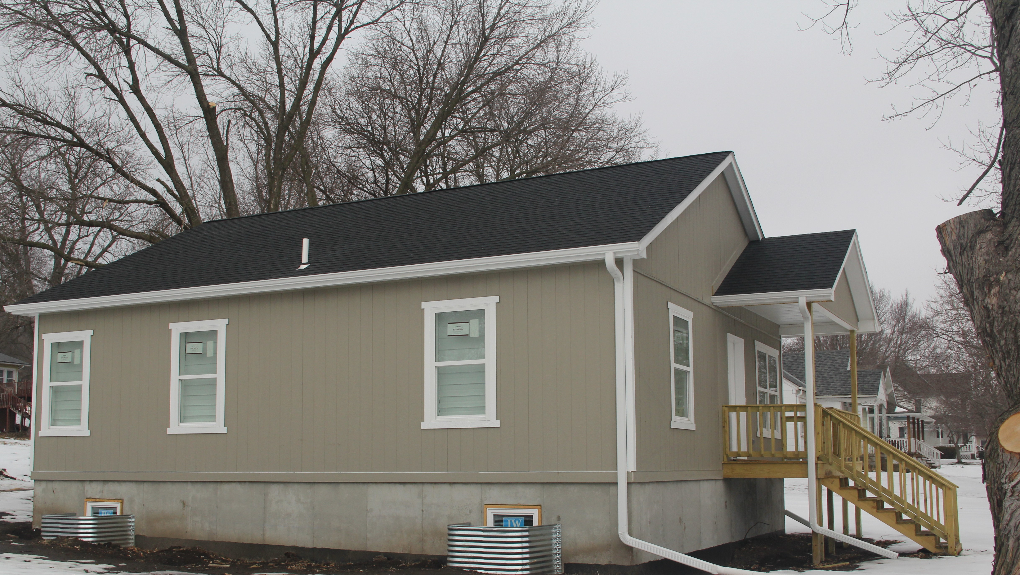
Single Family Housing Programs
Mission : Provide decent, safe, and sanitary housing to eligible applicants in eligible rural areas with populations of 20,000 or less:
502 Direct Home Loan Program (home purchase)
502 Guaranteed Home Loan Program (home purchase)
504 Home Repair Loan & Grant Program

Slide 37
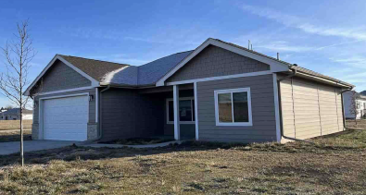
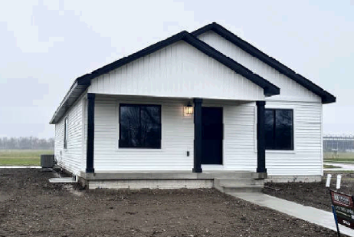
Single Family Housing - 502 Purchase Program
Safe and Affordable Housing
Home mortgages and home repairs
100% financing, up to $324,700
Assist low & very low-income applicants
Standard loan term – 33 years
Fixed Interest rates
Subsidy to lower monthly loan payments, if eligible
100% financing
No down payment typically required

Slide 38


Single Family Housing - Guaranteed Loans
 |  | INCOME | Moderate-income limits (115% of median family income)
 |  | LOAN AMOUNT | 101% of appraised value (closing costs, fees, & repairs)
 |  | INTEREST RATE | 30-year term - fixed rate with agency 90% guarantee
 |  | HOW TO APPLY | Apply through a participating SFHGLP lender

Slide 39
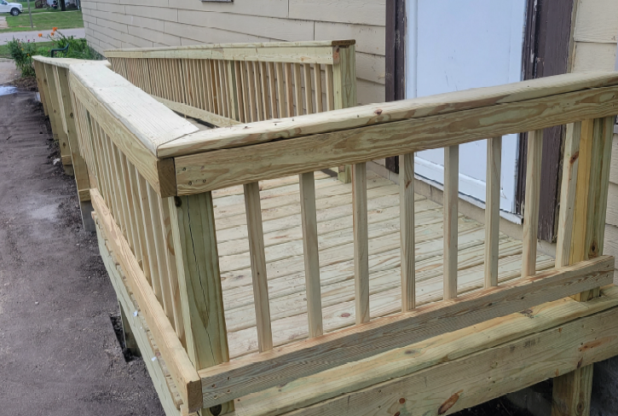
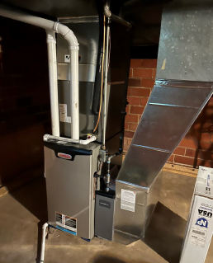
Single Family Housing – 504 Repair Program
Home repair loan & grant program for very low-income homeowners.
Applicant must own & occupy the property
Make a dwelling decent, safe, and sanitary
Remove health and safety hazards
Roof, Furnace, Water Heater, Plumbing,
Electrical, Structural Support, Home Access,
Steps/Stoops, Doors, Windows
Maximum loan of $40,000 - 1% interest rate - 20-year term
Grants up to $10,000 for applicants at least 62 years of age.

Slide 40
Iowa Single Family Housing Programs Contact Information:
Iowa Direct Housing Team
IowaHomeLoans@usda.gov
Phone: 515-284-4444
Fax: 855-415-3562
210 Walnut Street, Room 873, Des Moines, IA 50309
USDA is an equal opportunity provider, employer, and lender.

Slide 41
Rural Business Programs
Value-Added Producer Grants:
*Market new products or to new regions * Planning for future products
Business and Industry Loan Guarantees:
* Start or Expand rural businesses * Loans are made by participating lenders and guaranteed by USDA.
Intermediary Relending Program:
* Loans to local intermediaries that re-lend to businesses and for community development projects.
Rural Economic Development Loan and Grant programs:
*Zero-interest loans to local utilities which they, in turn, pass through to local businesses for projects
Rural Businesses Development Grants:
* Technical assistance and training * Feasibility studies * Business Incubators

Slide 42
Iowa Rural Business Contact Information:
Business Programs
iowabusinessprograms@usda.gov
Phone 515-284-4668
210 Walnut Street, Room 873, Des Moines, IA 50309
USDA is an equal opportunity provider, employer, and lender.

Slide 43

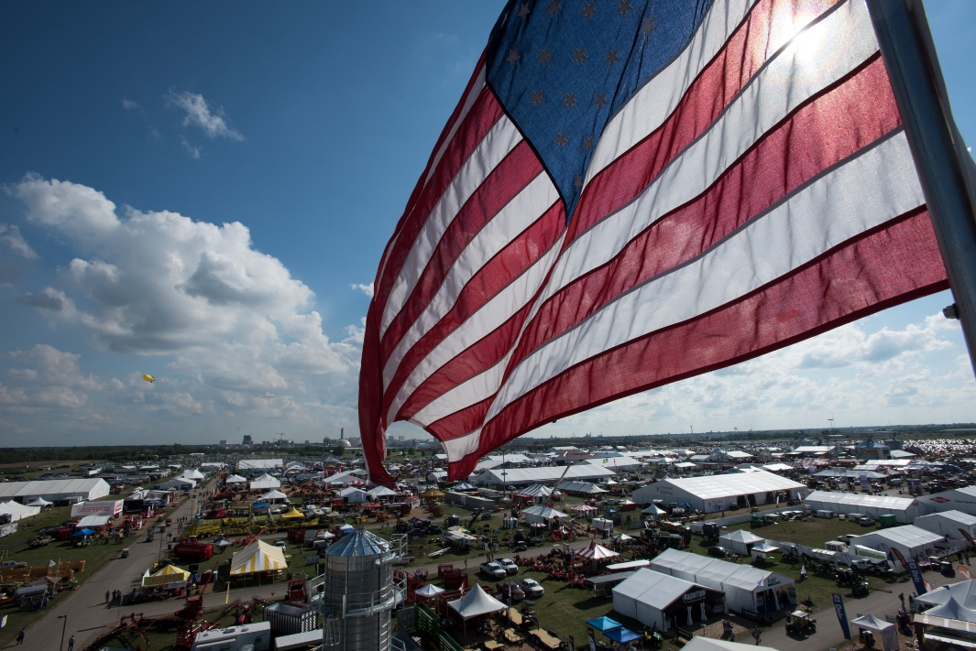
Flag over the Farm Progress Show
Questions?
Full Listing of Rural Development Programs http://rd.usda.gov/sites/default/files/RD_ProgramMatrix.pdf

Slide 44


Thank You!
Dee Fischer, Rural Development Iowa
Area Director
(712) 254-4360
dee.fischer@usda.gov
rd.usda.gov/ia
@usdaRD or
@RD_Iowa

Slide 45

Key Takeaways
Start early
Plan by phase
Coordinate with partners

Slide 46
Next Steps
Define
scope
Identify
funding
Engage
early

Slide 47

Principles of Effective Grant Writing
Begin early.
Clearly define your project and budget.
Funding agencies do not want to be the first dollar in on a project.
Know your funding source.
Look locally first.
Establish personal contact with the funding source.
Understand how the application will be evaluated.
Follow instructions.
Ensure your application is reviewer-friendly.
Massage the narrative for clarity and succinctness.
The first sentence of every paragraph is the most important.
Invest in plans/renderings.
Realize there are many worthy projects, but limited resources.
Have a contingency plan.
Fourteen hard‑earned lessons that turn good project ideas into fundable grant proposals.

Slide 48

Q&A
Open Discussion

Slide 49
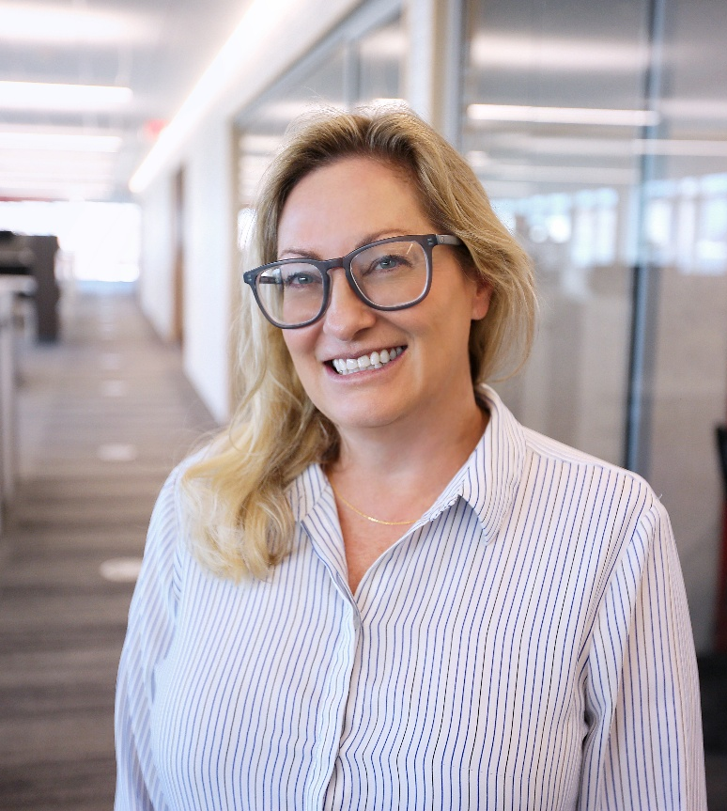
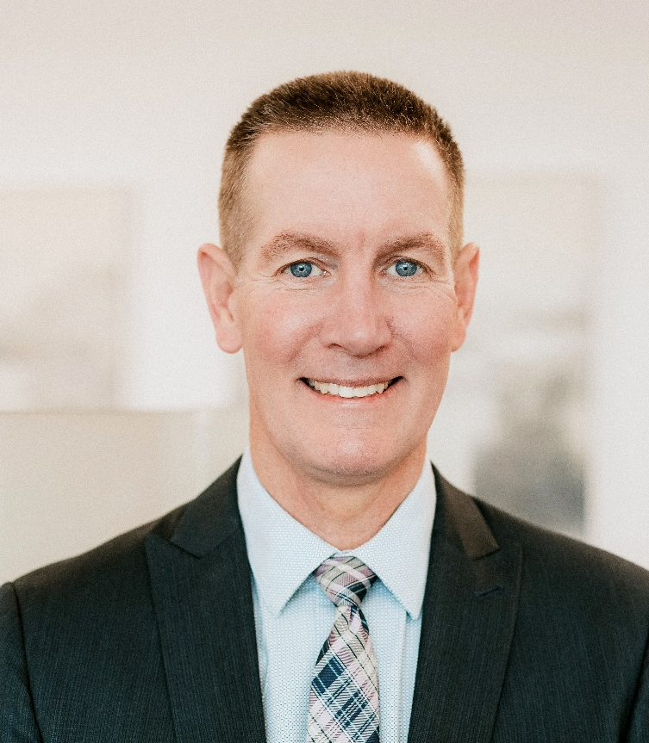

Thank You
Erin Pingel
Senior Grant Writer
712.229.9159
epingel@jeo.com
Gene Gettys
Senior Client Advisor
712.579.9798
ggettys@jeo.com

