Slide 1

Hot Topics in
Municipal Employment Law
Maddie Huntzinger
&
Holly A. Corkery
April 9, 2025

Slide 2

ROADMAP
Family Medical Leave Act (FMLA)
Issues Related to Minor Employees
Technology Issues
Dress Code
New Legislation?

Slide 3

Family Medical Leave Act (FMLA)

Slide 4


FMLA: Purpose
    When creating the Family Medical Leave Act (“FMLA”), Congress sought to "balance the demands of the workplace with the needs of families, to promote the stability and economic security of families, and to promote national interests in preserving family integrity." Dollar v. Smithway Motor Xpress, Inc., 2011 U.S. Dist. LEXIS 40753, (N.D. Iowa April 13, 2011); 29 U.S.C. § 2601(b)(1).

Slide 5
FMLA: Eligibility
    What does FMLA entitle an employee to?
Unpaid leave for up to twelve weeks in a twelve-month period as calculated by the employer (four ways to calculate) OR
Unpaid leave for up to 26 weeks in a twelve-month period to care for a covered servicemember with a serious illness or injury.

Slide 6

FMLA: Eligibility
    First, is the employer a “covered employer?”
      EVERYONE HERE.
    Second, is the employee “eligible?”
      Employee:
        1. Worked for at least 12 months (generally does not necessarily need to be consecutive);
        2. Worked 1,250 hours for the employer during the 12-month period immediately preceding the leave; and
        3. Works at a location where the employer has at least 50 employees within 75 miles.

Slide 7
FMLA: Qualifying Reason
Does the employee have a qualifying reason for FMLA leave?
  Birth or placement of a child with employee (up to twelve weeks total for both parents);
  Employee’s own serious health condition;
  Serious health condition of employee’s spouse, child, or parent requiring employee’s care.

Slide 8
FMLA: Qualifying Reason
Does the employee have a qualifying reason for FMLA leave?
  Employee caring for servicemember who incurred serious injury or illness while on active duty with U.S. Armed Forces (up to 26 weeks); OR
  Employee has a qualifying exigency due to their spouse, parent, or child being called for active duty service in the U.S. Armed Forces (up to 12 weeks).

Slide 9
FMLA: What is a Serious Health Condition?
(1) an illness, injury, impairment, physical or mental condition; (2) that involves inpatient care OR involves continuing treatment by a health care provider; and (3) prevents employees from performing the functions of their jobs or prevents the qualified family member from participating in school or other daily activities.

Slide 10
FMLA: What is Continuing Treatment?
There are five (5) different scenarios which constitute continuing treatment under the FMLA:
1) A period of incapacity of more than three (3) consecutive calendar days involving two or more treatments, by or under the orders of a health care provider, or treatment by a health care provider on at least one occasion that results in a supervised regimen of continuing treatment;

Slide 11
FMLA: What is Continuing Treatment?
There are five (5) different scenarios which constitute continuing treatment under the FMLA:
(2) Pregnancy (including severe morning sickness) and time needed for prenatal visits;
(3) A chronic health condition, such as asthma, diabetes, or epilepsy;

Slide 12
FMLA: What is Continuing Treatment?
There are five (5) different scenarios which constitute continuing treatment under the FMLA:
(4) A long-term condition such as Alzheimer’s, a severe stroke, or the terminal stages of a disease; and
(5) Restorative surgery after an accident or other injury, or a condition that is likely to result in a period of incapacity of more than three (3) consecutive calendar days if left untreated, such as physical therapy for severe arthritis or chemotherapy for cancer.

Slide 13
FMLA: Entitlement/Uses
    Block leave: 12 weeks in a 12-month period for:
      Birth of a child or placement of a child with the employee for adoption or foster care;
      Care for a spouse, child, or parent who has a serious health condition;
      A serious health condition that makes the employee unable to perform the essential functions of his or her job; or
      Any qualifying exigency arising out of the fact that a spouse, child, or parent is a military member on covered active duty or call to covered active-duty status.

Slide 14

FMLA: Other Entitlement/Uses
    Up to 12 workweeks in a 12-month period for:
      Reduced schedule leave
      Intermittent leave
    Up to 26 workweeks in a single 12-month period for:
      Care of a servicemember with a serious injury or illness

Slide 15
FMLA: What do I do if an employee requests FMLA leave?
Is the employee eligible?
  If yes, communicate to employee through the Notice of Rights and Responsibilities Form and provide certification forms with written job description.
  If no, communicate to employee through the Notice of Rights and Responsibilities Form.

Slide 16
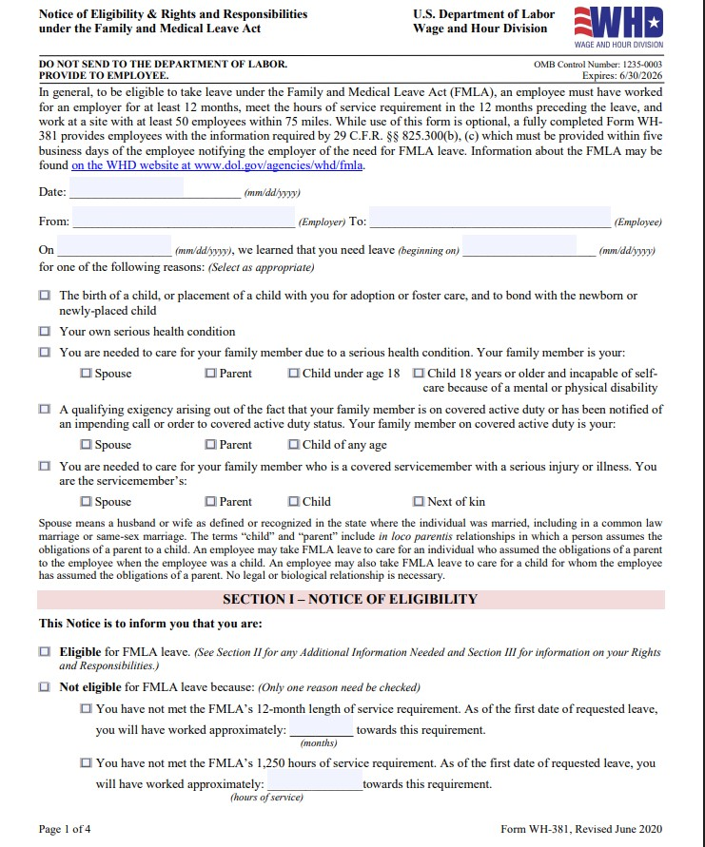

Slide 17
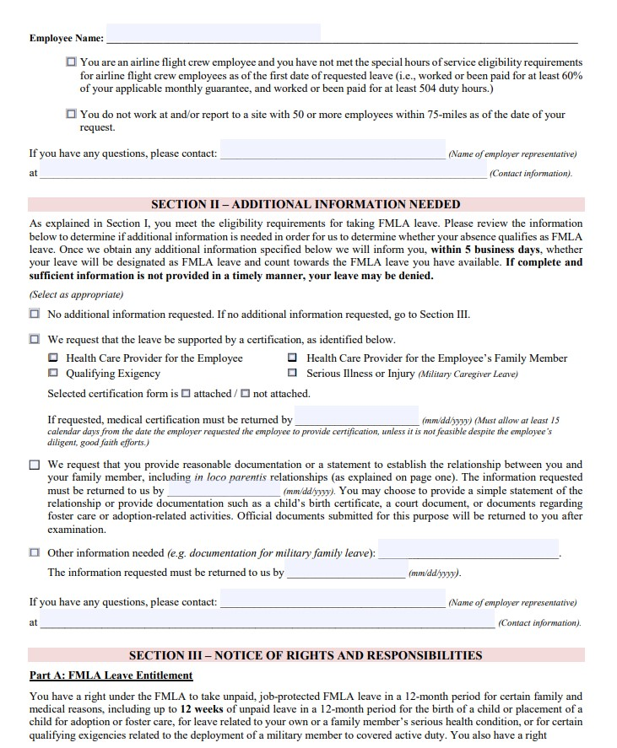

Slide 18
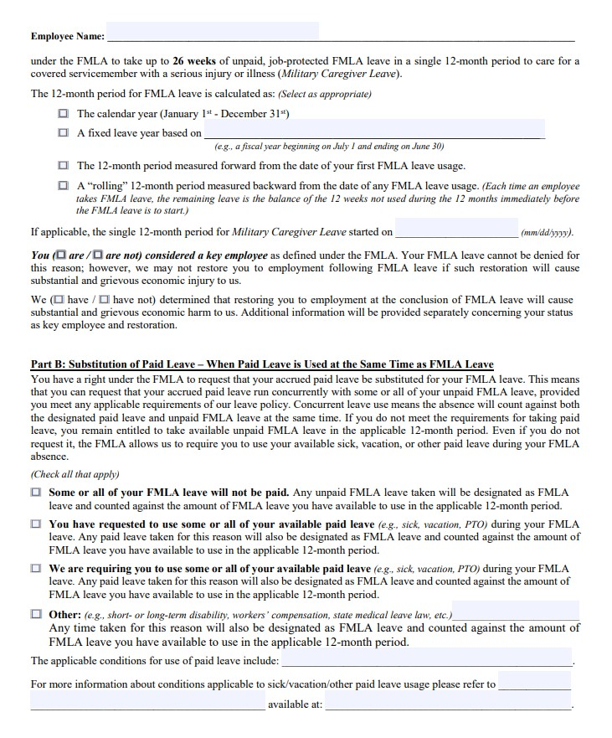

Slide 19
FMLA: How to calculate the
12-month period.
How you calculate the 12-month period the employee can use their 12 weeks of leave in. Four ways to calculate:
  Calendar year;
  A fixed leave year (fiscal year, etc.);
  The 12-month period measured forward from the date of your first FMLA use;
  A “rolling” 12-month period measured backward from the date of any FMLA leave usage.

Slide 20
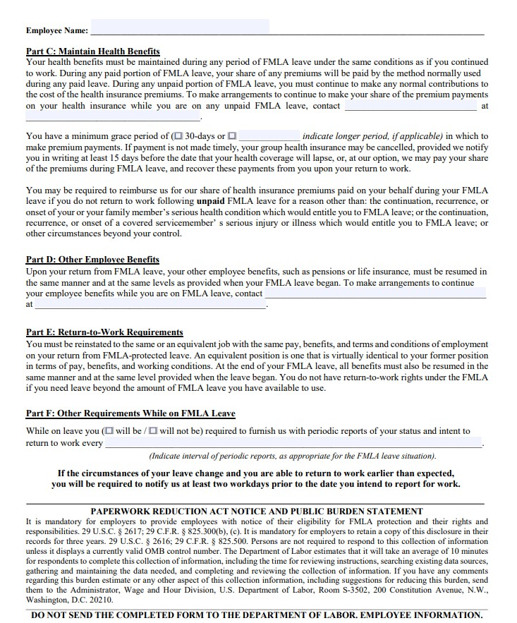

Slide 21
FMLA: Certification Form
Who needs a certification form?
When do I send it?

Slide 22
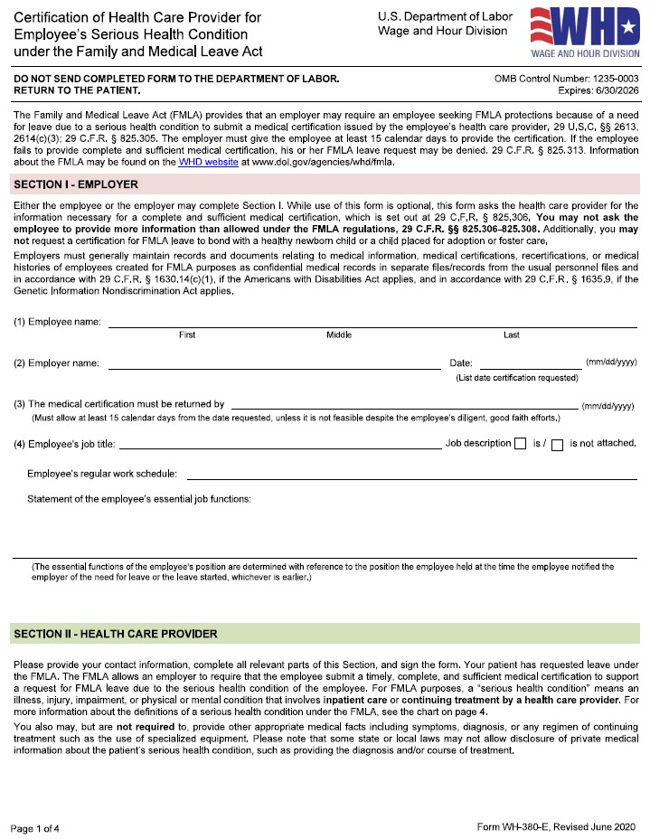

Slide 23
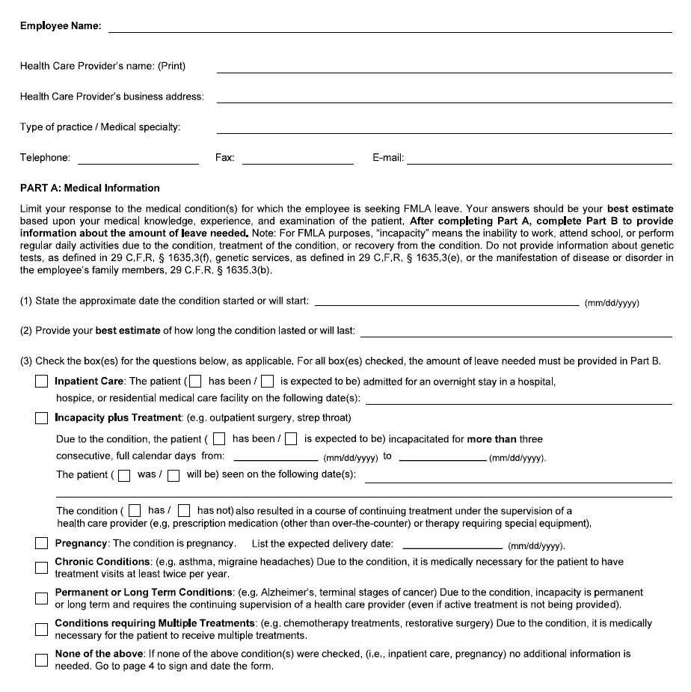

Slide 24
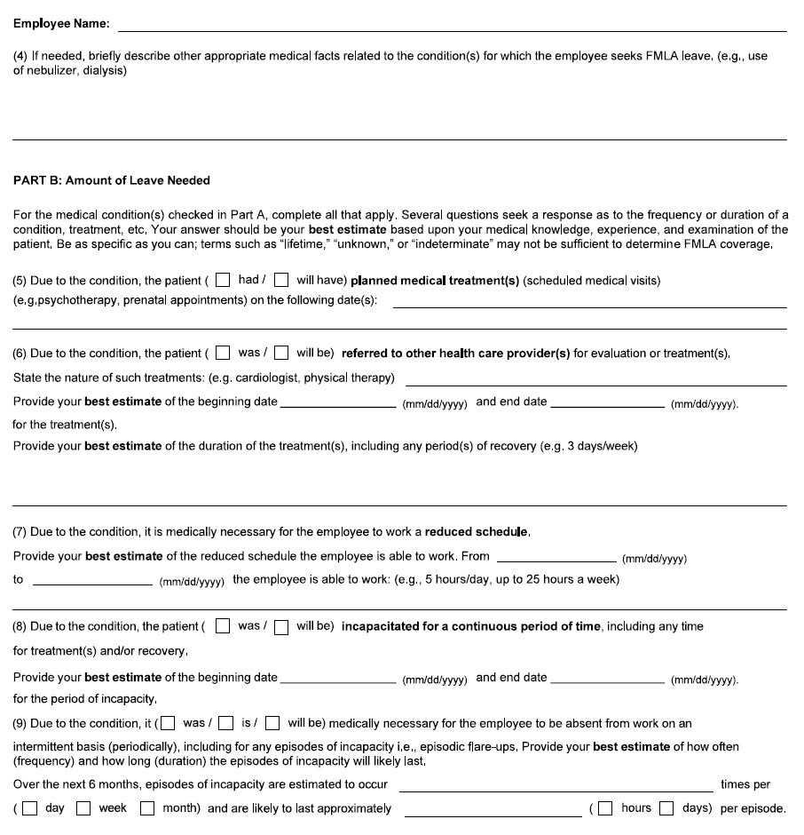

Slide 25
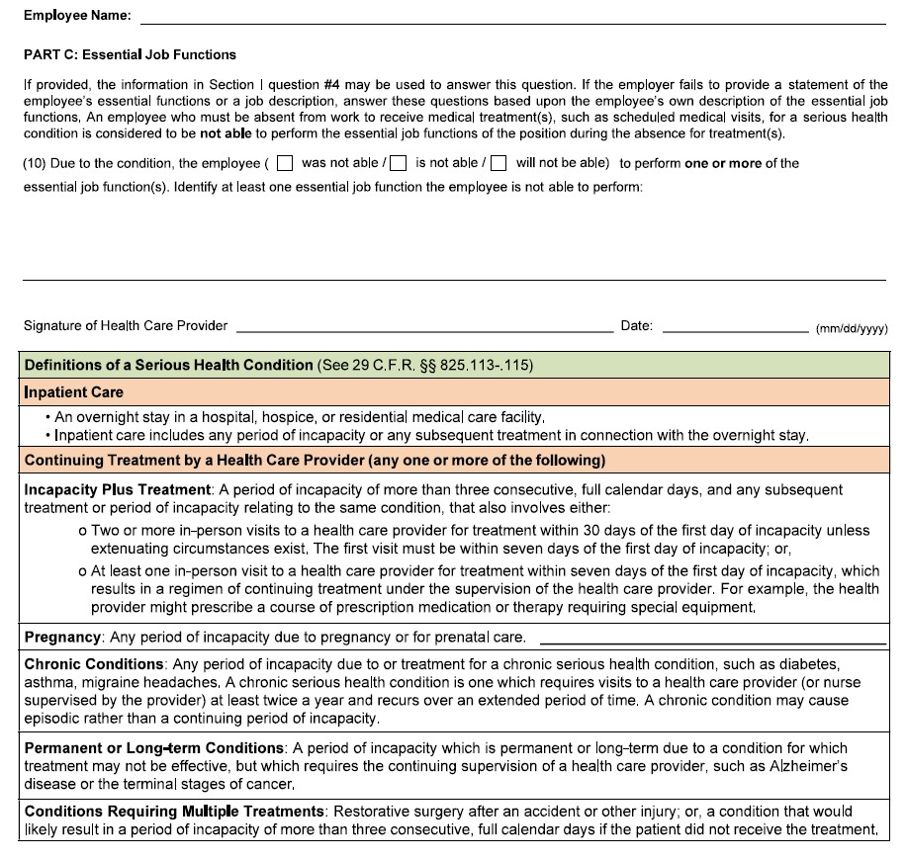

Slide 26
FMLA: Certification Form
What happens next?
Employee returns certification forms within 15 days.
Review certification form.
  Is it complete?
  Is it sufficient?
    If it is incomplete or insufficient, notice to employee in writing to correct the deficiencies.

Slide 27
FMLA: Certification Form
Key Things to Look for on Certification Form:
  Block leave?
  Is there a return-to-work date (look at “Probable Duration of Condition” line)?
  Reduced Schedule leave? (Scope and Duration?)
  Intermittent leave? (Scope and Duration?)
  Does the health care provider believe the employee can perform essential job functions upon return to work?
  Does information indicate that the employee will pose a direct threat to himself/herself or others when performing essential job functions upon return to work?
  These items will indicate that an ADA analysis is also required.

Slide 28
FMLA: Designation

Slide 29
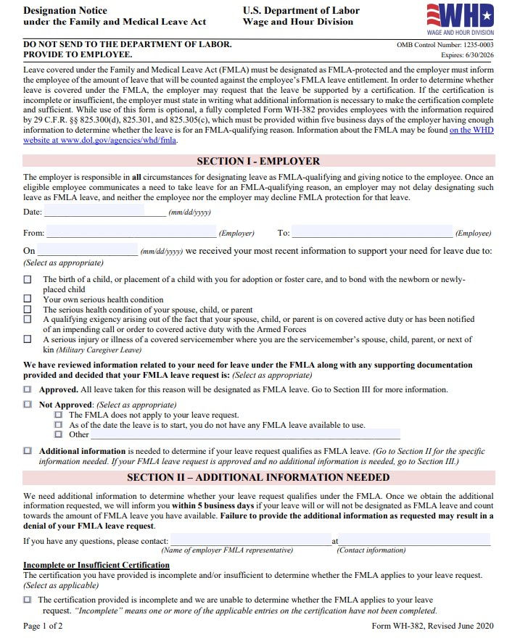

Slide 30
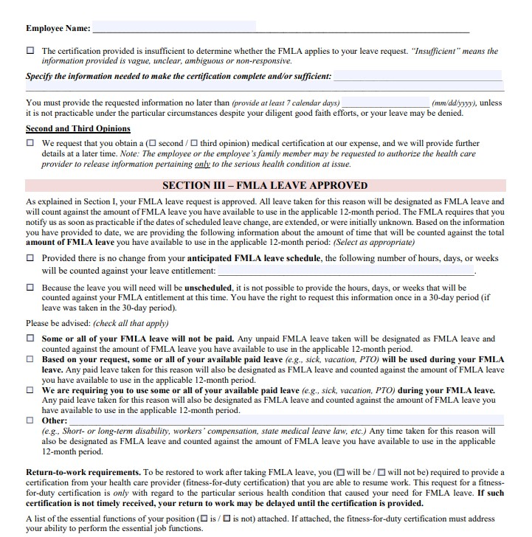

Slide 31
FMLA: Designation
Can you “save” FMLA by delaying designation?
What if an employee refuses?

Slide 32

FMLA: Key Issues
    Failing to designate the leave.
    Failing to manage the leave.
    Failing to have a policy on insurance premiums if unpaid leave.
    Failing to run concurrently with work comp or other leaves.
    Failing to prepare for the end of leave.

Slide 33

Americans with Disabilities Act (ADA) and Iowa Civil Rights Act

Slide 34


ADA: Overview
The ADA prohibits discrimination on the basis of a disability.
The ADA imposes an obligation on covered employers to make “reasonable accommodations” for an eligible employee’s known limitations unless doing so would create an “undue hardship” to the employer.

Slide 35
ADA: Reasonable Accommodations
Reasonable
A defined leave of absence;
Removing architectural barriers or reconfiguring office space;
Providing additional breaks;
Providing accessible parking, if parking is provided to all employees;
Providing assistive technology or equipment, including specially designed furniture.
Not Reasonable
An indefinite leave of absence;
Violating a Collective Bargaining Agreement;
Removing essential job functions;
Request of a personal use item (i.e., a hearing aid that is used on and off the job).
Undue hardship to employer (i.e., significant difficulty or expense to implement).

Slide 36
FMLA and ADA: Interplay with Work Comp
  If the person cannot return to work from a workplace injury and is not at MMI…
    Best practice to wait for it, put them on a “temporary accommodation” unpaid LOA.
  If the person can return to work but cannot perform all essential job functions…
    Can they perform light duty within restrictions?
  If the person cannot return to work from an illness or injury and needs a couple of more weeks to complete recovery…
    What is reasonable?

Slide 37

ADA: Medical Cannabis
    Medical cannabis is not protected under the ADA.
      In February 2024, a federal judge in Vermont ruled that employers are not required to accommodate cannabis use because, under the Controlled Substances Act, marijuana is a Schedule 1 drug with a “high potential for abuse” and “no currently accepted medical use in the United States.” See Skoric v. Marble Valley Regional Transit District et al. (VT state law permits it to be legally prescribed.)
    Iowa Code 124E - Medical Cannabidol Act
      Section 24 prohibits employees from bringing claims of discrimination or any other claims under Iowa Civil Rights Chapter 216.
Notes:
https://www.mslaw.com/mslaw-blog/where-states-stand-on-medical-marijuana-in-the-workplace
Disability discrimination case
https://www.legis.iowa.gov/docs/ico/chapter/124E.pdf

Slide 38
Minor Employees

Slide 39
Minor Employees
For minors, the Fair Labor Standards Act (FLSA) restricts the hours of work and nature of occupations. Federal child labor laws prohibit employment by minors in jobs and conditions detrimental to their health or well-being. Iowa child labor law largely mirrors federal law. However, Iowa amended in 2023, is broader in a few areas:
Minors ages 14-15 are permitted to work more hours per week under Iowa law;
Minors ages 14-15 are permitted to work in additional roles not permitted explicitly under Federal law; and
Minors aged 16-17 can serve alcohol under certain conditions.
What should an employer do with this conflict?
Notes:
https://www.mslaw.com/mslaw-blog/where-states-stand-on-medical-marijuana-in-the-workplace
Disability discrimination case
https://www.legis.iowa.gov/docs/ico/chapter/124E.pdf

Slide 40
Technology Issues

Slide 41
Technology Issues
When creating policies, include a policy that outlines expectations regarding technology and social media use.
Also include a policy outlining expectations related to driving and technology if applicable.

Slide 42
Technology Issues
When creating policies, include language outlining where and when employees have a reasonable expectation of privacy, and include technology.

Slide 43
Technology Issues
AI in the workplace?
Have a policy for the ethical and appropriate use of AI.
Provide notice before using AI in HR functions and obtain employee consent.
If using AI for HR, conduct regular bias audits.

Slide 44
Technology Issues
AI in the workplace?
Have human oversight of AI decisions.
Maintain awareness of AI laws.

Slide 45
Dress Code

Slide 46
Dress Code
      Religious Accommodation: Employers must reasonably accommodate an employee’s religious beliefs or practices unless doing so would result in substantial increased cost in relation to the conduct of the employer’s particular business.
      Employers should ordinarily assume that an employee’s request for a religious accommodation is based on a sincerely held religious belief.

Slide 47
Dress Code
      Accommodations should be individually evaluated on a case-by-case basis, but examples of accommodations an employer may be able to provide without an undue hardship could include:
      Shift trades;
      Changing schedules;
      AMENDING DRESS OR GROOMING CODES.

Slide 48
Dress Code
      Crown Act Issues?
      How to handle inappropriate dress/appearance issues?

Slide 49
New Legislation/Case Law

Slide 50
Bills Still Tracking
  SF 507: Would prohibit a City from having a DEI office, hiring a third-party to perform the duties of a DEI office, or gives preferential treatment based on a DEI statement.
  SF311/HF641: Change to civil service laws
    Requiring two trials (civil service commission and district court)
    Requiring City to pay attorney fees to employee if loses
    Amendments to standard for removal

Slide 51
Pregnant Workers Fairness Act (PWFA)

Slide 52

PWFA: Overview
  Employers must provide reasonable accommodations to employees or applicants with known limitations arising from childbirth unless such accommodations would cause undue hardship to the employer.
  Importantly, the Equal Employment Opportunities Commission (EEOC) published its guidance on the implementation of PWFA in June 2024.

Slide 53


PWFA: Eligibility
    First, is the employer a “covered employer?”
      Employer of 15+ employees.
    Second, is the employee “eligible?”
      Employees and applicants with known limitations because of pregnancy, childbirth or related medical conditions.

Slide 54

PWFA: Reasonable Accommodations
    Generally, modifications or adjustments to the application process or work environment.
    Employers cannot force a person to go on leave, but leave may be an option if no other accommodations can be made or the employee elects to do so.
    Reasonable accommodations include:
      Modifications to make the facilities where the employee works accessible;
      Restructuring the job, such as changes to work schedules, reassignment to vacant positions, providing a reserved parking space, modifying uniforms, providing seating, and more; and
      Breaks and other accommodations for lactation, such as providing a space for such activity.

Slide 55


Peace Officers Bill of Rights
Certified law enforcement
Fire fighter
EMT
Corrections or detention officer, jailer, probation or parole officer
Communications officer

Slide 56
Peace Officers Bill of Rights
    Iowa Code Ch. 80F.
    Starts with a “complaint”-written, signed.
    NOT criminal conduct. (GARRITY Warning.)
    Can be a “formal” or “informal” inquiry.
    Commence and complete within “reasonable period of time.
    Summary of allegations prior to interview (exceptions-domestic or sex abuse, workplace or sexual harassment.)
    No polygraph.
    Interview with union representative, attorney or other advocate (not a witness to the investigation).

Slide 57
Peace Officers Bill of Rights
    Interview at “any facility” of the investigating agency.
    Interview shall be audio recorded.
    Employee shall be paid.
    If a formal administrative investigation results in the removal, discharge or suspension or other disciplinary action against the employee: copies of witness statements and the complete report “shall be timely provided to the officer” upon request at the conclusion of the investigation.
    If a complaint is determined to be “false” or if there is a violation of the code, the employee has a cause of action for “actual damages, court costs and reasonable attorney fees.”

Slide 58
Discharging Appointed Officers
Iowa Code Section 372.15
  If the officer is “appointed” and you are going to remove (discharge) them, then you need to follow the requirements of Section 372.15.
  You must remove the employee by written order.
  The written order must be filed with the city clerk.
  The order must be mailed to the “appointee” by certified mail.
  The removed “appointee” has thirty days to file a request for a hearing with the city council to the city clerk.

Slide 59
Who is an appointed officer?
Iowa Code Section 372.15 removal of appointed officer. (Interplay with Veteran’s Preference Act.)
    Check your City Code.
    Check the resolutions to determine if the employee’s position was authorized or if the specific employee was appointed.

Slide 60
Special Note for Public Meetings:
Remember, the governing body may not go into a closed session to evaluate performance, discipline, or discharge unless the employee requests it AND the public body finds that the discussion will damage the reputation of the individual. If you must address performance, discipline, or discharge in a public meeting, ensure that the governing body is clear on what they can and cannot say to avoid a defamation claim.

Slide 61
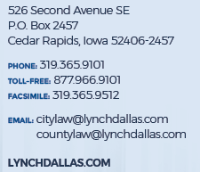

QUESTIONS?

