Slide 1



What to Expect When You’re Expecting – An Audit
Dustin Opatz, CPA
Notes:
My name is Dustin Opatz – I am a director from BerganKDV – I have been auditing cities for over 11 years and this is what to expect when you are expecting – an audit

Slide 2
Why Does the Audit Matter?
Public trust: Residents and Council get an independent check on how public money was handled.
Borrowing: Lenders and bondholders rely on audited financial statements when the City borrows.
Grants: State and federal funders often require audited statements, and sometimes compliance testing.
Council oversight: An outside view of the City's financial position and its controls.
Protection for you: Good controls and an independent review show the records are accurate if questions ever come up.
Notes:
New clerks often see the audit as a compliance chore that lands on top of their regular work. This slide is meant to give them the 'why' before the 'how'.
Public trust: the audit is the independent check that tells residents and Council the numbers are reliable.
Borrowing: when the City issues debt or refinances, lenders and bondholders look at audited statements.
Grants: many grant and loan agreements require audited financials or an audit.
Council oversight: the Council usually does not see the books in detail, and the audit and the communication letter give them an outside view.
Protection for you: If something ever looks wrong, documented controls and a clean independent review protect the employees who handle the money. It is not just about catching problems, it is also about showing nothing is wrong.
So with that in mind, let's look at what an audit actually is, and what it isn't.

Slide 3
What is an Audit?
Notes:
Transition: Let's start with the basics. Before we walk through what the process looks like, I want everyone on the same page about what an audit actually is, and just as importantly, what it isn't.

Slide 4
What a financial statement audit is:
Reasonable assurance that the financial statements are fairly presented in all material respects.
Risks of material misstatement due to fraud are considered but the audit is not designed to identify all fraud.
Stakeholders and Users of the financial statements – Citizens, Management, Bondholders, State and Federal government.
Basis of Accounting – GAAP/Cash/Regulatory – depending on state regulations, debt/grant covenants
Notes:
stakeholders and users of the financial statements (Citizens, Bondholders, Regulatory) helps to give decision makers "warm fuzzys" to make decisions based on those financial statements.
the basis of the financial statements (GAAP, Cash, Regulatory) can be different between entities based on regulatory and stakeholder needs – Stakeholders - Citizens, bondholders, state and federal agencies, and your own management and Council.
an audit provides reasonable assurance, not a guarantee. 'Material' means an error big enough to change a reader's decision.

Slide 5
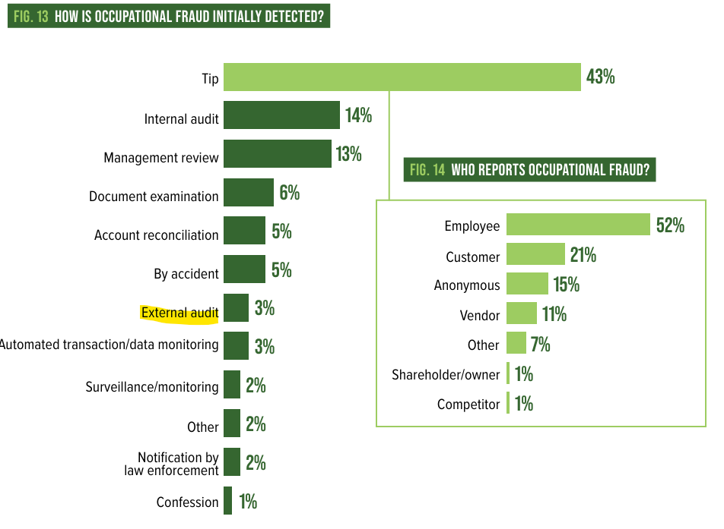
What a financial statement audit is NOT:
Absolute assurance or guarantee that all material misstatements were identified
A Forensic/Fraud Audit
Notes:
Association of Certified Fraud Examiners–Report to the Nations – only 3% of fraud is found through the external audit process
This is the most common expectation gap I see. Many people assume a clean audit means no fraud occurred. It doesn't.
An audit is not a forensic or fraud audit. We test samples and evaluate risk; we don't examine every transaction.
The rest of fraud is identified through tips, internal controls, and turnover, which I'll come back to in the fraud section.

Slide 6
Auditor’s Responsibilities:
Issue an opinion on the basic financial statements
  Generally Accepted Auditing Standards
  Government Auditing Standards
Exercise professional judgment and maintain professional skepticism throughout the audit.
Identify and assess the risks of material misstatement of the financial statements
Obtain an understanding of internal control relevant to the audit in order to design our audit – Not an opinion over internal controls
Evaluate the appropriateness of accounting policies and significant estimates
Conclude whether, the City is able to continue as a going concern – Will the City be able to continue operations for the 12 month period after the financial statement issuance
Notes:
Our job is to give an opinion on the financial statements, following Generally Accepted Auditing Standards and Government Auditing Standards
professional judgment and skepticism – asking questions about how things are recorded or why things are recorded the way they are – if it feels like your auditor is acting skeptical and pushing back on things that you tell them, that is literally part of their job.
Identifying and assessing risks of material misstatement; - this is part of our audit planning every year to examine holes/gaps in internal controls to design our audit procedures
Gaining an understanding internal controls to design our procedures. - We will walkthrough the internal controls to determine if they are functioning as designed/documented.
We do NOT give an opinion on internal controls in a financial statement audit. That comes up again in the Single Audit section.
We also evaluate going concern – which is whether the City can continue operations for 12 months after the financial statements are issued.

Slide 7
Management’s Responsibilities:
Take responsibility for the financial statements – even if the auditing firm is preparing them
Design, implementation and maintenance of an internal control system to prevent material misstatements from both fraud and error.
Evaluate the City’s ability to continue as a going concern - Will the City be able to continue operations for the 12 month period after the financial statement issuance
Notes:
Management owns the financial statements, period. Even when the audit firm helps draft them, they are the City's statements.
Management designs, implements and maintains internal controls to prevent fraud and error, and also evaluates going concern.
Going concern evaluation is on both slides- we evaluate going concern too, but management has the primary responsibility.

Slide 8
Opinions:
  Unmodified – Clean – best that is allowed to be issued
  Modified – Clean except for an identified departure
  Adverse – Financial statements are not in accordance with GAAP
    Example: Discretely presented component unit that should be included in the financial statements but are not
  Disclaim – No opinion is given at all
  Cash Basis – This is an acceptable basis of accounting for Cities in Iowa but is not a GAAP presentation so the opinion is modified and an unmodified opinion on the cash basis of accounting is given.
Notes:
These are the different types of opinions that can be issued
Unmodified (clean) is the best outcome available – gold standard. Anything other than that means there is something excluded or some deficiency
Modified means clean except for an identified departure.
Adverse means the statements are not in accordance with GAAP; example: a discretely presented component unit that should be included but isn't. Typically a separate utility, library, fire department or housing authority that is not included in the City's financial statements
Disclaimer means no opinion at all. I personally have never given one of these and hope to never have to.
Iowa-specific point: cash basis is an acceptable basis for Iowa cities but isn't GAAP, so the GAAP opinion is modified and we issue an unmodified opinion on the cash basis of accounting.

Slide 9
Audit Vs. Examination
Notes:
Next we look at the difference between a full audit and an examination, and which one may apply to your City.

Slide 10
Audit requirements for Cities
Over 2,000 population OR
Over $1,000,000 of federal funds expended (Threshold increased from $750,000 in 2026.) OR
There may be other grant or debt requirements requiring a full audit even if the above criteria are not met.
Annual Examination – Agreed upon Procedures
Under 2,000 population AND
Over $1,000,000 of budgeted expenditures in two consecutive years
  Cities below these thresholds are subject to Periodic Examinations at least once every eight years.
Notes:
Audit is required if the City has a population over 2,000 OR over $1,000,000 in federal expenditures (up from $750,000 beginning in 2026), or if other grant or debt requirements call for a full audit.
Annual Examination (agreed-upon procedures): population under 2,000 AND over $1,000,000 of budgeted expenditures in two consecutive years. Cities below those thresholds get a periodic examination at least every eight years.

Slide 11
Difference between an Audit and Examination
AUDIT
Issues an opinion and is the highest level of assurance that can be given
Risks of fraud and misstatement identified through planning/risk assessment process
Typical hours spent 100+
Typical Cost 2.5X-3X the cost of an examination
EXAMINATION
No opinion given
No risk assessment process – Only doing procedures identified by the State Auditor’s office.
Typical hours spent 25-30
Notes:
What’s the difference between and Audit and an Examination - A lot of times people will get these confused – many RFPs that I review use these interchangeably, they are not very similar.
An audit gives an opinion and the highest level of assurance; it includes a risk assessment and typically takes the auditor over 100 hours and costs roughly 2.5x to 3x the cost of an examination.
An examination gives no opinion, has no risk assessment, and follows only the procedures set by the State Auditor's office, typically 25 to 30 hours.
Each of these engagements has their own purpose and value that is dictated by the City’s desired purpose for the engagement, City’s size, budgeted expenditures and federal grants.

Slide 12
Stages of the Audit Process
Notes:
If you have 100 different auditors you will have 100 different processes, this is an insight into how we typically organize our audits
Our audits are broken into 4 phases - Planning, Fieldwork, Manager/Partner Review and Exit Conference, and Council Presentation. For each stage I'll cover what happens and how you can get ready.

Slide 13
The Audit Timeline
Your fiscal year ends June 30. The audit of that year runs from July through the following spring.
Jul
Aug
Sep
Oct
Nov
Dec
Jan
Feb
Mar
Apr
May
Jun
Stage 1: Planning
Planning call, request list
Jul–Aug
Stage 2: Fieldwork
Be available, answer questions
Aug–Nov
Stage 3: Review & Exit
Review draft, sign rep letter
Dec–Jan
Stage 4: Council & Filing
Attend Council, pay State fee
Jan–Feb
State filing
Due to State Auditor by Mar 31
Mar 31 – due to State
Jun 30 – last extension
Timing is approximate and varies by firm and City. Confirm your dates at the planning meeting.
Notes:
This is the whole audit on one page. Your fiscal year ends June 30, and the audit of that year starts in July and wraps up the following spring.
Walk left to right. Planning is shortly after year end and is mostly a phone call or meeting of about 30 minutes. Fieldwork is the busy stretch, roughly August through November, when most testing happens and the auditors need you available. The review and exit conference come several weeks after fieldwork while the firm does its manager and partner reviews. The Council presentation, if the firm does one, follows soon after, and the audit is filed with the State Auditor.
The two diamonds are the State deadlines: March 31, with an extension available to June 30 and no extensions beyond that.
Emphasize that these dates are approximate. Every firm schedules differently, and the dates also depend on when the City has its trial balance and bank reconciliations ready. Tell them to ask their firm for dates at the planning meeting and put them on the calendar, including the Council meeting.
the sooner the City is ready, the sooner fieldwork can happen and the sooner the audit is issued. Everything that slows an audit pushes this whole chart to the right.

Slide 14
Stage 1: Planning
Confirm scheduled fieldwork dates and talk about the large events that happened during the year.
Auditor will provide initial request letter/listing – also known as a PBC listing
Internally – the Audit team meets to discuss risks of material misstatement and how to address them.
  Every year the audit team must identify ‘surprise’ procedures that were not tested in the prior year. So, if you are in the 10th year of working with a firm and feel like they are asking for something they have never requested before, this could be why.
    Also each year there is an implementation of a number of new accounting and auditing standards that may add additional documentation requirements/new questions and procedures.
Notes:
Stage 1 happens shortly after year end. We confirm fieldwork dates, discuss the big events of the year (new debt, major projects, significant grants, staff turnover), and send the initial request list, also called the PBC list.
Internally, the audit team meets to discuss risks of material misstatement.
We also develop the 'surprise' procedures: each year we must include procedures not tested in prior years. If your firm asks for something new in year 10, this is likely why. There are also new accounting and auditing standards each year that add documentation and questions.

Slide 15
Stage 1: Planning
How to get ready for this stage?
  Be available to have this discussion – typically takes about 30 minutes
  Have Council minutes updated on the City's website.
  Ensure internal control documents are up to date and gather any updates to procedures/policies.
  Start compiling a draft SEFA (Schedule of Expenditures of Federal Awards), including CFDA/ALN numbers and recipients/subrecipients.
    Cash basis – goes based on when disbursements are dated
    Accrual basis – goes based on when work was performed.
  Prepare Cash/Debt/Revenue confirmations to be sent by the auditor.
Notes:
Preparation for Stage 1. The planning conversation takes about 30 minutes; just be available.
Action items: update Council minutes on the website, make sure internal control documentation is current, start a draft SEFA including ALN numbers and recipients/subrecipients, and prepare confirmations for the auditor to send.
SEFA timing: cash basis goes by when disbursements are dated; accrual basis goes by when the work was performed.

Slide 16
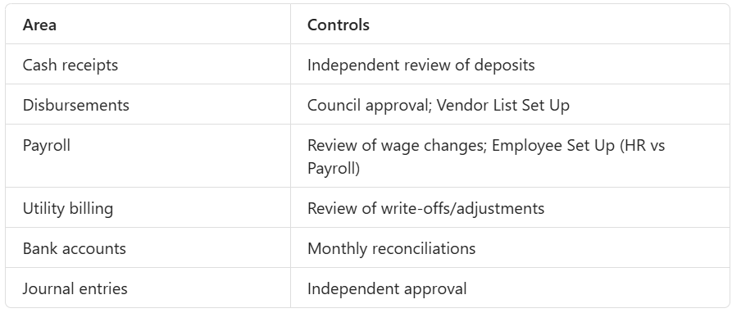
Internal Controls – Evaluating and Documenting
This is a good process to identify gaps in internal controls and evaluate where controls could be strengthened
Document who is preparing and reviewing each of the major functions – disbursements, receipts, payroll, journal entries, utility billing, bank reconciliations, etc. – I typically phrase the question – if this process goes wrong through fraud or error – how will it be caught and how timely will that be?
Internal controls are a cost vs benefit decision – limited by external funding considerations as well as ensuring the City processes run smoothly and efficiently.
Below are some internal control examples for many of the significant processes a City may have.
Notes:
When you are reviewing your internal control documentation annually as part of the planning process, this is a great way to find gaps. Documenting who prepares and who reviews each major function: disbursements, receipts, payroll, journal entries, utility billing, bank reconciliations.
My thought process is - if this process goes wrong through fraud or error, how will it be caught, who will catch it and how quickly? Also if it isn’t documented, it isn’t done – goes for signoffs, approvals, reviews – if there is no way to see that something was reviewed we have to assume it wasn’t
controls are a cost vs. benefit decision, limited by funding and the need for efficient operations. This chart shows some common internal controls that a small City could have or implement

Slide 17
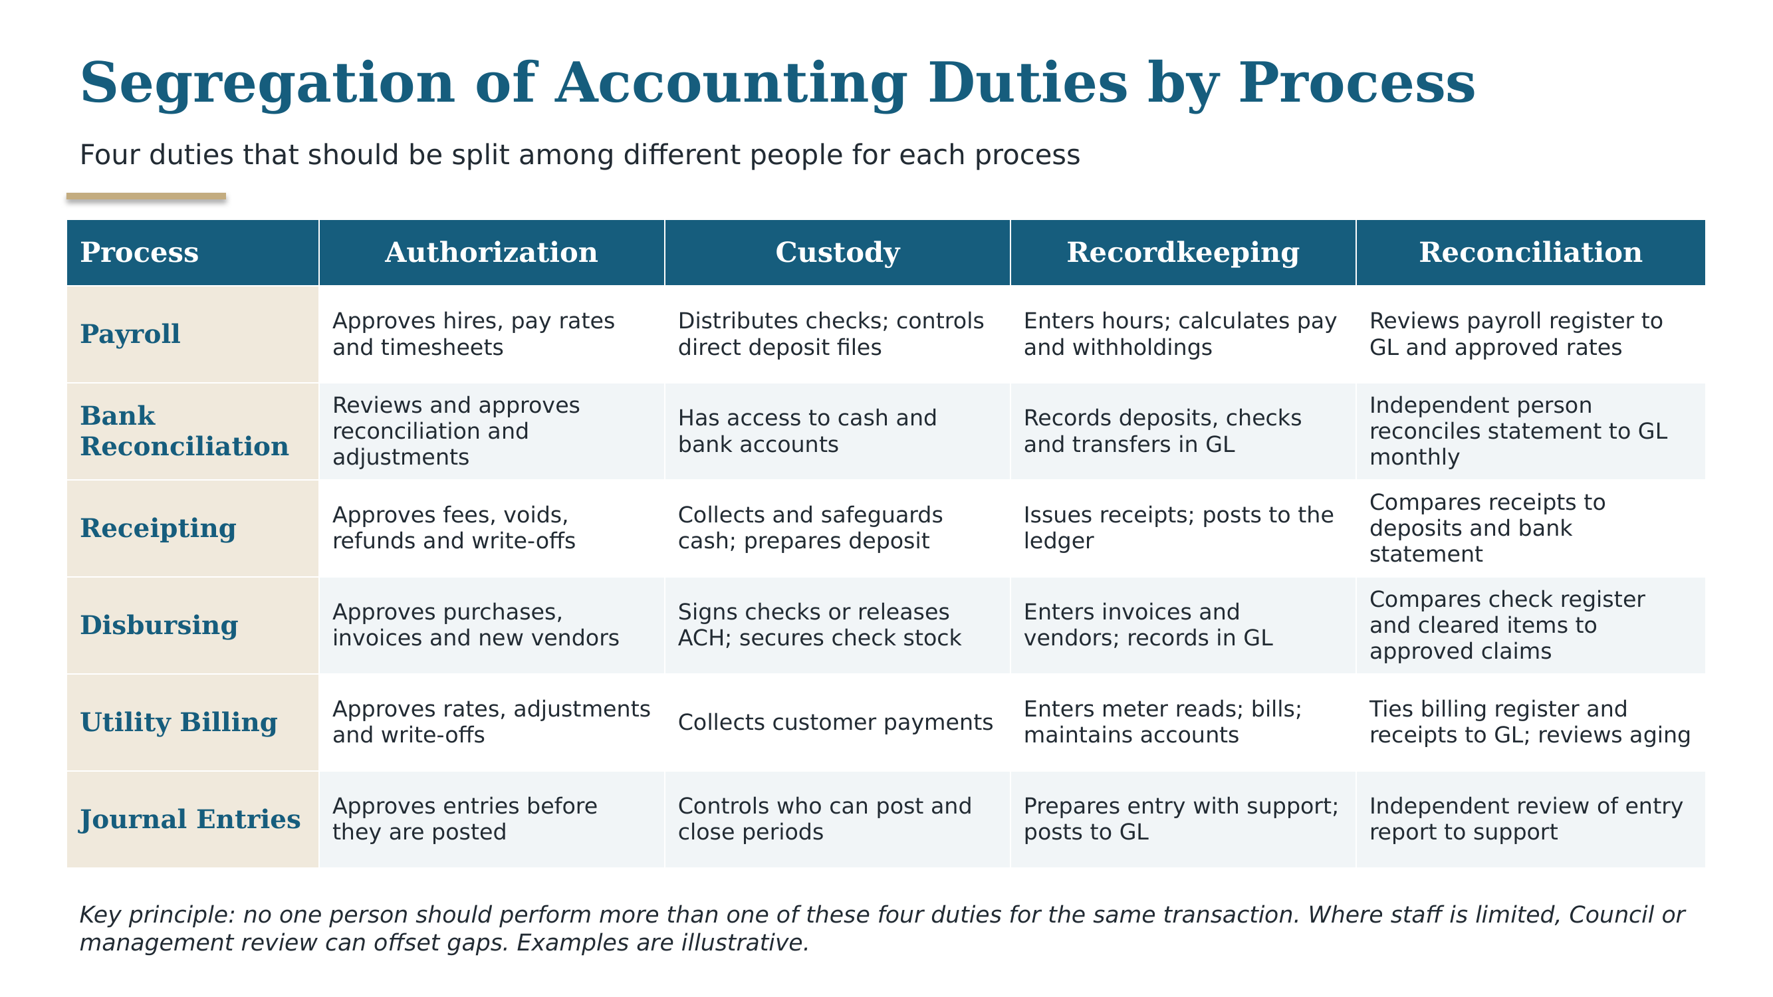
Notes:
In Dustin’s perfect world of internal controls there would be separate people doing all of these different functions for each of these processes
Lack of Segregation is a very common finding, which we will look at later but this is a great way to illustrate why it is such a hard bar to get over. Many times just having access to do multiple parts of the same process are enough to get the lack of segregation comment even if that person doesn’t typically do those functions – example – City Administrator has the ability to change pay rates – not something that they have ever done but having the access to do it, is an internal control issue
Keep these 4 areas of separation in mind as we walk through the next couple of slides

Slide 18
Small Office Scenario – Meet the City
The City: about 1,200 residents, a City Clerk, one part-time Deputy Clerk who also runs the utility office, a part-time Mayor and five Council members.
No finance director, no internal auditor. The Clerk handles most of the accounting as well as running payroll, accounts payable and utility billing.
Three processes to walk through: Receipting, Utility Billing and Journal Entries- There are many more processes than these but gives you a feel for what auditors are looking at.
For each one, ask: who does what, what could go wrong, and what can this City do about it with the people it has?
Notes:
This is a fictional City, but it looks like a lot of the Cities I work with. Two people in the office, part-time elected officials, and no one whose only job is finance.
For each of the next three slides, I will describe how the process works today, what could go wrong, and who would notice?
The point is that segregation of duties is hard to fully achieve in an office this size. The realistic goal is to separate what you can and add independent review for what you cannot.
It is likely that you will do all you can, and still receive a lack of segregation of accounting duties finding, that does not diminish the effort or make it not worth doing.

Slide 19
Scenario 1 – Receipting
Today: The Deputy Clerk takes payments at the counter, issues receipts, prepares the deposit and posts to the system. The Clerk takes payments when the Deputy is out and also does the bank reconciliation.
What could go wrong: A payment is taken, the receipt is voided or never entered, and the cash disappears. No one would see it.
What this City can do:
  Use system-generated, numbered receipts and review the void and adjustment report each month
  Have someone other than the preparer take the deposit to the bank
  Mayor, a Council member or someone else independent of the process compare receipts, deposit slips and the bank statement monthly
How it would be caught:
  Receipt report does not agree to deposits or the bank statement
  Void and adjustment report shows unexplained voids or a pattern tied to one person
  A resident has a receipt for a payment that is not in the system
  Someone covering during a vacation notices missing or unusual items
Notes:
Ask the room first: who could take money here and not be caught?
The Deputy Clerk touches the whole process, from collecting to recording to depositing. The Clerk also covers the counter and reconciles the bank account, which means the person who reconciles is not independent of the person who collects.
You cannot hire another person, but you can add review from outside the office. Someone who does not handle cash, such as the Mayor or a Council member, can compare the receipt report to deposit slips and the bank statement. That takes 15 to 30 minutes a month. Also depends on who is on your Council – some Cities have CPAs on their Council that they can utilize in their internal control structure, others not so much.
The review only helps if it is documented. Initial and date it, or note it in the Council minutes.

Slide 20
Scenario 2 – Utility Billing
Today: The utility clerk enters meter reads, runs the bills, collects payments and can adjust or write off customer accounts.
What could go wrong: A balance is adjusted or written off for their personal account, a friend or family member, or a payment is pocketed and the account marked paid.
What this City can do:
  Require written approval from someone else for adjustments, credits and write-offs
  Council reviews the monthly adjustment report and the delinquent list
  Compare the billing register to revenue in the ledger; compare gallons pumped to gallons billed
  Limit system access so the utility clerk cannot change rates or delete entries
How it would be caught:
  Adjustment report shows repeated or unusual adjustments on the same accounts
  Gallons pumped versus billed gap grows, or billing does not tie to revenue
  A customer who paid receives a delinquent or shutoff notice
Notes:
Utility billing is a high-risk area because the same person can often bill, collect and adjust accounts, and adjustments are easy to hide.
The best control here is approval of adjustments and write-offs by someone outside the utility office. Even a simple rule of the Clerk or Council approving any adjustments over a set dollar amount helps.
Comparing gallons pumped or purchased to gallons billed is useful because it can reveal unbilled usage or unusually large adjustments without anyone looking at individual accounts. Keep that comparison simple and do it on a regular schedule.
Also talk about system access: ask your software vendor who can edit rates, delete entries or reopen closed periods.

Slide 21
Scenario 3 – Journal Entries
Today: The Clerk prepares and posts every journal entry, including year-end adjustments, and has full access to the accounting system, including closed periods.
What could go wrong: An entry hides an error or a theft, or an unsupported entry changes the financial statements without anyone seeing it.
What this City can do:
  Another person reviews the monthly journal entry report against support and initials it
  Attach or reference support for every entry
  Lock closed periods and limit who can post
  Pay extra attention to unusual, round-dollar and year-end entries
How it would be caught:
  Reviewer asks for support on an entry and there is none
  Entry report shows odd accounts, round dollars, or entries posted after close
  Subledgers or the bank reconciliation no longer agree to the ledger
  Auditor tests manual entries during fieldwork
Notes:
Journal entries are how numbers get changed in the ledger without a transaction like a receipt or an invoice behind them. That is why auditors ask about them.
In a small office the Clerk often prepares, posts and is the only person who looks at them. The fix does not require a second accountant. Print or export the journal entry report each month and have the Mayor, a Council member or the Deputy Clerk look through it with the support in hand.
Locking closed periods is one of the easiest controls to put in place and many Cities do not use it. Ask your software vendor how to do it.
Also mention that the auditor may propose entries during the audit. Those are approved by management, which ties back to management owning the financial statements.

Slide 22
Takeaway – Short on Staff?
1. Separate what you can. Even a small change, like a different person opening the mail or taking the deposit, helps.
2. Add independent review. Someone outside the function, such as the Mayor or a Council member, reviews key reports each month.
3. Document the review. Initial and date it, or note it in the Council minutes. If it wasn’t documented, then it wasn’t done.
4. Limit system access. Know who can edit, delete and post, and reopen closed periods.
These steps reduce risk. Your auditor may still report limited segregation, and that is common in small Cities.
Notes:
Bring it back to the point from the findings slide: many Cities receive a lack of segregation finding, and the goal is continuous improvement where the benefit exceeds the cost, not perfection.
The four steps are separate what you can, add independent review, document the review, and limit system access. None of them require hiring.
Be honest with the audience: these steps reduce risk and show Council and the auditor that the City is aware of the gap. They do not guarantee the auditor will not report the finding.
Invite questions about how this would look in their own office.

Slide 23
Stage 2: Fieldwork
Can take place on site or remotely depending on preference and negotiation with the audit firm. Typically, will take from two days to a week.
  If onsite, the audit team will need a Wi-Fi connection and outlets.
Fraud Interviews – typically conducted with the City Clerk/Finance Director, City Manager/Administrator and potentially Council members and others. Some firms use questionnaires rather than inquiries.
This is when the majority of the testwork is completed by staff
  Samples and related support are reviewed
  Analytical procedures are performed
  Internal controls walk throughs are performed
  Office of the State Auditor’s Legal Compliance questionnaires are completed
  Lots of inquiry
Notes:
Stage 2 is fieldwork, - this is actually when the bulk of the audit procedures get performed
It can be on site or remote, depending on preference and negotiation with the firm. If on site, we need Wi-Fi and outlets.
This stage is where most of the testwork happens: samples and support reviewed, analytics, internal control walkthroughs, and the Office of the State Auditor legal compliance questionnaires which are checking for compliance with specific state statutes. - Expect lots of inquiry, which is why staff availability matters.
Fraud interviews: typically the Clerk/Finance Director, City Manager, and possibly Council members. Some firms use questionnaires. Not that the auditors have found or suspect any fraud, it is part of auditing standards to ask these questions.

Slide 24
Stage 2: Fieldwork
How to get ready for this stage?
  Upload/prepare as much as possible from the audit request listing – Especially a trial balance the week prior to fieldwork.
  Request samples from the audit firm ahead of time to give yourself more time to pull documentation.
  Be as available as possible during the dedicated fieldwork days.
  Ensure cash is reconciled through June 30.
  Accrual basis – ensure payables, receivables and capital assets are all recorded appropriately- ideally prior to sending the trial balance
Notes:
Preparation for Stage 2. Upload/prepare as much of the request list as possible, especially the trial balance the week before fieldwork. Some firms use a portal to upload things, some prefer items emailed and others will just look at documentation in person if onsite
Ask the firm for samples ahead of time so you have time to pull documentation. Especially with small office staff – getting those pulled ahead of time will save you time during the week of fieldwork
Be available during fieldwork days. It is tough when the main person is in meetings half of the week and unavailable for questions
Make sure cash is reconciled through June 30.
Accrual basis: all kinds of additional things - payables, receivables and capital assets should be recorded appropriately, ideally before the trial balance goes to us. The fewer journal entires that need to be made during fieldwork, the smoother the process will be.

Slide 25
What Slows Down an Audit?
These are common issues that we see that delay the start of an audit and impact how quickly the audit can be wrapped up and issued:
Delays in receiving a final trial balance
Trial balance not having all adjustments made prior to the start of fieldwork
Bank reconciliations not fully reconciled
City staff not available to answer questions during fieldwork
City staff slow to answer follow up questions after fieldwork
Capital assets not completed/updated/reconciled
Actuarial studies not being completed timely for Other Post Employment Benefits
Notes:
These are the most common causes of delays:
late final trial balance – Auditors schedules are pretty strict – if they don’t receive the final trial balance until partway through the week of fieldwork, it is unlikely that the audit will be able to be finished timely
adjustments not made before fieldwork – a preliminary trial balance is fine, but if there are hundreds of entries made afterwards, it feels like auditing a moving target and the potential for error is significantly higher
unreconciled bank accounts – this will often hold up the issuance of the audit if the bank accounts are materially off – typically we wont start fieldwork until this is resolved.
staff unavailable during fieldwork or slow to respond after fieldwork – 90% of the information for the audit comes from City staff whether it is inquiry, documentation or clearing up a misunderstanding, so being unable to answer questions timely really does slow the process down
capital assets not updated, and late OPEB actuarial studies- for accrual cities these are the items that most often cause delays
When I respond to an RFP and the City talks about timeliness of the audit being an issue with their current provider – I usually will ask if it was due to City preparedness or auditor slowness

Slide 26
Stage 3: Manager/Partner Review and Exit Conference
Typically takes place several weeks after fieldwork
Once staff have completed their areas and the in charge has drafted the report the Manager will review. After the Manager has completed their review, the Partner will review.
After the Partner review is completed and all questions are answered, a draft of the financial statements will be provided for City review.
Notes:
Stage 3 usually takes place several weeks after fieldwork. Internally the in-charge drafts the report, the Manager reviews, then the Partner reviews.
The review layers often will generate follow-up questions, so stay available.
Once the Partner review is complete and questions are answered, a draft of the financial statements goes to the City.

Slide 27
Stage 3: Manager/Partner Review and Exit Conference
How to get ready for this stage?
  Be available to answer follow up questions generated by the two levels of review.
  Review the draft of the financial statements and provide feedback.
    These are the City’s financial statements and are the City’s responsibility. Auditors are drafting these based on the information they are provided/aware of and there may be incomplete or incorrect information.
  Accrual basis – begin drafting the Management’s Discussion and Analysis (MD&A).
Notes:
Preparation for the exit conference. Be available for follow-up questions from the two review levels, and review the draft statements carefully and give feedback.
These are the City's financial statements. We draft them from the information we are given, and there may be incomplete or incorrect information, so your review matters.
Accrual basis: begin drafting the MD&A. – Management’s Discussion and Analysis will have comparative information – discloses the ‘why’ behind the numbers – talks about increases/decreases in assets, liabilities, net positions, revenues and expenses – also talks about capital assets and debt activity during the year as well as economic factors in the future.

Slide 28
Stage 3: Manager/Partner Review and Exit Conference
How to get ready for this stage?
  Be available to review and sign the Management Representations Letter:
    Typically will be signed by City Clerk/Finance Director and City Manager/Administrator.
    Confirms that the City is taking responsibility for the financial statements and that all known information has been provided to the best of the City's ability.
    The final financial statement documents cannot be issued until this is completed and returned.
Notes:
The Management Representation Letter is signed by the Clerk/Finance Director and City Manager/Administrator. It confirms the City takes responsibility for the statements and that all known information was provided to the best of the City's ability.
The final financial statements cannot be issued until this letter is signed and returned

Slide 29
Stage 3: Manager/Partner Review and Exit Conference – Communication Letter
Part of the discussion will also be a Communication Letter that will detail out items that are required to be communicated to management of the City as well as the City Council and includes items such as:
  Significant risks identified during the audit
  Corrected audit adjustments
  Uncorrected audit adjustments
  Internal Control Findings
  Any difficulties encountered during the audit
  Any significant estimates identified
Notes:
Another part of the reporting package is the Communication letter
Items we are required to communicate to management and Council, including significant risks, corrected and uncorrected audit adjustments, internal control findings, difficulties encountered, and significant estimates.

Slide 30
Stage 4: Council Presentation
Typically takes place shortly after the exit conference.
Final documents will be provided to the City as well as submitted to the Office of the State Auditor’s website – Due to the State March 31st, can ask for an extension to June 30th. The State will not offer extensions beyond June 30th.
Optional - the auditor may make a Council presentation discussing the findings.
How to get ready for this stage?
Pay the filing fee after the audit is submitted – the State Auditor’s office will not invoice you
Be available at the Council meeting to help provide context to the information that the auditor is presenting and help answer questions.
Notes:
Stage 4 happens shortly after the exit conference. Final documents go to the City and are submitted to the Office of the State Auditor.
Deadlines: due March 31, with an extension available to June 30; no extensions beyond June 30. Optionally, we present findings to Council.
Prep: pay the filing fee after submission (the State Auditor's office does not invoice), and be at the Council meeting to add context and answer questions. The questions that Council members ask can kind of be all over the place and may not directly related to the information being presented so you may have to bail out your auditor

Slide 31
Findings
Notes:
Findings tend to be the part people worry about most, so let's define the levels and give you a feel for what's common.

Slide 32
Findings – Different Levels
Material Weakness – Always in writing - deficiency, or a combination of deficiencies, in internal control such that there is a reasonable possibility that a material misstatement of the City's basic financial statements will not be prevented, or detected and corrected, on a timely basis
Significant Deficiency – Lower than a MW but still always in writing - deficiency, or a combination of deficiencies, in internal control that is less severe than a material weakness, yet important enough to merit attention by those charged with governance.
Other Deficiency – Lower than a SD, may be in writing or communicated to management verbally.
  Legal Compliance findings are considered to be Other Deficiencies
Many cities receive findings, especially lack of segregation – the goal is continuous improvement, where the benefit exceeds the cost, not perfection.
Notes:
Three levels of severity.
Material Weakness: always in writing; a reasonable possibility a material misstatement won't be prevented or detected timely. Essentially there are issues with the internal controls where large errors could happen and not be corrected timely
Significant Deficiency: less severe but important enough for those charged with governance to know; also in writing.
Other Deficiency: lower still; may be written or verbal. Legal compliance findings from the state auditor’s checklists are considered Other Deficiencies.
Many cities receive findings, especially lack of segregation. The goal is continuous improvement where benefit exceeds cost, not perfection.

Slide 33
Findings – Common Findings
Lack of Segregation of Accounting Duties – Related to limited number of office staff – not enough separation in the duties that perform the main accounting functions – Very common and hard to get rid of
Material Audit Adjustments/Prior Period Adjustments – Adjustments needed during the audit to ensure the financial statements are materially correct.
Timely Bank Reconciliations – Bank reconciliations were not performed timely. Typically due to staff turnover or system conversion – audit is typically not able to be issued if the bank reconciliations do not reconcile by material amounts.
Missing or Incomplete Supporting Documentation – This is typically around disbursements support and can be related to office filing issues, corrupted backups or other issues.
Notes:
Common findings:
(1) lack of segregation of duties, driven by limited staff, very common and hard to eliminate- reference earlier slide – who here receives the lack of segregation?
(2) material audit or prior period adjustments – difference between these – Material Audit Adjustment is an error correction of the current year numbers, Prior period adjustment is a correction of an error made in a previous year
(3) bank reconciliations not done timely, usually from turnover or system conversion, and an audit generally can't be issued if reconciliations are off by material amounts;
(4) missing or incomplete supporting documentation, often disbursement support.

Slide 34
Findings – Common Findings
Legal Compliance
  Budget – Each function of expenditures as well as in total is required to be under budget
  Unapproved Transfers – All interfund transfers are required to be approved by Council either through the budget process or separate resolution
  TIF(Tax Increment Financing) – the AURR(Annual Urban Renewal Report) not matching City records, having the AURR display a negative total amount of City debt, AURR not matching the County debt certificates
  Improper disbursements to nonprofits – if no 28E agreement or other contract
  Deficit fund balances
Notes:
These are legal compliance findings common in Iowa:
budget (each function and total expenditures must stay under budget),
unapproved interfund transfers (need Council approval via budget or resolution),
TIF issues with the AURR – Levy authority summary not matching City records or the Remaining TIF Obligations either not tying to County debt certificates or in total being negative.
Disbursements to nonprofits without a 28E agreements
Deficit fund balances.

Slide 35
Smooth Audit Process
Notes:
Now let's pull it together with practical steps for a smooth audit.

Slide 36
Call Your Auditor Before...
Issuing or refinancing debt
Signing a grant or loan agreement, especially a federal one
Starting or changing a TIF project
Selling or disposing of major assets
Changing accounting software
Replacing key finance staff
Making large or unusual transfers between funds
Why: It is much easier to record these correctly when they happen than to fix them months later.
Notes:
Nobody ever thinks of the accountants when entering into different agreements and arrangements – these are some of the large complex items that can come up that may be easier to figure out the accounting on the front end. This list is not meant to be all inclusive and hopefully your auditor is available to answer questions about anything weird or unusual that comes up.

Slide 37
How to have a smooth audit process
Ensure that
  all relevant items are discussed during the planning meeting.
  the timelines for fieldwork and wrap up are reasonable.
  the trial balance is completed the week before fieldwork and that all required entries are completed.
  the draft of the SEFA is accurate.
  Staff are available during and after fieldwork to answer questions and provide supporting documentation.
  Ask questions to the auditor throughout the year – most items are more easily handled in the moment so that they are recorded properly rather than coming in and fixing them months after the issue arose.
Notes:
Recap the takeaways: make sure all relevant items are covered in the planning meeting, timelines are reasonable, the trial balance is complete a week before fieldwork with all entries made, the SEFA draft is accurate, and staff are available during and after fieldwork.
ask your auditor questions throughout the year. Issues are far easier to record properly in the moment than to fix months later.

Slide 38
Fraud – What do I do?
Notes:
Second to last topic - What do you do if you suspect or discover fraud?

Slide 39
Fraud – What do I do?
Fraud in Municipal Governments is typically looking at three areas
  Actual theft of cash or other assets
  Financial statement fraud – Intentionally inflating or deflating numbers
  City employees taking home City property for personal use.
Fraud is an intentional and deliberate deception. Incompetence is a lack of skill, knowledge or experience that leads to mistakes without malicious intent.
If suspected embezzlement, theft, or other significant financial irregularities are identified, the government must immediately notify the Auditor of State
  info@aos.iowa.gov
Notes:
Municipal fraud typically falls in three areas: theft of cash or assets, financial statement fraud (intentionally inflating or deflating numbers), and employees taking City property home for personal use.
Distinguish fraud (intentional, deliberate deception) from incompetence (mistakes without malicious intent). These often can look similar.
Action step: if you suspect embezzlement, theft or significant financial irregularities, notify the Auditor of State immediately at the address on the slide. Suggest they also involve their auditor and legal counsel; verify current reporting requirements with the Auditor of State or Compliance.

Slide 40
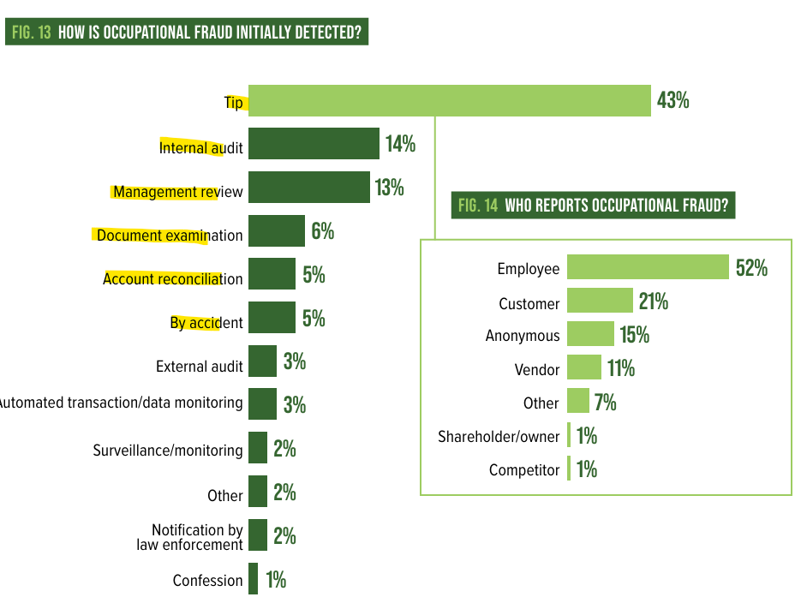
Fraud – How It Happens and How It Is Identified
Almost all fraud is identified as part of a tip, internal controls or employee turnover.
Situations that increase the potential for fraud
  One employee controlling an entire process
  Lack of review or oversight – “We just trust that they are doing the right thing”
    Trust is not an internal control
Notes:
Tie back to the ACFE statistic: almost all fraud is found through tips, internal controls, or employee turnover, not the external audit.
Situations that raise risk: one person controlling an entire process – Lack of Segregation – which is why auditors’ get so worked up over internal controls
and lack of review or oversight ('we just trust them'). The key line: trust is not an internal control.

Slide 41
Potential Fraud Red Flags
Employee never takes a vacation
Lifestyle appears to be inconsistent with compensation received from the City.
Personal financial difficulties
Sudden behavioral/work habit changes
Addiction issues
  All the Queen’s Horses – Dixon Illinois
Notes:
Red flags: an employee who never takes vacation, a lifestyle inconsistent with City compensation, personal financial difficulties, sudden behavior or work habit changes, and addiction issues. No single flag proves anything, but combined with weak controls they warrant attention.
The best known case study - 'All the Queen's Horses' is the documentary about the Dixon, Illinois embezzlement by the city's comptroller. Recommend it as a real-world illustration. One of the largest municipal frauds - $53.7M over 22 years – City of 14k

Slide 42
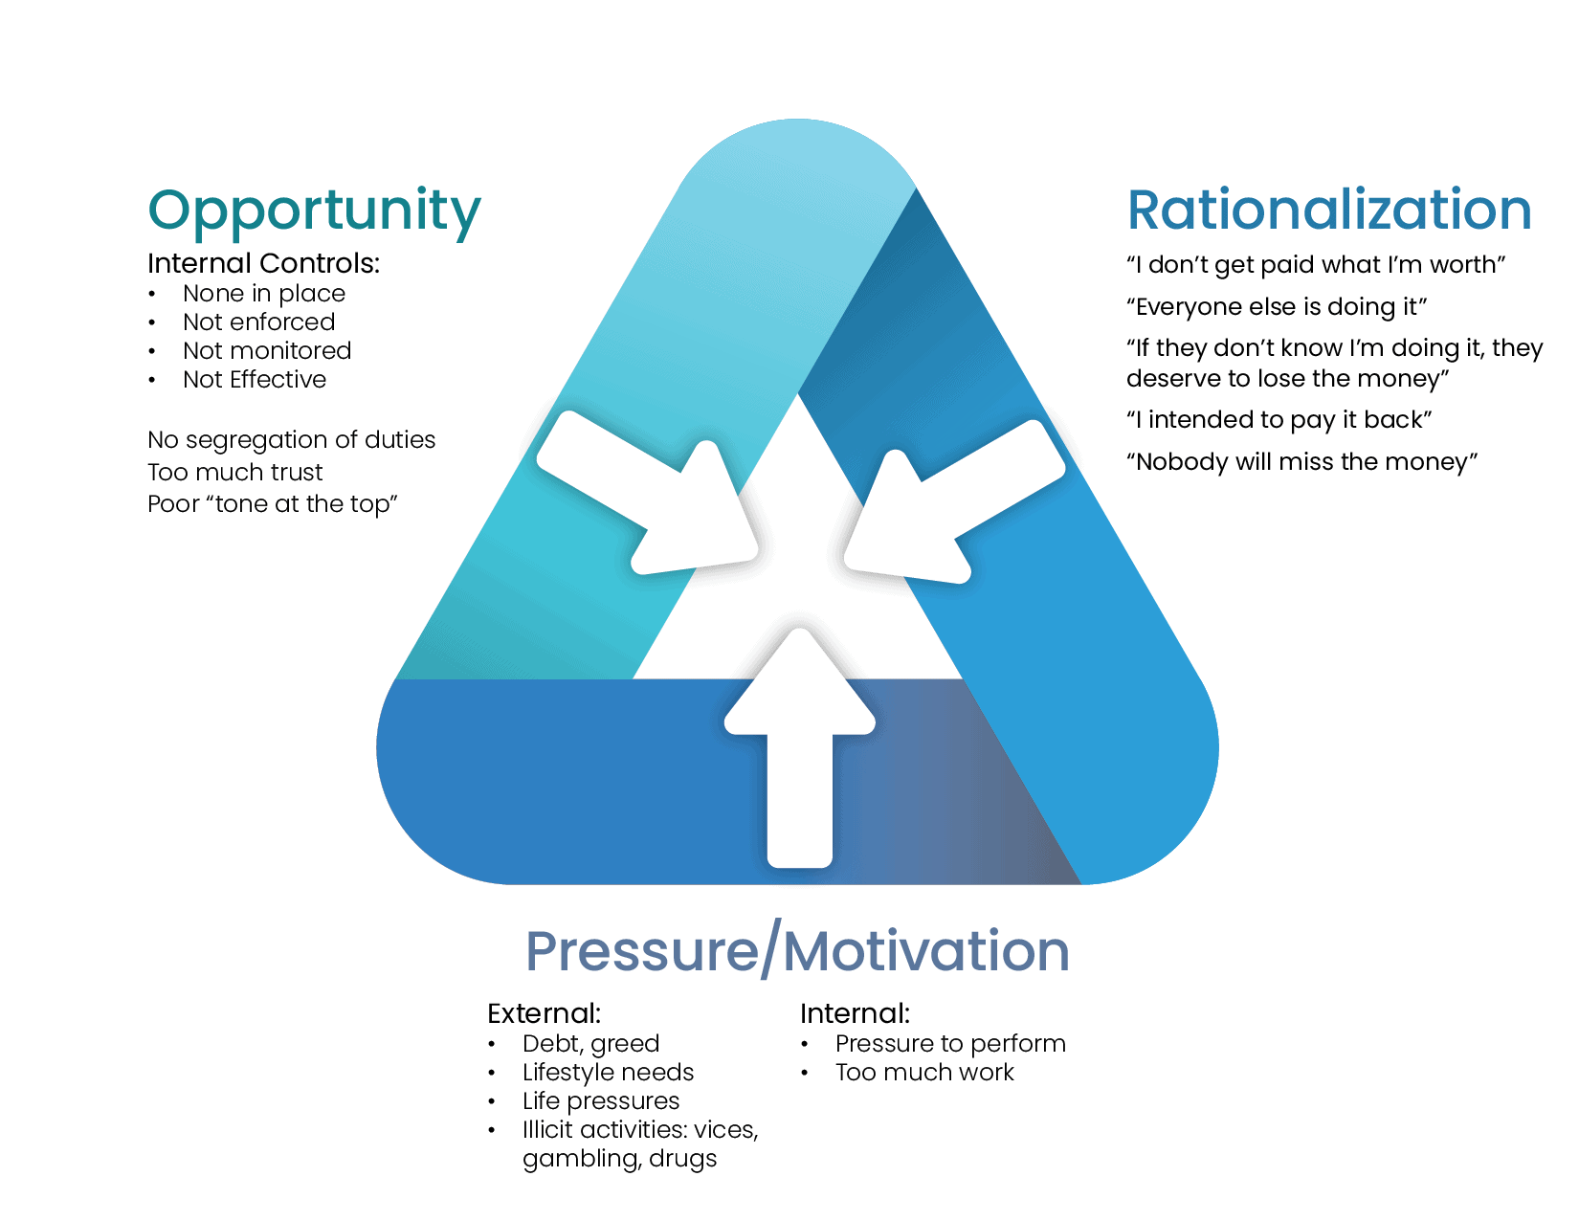
Fraud Triangle
Notes:
Something that we look at quite a bit is The Fraud Triangle explains why fraud occurs: pressure (financial or personal, internal or external), opportunity (weak controls, lack of oversight), and rationalization ('I'll pay it back’, “Im not paid what im worth”).
The City can't control pressure or rationalization because those are within the person committing the fraud, but it can control opportunity through segregation of duties, review, and mandatory vacations. That’s why you hear so much from auditor’s on internal controls and their importance because it is the only part of this triangle that you have any influence over.

Slide 43
Single Audit
Notes:
Lastly - Single Audit, which applies when federal spending crosses the threshold. If you are a small city with limited federal funding, this will be less applicable to you but the next large federal grant could be just around the corner ☺

Slide 44
Single Audit – What is it?
Single Audit – Also called Uniform Guidance Audit or A-133 (old terminology) is required when an entity expends more than $1,000,000 in federal funds. (Threshold increased from $750,000 in 2026.)
Single audits require auditors to pick large federal programs and do specific compliance and internal control testing over those programs.
Federal programs are designated with a CFDA/ALN(Catalog of Federal Domestic Assistance/Assistance Listing Number) XX.XXX
Certain CFDA/ALN numbers are grouped together in Clusters and are treated as one for program determination.
The Auditor will issue an additional opinion – internal controls over compliance for the specific program/programs selected.
  Financial statement audit – no opinion over internal controls is given
Notes:
A Single Audit (also called Uniform Guidance audit, or A-133 in old terminology) is required when federal expenditures exceed $1,000,000 (raised from $750,000).
We select large federal programs and test compliance and internal control over them. Programs are identified by ALN (formerly CFDA) numbers; some are grouped into clusters and treated as one.
We issue an additional opinion on internal controls over compliance for the specific program/programs selected. Contrast: in the financial statement audit, no opinion on internal control is given.

Slide 45
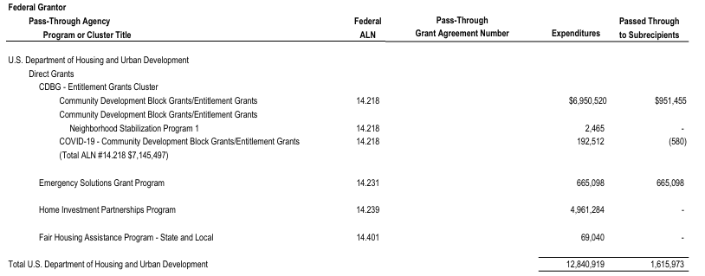
SEFA – What does it look like?
Notes:
This is typically what a SEFA will look like – it will have each individual grants, the ALN numbers, if it came directly from the Federal government or if it was passed through the state, county or other entity. It will have the total amount expended during the year. And the amount passed through to the subrecipients, if any

Slide 46
Single Audit – Program Determination
Two Types of Programs – Type A and Type B
  Type A – individual programs/clusters over $1,000,000
  Type B – individual programs/clusters over $250,000 (1/4 Type A threshold) but under Type A threshold
Type A programs – All High Risk Type A programs have to be tested – High risk if:
  The program has not been Audited as a major program in at least one of the two most recent audit periods
  Has had material weakness findings related to the specific program
  Identified as a High Risk program by the OMB (Office of Management and Budget)
Notes:
So we take that draft SEFA and use it to make Program determination. Program determination – very gross, technical and subjective – so If I lose you for the next couple of slides, no worries. At our firm we have a full 2 hour training on just Single audit program determination that our staff and in charges sit through – so this 30 second intro probably will leave something to be desired ☺
starting with Type A and Type B. Purely a dollar threshold - Type A: programs or clusters over $1,000,000. Type B: over $250,000 (one quarter of the Type A threshold).
All high-risk Type A programs must be tested. High risk if the program hasn't been audited as major in at least one of the two most recent periods, had material weakness findings, or was identified as high risk by OMB.

Slide 47
Single Audit – Program Determination
Type B programs –High Risk Type B programs have to be tested, but will only be assessed if there are low risk Type A programs –
  Type B risk determination is much more subjective – looks at employee turnover in the program, program complexity, prior year findings and compliance issues
If there are no high risk Type A or B programs are identified then the programs selected must meet at least 40% of coverage of total federal awards (assuming a high risk auditee)
  Most Cities are going to be high risk – to be low risk, there are many qualifications that all have to be met (Single audit performed and submitted timely for the past two years, no material weakness internal control findings for the last two years, etc.)
Notes:
Type B programs: high-risk Type B programs must be tested - but only assessed if there are low-risk Type A programs. Type B risk is more subjective: employee turnover, complexity, prior findings, compliance issues.
If no high-risk Type A or B programs are identified, the selected programs must meet at least 40% coverage of total federal awards for a high risk auditee

Slide 48
How Do I Get Ready for a Single Audit
Ensure that all federal activity (Receipts/disbursements are clearly identified in the General Ledger or a separate schedule.
For the major programs identified – gather all related documentation and request disbursements samples from the auditor.
  Reports submitted to the federal agency/state
  Draws requested
  Procurement performed (bids/quotes)
  Ensure your federal policies are up to date
  If there are subrecipients prepare a listing of amounts passed through to each
  Prepare written internal control documents surrounding the significant processes of these grants.
Notes:
How to get ready: make sure federal receipts and disbursements are clearly identified in the GL or a separate schedule. For major programs, gather all related documentation and request disbursement samples early.
Have ready: reports submitted to the agency, draws requested, procurement support (bids/quotes), current federal policies, a subrecipient listing as well as internal controls over subrecipients, and written internal control documentation for the significant grant processes.

Slide 49
How Do I Get Ready for a Single Audit
Try to identify the Major Programs that will be tested – have the auditor review the draft SEFA during planning and confirm which CFDA/ALN numbers they will be auditing.
Once identified go to the compliance supplement and review what is subject to audit.
  The 2026 compliance supplement has not been released yet so auditor’s are unable to issue these reports. Last year we had a similar issue and had to issue all of the single audit reports at a different date. Still issued the rest of the financial statements.
Notes:
Ask the auditor to review the draft SEFA during planning and confirm which ALN numbers they'll audit. Once identified, go to the Compliance Supplement and review what is subject to audit for each program. That tells you exactly what we will test. The 2026 compliance supplement is not out yet
Next slide shows what that compliance supplement will look like

Slide 50
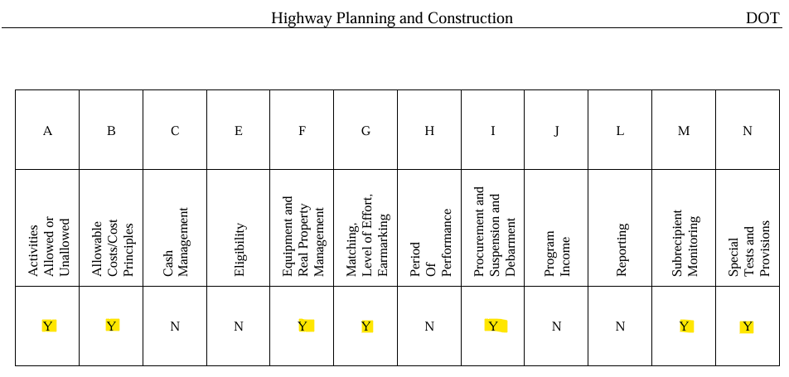
How Do I Get Ready for a Single Audit
Just because a compliance requirement is marked as ‘Y’ does not mean it will be direct and material to the audit
  Ex: Subrecipient Monitoring is marked as ‘Y’ but if the grant had no subrecipients, that would not be direct and material.
Compliance Supplement – OMB – The White House
Notes:
Who doesn’t love a good cheat sheet – these are publicly available on the OMB website – you can do a control find for your ALN and it will bring you to a section that looks like this.
The ‘Y’ means that it is subject to audit, not that it will be direct and material to the grant that is being tested
Example: subrecipient monitoring is marked 'Y', but if the grant had no subrecipients, it isn't direct and material for you.
Use the screenshot to show where to find this in the OMB Compliance Supplement.

Slide 51
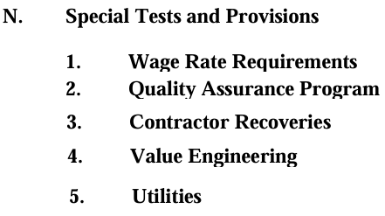
How Do I Get Ready for a Single Audit
If Special Tests (Compliance Requirement N) is marked as Direct and Material – the compliance supplement will detail out exactly what the federal agency would like to be subject to audit. This is an example from the 20.205 program– again, just because they are subject to audit does not mean they will be direct and material – in the supplement more detail is given about whether this applies to just the State or main recipient or subrecipient.
Notes:
If Special Tests (Requirement N) is marked direct and material, the supplement details exactly what the federal agency wants audited. This is an example from the 20.205 program.
Again, subject to audit does not always mean direct and material; the supplement gives more detail on whether it applies to the State, the main recipient, or subrecipients.

Slide 52
How Do I Get Ready for a Single Audit
After the Audit is finalized, either the audit firm or the City will have to complete the Data Collection Form through the Federal Audit Clearinghouse
The Federal Audit Clearinghouse
This report is due 30 days after report release or nine months (March 31^{st,} for a 6/30 year end) whichever is earlier, and must be signed by both the Auditor and the Auditee before it is submitted.
Notes:
After the audit is finalized, the firm or the City completes the Data Collection Form through the Federal Audit Clearinghouse.
Due the earlier of 30 days after report release or 9 months after the fiscal year end, and it must be signed by both auditor and auditee before submission. Agree with your firm up front who is filing it.

Slide 53
Presenter
Notes:
Transition to wrap-up. Thank the audience and introduce yourself briefly if needed.

Slide 54

Dustin Opatz
Audit Director
Dustin.Opatz@CREATIVEPLANNING.com
Notes:
And that’s me – this is how you would get ahold of me with any comments questions or concerns but I will take any questions if you have them!

Slide 55
Thank You
Notes:
Thank the audience and open for questions. Offer to stay after to talk through specific situations.

Slide 56

This commentary is provided for general information purposes only, should not be construed as investment, tax or legal advice, and does not constitute an attorney/client relationship. Past performance of any market results is no assurance of future performance. The information contained herein has been obtained
from sources deemed reliable but is not guaranteed.

