Slide 1
Navigating W-2s/1099s and Iowa’s Setoff Program
October 18, 2024

Slide 2
Ways to Stay Connected
Subscribe to GovDelivery updates
Attend webinars
Follow us on social media

Slide 3
Disclaimer
Please be advised that the information in this presentation contains informal opinions and are only applicable to the factual situations referenced and to the statutes in existence as of the date of this presentation.
The Iowa Department of Revenue may take a contrary position in the future to what is stated today. Any oral or written guidance or opinion by Department personnel not pursuant to a Petition for Declaratory Order under Iowa Administrative Code rule 701—7.24 is not binding upon the Department.

Slide 4
Welcome!
Agenda:
W-2 / 1099 Program
State of Iowa Setoff Program
How to Enroll
Debt Administration Portal
Common Questions
Speakers:
Chet Eginoire, Tax Operations Bureau Chief
Michelle Ramsey, Setoff Program Manager
Meagan McCarthy, Setoff Revenue Examiner

Slide 5
2024 Electronic Filing of W-2s & 1099s
Chet Eginoire, Tax Operations Bureau Chief

Slide 6
Overview
Overview
Tax Year 2024 Filing Requirements & Due Dates
Accepted Forms and File Types
Electronic Filing Options Available
Step-By-Step Filing Instructions & Helpful Tips
Penalty and Filing Extension Information
Available Resources

Slide 7
Tax Year 2024 Filing Requirements
Who | What | Is it Required? | Filing Due Date
Business with a withholding permit | Verified Summary of Payments (VSP) | No | No Longer Required
Business with W-2s | Must file W-2s containing Iowa Tax Withholding. | Yes | 2/15/2025
Business with 1099s | Must file 1099s containing Iowa Tax Withholding. | Yes | 2/15/2025
The Department will not issue permits for purposes of electronically filing 1099s or W-2s with no Iowa tax withholding.
Only W-2s and 1099s containing Iowa Tax Withholding are required to be filed.

Slide 8
1099 Forms Accepted
Form 1099-B, Proceeds From Broker & Barter Exchange Transactions
Form 1099-C, Cancellation of Debt
Form 1099-DIV, Dividends and Distributions
Form 1099-G, Certain Government Payments
Form 1099-INT, Interest Income
Form 1099-K, Payment Card & Third Party Network Transactions
Form 1099-MISC, Miscellaneous Income
Form 1099-NEC, Nonemployee Compensation
Form 1099-OID, Original Issue Discount
Form 1099-R, Distributions from Pensions, Annuities, Retirement or
Profit-Sharing Plans, IRSs Insurance Contracts, etc.

Slide 9
Iowa Does Not Accept
Paper W-2 wage statements and 1099 information returns
Files created on the IRS or SSA website
Iowa does not participate in the IRS Combined Filing program
CD-ROMs; Cartridges; Flash drives; Magnetic media; etc
Other types of files (i.e. PDFs scanned or created with any other software product, XLS, etc.)

Slide 10
How to File W-2s & 1099s
Do it yourself via GovConnectIowa
Manually enter W-2s & 1099s via the Manual Key option
Only supports W-2s, W-2Gs, 1099-Rs, 1099-Gs, 1099-NECs, and 1099-MISC
Use tax software to create a W-2 or 1099 file and upload it
Software must support electronic filings of W-2s & 1099s to Iowa
Use a Payroll Service Provider
W-2 & 1099 filing only options are available
Typically charge per W-2/1099 form
List of vendors and service providers is available on Department website

Slide 11
Submitting W-2s & 1099s

Slide 12
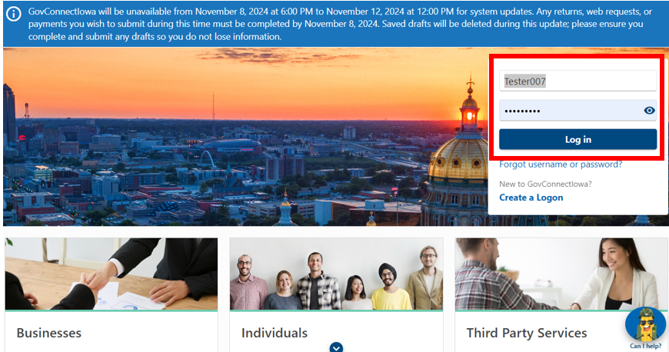
Log in to GovConnectIowa
Visit govconnect.iowa.gov
Enter your web logon information

Slide 13
Manual Key W-2s & 1099s
Select “Submit W-2s and 1099s” from the Accounts tab
Web logons must have access to the withholding account to file W-2s and 1099s
Cancelled withholding permits have three years to file and amend W-2 and 1099 forms with the Department

Slide 14
Manual Key W-2s & 1099s
Select “Manually key W-2 or 1099 forms”
Click “Next”

Slide 15
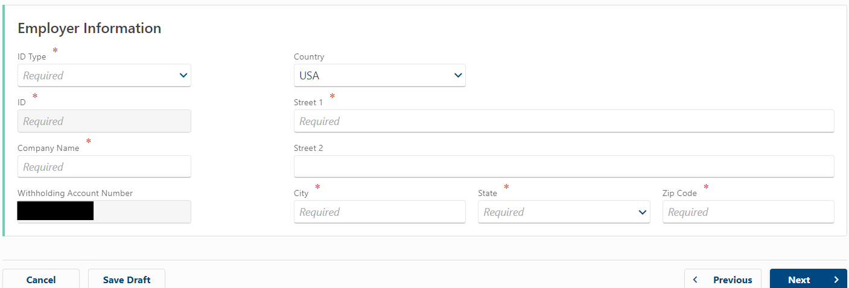
Manual Key W-2s & 1099s
Enter “Employer Information”
The Withholding Account Number will auto-populate

Slide 16
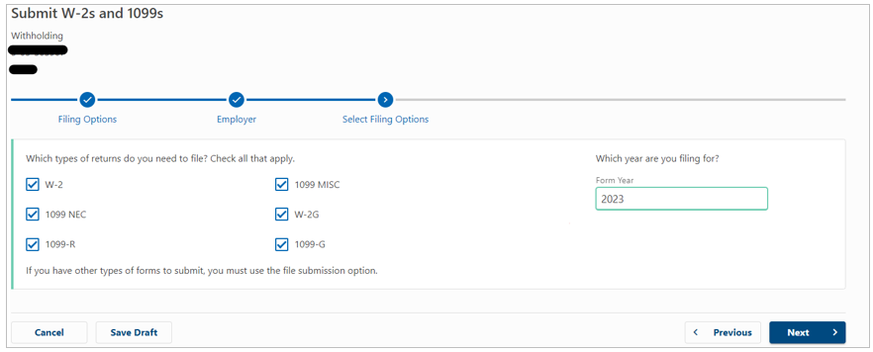
Manual Key W-2s & 1099s
Select the form type(s) to be filed
Enter the Form Year (aka Tax Year)

Slide 17
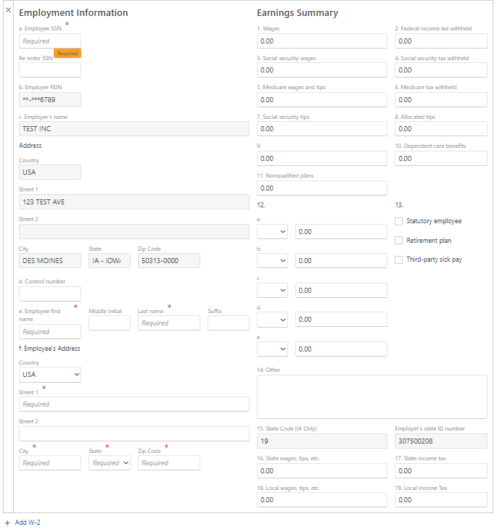
Manual Key W-2s & 1099s
Complete Employee Information and Earnings Summary fields
Employer FEIN will auto-populate
Earnings fields will default to zero (0)
Employee Social Security Number (SSN) is required
If there is no SSN available, enter zeros (0)
Click “Add W-2” (bottom left) to start a new form

Slide 18
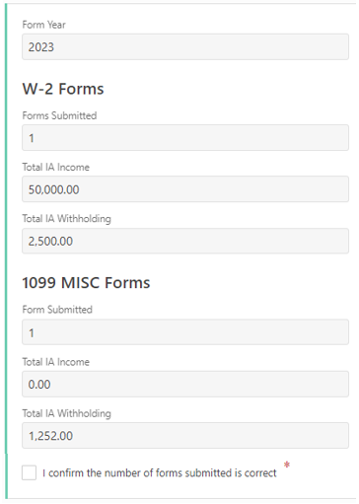
Manual Key W-2s & 1099s
Confirm the following information:
Form Year (i.e. 2024)
Number of each form submitted
Total IA Income
Total IA Tax Withheld
Check the confirmation box at the bottom of screen
Click “Next” to continue

Slide 19
Manual Key W-2s & 1099s
Confirm Submission by entering your web logon password
Submissions cannot be edited
Click Submit to complete your W-2 / 1099 filing

Slide 20
Upload a File
Select “Upload file submission”
Click “Next”

Slide 21
Upload a File
Users will be directed to the “Attach a File” screen
Click “Add Attachment”
Select the form type
Enter a description of the file (e.g. 2024 W-2s, Corrected W-2s, etc.)
Click “Choose File” and select the applicable file from your computer

Slide 22
Upload a File
Uploads that do not meet the Department’s file specifications will be receive an error message
Click “OK” to view a list of errors within the file

Slide 23
Upload a File
A detailed description of each error will be provided
All errors must be corrected to successfully complete an upload
Requires the user to create a new file and re-upload
The Department cannot assist users with errors that require software developer intervention (e.g. format and positioning errors)

Slide 24
Upload a File
Uploads that meet file specifications will receive a green message
File details (i.e. file type, name, etc.) will be displayed for confirmation
Click “Next” to continue

Slide 25
Upload a File
Confirm the number of forms to be submitted
Check the confirmation box at the bottom of screen
Click “Next” to continue

Slide 26
Upload a File
Confirm Submission by entering your web logon password
Submissions cannot be edited
Click Submit to complete your W-2 / 1099 filing

Slide 27
How to File Corrected W-2s & 1099s
Corrected W-2s & 1099s
Create a new file using your software and upload it following the same steps as the original file
OR
Use the “Manually key W-2 and 1099 forms” option to submit individual corrected forms
Incorrect SSN Submissions
Upload a file or manually key the form under the incorrect SSN and enter $0 for all currency fields to void the W-2 or 1099
Submit a new form with the correct SSN and employee earning
The Department will always use the last uploaded file for data purposes. Duplicate W-2 & 1099 forms will be discarded.

Slide 28
Penalties, Filing Extensions,
and Resources

Slide 29
Penalties & Filing Extensions
HF 2552 introduced a $500 civil penalty to each payer for each occurrence:
Willful failure to furnish an employee, nonresident, or other person with an income statement
Willfully furnishing false or fraudulent income statement
Willfully filing a false or fraudulent income statement with the Department
Willful failure to file an income statement with the Department
Example:
$500 x 10 = $5,000 for failing to furnish each employee with a W-2
$500 penalty for failing to furnish the Department with employee W-2s
The Department allows one 30-day filing extension
Must be submitted by filing due date (February 15, 2025)
Must apply for the extension at revenue.iowa.gov

Slide 30
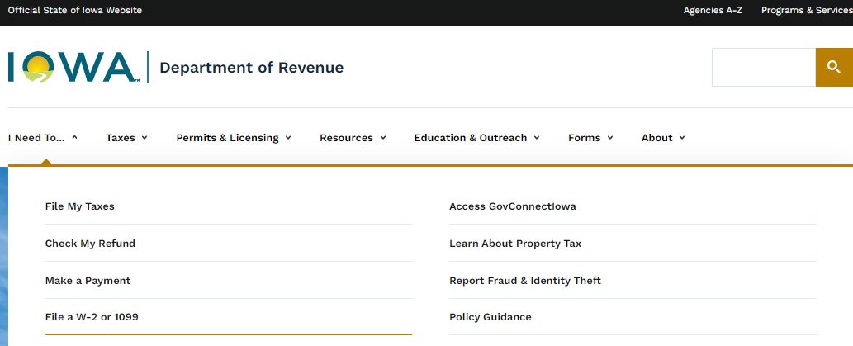
Resources
revenue.iowa.gov

Slide 31
Resources
Taxpayer Services
Phone: 800-367-3388 or 515-281-3114
GovConnectIowa Assistance = Option 2
Withholding Tax Assistance = Option 4, then option 3
W-2 & 1099 Filing Assistance = Option 5
Email: idr@iowa.gov
GovConnectIowa: Send a Message
W-2 & 1099 Information:
revenue.iowa.gov/i-need/file-w-2-or-1099
Withholding Tax Information:
revenue.iowa.gov/taxes/tax-guidance/withholding-tax/iowa-withholding-tax-information

Slide 32
Summary
Only forms containing Iowa Tax Withholding are required to be filed
Users must have access to the withholding account to file W-2s & 1099s on behalf of a business
Tax year 2024 filings are not available until January 2, 2025
30-day Filing Extension is available on the Department’s website
Failure to comply could result in a civil penalty of $500 or more
Visit Department website (revenue.iowa.gov) or contact the Department’s Taxpayer Services team for assistance

Slide 33
State of Iowa Setoff Program

Slide 34
What is the State of Iowa Setoff Program?
A method to collect money on debts owed to the State, Cities, Counties, or other public entities.
Matches people and businesses who have qualified debts with funds that can be applied toward those debts.

Slide 35
Definitions
Credit Vendor: An agency or entity who submits funds to the Setoff Program.
Setoff: Money collected to pay an overdue debt to a public agency
Debt: Money owed to a public agency
Obligor: A person, not including a public agency, who has been determined to owe a qualifying debt
Public Agency: A board, commission, municipality, department (including IDR), or other administrative office or unit of the State of Iowa or any other state entity. See HF 2565 for complete definition.

Slide 36
History of the Program
The setoff program was developed in the early 1970s
Allowed the Iowa Department of Revenue to withhold income tax refunds for liabilities owed to the Department
By the late 1970s, refunds were allowed to be withheld for other state agencies
In 1989, the program expanded to payments issued to state vendors
In 2003, the Department of Administrative Services (DAS) began managing the program
House File 2565 returned the program to the Iowa Department of Revenue

Slide 37
Why Move Setoffs to the Department of Revenue?
Capitalize on IDR’s centralized collections capabilities
Modernize the entire
approach to setoffs, leveraging our new configurable technology

Slide 38
Benefits Achieved to Date
$29.5 million
Debt collected to date
From 7 days to 48 hours
Customer response time shortened
From 45 days to 7 days
Payment released faster

Slide 39
Program Overview
Setoff payments intercepted are received by IDR within seven days
A Notice of Setoff of Public Payment letter is sent to the obligor
Payments are sent out to each agency every Friday
The fee to participate is $7.00 per setoff payment
Obligors have 15 days to challenge or request a split
Once challenge period has passed and a challenge is not received, a Notice of Completed Setoff is sent to the obligor
The agency will also be notified of setoff results

Slide 40
How to Sign Up
Complete the following:
Enrollment Application
Questionnaire
Memorandum of Understanding
Why are these forms needed?
Allows IDR to verify who should be signing legal documents on behalf of each agency, who should have access to the Debt Administration Portal, and that Iowans are treated consistently and fairly.

Slide 41
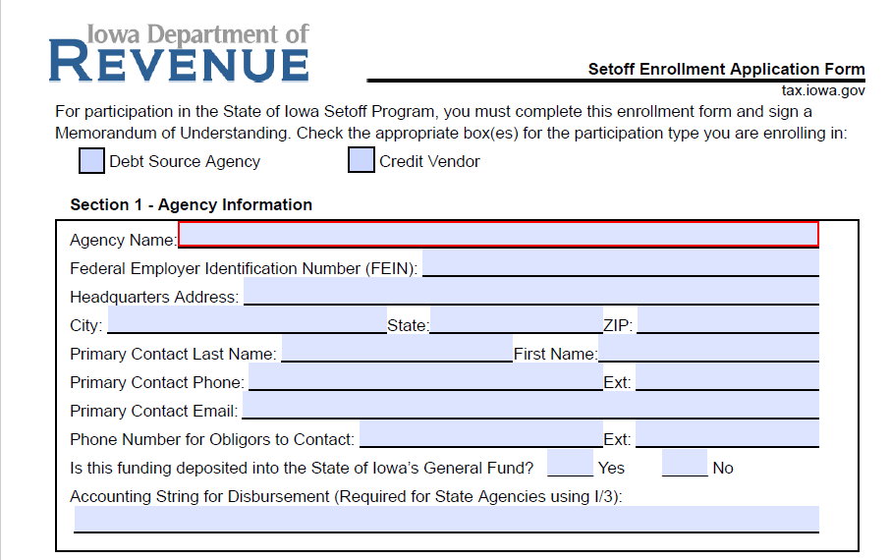
Setoff Enrollment Application, Section 1

Slide 42
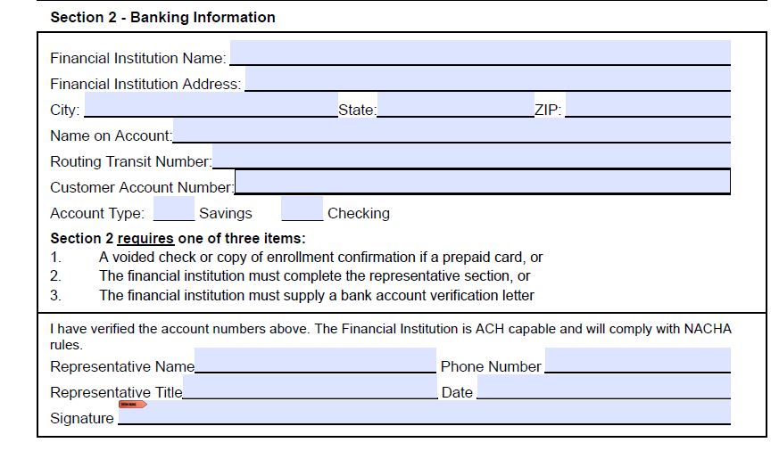
Setoff Enrollment Application, Section 2

Slide 43
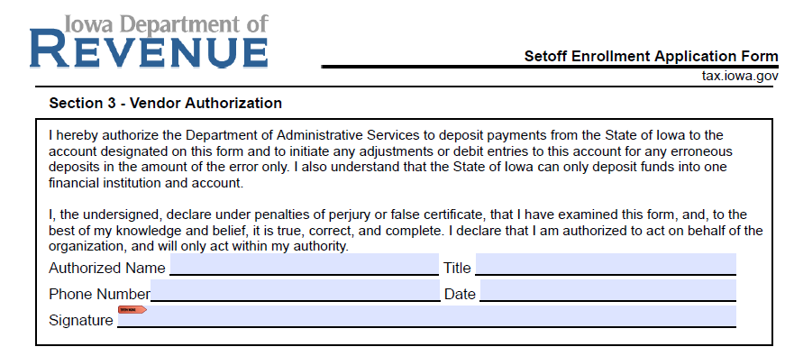
Setoff Enrollment Application, Section 3

Slide 44
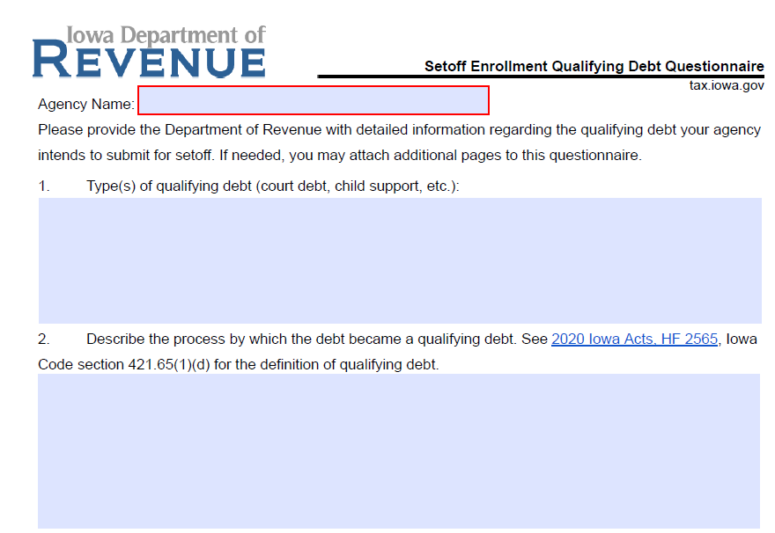
Setoff Enrollment Questionnaire

Slide 45
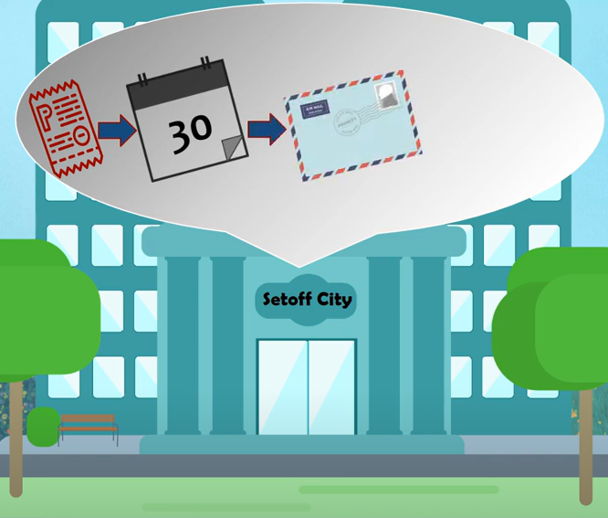
Due Process
The process to inform the obligor of their debt as well as their right to appeal or contest the debt
How the debt is established
How the obligor is notified
Steps taken to recover the debt
How you attempt to collect the debt
Timeframe for filing an appeal

Slide 46
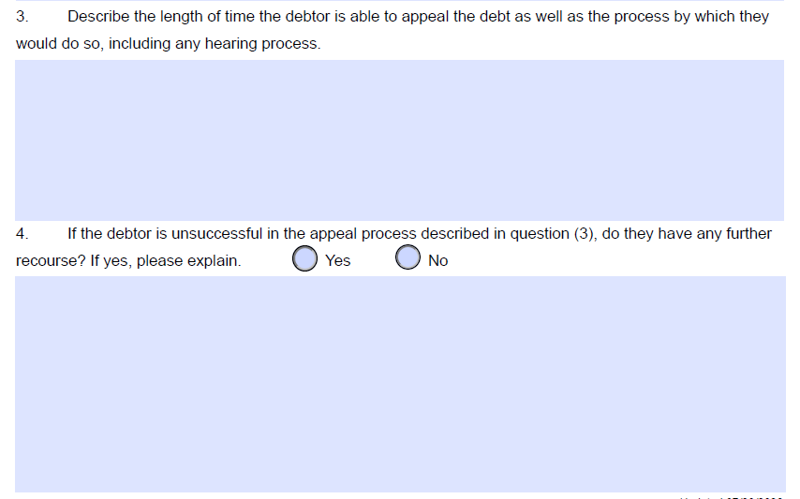
Setoff Enrollment Questionnaire, Cont’d

Slide 47
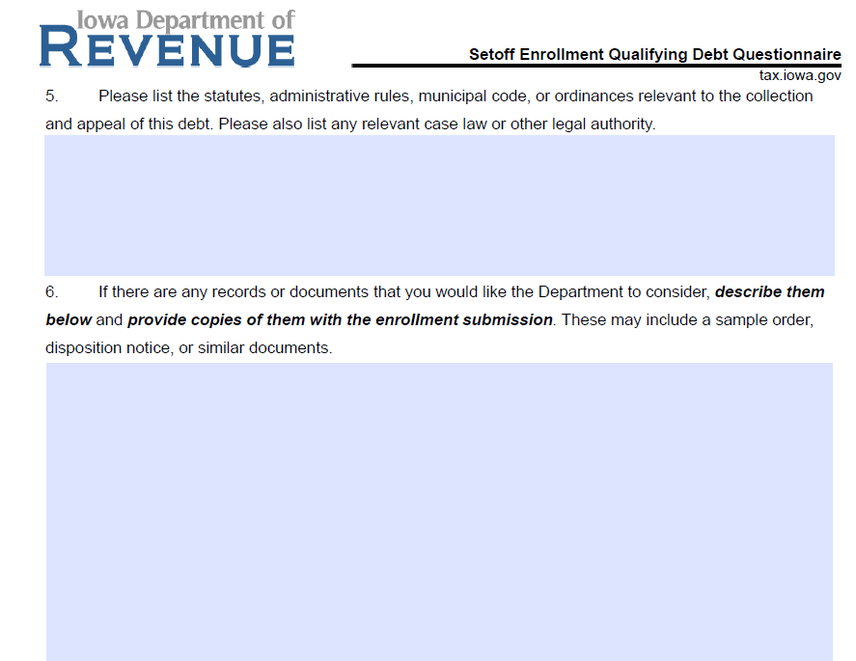
Setoff Enrollment Questionnaire, Cont’d

Slide 48
Legal Authority
Consists of statutes, administrative rules, municipal code or ordinances relevant to the collection and appeal of the debt.
Note: The relevant legal authority is different for each agency depending on the debt type. Contact your attorney for further assistance.
Example:

Slide 49
What Happens Next?

Slide 50
What Happens Next?
The Department will email a copy of the signed MOU, a link to the Debt Portal, and a copy of the Participant Guide.
Your agency will be set up to receive payments from us.
Once setup is complete, an examiner will contact you and provide your Debt Portal login credentials.
Note: Applicants will be notified via email of missing information or if any corrections are required for approval.

Slide 51
IDR Debt Portal
24/7/365
Online Self-Service

Slide 52
What Public Agencies Can Do Through the Portal
Place qualifying debt in the system
Keep balances up to date - also known as recertification
Assign their staff specific access and capability
View on-demand video tutorials for Setoff Program
Upload documents needed for Setoff Challenges
Were the records from DAS transferred to IDR?
No files from previous enrollment with DAS were transferred but we made it easy with the template!

Slide 53
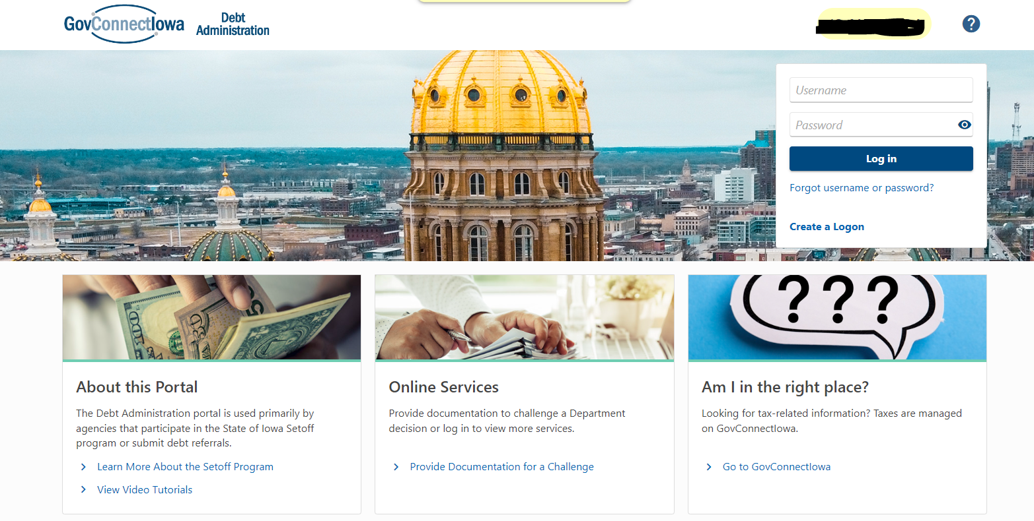
Debt Administration Portal

Slide 54
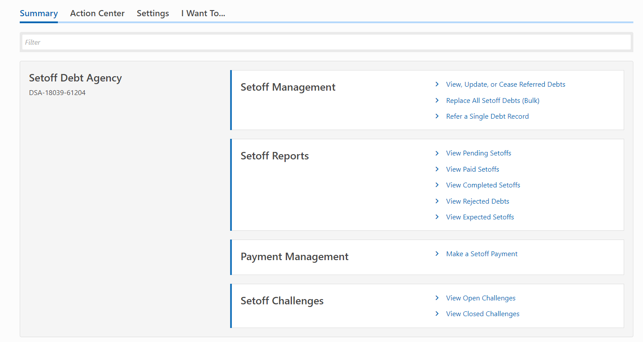
Main Page

Slide 55
Other Available Options

Slide 56
Debt Portal - File Upload
View, Update, or Cease Referred Debts
Someone files bankruptcy and you need to cease them right away
Replace all Setoff Debts
Use to add your first file or when replacing all Debts in the program
Can enter multiple debts for one social security number under the $50 threshold
Refer a Single Debt Record
Individual debts must be $50 or higher

Slide 57
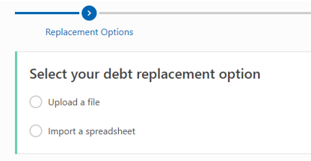
Replace All Setoff Debts
Upload a file
Requires help from IT because this is a complex option
Made for agencies with a large amount of debt

Slide 58
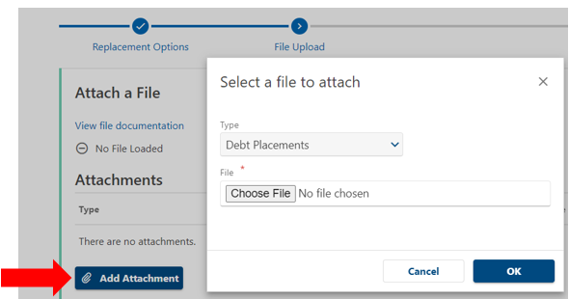
Upload a File
Click the “View file documentation” hyperlink to view file layout requirements
Click “Add Attachments”
Choose applicable file to upload from your computer

Slide 59
Upload a File
The system will confirm how many debts is to be processed
Click “Next” to continue

Slide 60
Spreadsheet Upload
Import a spreadsheet
Import a spreadsheet (Excel) - Easier option
IDR created an easy to use template

Slide 61
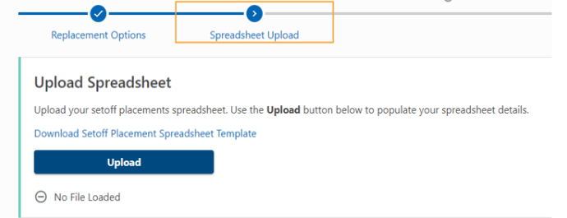
Spreadsheet Upload
Located within the Debt Administration Portal
Download, complete, and save prior to uploading

Slide 62
Spreadsheet Upload
Spreadsheet Template Definitions
Field Name | Description
Agency Number | Unique identifier for the agency who maintains the debt. Assigned by IDR. (Required)
Unit Code | Unique identifier for a group within the agency. Assigned by IDR. (Required)
Obligor ID Type | ID Type of the of the obligor. (Required)
Obligor ID | ID of the of the obligor. (Required)
Debt ID | Agency's unique identified for the debt. This ID should not change. If your agency always sends one record for each ID, populate this field with the Obligor ID. (Required)
Obligor Last Name / Business Name | Last name of the person who owes the debt, or business name if the debt belongs to a business. (Required)
Obligor First Name | First name of the person who owes the debt. Leave blank if the ID Type is FEIN (2).
Obligor Middle Name | Middle name of the person who owes the debt. Leave blank if the ID Type is FEIN (2).
Qualified Date | Date the debt first became qualified for setoffs. (Required)
Debt Amount | The amount owed to the participating agency. Expressed in pennies. (Required)
Description of Debt | Description of the debt. May be displayed on correspondence to the obligor pertaining to their setoff.

Slide 63
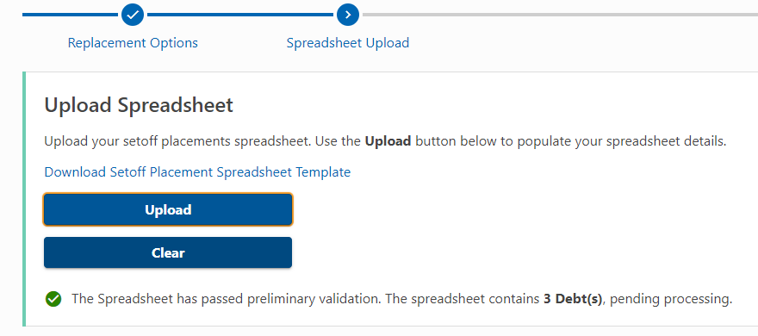
Spreadsheet Upload

Slide 64
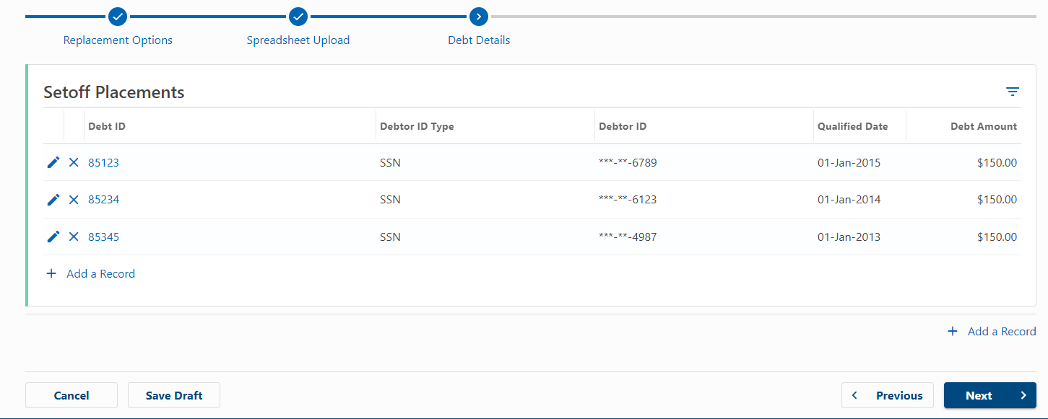
Spreadsheet Upload

Slide 65
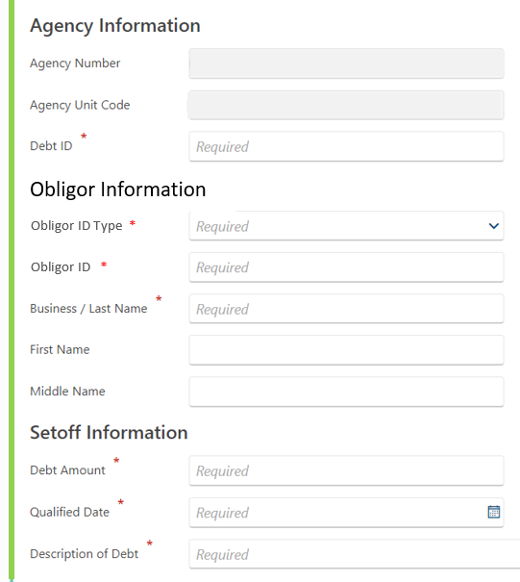
Spreadsheet Upload
Clicking “Add a Record”
Will generate a pop-up window
Agency Number and Unit Code will auto-populate
Allows users to add an additional debt without creating and uploading a new spreadsheet

Slide 66
Spreadsheet Upload
The system will confirm how many debts is to be processed
Click “Next” to continue

Slide 67
Refer a Single Debt Record
Refer a Single Debt Record
Individual debts must be $50 or higher
To add one obligor at a time OR to add an additional debt that was missed

Slide 68
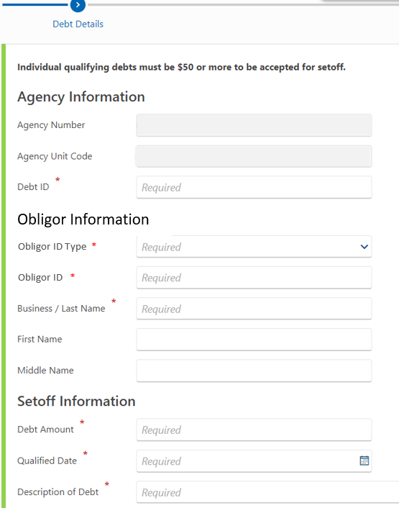
Refer a Single Debt Upload
Agency Number and Unit Code will be auto-populated
Debts must be $50 or more

Slide 69
What Credit Vendors Can Do Through the Portal
Look up balances
Print and provide letters to obligors
Assign their staff specific access and capability
View on-demand video tutorials for Setoff Program

Slide 70
Strong Partnerships Prevent Fraud
A story about casino winnings.

Slide 71
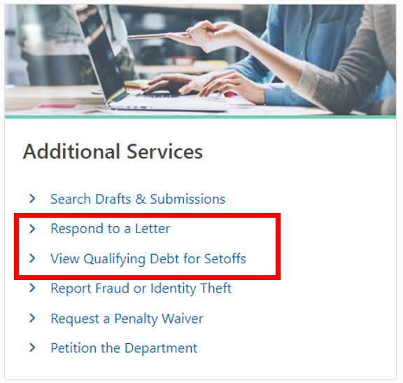
Obligors 24/7/365 Online Access
Visit govconnect.iowa.gov
No logon required
View all debt within Setoff Program
Respond to Notice of Setoff letters
Upload documents needed for Setoff Challenges

Slide 72
Setoff Challenge Rights
The Notice of Setoff of Public Payment letter from the Iowa Department of Revenue explains how to challenge the setoff. You have 15 days from the date of the Notice of Setoff letter to challenge the setoff in writing.
There are three (3) types of challenges:
Debt is not qualified
Mistake of identity of the obligor
Mistake of amount owed
There are three ways to challenge a setoff payment:
By going to GovConnectIowa
Sending an email to IDRChallenges@iowa.gov
Send a challenge letter by mail

Slide 73
Split and/or Divide Request
IDR will review requests to divide a jointly or commonly owned right to payment.
The participating agency will be notified regarding the divide request if:
A refund of the setoff payment amount to the obligor or co-payee is required
A legal hearing is determined
A refund of the setoff payment to IDR for another qualifying debt is required
Example: A married couple files a joint tax return. Spouse 1 owes money to a public agency. Spouse 2 doesn’t have any debt. The tax refund is intercepted for public agency setoff. Spouse 2 files for a split request to receive her portion of the refund and wins. The setoff agency will receive a request to refund Spouse 2’s portion or return it to IDR to be refunded.

Slide 74
Common Questions
I don’t know how to sign up or what I need to provide. Can IDR provide step-by-step instructions?
Definitely! We have video tutorials on our YouTube to walk you through the enrollment process.
www.youtube.com/watch?v=Gfs0qu8nOaA
More information available at: revenue.iowa.gov/taxes/tax-guidance/general/state-iowa-setoff-program
Contact the Setoff Team for assistance.

Slide 75
Common Questions
We have not received confirmation that we got everything needed in order to utilize the new setoff program. Is there something we can do to check our status?
Please contact the Setoffs team for assistance:
Email: IDR-Setoffs@iowa.gov
Phone: 833-825-0800

Slide 76
Common Questions
What happened to the delinquent outstanding debts from the old site? Will those need to be resubmitted after we get approval to participate in the new program?
No delinquent or outstanding debts with DAS were converted from the old system. Agencies must submit new debts via the Debt Portal
After you are approved with the Department of Revenue, you will be able to begin submitting debt files

Slide 77
Common Questions
Can the State of Iowa Setoff Program take my federal tax refund?
No, we cannot take the federal tax refund. If the refund has been held, please contact the Internal Revenue Service (IRS) for assistance.
To learn more about how the Treasury Offset Program (TOP) works, visit the IRS website or call them at 1-800-829-1040.
The Iowa Department of Revenue’s Setoff Team does not receive information from the Federal Government and cannot address questions regarding federal tax refund offsets.

Slide 78
Common Questions
Why would user accounts get deactivated?
The Debt Administration Portal account will be deactivated if you do not log in for 30 days
To keep your account active, you must log in at least once a month
A reminder email will be sent after 20 days of inactivity
If your account is deactivated, contact the Setoff team for assistance

Slide 79
Common Questions
Is the $7.00 fee deducted from the amount forwarded to the participating agency?
There is a fee charged per payment of $7.00.
The fee is taken out before IDR sends the payment to the agency.
The fee cannot be added to the debt that is the source of the fee in the setoff program.
Agencies can submit their own administrative fee and would need to follow the same process as any other debt type.

Slide 80
Common Questions
Can the fee be made qualified debt?
Debts submitted to setoffs may not include any additional amount for administrative fees owed by the taxpayer to the public agency unless these amounts meet the definition of qualifying debt in Iowa Code section 421.65(1)(d) and have been approve by IDR. Debt may also not include the $7 fee which will be collected by the Department of Revenue from the amount forwarded to the public agency.
Iowa Administrative Rule 701–26.10(1) is clear that the $7 fee charged by the Department when applying a public payment to a debt may not be collected by the public agency from the taxpayer via the setoff program unless it is a qualifying debt in its own right. If your agency charges an administrative fee, collection fee, or service fee to the taxpayer when you submit a debt to setoffs, it must also be a qualifying debt. You must apply separately and be given approval for those fees as their own debt type. A setoff fee cannot meet the definition of qualifying debt before the setoff takes place, which is why the fee cannot be added to the debt that created the fee.

Slide 81
What’s Coming?
Customer Experience
Increased self-service function: The Kernel
Ease of communication in the system using Send a Message
Program Growth
Expanding participation of credit and debt sources
Explore additional credit sources within the state such as the Great Iowa Treasure Hunt

Slide 82
Resources
State Setoff Program:
Phone: 833-825-0800
Email: IDR-Setoffs@iowa.gov
Challenge Email: IDRChallenges@iowa.gov
Website: revenue.iowa.gov/setoffs

Slide 83
Upcoming Dates
Date | Description
November 8, 2024 @ 6:00 PM to November 12, 2024 @ 12:00 PM | GovConnectIowa portals are temporarily unavailable for 2024 system upgrades
November 13, 2024 | Withholding Income Tax Series webinar
December 11, 2024 | Electronic Submission of W-2s & 1099s Tax Year 2024 webinar

Slide 84
Subscribe to Updates
Topics Include:
Newsroom
Tax Information
Law & Policy Updates
GovConnectIowa

Slide 85
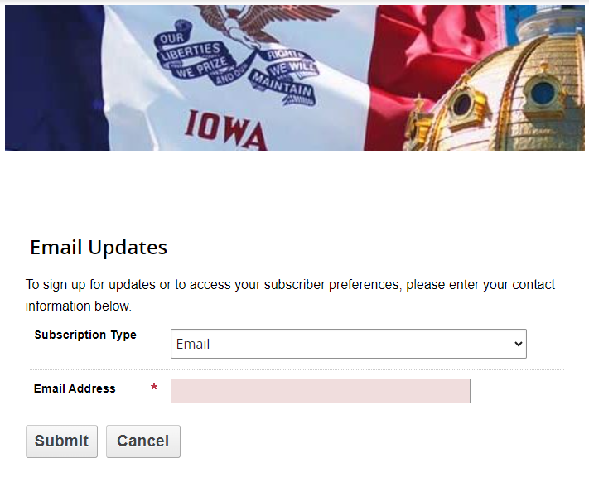
Subscribe to Updates

Slide 86
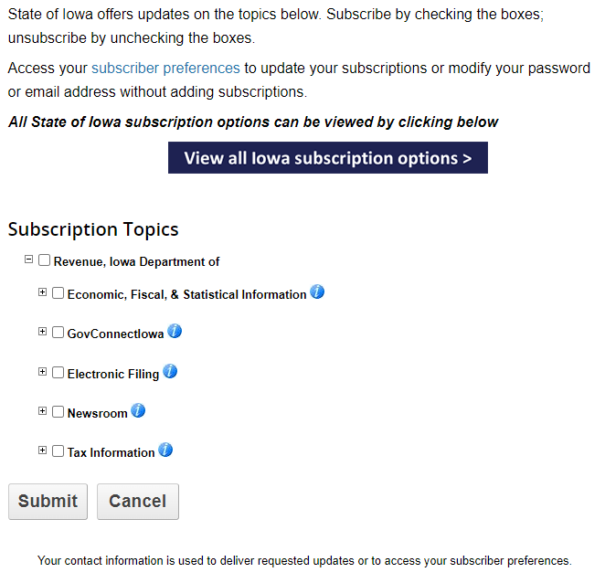
Subscribe to Updates

Slide 87
Follow us on social media

Slide 88
Thank you!
Questions?

