Slide 1
Cybersecurity Threat Landscape for Municipal Finance Officers
Notes:
County recorders face a variety of cyber threats due to the sensitive nature of the information they handle. This section covers common cyber threats targeting local governments, recent incidents, and the potential impacts on public records.

Slide 2
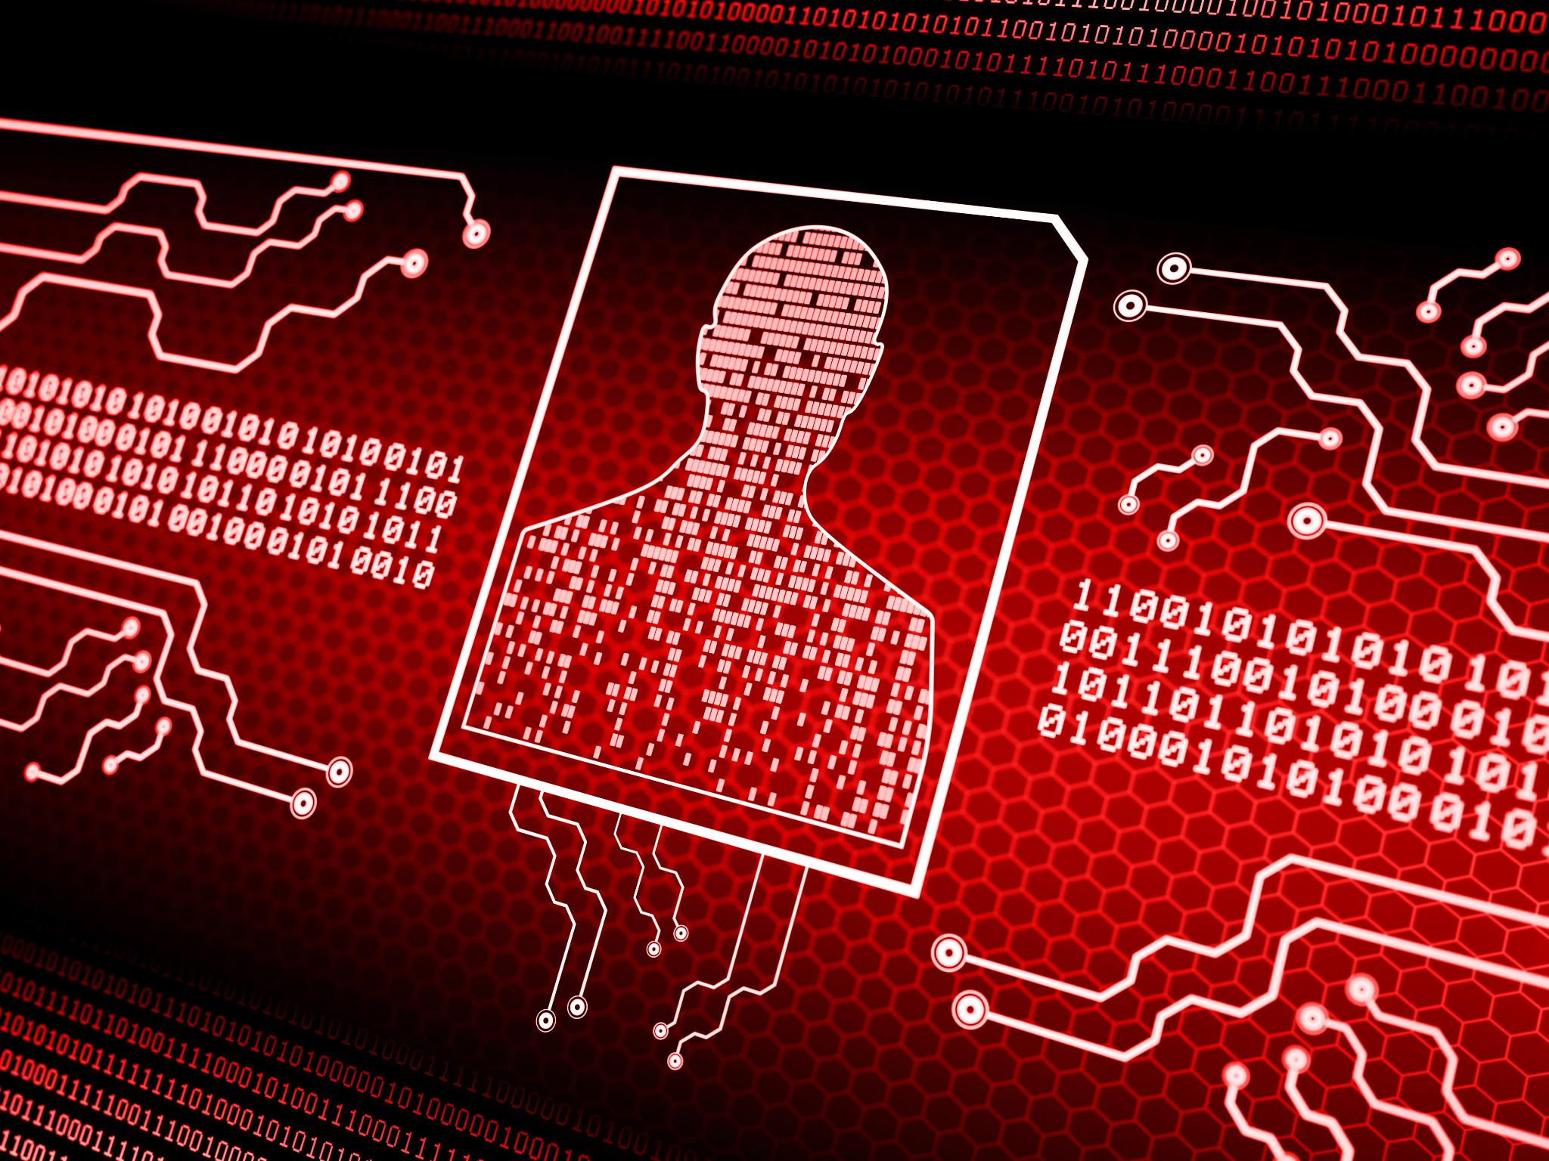
Common Cyber Threats Targeting Local Government
Phishing /Smishing Attacks
Phishing targets local government employees to steal sensitive information through deceptive emails and links.
Ransomware Threats
Ransomware infects systems to encrypt data, demanding ransom to restore access and halt operations.
Insider Threats
Insiders with access can misuse data or disrupt systems, posing serious risks to government security.
Malware Attacks
Malware disrupts local government operations by damaging or stealing data from computer systems.
Notes:
--- Local governments, including recorders’ offices, are often targeted by phishing, ransomware, insider threats, and malware attacks. These threats aim to disrupt operations, steal data, or demand ransom payments. Image source: Microsoft 365 content library

Slide 3

Potential Impact on Public Services
Integrity Compromise
Cyberattacks can alter or corrupt city systems, undermining data accuracy and reliability.
Availability Disruption
Attacks can make public services inaccessible, causing operational delays and interruptions.
Confidentiality Breach
Sensitive public information can be exposed, leading to privacy violations and legal risks.
Loss of Public Trust
Compromised city systems and disruptions reduce citizens' confidence in public institutions.
Notes:
--- A successful cyberattack can compromise the integrity, availability, and confidentiality of public records, leading to operational disruption, legal liabilities, and loss of public trust. Image source: Microsoft 365 content library

Slide 4
Cybersecurity Tabletop Exercise for Municipal Financial Officers: Preparedness and Response Strategies
Enhancing readiness through simulated incident response scenarios
Notes:
AI-generated content may be incorrect. --- This presentation focuses on strengthening cybersecurity preparedness and response for Iowa County Recorders through a comprehensive tabletop exercise. We will cover the roles of county recorders, the threat landscape, exercise planning, incident response, and lessons learned to build resilience.

Slide 5
What Happened Day 1
An early morning email from gworks alerts you to a possible cyber attack on their software. They have a link in the email to explain the situation.
Later that afternoon an email from gworks states that they have been made aware of a compromised email address from their company with a spear phishing message that went out to their customers.
What do you do? Who do you contact?

Slide 6
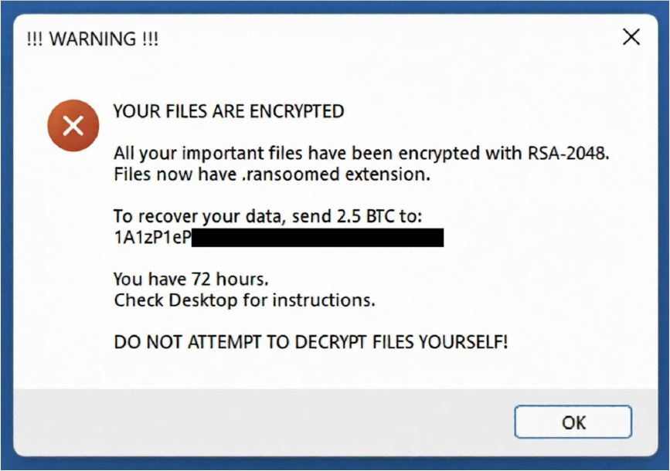
Day 2
8:00AM – Your computer workstation has the following message:
8:10AM – Other employees are trying to access documents but can’t open any of them.
What do you do? Who do you contact?
Notes:
Who decides whether to engage law enforcement?
• Do you contact your insurer?
• What is your policy on ransom payments?
• How do you maintain essential financial operations?

Slide 7
Day 2 – 12:00PM
The FBI calls and informs you that some of the city data has been identified on the dark web with threats that the data will be released if the ransom is not paid.
All employes are directed to stay out of all computer systems until further notice.
What do you do? What does your IRP instruct you to do?
Notes:
What are your manual workarounds?
• How do you prioritize essential financial functions?
• How do you document decisions for audit and compliance?

Slide 8
Day 3
7:00AM – Payroll and utility billing are due tomorrow, and all computer systems are still down
8:30AM- Local TV and newspaper show up and ask for comments on the city computer issues- Local media is running a story on “ City Compromised in Cyber Attack!”
12:00PM- IT Services has stated that recovery of data from backups and cleaning of infected systems will take a week.
What do you do?
Notes:
• Who is authorized to speak publicly?
• What messages do you share to maintain trust?
• How do you coordinate with county/state partners?

Slide 9
Post Recovery
Develop, maintain, and test an Incident Response Plan
Implement a mandatory Cyber Education and Testing program for all employees
Develop policies for situations- IE Someone asking to change their payroll routing information
Test Disaster Recovery and Back Up Systems.
Implement an external device policy for USB, Cell phone, BYOD, etc.
MFA FOR ALL EMPLOYEES!
The worst time to come up with an Incident Response Plan is during an incident!

Slide 10
Lessons Learned and Strengthening Cyber Resilience
Notes:
Post-exercise analysis helps identify strengths and areas for improvement. This section discusses key takeaways, policy enhancements, and ongoing training to build a resilient recorder office.

Slide 11
Improving Security Policies and Procedures
Incident Response Plans and Policies
Updating incident response plans ensures faster and more effective handling of security breaches and threats.
Stronger Access Controls and MFA
Implementing stronger access controls helps prevent unauthorized access and protect sensitive information.
Enhanced Data Backup Protocols
Enhancing data backup protocols reduces risk by ensuring reliable backup and recovery of critical data.
Notes:
--- Recommendations include updating incident response plans, implementing stronger access controls, and enhancing data backup protocols to reduce future risk. Image source: Microsoft 365 content library

Slide 12
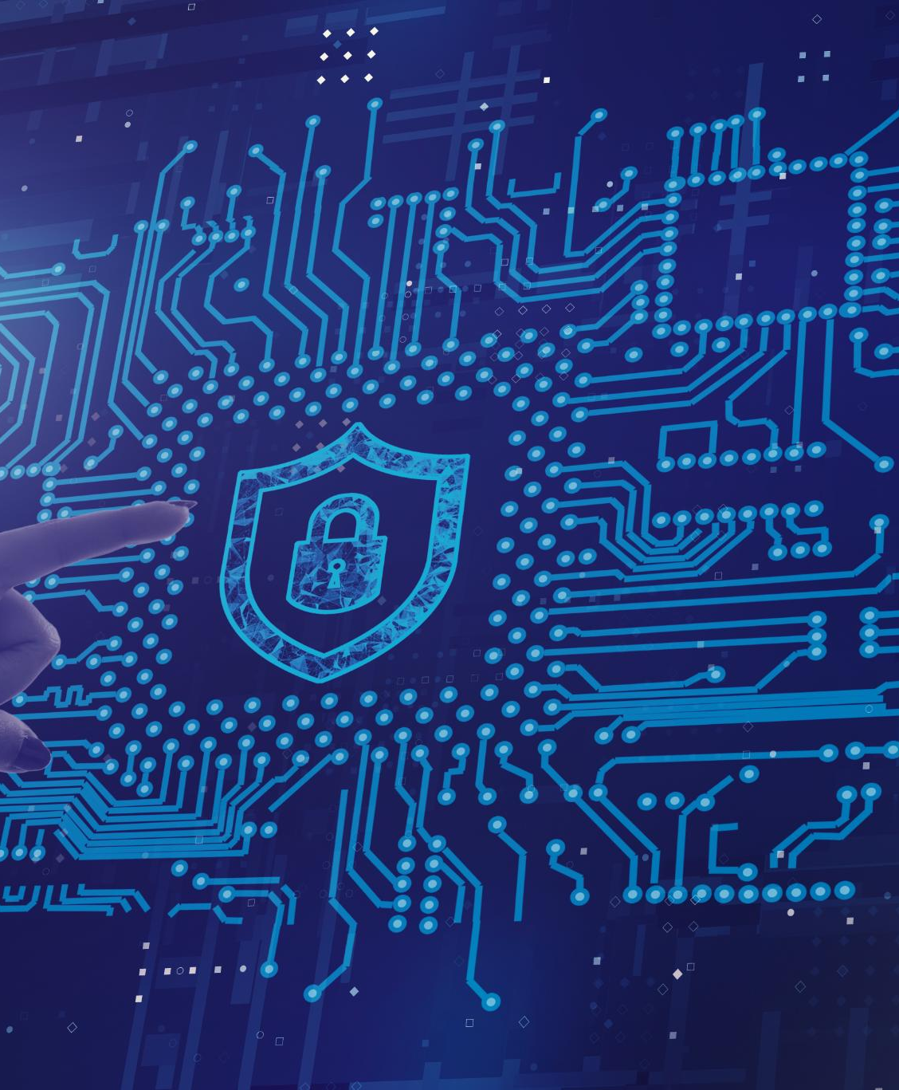
Ongoing Training and Resources
Continuous Cybersecurity Education
Regular training on cybersecurity threats helps personnel stay updated on evolving risks and protection methods.
Best Practices Implementation
Adopting cybersecurity best practices enhances defenses and minimizes vulnerabilities in daily operations.
Tabletop Exercises
Regular tabletop exercises simulate cyber incidents to improve preparedness and response capabilities.
Notes:
--- Continuous education on cybersecurity threats, best practices, and regular tabletop exercises ensure that personnel remain vigilant and prepared for evolving cyber risks. Image source: Microsoft 365 content library

Slide 13
Q&A Ask us Anything
Notes:
Post-exercise analysis helps identify strengths and areas for improvement. This section discusses key takeaways, policy enhancements, and ongoing training to build a resilient recorder office.

Slide 14
Conclusion
Strengthening Cybersecurity
Awareness, planning, and practice are key to improving cybersecurity posture effectively.
Importance of Tabletop Exercise
Tabletop exercises enhance preparedness and response to cybersecurity threats.
Ensuring Operational Resilience
Preparedness ensures continuous operations despite cybersecurity challenges.
Notes:
Through awareness, planning, and practice, Iowa County Recorders can strengthen their cybersecurity posture. This tabletop exercise is a vital step toward enhancing preparedness, protecting public records, and ensuring operational resilience.

Slide 15
Contact Information
Joel Rohne- Iowa State Association of Counties IT Strategy Manager – jrohne@iowacounties.org
Andrew De Haan- Iowa State Association of Counties IT Director - adehaan@iowacounties.org
Jordan Hagans- Iowa League of Cities IT Director- jordanhagans@iowaleague.org

