Slide 1



IMFOA 2026
Fall Conference
House File 2634 and the Regulation of Government Cemeteries

Slide 2

Cody Butenhoff
Legislative Liaison
Iowa Insurance Division
515-918-1912 (Cell)
cody.butenhoff@iid.iowa.gov

Slide 3
AGENDA
  Introduction to the Iowa Department of Insurance & Financial Services (DIFS) - Iowa Insurance Division (IID)
  2. The History and Current State of Cemetery Regulation in Iowa
  3. House File 2634 - What’s Changed?
  4. Filing System Update and IID Contacts
  5. Q&A

Slide 4



Department is governed by Iowa Code Chapter 546 -Iowa Administrative Rules Section 181.
Administers and coordinates all regulatory, service, and licensing functions of the state relating to:
BANKING
CREDIT UNIONS
INSURANCE

Slide 5



OUR LEADERSHIP TEAM
James Johnson
Katie Averill
Doug Ommen
Superintendent
of Banking
Superintendent
of Credit Unions
DIFS Director and
Insurance Commissioner

Slide 6

DIFS MISSION
The Department of Insurance and Financial Services protects consumers and ensures regulated entities operate in a safe and sound manner by applying a fair, effective, and positive environment for the entities we supervise and regulate that adheres to applicable laws and regulations while also promoting consumer education and promoting financial literacy for Iowans.
Serve Iowans by effectively and efficiently providing a fair, flexible, and positive regulatory environment.
Develop leaders that promote empowerment, communication, trust, and cooperation. Develop employee’s knowledge and skills to effectively regulate and meet customer needs. Increase consumer and customer awareness through public education.
Increase efficiency and responsiveness by sharing departmental resources. Increase efficient transfer of information through advanced technology.

Slide 7
Doug Ommen
Insurance Commissioner
IOWA INSURANCE DIVISION
CEMETERY REGULATION TEAM
  The Product Regulation Bureau is in the process of hiring an experienced examiner that will be assigned to cemeteries, and preneed sellers and sales agents.
Julie Pearce
Acting Deputy Insurance Commissioner
  Consumers, or other persons, may file a complaint with the Market Regulation Bureau in the following cases:
    There is a belief that a person has violated Iowa law under the jurisdiction of the Commissioner.
    There is a belief that the provisions of a contract under the jurisdiction of the Commissioner are not being followed by one or more parties.
Jess Pollmeier
Acting Bureau Chief
Product Regulation
David Sullivan
Bureau Chief
Market Regulation
Product Regulation Team
Market Regulation Team

Slide 8
History of Cemetery Regulation in Iowa
Pre-1953 - Regulations for cemeteries existed in various chapters throughout Iowa Code and generally fell under the jursidiction of the local/state judicial system.
1953 - The first regulatory framework for cemeteries’ trusts and financials is created in Iowa Code Chapter 566A under the jurisdiction of the local/state judicial system.
1994 - Changes are made in Chapter 566A to require submission of certain financial reports and audits to the Iowa Insurance Commissioner.
1995 - New Iowa Code Chapter 523I creates licensing framework and enforcement provisions under the jurisdiction of the Commissioner.
2005 - Chapters 566 and 566A are repealed, and the regulatory framework for cemeteries is fully transitioned into Chapter 523I under the jurisdiction of the Commissioner.

Slide 9
Perpetual Care Cemeteries in Iowa
Iowa Code Chapter 523I applies to all cemeteries operating in the state of Iowa, except veterans cemeteries and religious cemeteries that began operating prior to July 1, 2005. Chapter 523I requires perpetual care cemeteries to file annual reports.
Number of Perpetual Care Cemeteries in Iowa (as of April 1, 2026)
Non-Government Perpetual Care Cemeteries - 145
Government Perpetual Care Cemeteries - 169
TOTAL - 314

Slide 10
Perpetual Care Fund Balances
Perpetual care cemeteries annually report the balance of their perpetual care fund. The following information on care fund balances was collected in 2025 and is based on the 2024 calendar year.
Range for All Cemetery Types (Association, Church/Religious Organization, Corporation, Governmental Subdivision, Non-profit Organization, Privately-owned)
$250.00 to $15,243,083.00
Range for Governmental Subdivision Cemeteries
$250.00 to $4,350,120.00

Slide 11
Perpetual Care Cemeteries Requesting Use of Care Funds
Perpetual care cemeteries may withdraw and use the principal of the perpetual care fund for limited purposes under Iowa Code sections 523I.810 and 523I.811A. The Division reviews these requests.
From 2023 to 2025, 11 requests were made to the Division, with four of those coming from governmental subdivisions. The requests ranged from $7,200 up to $238,775.

Slide 12
Receiverships of Perpetual Care Cemeteries in Iowa
Under the authority of Iowa Code section 523I.212, the Division may serve as a receiver of a cemetery that is insolvent, has utilized trust funds in a fraudulent manner, or holds insufficient funds required to fulfill their promise to Iowans.
In this role, the Division makes operational decisions to keep the cemetery operating temporarily and attempts to find long-term solutions to prevent a transition of cemetery operations to local governments. In cases where a non-government operator is not willing to assume the duty of preserving and protecting the physical integrity of the cemetery, that duty is transferred to the applicable governmental subdivision.
Since 2017, the Division has served as a receiver for four separate cemeteries. All four receiverships have been terminated and ownership was transferred to another organization or governmental subdivision.

Slide 13
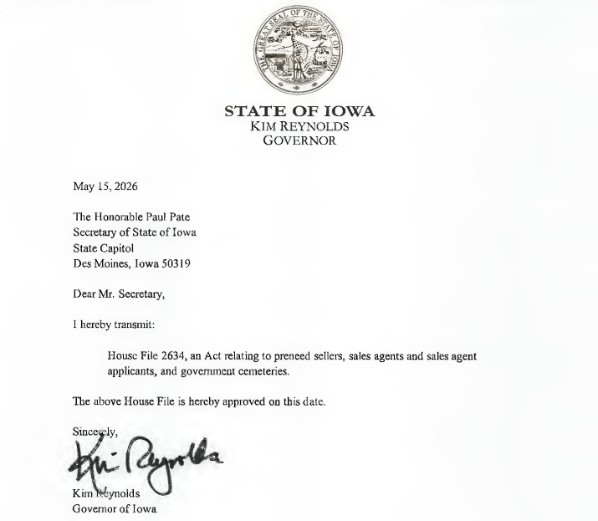
House File 2634
Effective Date: July 1, 2026
What’s changing in cemetery regulation?

Slide 14
HF 2634 - Definitions
In addition to removing unnecessary definitions from Chapter 523I, the law further clarifies the definition of “perpetual care cemetery” to exclude “government cemeteries”.
“Government cemetery” means a cemetery that is owned, operated, or controlled by a governmental subdivision. — 523I.102(13A)
“Governmental subdivision” means a city, county, or township. — 523I.102(13B)
Beginning July 1, 2026, government cemeteries are no longer considered perpetual care cemeteries for the purposes of Chapter 523I. These updated definitions lay the groundwork for some of the changes mentioned on the following slides.

Slide 15
HF 2634 - Examination Schedule
The law strikes a specific examination schedule requirement within Iowa Code section 523I.213A. The Division will transition to a risk-based approach for examinations of cemeteries and preneed sellers, instead of the fixed examination timeline previously required by Iowa Code.
Previously, perpetual care cemeteries were required to be examined by the Division at least once every five years. With the fixed timeline requirement removed, all cemeteries (including government cemeteries) will be examined on an as-needed basis.

Slide 16
HF 2634 - Required Disclosures to Consumers
Cemeteries are required under Iowa Code section 523I.312 to make certain disclosures to consumers in their agreement for interment rights. The law updates one disclosure, related to the contact information for the Iowa Insurance Division, that must be provided to the consumer. The updated required disclosure reads as follows and should be included in all interment rights agreements:
“This agreement is subject to rules administered by the Iowa insurance division. You may contact the Iowa insurance division with inquiries or complaints at iid.iowa.gov.”
Cemeteries are expected to make this update in the disclosure section of their interment rights agreements as soon as possible. Cemeteries who do not include the required disclosures of Iowa Code section 523I.312 in their interment rights agreements may face enforcement action.

Slide 17
HF 2634 - Applicability of Subchapter VIII (Perpetual Care Cemeteries)
Subchapter VIII of Iowa Code Chapter 523I details the requirements of perpetual care cemeteries operating in the state of Iowa.
As mentioned previously, government cemeteries are no longer included in the definition of a “perpetual care cemetery”. As of July 1, 2026, government cemeteries are explicitly excluded from the requirements of Subchapter VIII.
The next eight slides explain what this means for the regulation of government cemeteries by the Division.

Slide 18
Regulation of Government Cemeteries - Jurisdiction
Government cemeteries are still regulated by the Division under Chapter 523I, and all provisions of the chapter apply to government cemeteries, unless stated otherwise in the chapter. After enactment of House File 2634, the following provisions do not apply to government cemeteries:
Iowa Code Chapter 523I, Subchapter III, Section 523I.312, Subsection 1
Iowa Code Chapter 523I, Subchapter VIII, Sections 523I.801 through 523I.814
Iowa Code Chapter 523I, Subchapter III, Section 523I.312, Subsection 1 requires nonperpetual care cemeteries to clearly state on all documents and advertising that they are a nonperpetual care cemetery. Government cemeteries do not fall under the definition of nonperpetual care cemetery, thus are not required to follow this provision.

Slide 19
Regulation of Government Cemeteries - Communication with the Division
Governmental subdivisions do not need to report to the Division that they own, operate, or control a government cemetery if they have already made filings with the Division prior to July 1, 2026. The Division will be able to make the distinction internally without any formal action by the governmental subdivision.
If a governmental subdivision owns, operates, or controls a government cemetery that hasn’t been disclosed to the Division, they should do so immediately.

Slide 20
Regulation of Government Cemeteries - Irrevocable Trust
Government cemeteries are no longer required to establish and maintain their care fund(s) as an irrevocable trust administered under the jurisdiction of the district court.
Government cemeteries may choose to petition the district court to end the supervision of their existing trust(s).

Slide 21
Regulation of Government Cemeteries - Annual Reports and Associated Fees
Government cemeteries are no longer required to submit an annual report to the Division.*
Accordingly, government cemeteries are no longer required to pay a $10 examination fee for each certificate of interment rights issued during the time period covered by the annual report.
*Government cemeteries are required to complete and file an annual report with the Division for the time period of January 1, 2026 to June 30, 2026. The filing period for this final report will be shared in the near future.

Slide 22
Regulation of Government Cemeteries - Financial Requirements
Government cemeteries are no longer required to “set aside” and deposit in a care fund a set amount of moneys received for each sale of interment rights after July 1, 2026.
Existing perpetual care funds must be used for the perpetual care of the designated cemetery in accordance with the contracts entered into between the government cemetery and Iowa consumers.
Perpetual care funds maintained by government cemeteries may be transferred to another existing cemetery fund, but must be treated as separate funds for accounting purposes.

Slide 23
Regulation of Government Cemeteries - Financial Requirements (cont’d.)
Government cemeteries are no longer required to apply to the Division for approval to withdraw funds from the government cemetery’s care fund.
Again, existing perpetual care funds must be used for the perpetual care of the designated cemetery in accordance with the contracts entered into between the government cemetery and Iowa consumers.

Slide 24
Regulation of Government Cemeteries - Cemetery Operations
After July 1, 2026, government cemeteries may choose to continue operationally as a perpetual care cemetery, or they may choose to write new contracts, collect different fees, and maintain new funds.
Regardless of the government cemetery’s choice, the provisions of Iowa Code Chapter 523I, Subchapter VIII will not apply to their operations after July 1, 2026.

Slide 25
Regulation of Government Cemeteries - Iowa Administrative Code
The Division intends to review and update Iowa Administrative Code Chapter 191–101 to reflect the updated provisions in Iowa Code Chapter 523I. Where there is a conflict between the provisions of Chapter 523I and IAC Chapter 191–101, Chapter 523I takes precedence.
Governmental subdivisions are encouraged to consult with their legal counsel to ensure that they are compliant with all applicable provisions of Chapter 523I and IAC Chapter 191–101 .

Slide 26
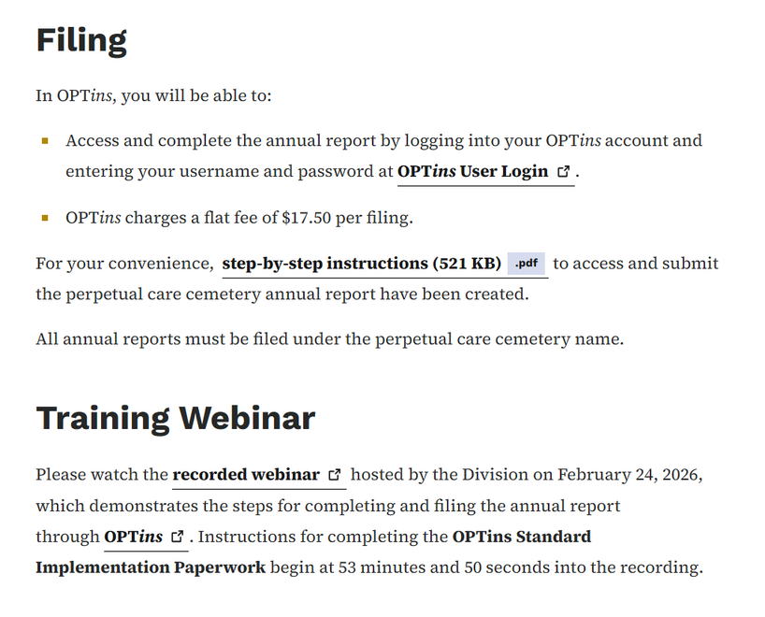
Filing System
The Division requires the use of OPTins (Online Premium Tax for Insurance) for the submission of the perpetual care cemetery annual report. OPTins is a secure Web application which facilitates the submission of premium tax, surplus lines, and other state-specific filings and payments to participating states.
More information about the filing process, including step-by-step instructions and a training webinar, can be found on our website:
iid.iowa.gov/consumers/securities-regulated-businesses/perpetual-care-cemeteries-burial-sites

Slide 27
Legislation, Administrative Rules, Regulations
The Iowa Insurance Division is preparing for the 2027 legislative session and meeting with stakeholders this fall. In accordance with Executive Order 10, the Division continues to conduct red tape reviews of our Administrative Code chapters.
The Division welcomes and appreciates any feedback that governmental subdivisions, or IMFOA, may have related to Iowa law, administrative rules, or regulatory actions. We are grateful for, and intend to maintain, the open line of communication we have with you and the other industries that we regulate.

Slide 28
QUESTIONS?
Product Regulation Bureau
riu@iid.iowa.gov
Market Regulation Bureau
marketregulationbureau@iid.iowa.gov
Julie Pearce, Acting Deputy Insurance Commissioner
julie.pearce@iid.iowa.gov
515-654-6649
Jess Pollmeier, Acting Bureau Chief - Product Regulation
jessica.pollmeier@iid.iowa.gov
515-654-6487
Cody Butenhoff
Legislative Liaison
515-918-1912 (Cell)
cody.butenhoff@iid.iowa.gov

