Slide 1
FROM REVIEW TO APPROVAL:
NAVIGATING THE TOBACCO LICENSING PORTAL
April 10, 2025
Jessica Ekman, Executive Officer
Jerika Pellington, GovConnectIowa Program Manager

Slide 2
Disclaimer
Please be advised that the information in this presentation contains informal opinions and are only applicable to the factual situations referenced and to the statutes in existence as of the date of this presentation.
The Iowa Department of Revenue may take a contrary position in the future to what is stated today. Any oral or written guidance or opinion by Department personnel not pursuant to a Petition for Declaratory Order under Iowa Administrative Code rule 701—4.7 is not binding upon the Department.

Slide 3
Agenda
Reviewing the customer journey and GovConnectIowa
Understanding permit types
Navigating the Tobacco Licensing Portal
Available resources
Q&A

Slide 4
The Customer’s Journey: Applying for & Renewing a Permit

Slide 5
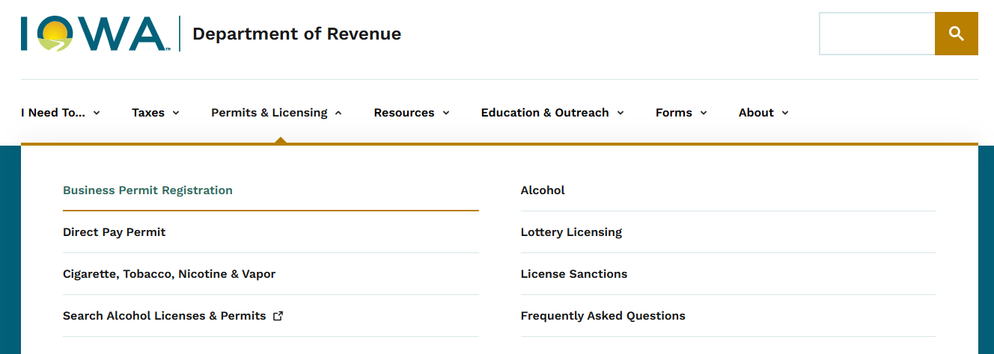
First-Time Application Process
How do businesses know they need a permit?
Visit our website to learn more about permit types.

Slide 6
Steps to Apply
Determine the correct permit type
Create a GovConnectIowa account, and do one of the following:
Request access to an existing account, or
Register a new business
Submit the application and fees
Wait for approval

Slide 7
Determine the Correct Permit Type
IDR offers several licenses and permits
Only two can be approved or denied on the Tobacco Licensing Portal
Permits on the Tobacco Licensing Portal
Device Retailer
Tobacco Retail
Often referred to as: Retail Tobacco - Cigarette/Tobacco/Nicotine/Vapor

Slide 8
Retail Tobacco
Required for retailers selling cigarettes, tobacco, alternative nicotine, or vapor products
Retailers must have an active Sales and Use Tax Permit
Wholesalers and distributors do not qualify for this permit

Slide 9
Device Retailer
Required for retailers selling glass and metal devices designed for use in inhaling through combustion tobacco, hemp, other plant materials, or a controlled substance
Retailers must also have an active Tobacco Retail Permit

Slide 10
Getting Started on GovConnectIowa
3 C’s of GovConnectIowa:
Create a Logon
Connect to your account
Conduct your business

Slide 11
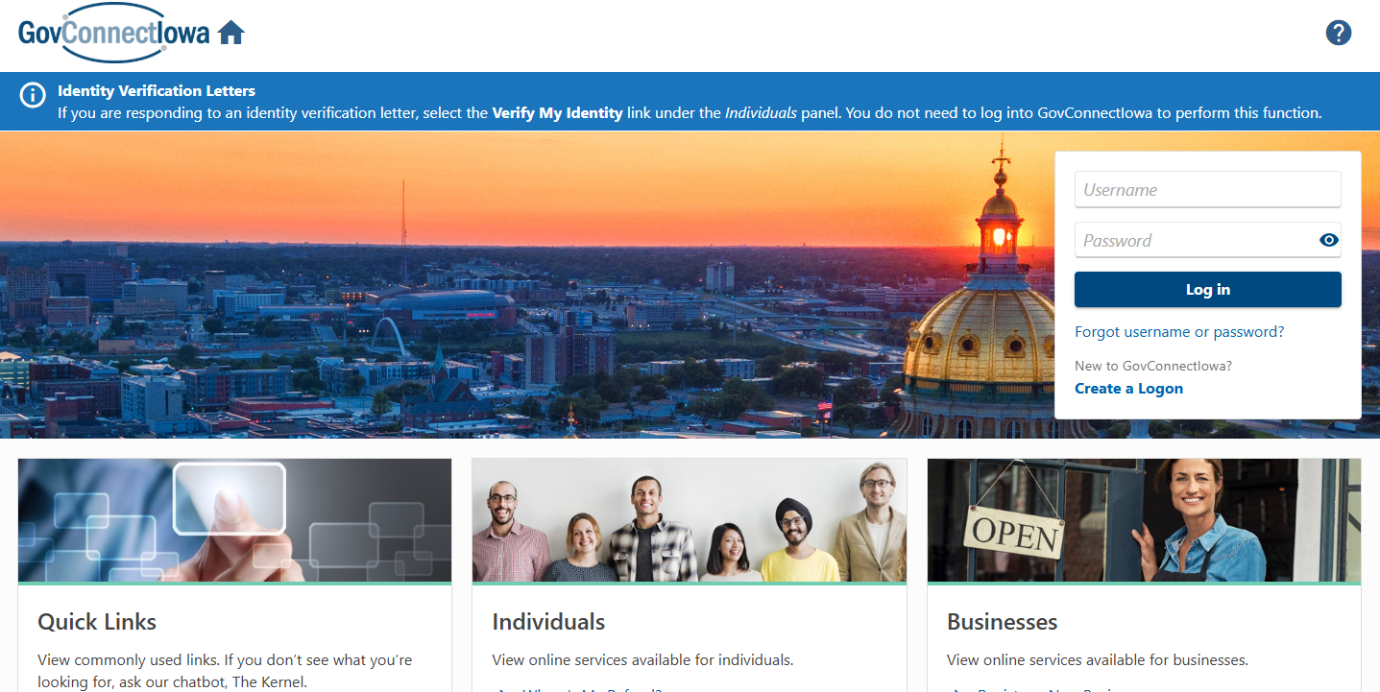
Creating a Logon
govconnect.iowa.gov

Slide 12
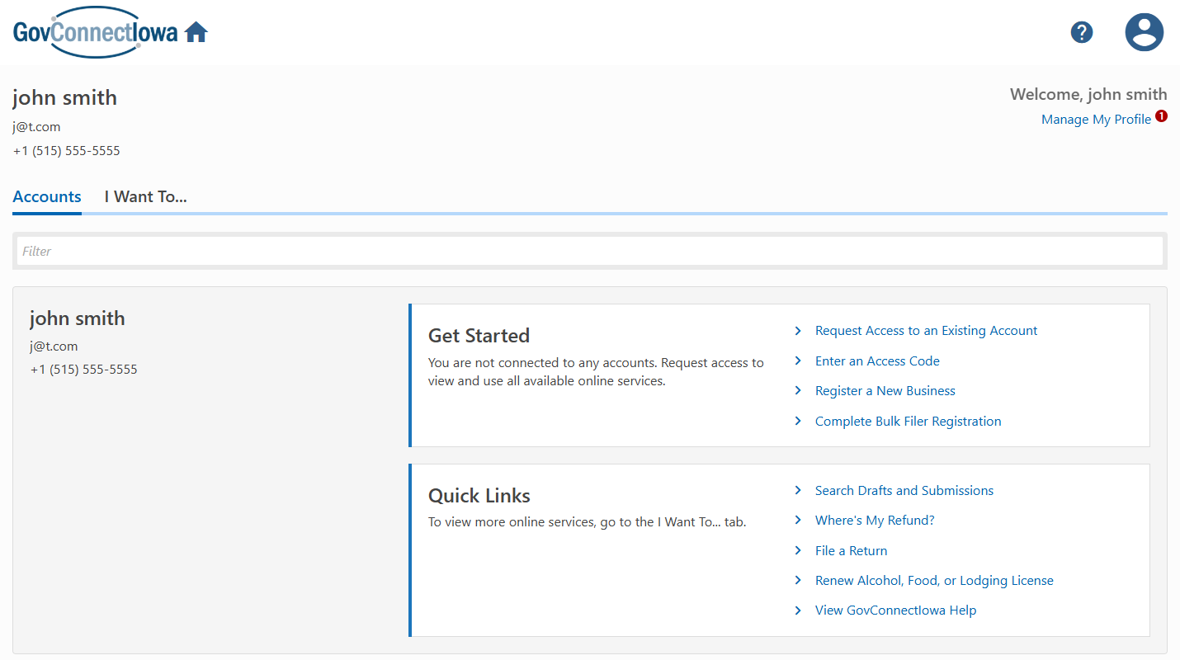
Getting Started

Slide 13
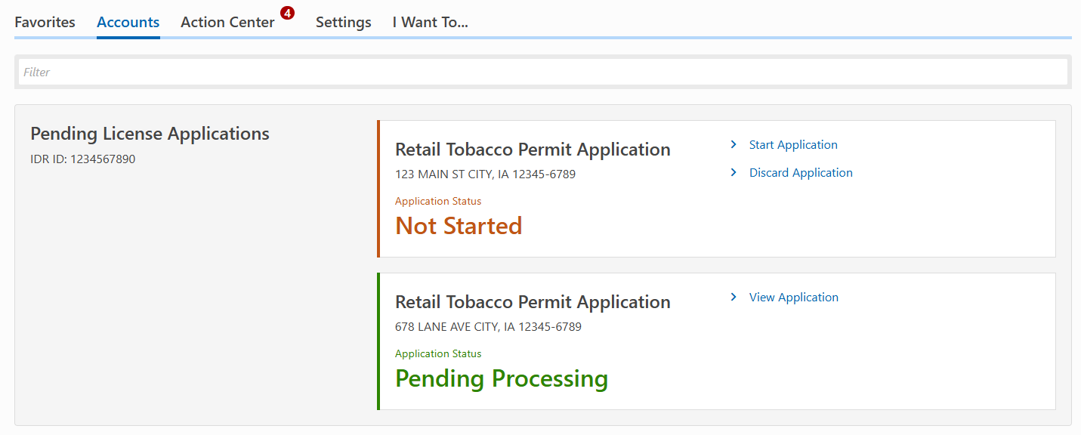
Submit the Application and Pay Fees

Slide 14
Waiting for Approval
The following statuses are displayed to retailers on GovConnectIowa:
Status | What does it mean?
Not Started | Application has not been started
In Draft | Application has been saved but has not been submitted
In Cart | Application has been submitted but has not been paid for, it’s in the cart
Pending Processing | Application has been submitted and paid for, waiting to be approved or denied

Slide 15
Challenges Applicants Face
How to get started
Requesting access and connecting to their existing business
Understanding why a permit was denied
Curious about the time frame it takes for a local authority to review the application
Confusion about when to use the paper vs. electronic processes
Duplicate applications and payments
Customers applying for new permits instead of renewing existing permits

Slide 16
Renewing a Permit
Retailers can renew their permit via paper or online
Applications should be consistent year-to-year
Legal Ownership Name, Location Name (DBA), Location Address, Sales and Use Permit Number
How do businesses know when it’s time to renew?
Local authorities should continue to send reminders
IDR exploring opportunities to send renewal reminders
Communications will be shared when available

Slide 17
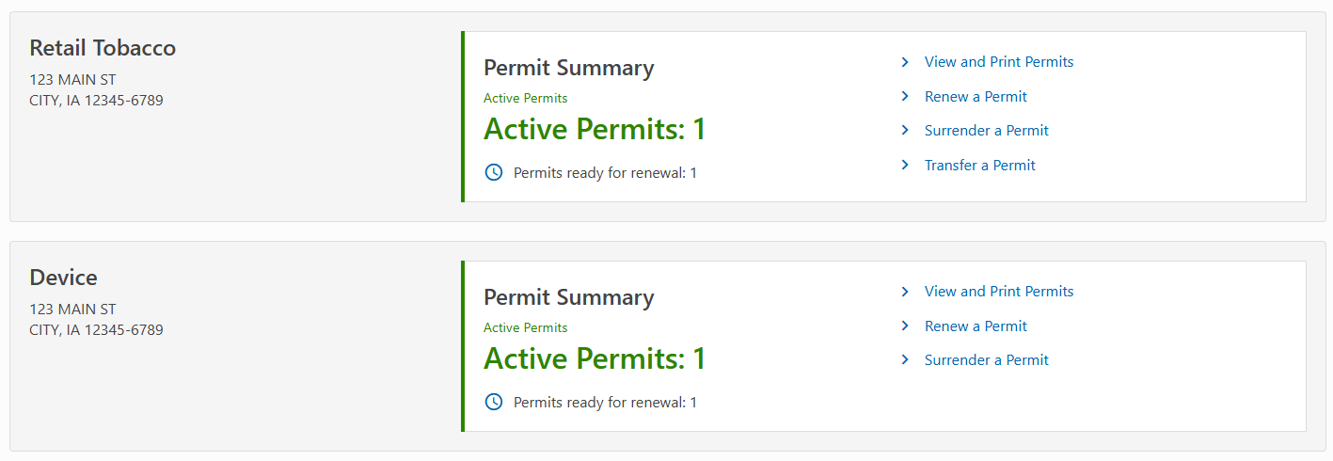
Renewal View on GovConnectIowa

Slide 18
Understanding the Renewal Process
(Required only if the user is new to GovConnectIowa): Retailer needs to create a GovConnectIowa account and request access to the existing license
Begin the renewal application process
Confirm business details and identify any changes
Submit renewal fees
Receive approval or additional requests for documentation

Slide 19
Resources for Retailers
Phone: Taxpayer Services at 515-281-3114
Email: idr@iowa.gov
The Kernel: GovConnectIowa’s Chatbot
GovConnectIowa Help: revenue.iowa.gov/govconnectiowa
We’re continuously updating our website to provide retailers with clearer, more helpful information.

Slide 20
Understanding Permit Types

Slide 21
What does IDR Expect of Local Authorities?
Review applications efficiently and timely
Ensure compliance with local and state laws
Submit complaints via GovConnectIowa

Slide 22
Is a Retail Permit Needed?
Retail Tobacco: An establishment that sells cigarettes, tobacco, vapor products or alternative nicotine products at retail to ultimate consumers is required by Iowa Code Chapter 453A to hold a valid Retail Tobacco Permit.
Device Retailer: An establishment that sells glass or metal devices at retail to ultimate consumers is required by Iowa Code Chapter 453E to hold a valid Device Retailer Permit and Retail Tobacco Permit.
Local authorities are responsible for reviewing and approving or denying Retail Tobacco and Device Retailer applications.

Slide 23
Permit Types
What am I approving?

Slide 24
Retail Tobacco Permits
Must have a Sales and Use Tax Permit for the retail location
Renewal permits are issued July 1 through June 30
New permits issued expire June 30
Fee chart to determine permit fee
Retailers can apply via paper process or GovConnectIowa

Slide 25
Retail Tobacco Permits
Paper Process - Active prior to November 2024
Application form (provided by IDR) and permit fee collected by Local Authority (LA)
LA reviews and approves or denies permit application
If LA approves, LA completes the bottom section of application and sends approved applications to IDR within 30 days of issuance
Approved applications are sent by email or Tobacco Licensing Portal upload (preferred)
Important to ensure all fields are completed accurately and legible
LA completes permit form (provided by IDR), includes local permit number
LA retains fee at the local level

Slide 26
Retail Tobacco Permits
Electronic Process on GovConnectIowa - Active after November 2024
Application and permit fee is collected by IDR
LA receives a notification when there is an action item pending review in the Tobacco Licensing Portal
LA logs into the portal to review and approve or deny permit application
IDR issues a permit number; local permit number is optional
Permit is available online and can be printed by the LA and retailer
IDR remits the payment to the LA the month following the LA’s approval or denial in the portal
The permit must be posted in the retail establishment in public view

Slide 27
Device Retailer Permits
Requirements
Retailer must have an active Sales and Use Tax Permit and a Retail Tobacco Permit for the retail location
$1,500 fee - no proration or refunds for unused quarters
Can only apply on GovConnectIowa
Permit Dates
FY25: January 1 - June 30
FY26 and beyond: July 1 - June 30

Slide 28
Things to Look For
Renewal Applications should be consistent year-to-year
Legal Ownership Name
Location Name (DBA)
Location Address
Sales and Use Permit Number
On new applications, ensure the effective date is not prior to the LA approval date
Verify the information on the Device Retailer application matches what is on the Retail Tobacco Permit

Slide 29
Overview of Filing Steps for GovConnectIowa
Retailer submits and pays for the application
Local Authority reviews and approves or denies permit
Permit is issued and available for retailer and LA to print online
Permit must be posted in retail establishment in public view
Permit number issued by IDR and local permit number optional
Permit fee disbursed to local authority the month following the approval or denial of the permit in the portal

Slide 30
Navigating the Tobacco Licensing Portal
What do you see?

Slide 31
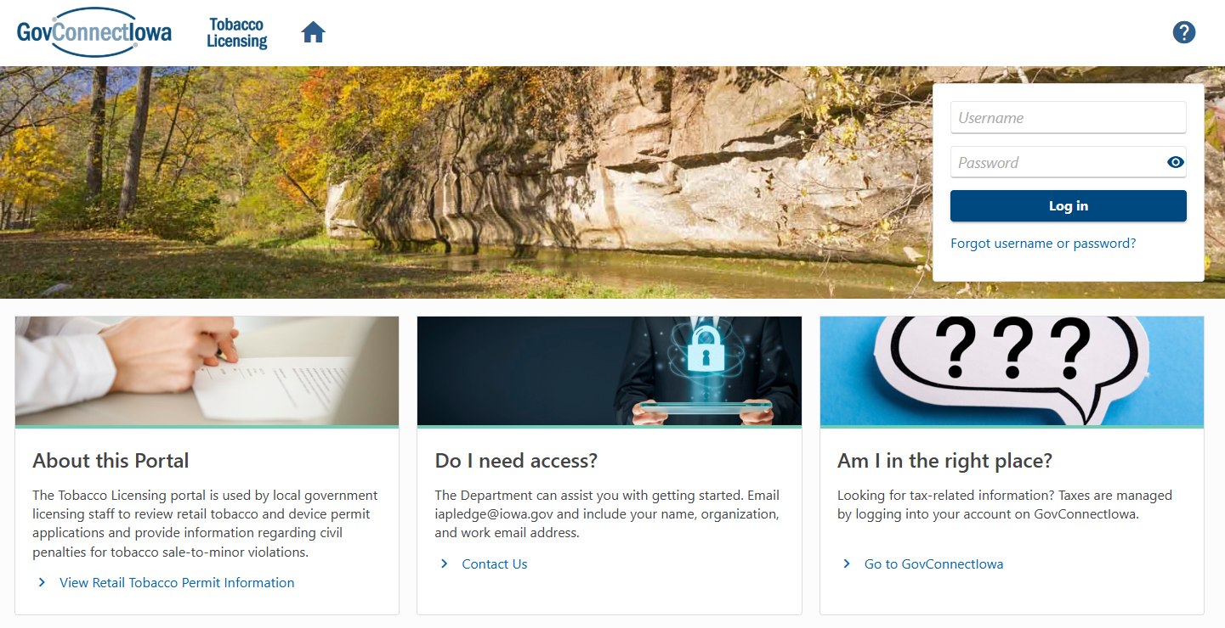
Tobacco Licensing Portal
What is it?
Portal used by local authorities to review and approve or deny Retail Tobacco Permit and Device Retailer Permit applications and report actions for tobacco sale-to-minor violations
Am I in the right place?

Slide 32
Accessing the Portal
Access was granted in November 2024 to cities and counties
If you have never used the portal and need access, email iapledge@iowa.gov.
If you’ve logged in before and are having trouble logging in, call our Taxpayer Services team at 515-281-3114

Slide 33
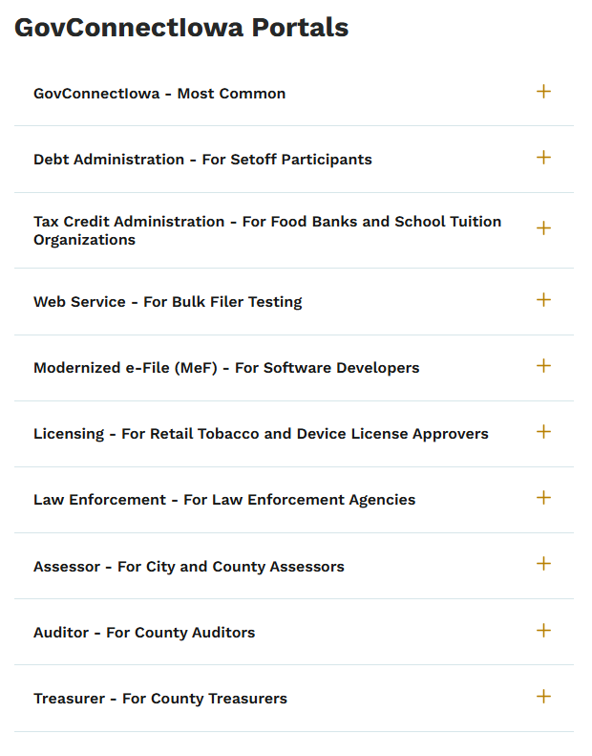
Using Multiple Portals
Full list of portals can be found at revenue.iowa.gov/portals.
Streamlined Access with Single Sign-On
You can use a single set of login credentials across all portals. If you're managing multiple usernames, contact us, and we'll merge them into one account for easier access.

Slide 34
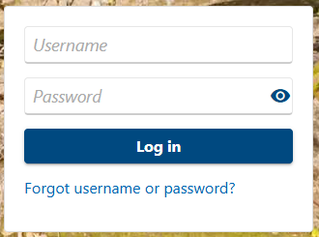
Forgot Username or Password?
Forgot your login information? You can reset it yourself!
Click “Forgot username or password?”
Enter your username or click “Forgot your username?”
Check your email (including spam/junk folders) for reset instructions
Tip: If you don’t remember your secret question you might have to call us. But you can try this first!

Slide 35
What Can I Do on the Tobacco Licensing Portal?
View messages and letters we send you
View outstanding applications that need your review
View approved permits in your jurisdiction
Submit and view paper applications you provided
View prior permit fee distributions
Tell us if you’re pursuing civil penalties for sale-to-minor violations
Submit information for civil penalties for sale-to-minor violations you pursued

Slide 36
Notifications
We will send you an email or web message when:
An application is ready for your review
A response is needed regarding a civil penalty for a sale to minor violation
A letter is ready for your review
An update has been made to your portal account

Slide 37
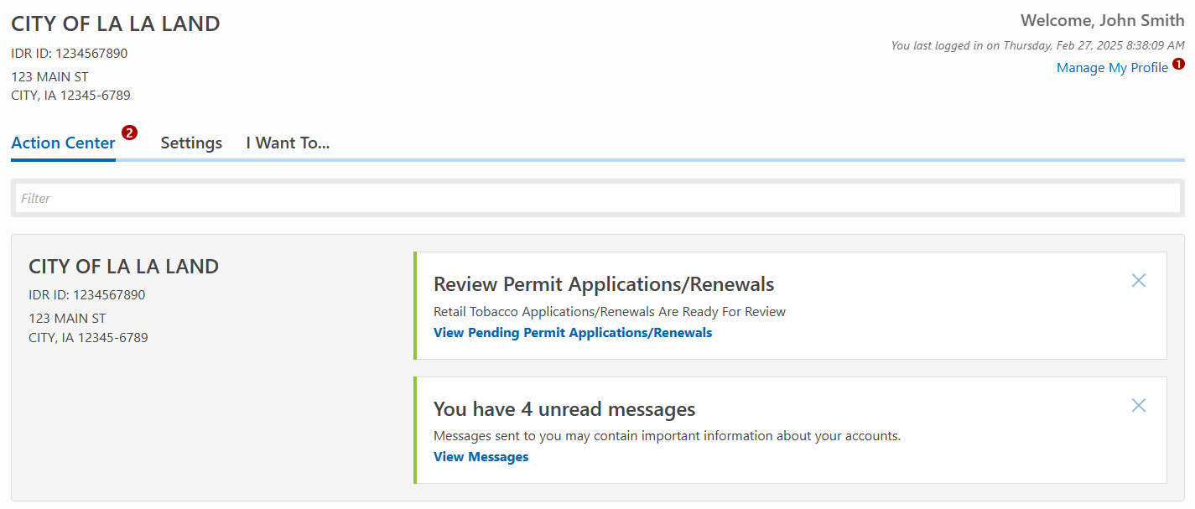
Action Center
What is it?
The Action Center tab lists all the current actions that the portal expects you needs to take.

Slide 38
Viewing Outstanding Applications
Applications Ready For Review
Two application types:
Tobacco Retail
Device Retailer

Slide 39
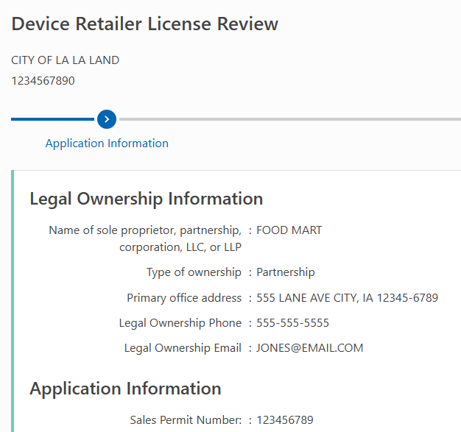
Step 1: Application Information
Legal ownership information

Slide 40
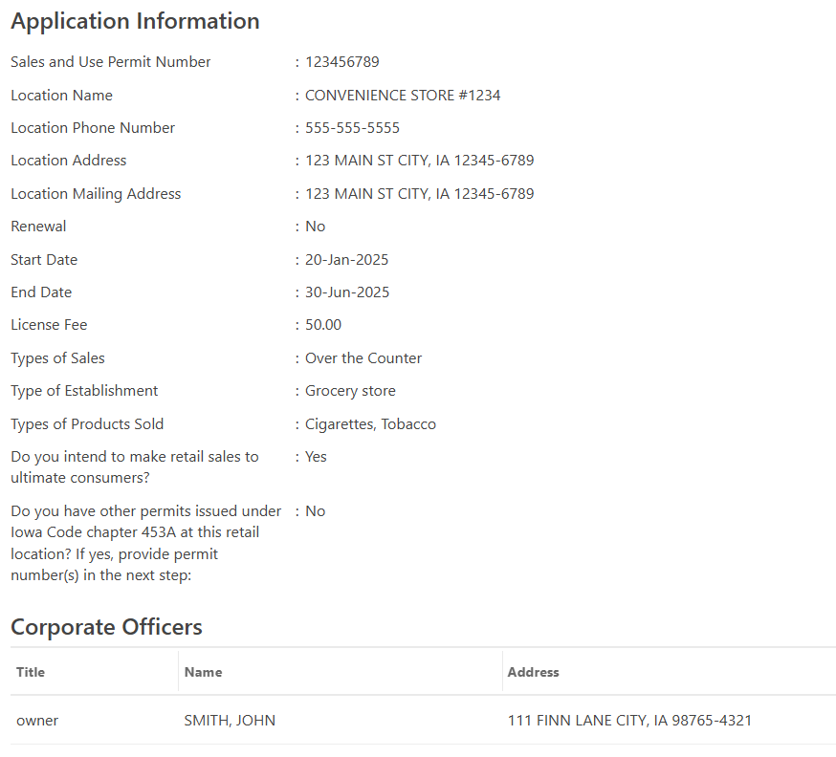
Step 1: Application Information
Verify the information matches your records
On new applications, ensure the effective date is not prior to the LA approval date

Slide 41
Step 1: Application Information (cont’d)

Slide 42
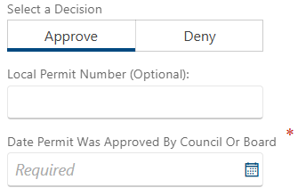
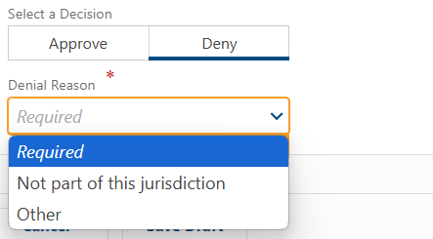
Decision Options
Approve
Deny

Slide 43
Tobacco Sale-To-Minor Violations

Slide 44
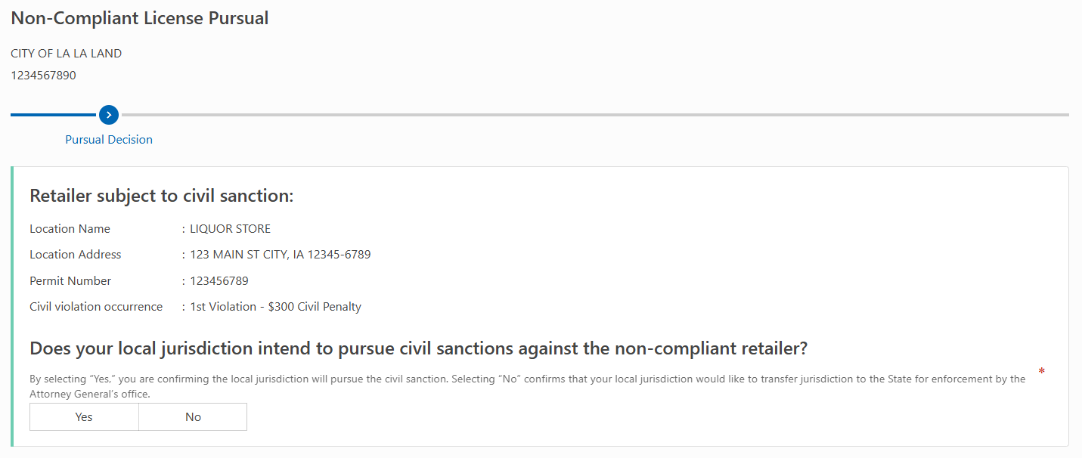
Non-Compliant License Pursual

Slide 45
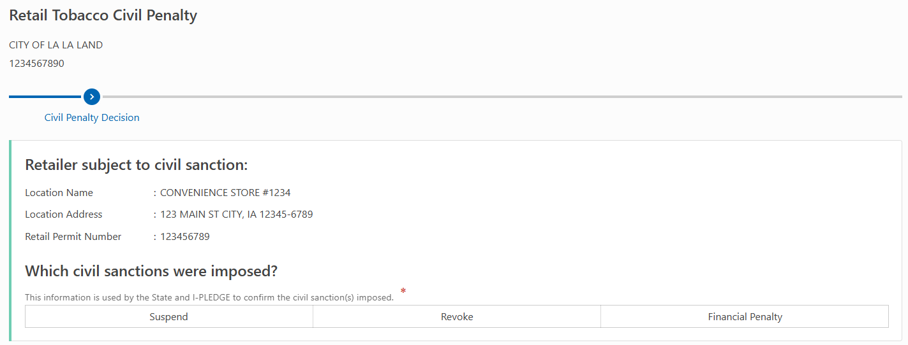
Retail Tobacco Civil Penalty
Upcoming steps vary based on civil sanction imposed.

Slide 46
Resources

Slide 47
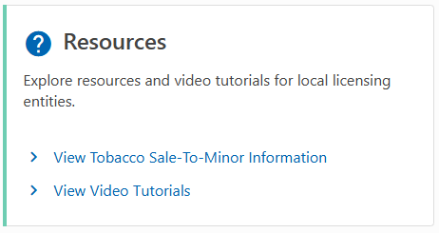
Need Help?
Retailers:
Send us a message on GovConnectIowa
Email us at idr@iowa.gov
Call us at 515-281-3114
Local Authorities:
Email us at iapledge@iowa.gov
Call us at 515-281-3114
View video tutorials on our YouTube channel

Slide 48
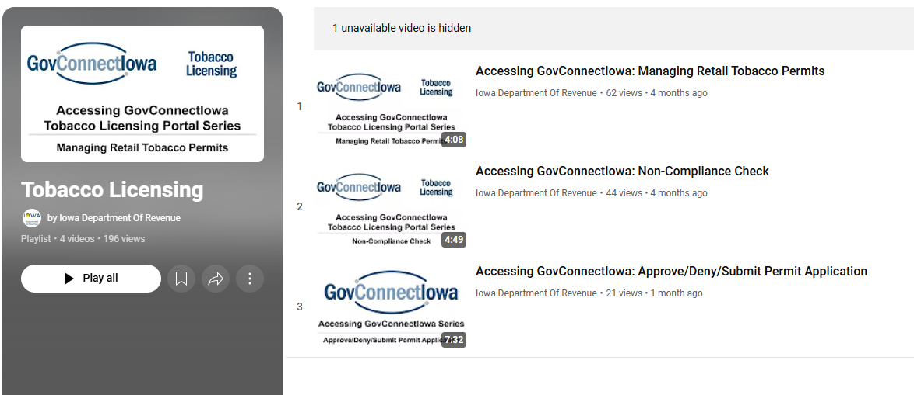
Video Tutorials

Slide 49
Subscribe to Updates
Topics Include:
Newsroom
Local Governments
Law & Policy Updates
GovConnectIowa
Alcohol Licensing
Revenue News and Notices

Slide 50
Social Media

Slide 51
Q&A and Discussion
Thank you!

