Slide 1

Special Event Licensing
Notes:
Vetted and approved by CX and Licensing management 04/03/2026.

Slide 2
Disclaimer
Please be advised that the information in this presentation contains informal opinions and are only applicable to the factual situations referenced and to the statutes in existence as of the date of this presentation.
The Iowa Department of Revenue may take a contrary position in the future to what is stated today. Any oral or written guidance or opinion given by Department personnel not pursuant to a Petition for Declaratory Order under Iowa Administrative Code 701—4.7 is not binding upon the Department.

Slide 3
Special Event Licensing
There are 3 main ways in which alcoholic beverages may be lawfully sold and served during special events:
5-day and 14-day* licenses
Outdoor service extension to existing licensees
License transfers* for existing licensees
We suggest that all applications are completed 45 days in advance of the event to compensate for any possible delays with approvals by the insurance company or the local authority.
*Not applicable to Native Alcohol Manufacturers

Slide 4
On-Premises Retail Licensing Process
Application Submitted
Dramshop Endorsed
Local Authority Consideration
IDR
Consideration
License Issued If Licensing Conditions Met

Slide 5
5 & 14-Day Licenses/Permits
Types
Special Class “C” Retail Alcohol License (BW) – Allows commercial establishments to sell wine and beer for on-premises consumption. Allows carry-out sales of wine and beer in original sealed containers.
Class “C” Retail Alcohol License (LC) – Allows commercial establishments to sell alcoholic liquor, wine, and beer for on-premises consumption. Allows carry-out sales of liquor, wine, beer, and mixed drinks or cocktails.
Other License Types available, but less common:
Class “D” Retail Alcohol License (LD)
Class “F” Retail Alcohol License (LF)
Special Class “C” Retail Native Wine Permit (WCN)

Slide 6
How to Apply
Create a GovConnectIowa account at govconnect.iowa.gov
Request access or register:
Request access if the business has a sales tax permit or is previously registered, request access to the business
Register if the business has never operated in Iowa before
Contact your dram shop insurance carrier
Notify your local authority of your intent to apply
Tip: Effective date must allow for delivery of product to licensed premises.

Slide 7
Outdoor Service Areas
Discernable boundary
Check with local authority for any ordinances that require fencing, double fencing, etc.
Only alcoholic beverages permitted by the license may be served
Outdoor area must be contiguous with the rest of the licensed premises

Slide 8
Temporary License Transfers*
Within same local authority jurisdiction
24 hours minimum
No selling or serving at original location
Only alcoholic beverages permitted by the license may be served
*Not applicable to Native Alcohol Manufacturers.

Slide 9
Required Documents - Control of Property
Control of Property Document May Include:
Lease for the area described in your sketch (signed and dated)
Deed for the area described in your sketch
Permission (from property owner) to serve and sell alcohol in the area described in your sketch. This must include:
The address of the area described in your sketch as listed on your application
The dates you are allowed to serve and sell alcohol in the area described in your sketch
If the permission includes a sketch, the entire area described in your sketch must be included.
Your legal name, exactly as listed on your 5-day application
Must be to the legal entity/company name, not the DBA, and it must be signed and dated.

Slide 10
Required Documents - Sketch
Sketch must include:
The boundary of your licensed premises (must be discernible).
Entrances and exits of your licensed premises.
Seating for 25 within your licensed premises.
Where you will be selling alcohol within your licensed premises.
At least one conveniently located accessible bathroom.

Slide 11
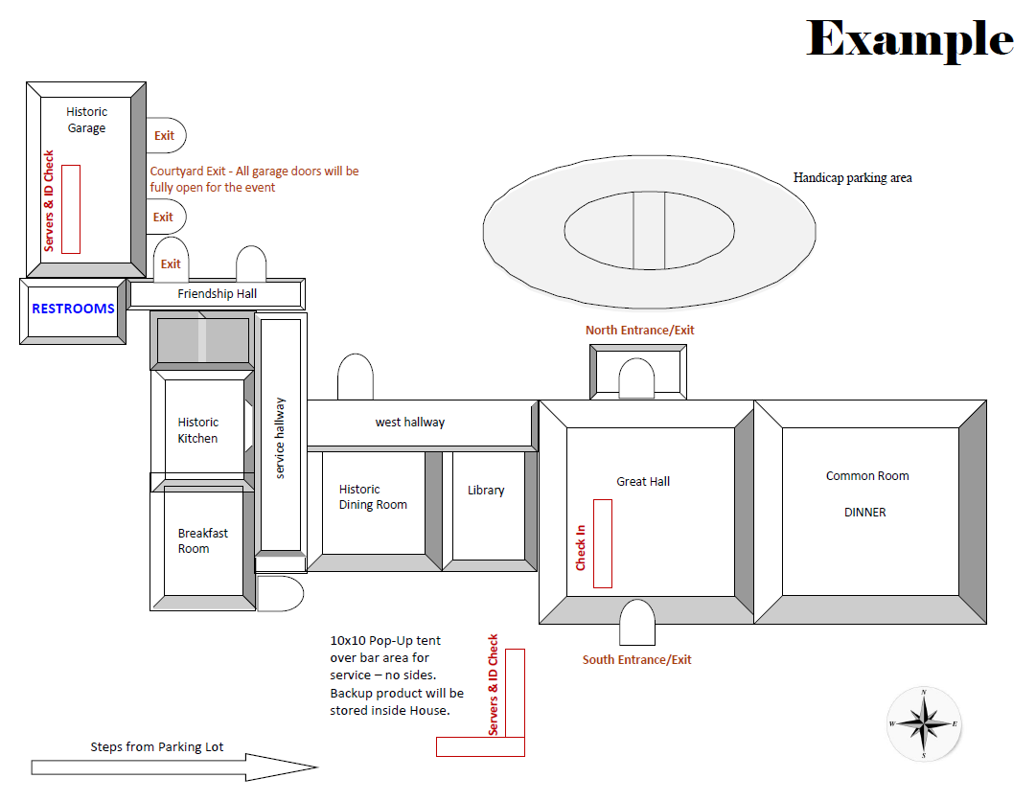

Sketch Example
Boundary
Entrances/Exits
Seating for 25
Selling Location
Bathrooms

Slide 12
Alcohol Deliveries/Returns
Alcohol must be delivered to the 5 or 14 day licensed premises, not to another one of your permanent licensed premises.
Alcohol must be secured on the licensed premises for the duration of the license.
Upon cancellation, alcohol (unopened containers) can be returned to the wholesaler, if the wholesaler agrees to take it back. They do not have to take it back!
Do not take beer, wine, or liquor back to your permanent licensed premises! It must be returned to the wholesaler or destroyed.

Slide 13
Special Events
Operationally, special events (5 and 14 day licenses) are no different than 12 month bars and restaurants:
Alcohol must be ordered separately for the stand alone license and must be delivered to the licensed premises.
Open containers of beer, wine and liquor can leave the licensed premises into ONLY these 3 immediately adjacent areas:
A licensed premises authorized to sell the same type of alcoholic beverage for consumption on the licensed premises
A temporarily closed public right-of-way
A private place

Slide 14
Selling on Licensed Premises
A licensed premises authorized to sell the same type of alcoholic beverage for consumption on the licensed premises.
The licensee of the immediately adjacent licensed premises, or owner of the immediately adjacent private place, may refuse to allow the customer to enter the licensed premises or private place with an alcoholic beverage in an open container.

Slide 15
Temporarily Closed Public Right-of-Way
Closing a public right of way for an event involves temporarily restricting access to a public right-of-way, such as a road or sidewalk, for a specific time and purpose. This typically requires approval from a local authority through a permit process that includes submitting event details, safety plans, and ensuring emergency access.

Slide 16
Private Place
A location which, at the time alcoholic beverages are kept, dispensed, or consumed, meets all of the following criteria:
The general public does not have access to the location and attendees are limited to bona fide social hosts and invited guests
The location is not of a commercial nature
Goods or services are neither sold nor purchased at the location.
The location is not a licensed premises
Admission fees or other kinds of entrance fees, fare, ticket, donation or charges are not made or are required of the invited guests to enter the location

Slide 17
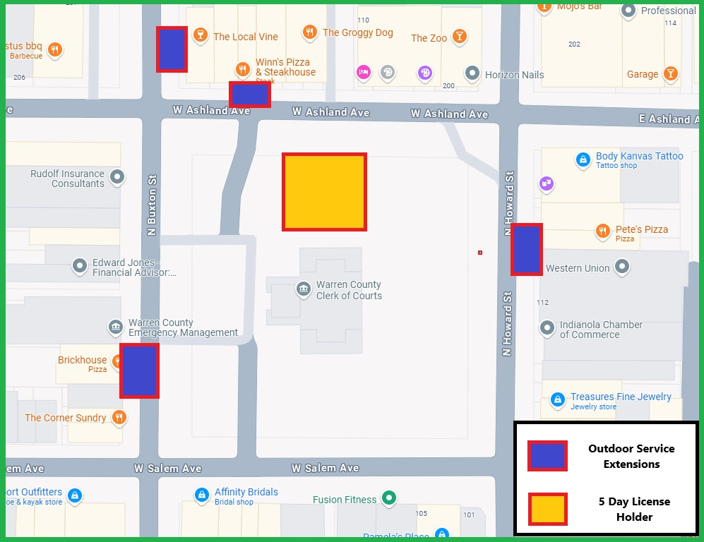
Laws & Regulations

Slide 18
Allowed Hours of Operation
Monday – Sunday
6:00 a.m. – 2:00 a.m.
No alcohol can be sold, served, consumed, or given away after selling/serving hours.

Slide 19
Age to Serve or Drink
Legal Drinking Age
21 & older
ID
If in doubt, do not serve
Age to Serve
18 & older
16 & 17 year olds in restaurants. Requirements found in link below.
Local ordinances apply.
revenue.iowa.gov/resources/law-policy-information/alcohol-laws/employing-16-and-17-year-olds
Intoxicated Persons - If in doubt, DO NOT SERVE.

Slide 20

I-PACT
Iowa Program for Alcohol Compliance Training
Free to Users
Available 24/7
Why should I have my employees take the training?
Assists in preventing illegal sales
Provides education for owners/employees/volunteers
Affirmative defense for licensee’s civil penalties (once every 4 years)

Slide 21
Sales and Use Tax Permit Requirements
Who must obtain a Sales and Use tax permit?
Vendors that sell taxable tangible personal property, services, and products in or into Iowa must obtain a Sales and Use tax permit.
A vendor does not need to get an Iowa sales and use tax permit or file Iowa Sales and Use tax returns if the business does not make any taxable retail sales.
If these businesses begin making taxable retail sales in Iowa, they must collect sales tax and applicable local option sales tax, obtain an Iowa Sales and Use tax permit, and begin filing Iowa Sales and Use tax returns.

Slide 22
External Agency Contacts
Department of Inspections, Appeals & Licensing - Food Licenses
Phone: 515-281-6538
dial.iowa.gov/licenses/food-hotels
Department of Inspections, Appeals & Licensing - Social Gambling
Phone: 515-281-6848
dial.iowa.gov/licenses/gambling
Department of Revenue - Sales Tax Permitting
Phone: 515-281-5777
revenue.iowa.gov

Slide 23
Contact Us
Email:
Licensing: licensing@iowaabd.com
Accounting: accounting@iowaabd.com
Send a message via GovConnectIowa
Phone:
Portal navigation: 515-281-3114
Alcohol: 515-281-7400, option 1
Website:
revenue.iowa.gov/alcohol

Slide 24






Meet “The Kernel” - GovConnectIowa’s Chatbot
Available 24/7/365 to help you
Does not answer specific questions about your license
Notes:
Before we dive in further, I want to introduce you to someone very special. This is The Kernel, our chatbot and unofficial mascot. Yes, he’s a corncob, and yes, he’s all ears. He’s available 24/7 to answer your questions, tell a few corny jokes, and help you out anytime. You’ll find him in the bottom right hand corner of the screen. He is pre-programmed which means, staff here at IDR specifically wrote answers to your questions. He is not Ai so he cannot give specific answers about your particular account, letter, or situation. But he is here to help you navigate GovConnectIowa and answer all of your general tax and licensing questions.

Slide 25




Social Media

Slide 26
Thank you!
Questions?

