Slide 1

Can We All Just Get Along?
2026 IMFOA Fall Conference

Slide 2
CITIES IN IOWA
IOWA HAS 937 INCORPORATED CITIES
  POPULATION RANGE:
  11 (LE ROY) – 214,133 (DES MOINES)
A STATE OF SMALL CITIES
  MORE THAN 100 CITIES HAVE A POPULATION OF UNDER 100
  500 CITIES HAVE A POPULATION OF 500 OR LESS
LEAGUE MEMBERSHIP - 867 CITIES

Slide 3
FORMS OF GOVERNMENT
SIX FORMS OF GOVERNMENT ARE OUTLINED IN IOWA CODE
  COUNCIL MANAGER-AT-LARGE
COMMISSION
SPECIAL CHARTER
2
4
6
1
3
5
MAYOR-COUNCIL
COUNCIL-MANAGER-WARD
HOME RULE CHARTER

Slide 4
FORMS OF GOVERNMENT
MAYOR-COUNCIL
97%
5
3
COUNCIL
COUNCIL
OPERATE UNDER THIS
FORM OF GOVERNMENT
MAYOR ELECTED AT-LARGE
TYPICALLY FIVE COUNCIL MEMBERS ELECTED AT-LARGE OR BY WARD
FEW SMALLER CITIES
CITY MAY CREATE A PROFESSIONAL CITY MANAGER/ADMINISTRATOR POSITION TO PERFORM ADMINISTRATIVE DUTIES WITHOUT CHANGING ITS FORM OF GOVERNMENT
1500
RESIDENTS
GENERALLY, THESE CITIES (AND HIGHER) HAVE
A CITY MANAGER/ADMINISTRATOR

Slide 5
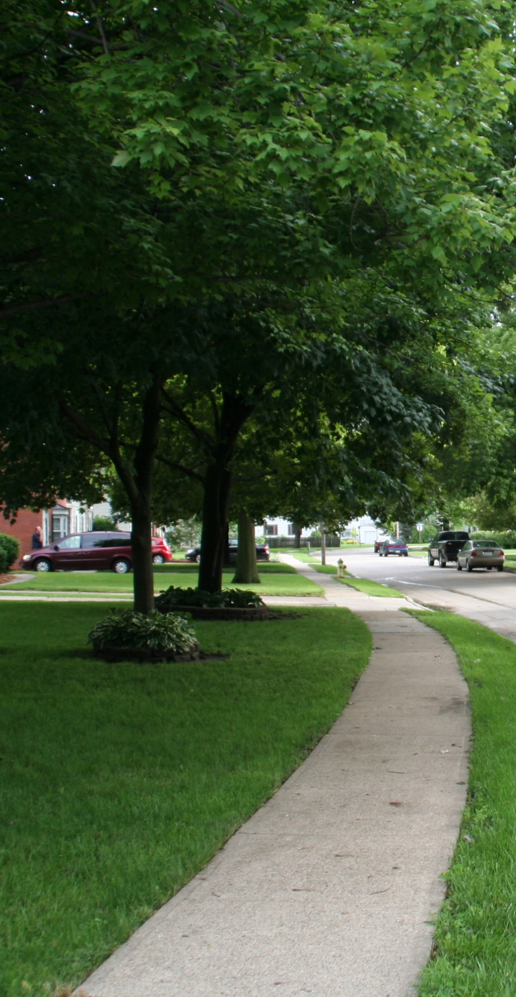
MAYOR
CITY STAFF
CITY COUNCIL
CITY CLERK
CITY MANAGER/
ADMINISTRATOR
ROLES
AND
RESPONSIBILITES

Slide 6





MAYOR’S DUTIES
SUPERVISION OF
CITY ACTIVITIES*
LEGISLATION
SIGN/VETO/NO ACTION
CERTAIN
APPOINTMENTS*
PRESIDING OFFICER AT
COUNCIL MEETINGS
INFORMAL DUTIES

Slide 7

CITY COUNCIL DUTIES
  DECISION-MAKING ON DIRECTION AND RESOURCES
ADOPTING LEGISLATION
ORDINANCES
RESOLUTIONS
MOTIONS

Slide 8






CITY COUNCIL DUTIES
APPROVE/AMEND/
MONITOR BUDGETS
ESTABLISH
CITY POLICIES
APPROVE PLANS
AND PROGRAMS
APPROVE EXPENDITURES
AND PAYMENTS
APPROVE
CONTRACTS
APPOINTMENTS*

Slide 9


CITY COUNCIL AUTHORITY
INDIVIDUAL COUNCIL MEMBERS HAVE NO AUTHORITY ON THEIR OWN.
COUNCIL ONLY EXERCISES ITS POWERS WHEN ACTING AS A GROUP IN OFFICIAL SESSION AND ADOPTING LEGISLATION

Slide 10

MAYOR/COUNCIL
JOINT ROLE
ANTICIPATE AND FOCUS ON ISSUES
DETERMINE GOALS/PRIORITIES
EVALUATE PROGRAM AND
SERVICE EFFECTIVENESS

Slide 11
MAYOR/COUNCIL
JOINT ROLE
LISTEN TO THE PUBLIC
EDUCATE THE PUBLIC
MOBILIZE SUPPORT IN THE
COMMUNITY
SET THE “TONE” FOR THE CITY

Slide 12
CITY STAFF
PROVIDE SERVICES
RESPOND TO CITIZEN ISSUES
IMPLEMENT DECISIONS, PLANS, PROGRAMS AND POLICIES

Slide 13
CITY MANAGER/ADMINISTRATOR
ANALYZES ISSUES
AND
DEVELOPS
PROFESSIONAL
RECOMMENDATIONS
IMPLEMENTS
COUNCIL
GOALS
SUPERVISES
DEPARTMENTS/
EMPLOYEES*
DAY-TO-DAY
OPERATIONS/
ADMINISTRATION
INFORMATION
SOURCE FOR COUNCIL; BETWEEN COUNCIL AND STAFF; WITH PUBLIC
DEVELOPS
PROPOSED
BUDGET*

Slide 14

CITY CLERK
EVERY CITY IS REQUIRED TO APPOINT A CITY CLERK
OFTEN THE MAIN POINT OF
CONTACT FOR A CITY
POPULATION LESS THAN 1500 OFTEN RESPONSIBLE FOR DAILY OPERATIONS
INFORMATION SOURCE FOR COUNCIL

Slide 15
Politics 101
All politics is local
The actors do not remain the same
Many different motivations and priorities
“Horse Trading”
Sometimes losing is winning

Slide 16
City Council/Staff Dynamics
City government is unique!
  Elected citizens are the decision-makers
  Equal power among the council + majority vote required to do anything
  Appointed staff are professional service providers, but have limited individual authority
  Decision-making is done in public

Slide 17
Top 10 Quotes About Council/Staff Issues
10. It was in your council packet
9. My neighbor told me
8. Why am I always the last to know?
7. Council meetings are for council members
6. I wish you would have told me sooner

Slide 18
Top 10 Quotes About Council/Staff Issues
5. Now the whole town will know about it
4. My brother would be great for that job
3. I thought the clerk did that
2. Sure, the city will take care of that
1. Who’s the boss?

Slide 19
Why is This So Hard?
Poor communication
Misunderstanding of roles & responsibilities
Personal conflicts
Lack of trust
Poor ethical standards/policy enforcement

Slide 20
BREAK

Slide 21
Improving Communication
Emails, memos, reports, study sessions
Notify all of issues from around town
Discuss relationship problems
Inform each other of events and meetings

Slide 22
Understanding Your City
Form of Government
  Basic structure + powers/duties of key officials
Organizational Structure
  Staffing
  Chain of command
  Project management
  Citizen complaint process
  Responding to media

Slide 23
Support Through Policies and Procedures
Council meetings
  Setting agenda
  Council packets
  Discussion
  Public comments
  Enforcement

Slide 24
Support Through Policies and Procedures
Employment Policies – General provisions and expectations for behavior can apply to all city officials
  Work environment
  Complaints/grievances
  Decorum, harassment, etc.

Slide 25
Support Through Policies and Procedures
Code of Ethics
  Act in the public interest
  Comply with the law
  Conflicts of interest
  General conduct
  Understand and follow established process (until it’s changed!)

Slide 26
Support Through Policies and Procedures
Code of Ethics
  Follow state and local gift laws/policies
  Follow open meetings/open records laws (particularly confidential records)
  Use of public resources
  Understand role with city
  Maintain a positive work environment

Slide 27
Conflict of Interest
Conflict of Interest
  Section 68B.2A
  “Any person who serves or is employed by the state or a political subdivision of the state shall not engage in any outside employment or activity which is in conflict with the person's official duties and responsibilities.”
  City officials may not use city authority, time or resources to give themselves or an immediate family member and advantage or benefit not available to the public

Slide 28
Conflict of Interest
Conflict of Interest
  Section 362.5
  “A city officer or employee shall not have an interest, direct or indirect, in any contract or job of work or material or the profits thereof or services to be furnished or performed for the officer's or employee's city. A contract entered into in violation of this section is void.”
  13 exemptions listed, including two primary ones for city officials:
    Contracts that are competitively bid
    Contracts/purchases less than $6,000 in a year (still must be approved by council)

Slide 29
Gift Law
Section 68B.22
“A public official, public employee, or candidate, or that person’s immediate family member shall not, directly or indirectly, accept or receive any gift or series of gifts from a restricted donor.”
  May accept gifts less than $3 in value
  May donate prohibited gifts to bona fide educational or charitable organization

Slide 30
Support Through Policies and Procedures
Some cities set polices regarding council/staff relationships
  Limit contact to appropriate staff (typically city manager, clerk and department heads)
  Do not attend staff meetings unless requested
  Do not get involved in administrative functions
  Do not solicit political support from staff
  Treat one another professionally

Slide 31
Support Through Policies and Procedures
Expected conduct with public and media
  Be welcoming, fair and equitable
  Ask for clarification when needed
  Do not make promises on behalf of city
  No personal attacks of any kind
  Follow any protocol for comments on record (i.e. direct media to official city spokesperson, if identified)

Slide 32
Interpersonal Dynamics
Always keep it professional
  Divorce yourself from the personal side when at work
Attempt to resolve issue directly
If problem persists, use a 3rd party
  City attorney, city administrator, League, COG, mentor, etc.

Slide 33
Interpersonal Dynamics
Treat each other professionally, fairly and consistently
Share info, ideas, issues and questions
Know the rules and laws and follow them
Keep promises

Slide 34
How Do We Make Things Better?
Council member and staff orientations
Council rules of procedure
Employee/Personnel manual (review and update)
Goal setting/strategic planning
Team building

Slide 35
How Do We Make Things Better?
Plan to Deal with Difficult Residents/Groups
  Maintain customer service principles
  Listen carefully
  Take notes/file official complaint
  Don’t take it personally (most of the time)
  Determine next steps (if any, along with council action)
  Take a vacation! (Seriously)

Slide 36
We’re Here to Help!
Please contact us with any questions or comments
  mickeyshields@iowaleague.org
  www.iowaleague.org
  (515) 244-7282

