Slide 1

KNOWING YOUR CITY’S FISCAL HEALTH
IOWA MUNICIPAL FINANCE OFFICERS ASSOCIATION
THURSDAY, October 22, 2026
MAGGIE BURGER, sr. vice president, SPEER FINANCIAL, INC.
mburger@speerfinancial.com pH: 319-291-2077

Slide 2

DO YOU HAVE QUESTIONS ABOUT YOUR CITY?
This Photo by Unknown Author is licensed under CC BY-NC-ND

Slide 3
ASSESSED VALUE OR TAXABLE VALUE
Assessed Valuation is 100% of all values located within your City limits. This is “actual” or full value.
Taxable Valuation is the remaining valuation after all rollbacks by classification are applied. A City levies property taxes on a Taxable Valuation.
Rollbacks for FY 2027
  Commercial & Industrial 90%
  Residential 44.5345%
  Agricultural 59.4401%
  Senate File 2472 re-established a future multi-residential rollback that will not be higher 6% more than the annual residential rollback.
  FY 2028 – 3% Plus Residential FY 2029/Beyond – 6% Plus Residential

Slide 4

SENATE FILE 2472 - ALERT
2% Cap on Combined General Fund Levy (CGFL)
Caps total general fund property tax collections
NO CAP on: Debt Service, Tort/Property Insurance, Employee Benefits
$8.10 Limitation remains but deadline extended from FY 2029 to FY 2031
New Construction counted outside the cap
All new construction property tax receipts (outside of TIF & Abatement) will not be limited to 2% cap
Re-think a City’s approach in year 1 to TIF or Abatement Schedule

Slide 5
PROPERTY TAX CONSTRAINTS
Problem
Combined General Fund Levy (CGFL) constraints
Cannot keep a City Clerk, Police or Public Works employee
Need to bring more dollars into the City for funding
We used to fund street sweepers out of our general fund but can no longer afford that
Consideration
Roll expenses out for employee benefits, insurance, capital improvement reserve
Share services with another City
Does your City charge a franchise fee, hotel/motel tax or capital improvement reserve
Consider a GO debt issuance to be paid with a debt service levy
These considerations may lead to more fees or a higher property tax rate, but with restrictions on your City’s budget this may be necessary to offer your citizens with the services they expect.

Slide 6
DEBT CAPACITY
DEBT CAPACITY IS THE LEGAL LIMIT ALLOWABLE FOR OUTSTANDING GENERAL OBLIGATION INDEBTEDNESS
UNABLE TO ISSUE MORE IN GENERAL OBLIGATION DEBT THAN YOUR DEBT CAPACITY ALLOWS
CALCULATION:
  100% ACTUAL VALUE
  X
  5% = DEBT CAPACITY
  Examples:
  $150,000,000 X 5% = $7,500,000
  $25,000,000 X 5% = $1,250,000

Slide 7
REMAINING DEBT CAPACITY
TOTAL DEBT CAPACITY MINUS
  GENERAL OBLIGAITON PRINCIPAL INDEBTEDNESS OUTSTANDING
  REBATE AMOUNT OR ANNUAL APPROPRIATION AMOUNT OUTSTANDING
  SALES TAX REVENUE PRINCIPAL AMOUNT OUSTANDING
  TIF REVENUE PRINCIPAL AMOUNT OUTSTANDING
  SHOULD NOT HAVE DEBT/OBLIGATIONS OUSTANDING THAT
  EXCEEDS 80% - 85% OF TOTAL CAPACITY
  WATER/SEWER REVENUE INDEBTEDNESS DOES NOT COUNT AGAINST DEBT CAPACITY

Slide 8
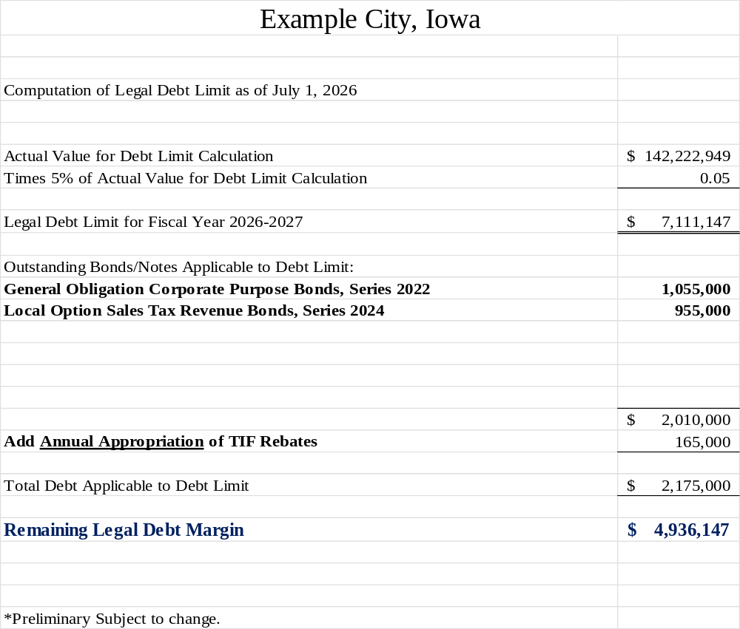
DEBT CAPACITY CALCULATION

Slide 9
Capital improvement planning
(CIP)
CIP is a process the Mayor, Council, Clerk and possibly community members outline “wants and needs” for the City over a 3-5-10 year look forward.
The CIP should include all projects, small or large across all departments.
Possible funding of each project should be identified, and not all of it is going to be borrowed funds.
CIP’s should be implemented and re-visited on an annual basis, to identify changes needed.
Don’t be afraid to move things up from later years or take things off the CIP, times change what is important to Cities.
This process will allow the City to do more accurate budget forecasting from year to year.
THE FINAL STEP IS INDENTIFYING SOURCE OF FUNDS/BORROWING FOR CIP PROJECTS

Slide 10
Capital improvement planning
(CIP)
STREET/PARKS
WATER/SEWER UTILITY
CITY HALL
POLICE/FIRE
Elm Street Reconstruction - $1,200,000
Splash Pad at Oriole Park - $450,000
Downtown Sidewalk Plan - $550,000
Water Meter Upgrade - $85,000
Water Tower Replacement - $2,500,000
Sewer Main Lining - $250,000
Sewer Lift Station - $900,000
City Hall New Computers - $25,000
Police Vehicle - $45,000
Fire Pumper Truck - $425,000
Police Station Improvements - $250,000
Cities should consider different methods for funding projects, and multiple types of funds could be used on one project. Funds to be considered:
Fund Balance Local Options Sales Tax 28E Agreement Funds
Debt Borrowing Franchise Fees User Fees

Slide 11
Essential purposes vs. general purposes
ESSENTIAL CORPORATE PURPOSE (ECP)
GENERAL CORPORATE PURPOSE (GCP)
Streets/Bridge/Sidewalks
Water / Sewer Utility
Fire / Police / Ambulance Equipment
Street Department Equipment
Dilapidated/Dangerous buildings
Rehab/Improve Existing City Parks
Urban Renewal Projects (Chapter 403)
Public Buildings (City Hall, Fire Station, Police Station, Library, Community Center, Swimming Pool, Golf Course)
Build a New Park (land, equipment)
GCP DEBT ISSUANCE VOTER THRESHOLD
commonly called
Reverse Referendum Public Hearing
Population 5,000 or less $553,799
Population 5,001 to 75,000 $969,149
Population 75,001 or greater $1,384,499

Slide 12
Tax exempt and taxable debt
Tax Exempt debt obligations allow investors to earn interest that is exempt from federal income taxes. As a result, investors generally do not have to report the interest they receive as taxable income on their federal income tax forms.
  Double Tax Exempt in Iowa is possible if the project is an urban renewal project, this means it is tax exempt from Iowa income taxes also.
Taxable debt obligations typically are for private purpose activities or operating costs. The investors of taxable bonds to pay federal income tax on the interest you pay them.
Bond Counsel will determine the taxability of the issuance.

Slide 13
FUND BALANCES
Cities may have many different funds that are tracked separately and combined.
Assigned or Restricted fund balances indicate that the City plans to use those funds or will be required to use those funds in the future and should not be considered eligible for use anywhere else.
Cities should work towards positive fund balances and be able to explain negative fund balances as possibly a one-time expense with revenues coming in to offset.
Expenses or liabilities are subtracted from revenues or assets. Positive fund balances occur when there are more revenues than expenditures.
Use June 30 reports as a good indicator of fund balance when identifying remaining balances. This balance is calculated after all revenues have come in and expenses have been paid out.
Allows Cities to monitor inflows and outflows.

Slide 14
Fund balance
EXAMPLE FUNDS
GENERAL FUND GUIDELINES
General Fund
Debt Service Fund
TIF Fund
Proprietary (Water/Sewer/Stormwater)
Capital Projects Fund
Special Revenue
Best Practices by GFOA
https://www.gfoa.org/best-practices
Formalize a policy for unrestricted general fund balance that should be maintained.
Recommendation of 25 – 35% of annual budget expenditures in unrestricted funds (General Fund)

Slide 15
SENATE FILE 2472 - ALERT
The General Fund (GF) caps un-assigned cash balances at 35% of general fund budgeted expenditures.
This bill does create an “obligated funds account” for money budgeted/saved for large equipment or infrastructure purchases or projects that is not part of the cap on reserve funds.
THIS DOES NOT MEAN YOU HAVE TO SPEND DOWN CASH. YOU NEED TO STRATEGICALLY “ASSIGN” THE FUNDS IN EXCESS OF THE 35% CAP TO OTHER PURPOSES

Slide 16
SENATE FILE 2472 - ALERT
City’s can no longer issue debt for operational costs that will be serviced by a
debt service levy.
Reflects the importance of cash fund balances in the general fund
Reflect the importance budgeting and meeting budgeting deadlines
Bonding for direct and indirect capital expenditures or large expenses/infrastructure projects are EXEMPTED from restrictions

Slide 17
WORKING CAPITAL GOALS/TARGETS
FOR PROPRIETARY FUNDS
GFOA Best Practices recommends no less than 90 days of working capital (3 months) revenues as a baseline for a proprietary fund.
You should consider strength of collections practices and historical consumption of inventories or prepaids when setting this amount.
Most small Cities in Iowa should consider 180 days or 6 months of working capital as a fund balance. Some Cities consider 365 days or 12 months of working capital as a fund balance.
Consider designated or restricted fund balances outside (over and above) working capital for upcoming capital projects.

Slide 18
RATING AGENCY
ARE MY BONDS RATED?
Not every bond issue sold has a rating.
Ratings provide a third party financial, economic and debt/pension analysis
Determining factors for having an issuance rated are:
  Financial health of a City
  Size of the issuance
  Cost of the rating
  Prior rating experience
  Audited Financials (required)
Ratings typically provide more investors looking at the issuance, along with lower interest rates associated with rating level.
Four rating agencies
  Moody’s
  S & P
  Fitch
  Kroll

Slide 19
RATING AGENCY SCALES
Moody’s
S & P and FITCH
Kroll
Aaa
Aa1
Aa2
Aa3
A1
A2
A3
Baa
AAA
AA+
AA
AA-
A+
A
A-
BBB+
AAA
AA
A
BBB
*Kroll may assign a + or – to indicate lower or higher risks

Slide 20
BOND INSURANCE
Bond Insurance is an insurance policy that ensures investors are paid their principal and interest payments if the City is unable to do so.
Bond Insurance Premium is based on total debt service of the bond issue and risk related to the Issuer.
Risk is based on the Insurance Company’s financial review of your City.
Becoming more popular in the market
2 Firms Offering Municipal Bond Insurance:
Build America Mutual (BAM) – current rating AA
Assured Guaranty (AG) – current rating AA
Competitive Bond Sales - City may purchase up front insurance to enhance the marketability of the bonds. (City’s expense)
City may offer “Bidder’s Option” which makes the insurance the option and expense of the winning underwriter
Negotiated Bond Sales may require insurance at the City’s expense for their credit approval.

Slide 21
Audits and annual examinations
Audited Financial Statements are completed by third party audit firms that take a broad scope look at financials, procedures and compliance.
Annual Examinations are less in scope than an audit that reviews financial activities and compliance with legal requirements.
Annual Examinations cost less than full Audits
Cities with populations larger than 2,000 people need an audit annually
Cities with populations under 2,000 people and two consecutive years of $1m in budgeted expenditures need an annual examination
Cities with populations under 2,000 people and less than $1m in budgeted expenditures require a periodic examination.
Single Audit is required in any year the city spends $750,000 or more in federal awards

Slide 22
SENATE FILE 2472 - ALERT
Tax Increment Financing (TIF) Repeals IA Code 403.22 LMI (Low to Moderate Income)
All existing LMI funds on hand must still be used for LMI related projects/persons
Your City may have LMI requirements currently in your TIF Rebate Housing Agreements or on your GO borrowing related to a TIF Housing Project
Review your current Rebate Agreement
Contact Bond Counsel to discuss a possible Amended Agreement
If you asked for FY 2027 TIF Receipts for LMI, you should fund the LMI since that asking was before the law was signed into law.
Should affect your FY 2028 and beyond TIF Receipts for Housing Projects

Slide 23
SENATE FILE 2472 - ALERT
OTHER SF 2472 CHANGES/UPDATES
Increases the EMS Levy, by Counties, from $0.75 to $1.50. Those at $0.75 will need a new taxpayer vote to go up to $1.50.
Schools will lose up to 25% of their current SAVE (one cent) revenue over the next 5 years. This may create some downgrades of ratings on debt outstanding for schools.
Lowers the School Foundation Levy that can be levied from $5.40 to $4.90 over 3 years. (Will have an effect on your City’s TIF TAX RATE if you collect TIF)
DOM must use League of Cities Taxpayer form for March mailing related to the budgets.

Slide 24
SENATE FILE 2472 - ALERT
OTHER SF 2472 CHANGES/UPDATES
TIF Changes:
23 yr sunset on all future TIF districts
  Counties may automatically shut off TIF receipts on an area with a 23 yr life.
Perpetual TIF districts – normal for next 20 years, then capped at 60% of collections from area.
  Blight areas can still exist but will be subject to this cap of funds restriction
  New blight areas can start, with no LMI, so this is no longer benefit of blight
  New blight areas are subject to 23 yr sunset

Slide 25
WHAT CAN YOU DO TO
MAKE YOUR CITY BETTER
Attend Iowa League of Cities Budget Workshops!
Watch Department of Management Webinars!
Encourage your Mayor and Council to be Informed!
Encourage other City Clerks/Finance Directors within your County or around you to also stay informed!
Communicate with others: Share ideas!

