Slide 1


IMFOA Spring Conference
League of Cities Government Affairs Update
Chelsea Hoye, Director of Government Affairs
Cody Carlson, Manager of Government Affairs
April 17th, 2026

Slide 2
Legislative Status
By the Numbers
Over 650 Bills included in Legible tracking software
About 10 bills the League followed this sessio has been sent to the Governor’s desk–stay tuned for New Laws of Interest after session this summer
Under 30 bills remain “alive” this session post the 2nd funnel week
2 Property Tax Bills
3 League Priority Bills
Approximately 15 Other Notable Bills
Bills remain viable due to being introduced in a “funnel-proof” Committee, being eligible for floor debate in the House or Senate, or being placed on “unfinished business” by Chamber Leadership
Final day of per diem for lawmakers is April 21st, though the League currently expects session to stretch past that date potentially into May
Notes:
https://docs.google.com/presentation/d/15HWjikTWT-os8Y-xnv7qGrMP_m-RqdNg/edit?slide=id.g3601c917120_0_0#slide=id.g3601c917120_0_0

Slide 3
League Priorities
Sidewalk Liability - HF 2592 / SF 2146
Restores liability for negligent maintenance of sidewalks to adjacent property owners if the city has passed an ordinance to that effect. A city must also notice the property owner of necessary maintenance and include an appeals process to demonstrate hardship for residents.
25% IPAIT Fund Cap - HF 2592 / SF 2286
Restricts political subdivisions to investing 25% of their funds in joint investment trusts, outlining new risk acknowledgment requirements and restrictions on trust payments. It also updates rules for investing uninsured public funds, permitting placement with credit unions and registered broker-dealers, while revising reporting and custodial arrangements.
Public Notice Modernization - SSB 3183
Shifts required public notices from newspapers to a Secretary of State–run online portal for all Iowa public entities. A $5 posting fee funds a capped ($350,000) administration fund. It updates Iowa Code accordingly, keeps physical posting requirements, includes limited exceptions and transition rules, and assigns dispute resolution to the Iowa Public Information Board.

Slide 4
Other Notable Bills
Local REINS Act - SF 2434
Prohibits county and city departments, offices, or subunits from adopting, implementing, or enforcing internal policies or rules unless these have been submitted to, and approved by, the respective governing body via ordinance. Each ordinance must be accompanied by a public cost analysis detailing economic impacts.
Smart Planning Principles - HF 2618
Significantly amends Chapter 18B, which contains the Iowa smart planning principles. It removes the obligation for cities and counties to consider or apply smart planning principles in comprehensive development plans, zoning regulations, and infrastructure grant applications.
Township Fire Protection Levy Uses - HF 2614
Allows township trustees to use reserve account funds, derived from fire protection levies, for the construction of a fire station. Previously, such funds could only be used for the purchase or replacement of supplies and equipment necessary for fire protection and emergency services.
Notes:
Speaker points to note:
Rep. Kaufmann replacing Rep. Matt Windschitl who is running for Congress in District 4 (Sac City’s federal district)

Slide 5
Other Notable Bills
Public Notice Requirements Revision - HF 2490
Updates Iowa's public notice law to require governmental bodies to provide meeting notices through several specified methods: advising news media that have requested notice, posting in a designated prominent and always-visible location, and posting on the body's website or internet presence. It also establishes requirements for marking and updating amended agendas.
Government Cemetery Regulation - SF 2148/HF 2634
Redefines and excludes government cemeteries from perpetual care requirements.
Junior Firefighter Program for High School Students - SF 2086
Allows Iowa high schools to offer elective junior firefighter programs with local departments under defined agreements. Prepares students for Firefighter I certification, limits permitted activities, and clarifies participants are neither employees nor volunteer firefighters. Schools must provide medical and liability insurance.
Notes:
Speaker points to note:
Rep. Kaufmann replacing Rep. Matt Windschitl who is running for Congress in District 4 (Sac City’s federal district)

Slide 6
Other Notable Bills
ALPRs & Noise Camera Uses and Regulations- SF 2284
Restricts the sharing of images or data from automated traffic detection systems to specified parties, prohibits issuing citations based on automated vehicle noise enforcement systems for noise emitted during braking or deceleration, and enhances due process protections for vehicle owners who receive citations from automated systems. It provides procedures for contesting citations and ensures dismissal for owners not operating the vehicle at the time of the violation.
Consolidation of 911 Service Boards - SF 2458
Repeals the framework for joint 911 service boards, shifting all duties, powers, and fiscal responsibilities related to 911 services to local emergency management commissions. It requires consolidation of all county PSAPs to a single entity (with limited exceptions) by 2031, increases the 911 service surcharge from $1.00 to $1.20, and directs property tax allocations for PSAP operations only to the commission operating the primary PSAP. The bill also establishes annual planning and reporting duties for commissions, new compliance standards for accessing criminal justice information, and prescribes penalties and funding reductions for non-compliance.
Notes:
Speaker points to note:
Rep. Kaufmann replacing Rep. Matt Windschitl who is running for Congress in District 4 (Sac City’s federal district)

Slide 7
Other Notable Bills
Township Governance Changes - SF 2431
Ends elected township trustees and clerks, requiring county supervisors to appoint three registered voters as trustees to staggered three-year terms. Trustees choose a secretary to handle former clerk duties, and three serve as county-wide fence viewers. Township budgets—and any amendments—must be approved by the board of supervisors.
Transfer of Local Health Boards to the County - SF 2432
Removes the ability of cities in Iowa to establish or maintain city boards of health or city health departments. Instead, cities must provide public health services through their respective county or district boards of health.
Amendment (Formerly HF 2622): creates new statutory requirements for city libraries regarding the adoption and enforcement of age-appropriate material policies, increases parental rights and transparency, shifts primary oversight to city councils, and makes funding for libraries contingent on compliance.
Notes:
Speaker points to note:
Rep. Kaufmann replacing Rep. Matt Windschitl who is running for Congress in District 4 (Sac City’s federal district)

Slide 8
Other Notable Bills
E-Verify Required Use for Local Governments - SF 2412
Requires all branches of state government, local governments, school districts, the state board of regents, and licensing boards to use the federal E-Verify system to confirm the employment eligibility of newly hired employees. It also creates a SAVE program clearinghouse for verifying the citizenship and immigration status of professional license applicants. Specific procedures for employee/applicant appeals of E-Verify or SAVE results are established, and adverse findings must be reported to federal immigration authorities. Licensure boards are prohibited from issuing or renewing licenses for individuals not lawfully present in the U.S., as determined by these systems.
Notes:
Speaker points to note:
Rep. Kaufmann replacing Rep. Matt Windschitl who is running for Congress in District 4 (Sac City’s federal district)

Slide 9
Senate Proposal - SF 2472
Focused on delivering property tax relief through a broad, systemic reform of Iowa’s property tax system
Imposes a 2-5% growth limit on CGFL revenues for cities, counties, and certain special districts, tying allowable increases to inflation and assessed value growth. New Valuation is exempt from these
Ratchets up the Residential Rollback over next 3 years to current rollback for assessment year 2025, 55% for assessment year 2026, and 65% for assessment year 2027 and beyond–freezing rollback at 65%
Multi-Residential rollback frozen at 80% in AY27
Commercial/Industrial rollback frozen at 100% in AY27
First $150K of valuation is taxed at residential rate
Adds a Homestead Exemption on top of the rollback that result in 50% of home values being subject to taxation up to a maximum dollar value of $350,000
Seniors receive and additional exemption of 10% valuation based on their decade of age
Includes revenue diversification of an allowable 0.25% LOSST increase–subject to voter approval–and an automatic inflation-based adjustment to the Road Use Tax Fund (RUTF)
Limits Urban Renewal Areas/TIFs to 20 years unless approved by DOM
Perpetual TIFs must be closed within 20 years
Prevents further indebtedness within a perpetual TIF
Prohibits the expansion of the Urban Renewal Area
Removes $5.40 School Foundation levy from future TIFs unless school board adopts a resolution allowing for levy diversion
TIF revenues not allowed to be used for the salaries or benefits of a permanent staff member of a municipality or a local or regional economic development authority

Slide 10
House Proposal - HF 2745
Focuses on delivering property tax relief primarily through expanded exemptions for homeowners and commercial property, incorporating several provisions from the Governor’s bill.
Caps local government unassigned general fund reserves at 35% of the prior year’s expenditures (excluding school districts). Noncompliance would prevent a jurisdiction from certifying its property tax levy.
Limits annual property tax revenue growth for cities, counties, and other non-school entities to 102% of the prior year (excluding new valuation and certain voter-approved levies), with required pro rata reductions if the cap is exceeded.
Prohibits the use of bond or debt proceeds for general operating expenses of local governments, effective July 1, 2026.
Increases the business property tax exemption threshold from $150k to $350k and eliminates associated state “backfill” payments after FY 2027.
Establishes a new homestead exemption equal to 10% of taxable value or $25,000 (whichever is less) for qualifying properties receiving the homestead credit, excluding school levies.
Extends the Secure an Advanced Vision for Education (SAVE) sales tax through 2071 and increases the share of funding allocated for school infrastructure and equity purposes.
Modifies urban renewal/TIF authority by restricting the use of school foundation taxes for new projects, limiting the duration of TIF districts, adjusting low-and moderate-income housing requirements, and narrowing certain levy exclusions (including EMS).
Creates a $10 million Local Government Efficiency Grant Fund to support shared services and consolidation efforts among local governments.
Established the “First Home Iowa” savings program, a state-administered, tax-advantaged account to support first-time homebuyers.

Slide 11
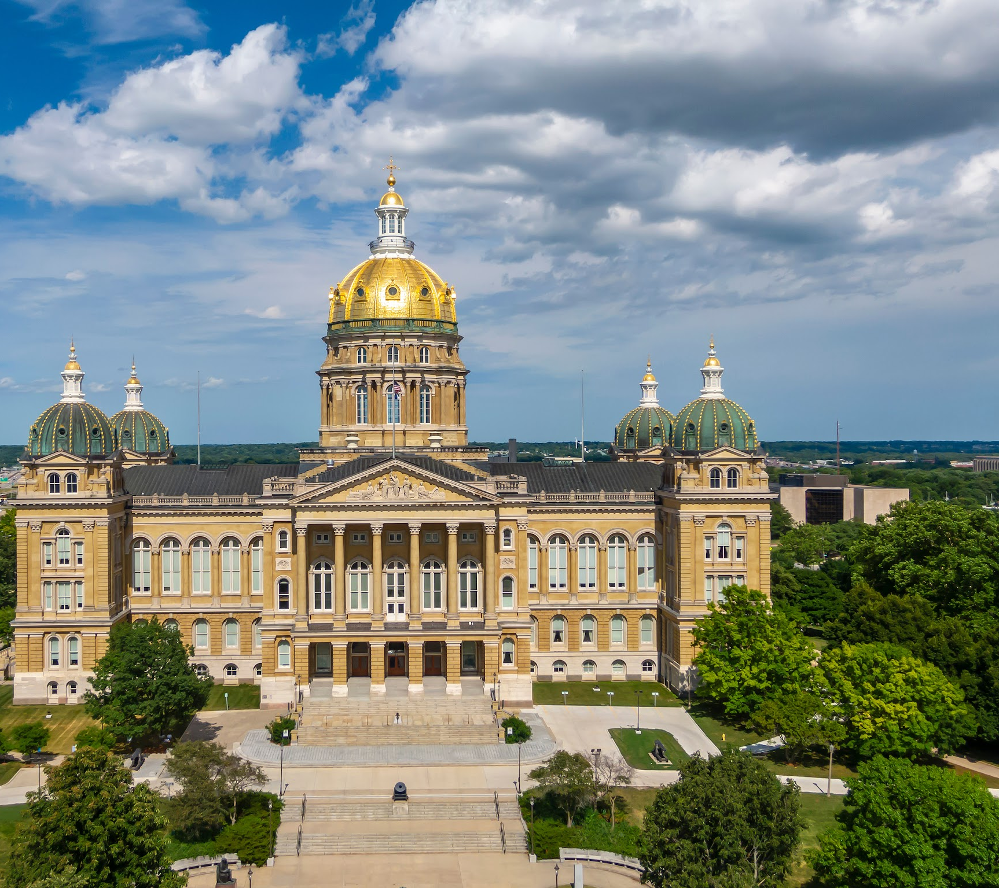

Questions?
legislativestaff@iowaleague.org

