Slide 1

Iowa’s Unclaimed
Property Program
Administered by State Treasurer Roby Smith

Slide 2


What is Great Iowa Treasure Hunt?
Roby Smith, Iowa State Treasurer
GreatIowaTreasureHunt.gov

Slide 3

What Are Examples of Unclaimed Property?
  Forgotten bank accounts
  Uncashed checks
  Insurance payouts
  Safe deposit box contents
  Utility deposits
Roby Smith, Iowa State Treasurer
GreatIowaTreasureHunt.gov

Slide 4




Who Can Have It?
Anyone can have unclaimed property, including businesses and individuals.
What Are the Odds?
Approximately 1 in 7 people have unclaimed property waiting for them.
UNCLAIMED
PROPERTY
Roby Smith, Iowa State Treasurer
GreatIowaTreasureHunt.gov

Slide 5


How Does It Happen?
After a specific period of time, unclaimed property is sent to the Treasurer’s Office. Common reasons include:
  Clerical errors
  People move
  Name changes
  Unclaimed inheritances
Roby Smith, Iowa State Treasurer
GreatIowaTreasureHunt.gov

Slide 6






How Do You Find the Rightful Owners?
24/7 Database
State Wide Events
First-Class Mail
Social Media
Public Outreach
Roby Smith, Iowa State Treasurer
GreatIowaTreasureHunt.gov

Slide 7

By the Numbers
$396+ Million Returned
1+ Million Owners Reunited
$587 Million Currently Safekeeping
Roby Smith, Iowa State Treasurer
GreatIowaTreasureHunt.gov

Slide 8

Prevent Your Assets from Becoming Unclaimed
  Update institutions with name or address changes.
  Keep records of accounts, policies and investments.
  Cash or deposit checks promptly.
  Respond to account confirmation requests.
  Use gift cards promptly.
Roby Smith, Iowa State Treasurer
GreatIowaTreasureHunt.gov

Slide 9




Claiming Property
Step 1
Step 2
Step 3
Search your name at GreatIowaTreasureHunt.gov.
Select all the properties you are claiming.
Complete the form and verify your identity.
Check back often for new properties, including those for family and friends!
Roby Smith, Iowa State Treasurer
GreatIowaTreasureHunt.gov

Slide 10

Reporting Unclaimed Property
Entities must review records annually for unclaimed property and report it to the State.
Examples of reportable property:
  Uncashed payroll checks
  Dormant accounts
  Insurance payouts
Deadline: Reports must be filed on or before November 1 each year.
Roby Smith, Iowa State Treasurer
GreatIowaTreasureHunt.gov

Slide 11

Dormancy Requirements
Property Type
Wages, Commissions & Utility Deposits/Refunds
Stocks & Dividends
Accounts, Checks & Safe Deposit Boxes
Court Deposits
Government
Dormancy Period
1 year
3 years
3 years
2 years
2 years
Last Activity Date
June 30, 2024
June 30, 2022
June 30, 2022
June 30, 2023
June 30, 2023
Roby Smith, Iowa State Treasurer
GreatIowaTreasureHunt.gov

Slide 12



Steps for Reporting
Step 1
Step 2
Step 3
Step 4
Identify reportable property.
Contact owners by sending a due diligence letter.
Submit the report using NAUPA format.
Remit payment to the State.
Roby Smith, Iowa State Treasurer
GreatIowaTreasureHunt.gov

Slide 13




What Information is
Required to Report?
Owner’s name, last known address, date of birth and Social Security number (if available)
Date of last owner activity
Amount
Type of property
Roby Smith, Iowa State Treasurer
GreatIowaTreasureHunt.gov

Slide 14
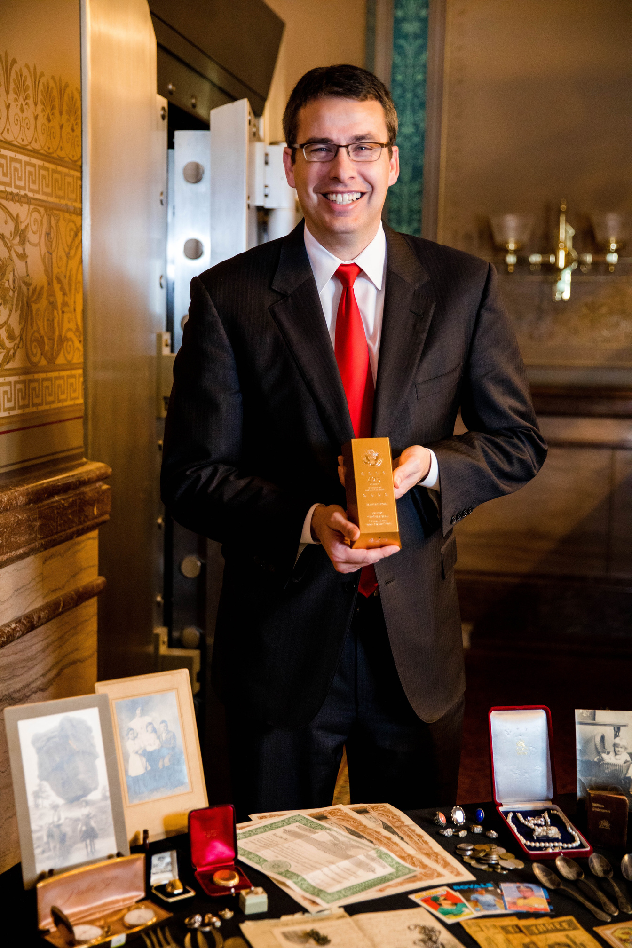
Reporting
Resources
Access manuals, payment resources, codes, rules, FAQs and links on the Great Iowa Treasure Hunt website.
Roby Smith, Iowa State Treasurer
GreatIowaTreasureHunt.gov

Slide 15

Submitting A Report
Electronic Reporting Required:
Reports must be submitted in NAUPA format.
Roby Smith, Iowa State Treasurer
GreatIowaTreasureHunt.gov

Slide 16
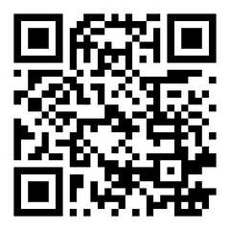
Questions?
Thank you!
GreatIowaTreasureHunt.gov
Follow @IowaTreasurer on Facebook, Instagram and X.
Scan the QR code to search and see if you or someone you know has unclaimed money!
Roby Smith, Iowa State Treasurer
GreatIowaTreasureHunt.gov

