Slide 1

1st Amendment Auditors
Do’s and Don’ts – It’s never personal

Slide 2
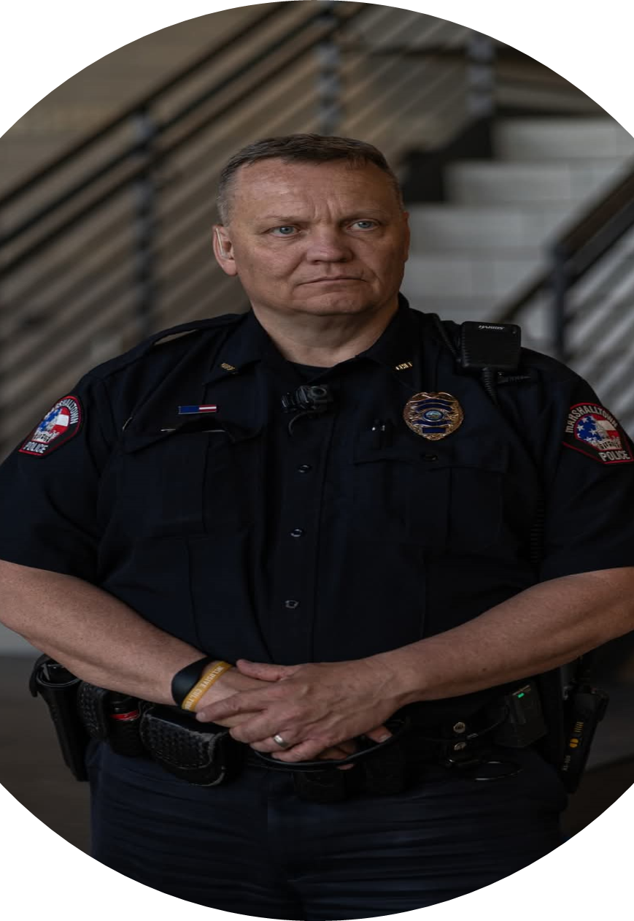

Mike Tupper
Law Enforcement Risk Control Specialist
BA – Criminal Justice
FBI National Academy Graduate
32 years law enforcement experience
20 years as a police chief

Slide 3
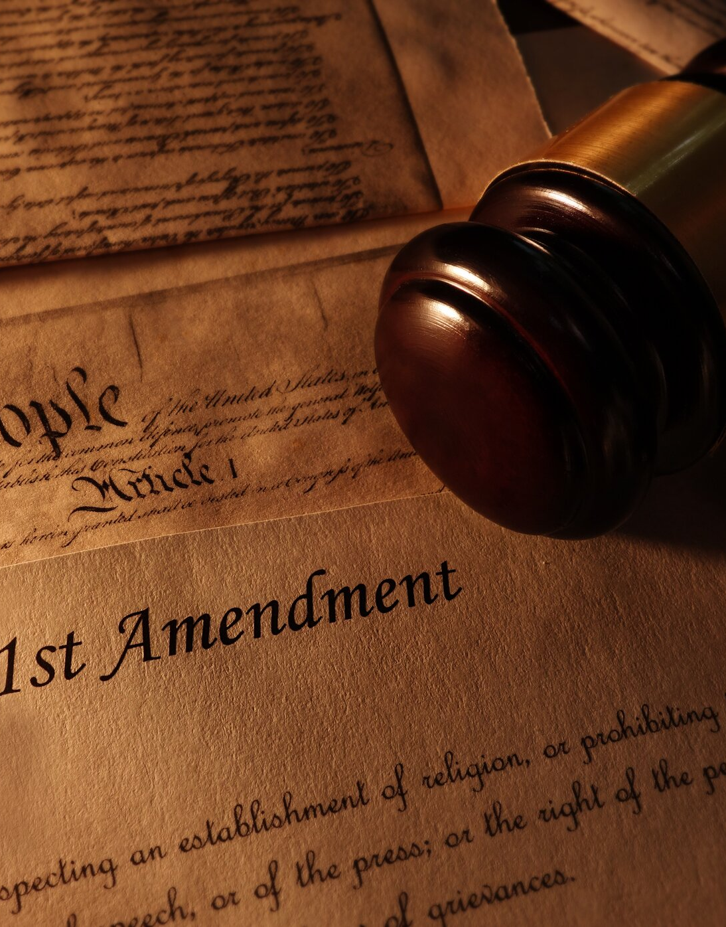
Agenda
1st Amendment Auditors – who are they?
Common Tactics
Recording in Public Spaces
Legal Thoughts
Final Tips and Takeaways

Slide 4
Legal Disclaimer
“FIRST, I’m not a lawyer”
This presentation is not a substitute for professional legal advice, nor is it a solicitation to offer legal advice
Always work with your legal advisor when faced with questions of law or legality of action

Slide 5

The Power of Communication
Control the Moment
It is not Personal

Slide 6
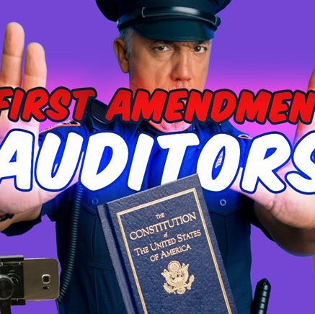
Who Are They?
https://www.youtube.com/shorts/_BV5U5jA24s?feature=share
Notes:
https://www.youtube.com/shorts/_BV5U5jA24s?feature=share

Slide 7
1st Amendment Auditors
What are they doing?
Record
Test
Release
First Amendment auditors are individuals who record interactions with government officials and public spaces, often in public buildings or areas, to test and document their rights under the First Amendment
They aim to ensure government employees and officials respect First Amendment rights, particularly freedom of speech and the press
Potentially sharing these recordings and interactions online, primarily on platforms like YouTube

Slide 8

Common
Tactics
What can you do?

Slide 9
Auditors record interactions with public officials and post videos to the Internet as a form of activism

Slide 10
Common Tactics
What do they do?
Unannounced Filming
Auditors enter public buildings, often with cameras already rolling, to record interactions with government employees without warning
Provocation
They ask repeated, provocative questions, make statements designed to inflame, or use profanity to elicit an angry or aggressive response from officials
Video
Cop Gets Owned So Bad, He Quits! Ultimate First Amendment Audit! Grundy County, Iowa! #funny #1a.
Notes:
Cop Gets Owned So Bad, He Quits! Ultimate First Amendment Audit! Grundy County, Iowa! #funny #1a.

Slide 11
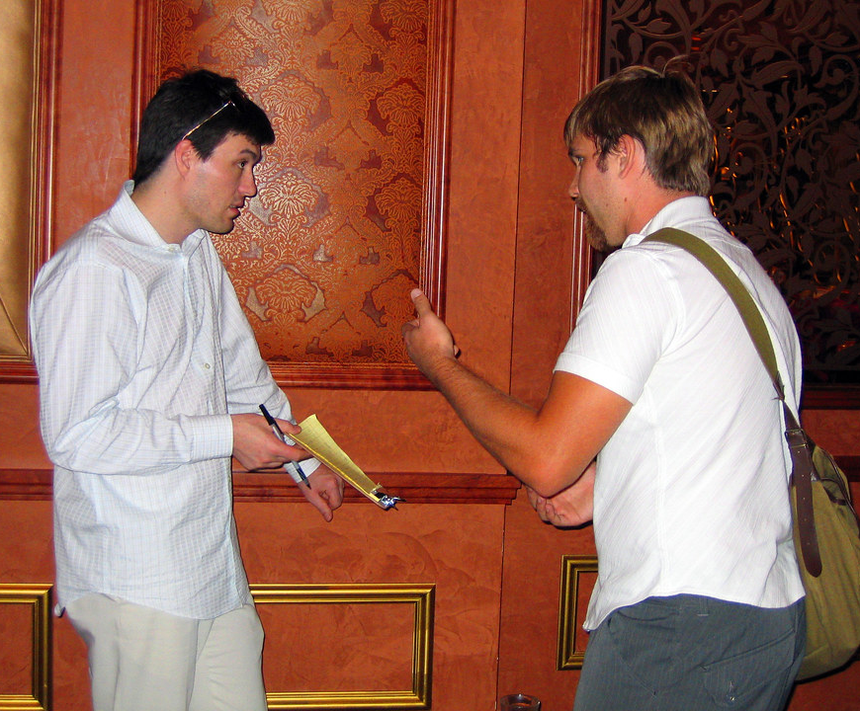
Common Tactics
What do they do?
Intimidation
Tactics can include refusing to leave when asked, making demands, or entering public spaces while openly carrying firearms to create a tense or fearful situation
Selective Editing
Auditors may edit the recorded footage to make officials appear in a negative light, often leading to public backlash or a deluge of hateful messages
Testing for Violations
The stated intent is often to "test" whether officials respect their First Amendment rights, but the real goal is to provoke a reaction they can exploit

Slide 12

Goal:
Provoke negative response, unlawful detainment, 1st Amendment rights violations

Slide 13
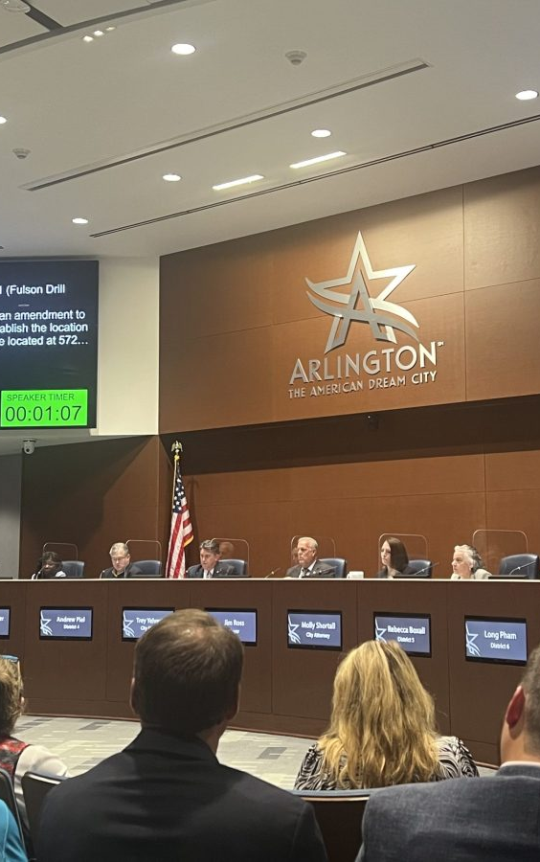
Public Forums
Where do they usually target?
Exploiting at Public Forums
Auditors use the traditional right to record and assemble in public spaces to their advantage, challenging rules about recording in areas traditionally open to the public
Where
Typically conducted at police stations, city halls, and public buildings
Liability
Can expose you to severe Liability: Colorado Springs - $41k for wrongful detainment

Slide 14
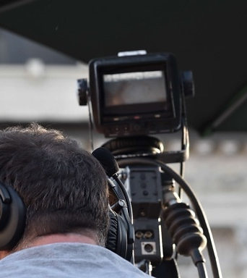
Recording
In Public Spaces

Slide 15
Are these Audits Legal?

Slide 16
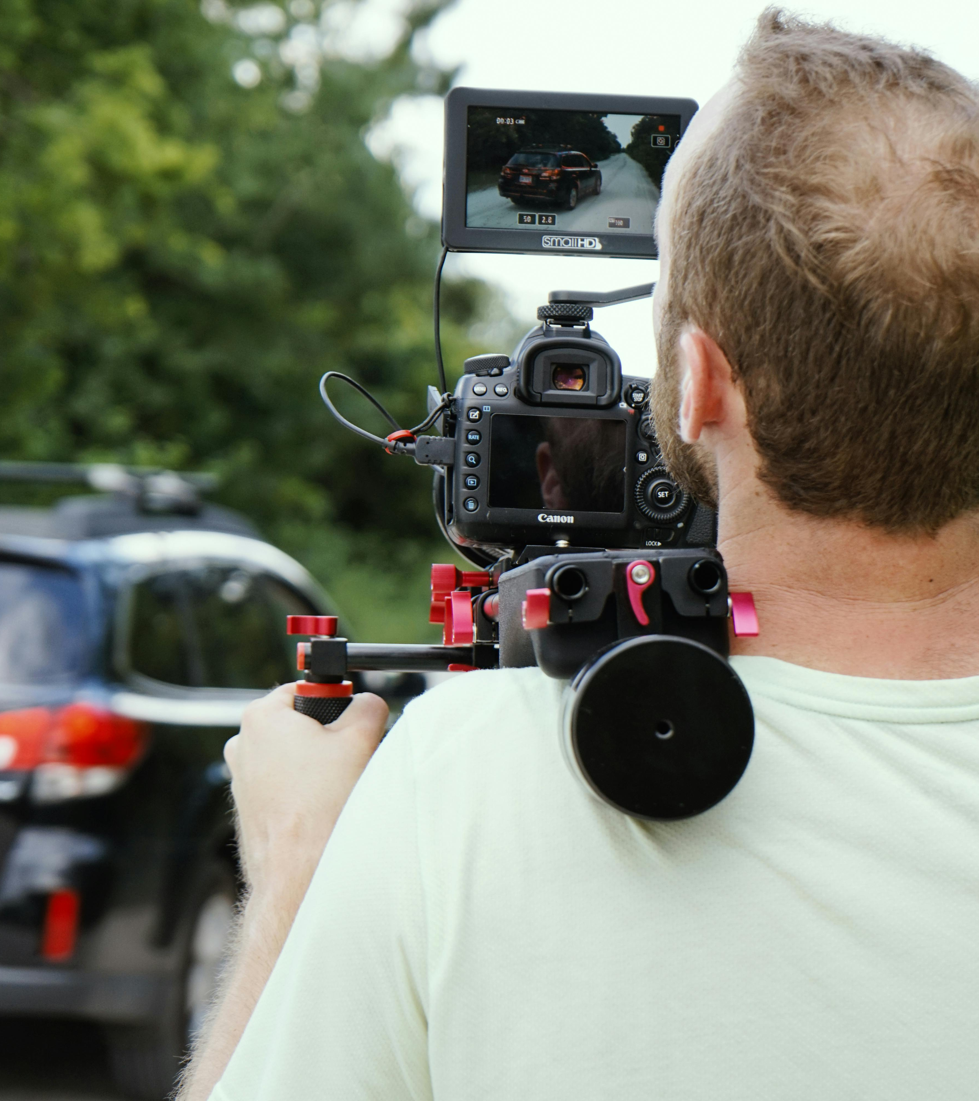
Yes!
Recording public officials conducting public business, as well as public spaces, is 100% legal.

Slide 17
If they are in a public space, they are permitted to be there
Treat auditors like any other visitor or community member
It is never personal!

Slide 18
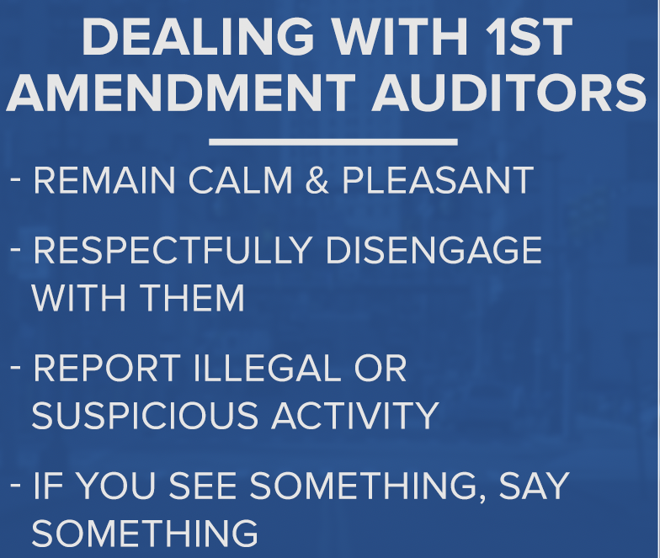
What
to do?

Slide 19

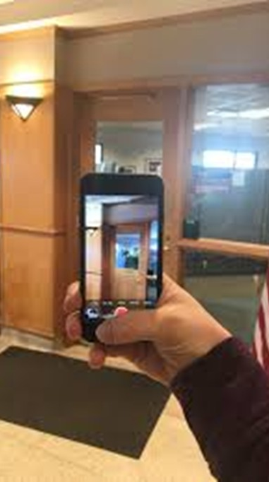
Review What is Public Facing
Protect private information and documents
Public v. Employee Only Areas
But…
if you bring someone into a private area…it may now be public

Slide 20
If an auditor sees this…you cannot bar the auditor from entering

Slide 21
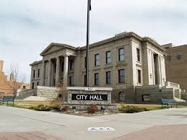
Consider determining in advance who handles services for 1st Amendment Auditors

Slide 22
Rule #1
It is never personal. Stay calm!

Slide 23
What can you do?
01
02
03
04
Avoid Confrontation
Be Boring
No Sarcasm Zone
Business as Usual

Slide 24
What can you do?
05
06
07
08
Stay Professional
Follow Policies
Follow Public Record Laws
Be Polite

Slide 25
What can you do?
Avoid
Remember
Record
Contact
Avoid debating and continue with your duties
Remember to answer basic public information questions such as first name and title
DO NOT record the auditor, argue with them, engage in a physical altercation, detain, or try to confiscate the recording
Contact law enforcement if laws are being broken

Slide 26
Public
Records Requests

Slide 27
Public Record Requests
What to do
Offer
Information
Policies
Offer an opportunity to make a written request but this is not required
They do not have to give name, etc
Follow policies and Iowa law

Slide 28
Public Records Requests
Responsibilities
Be Reasonable
Be Responsive
Be Timely

Slide 29
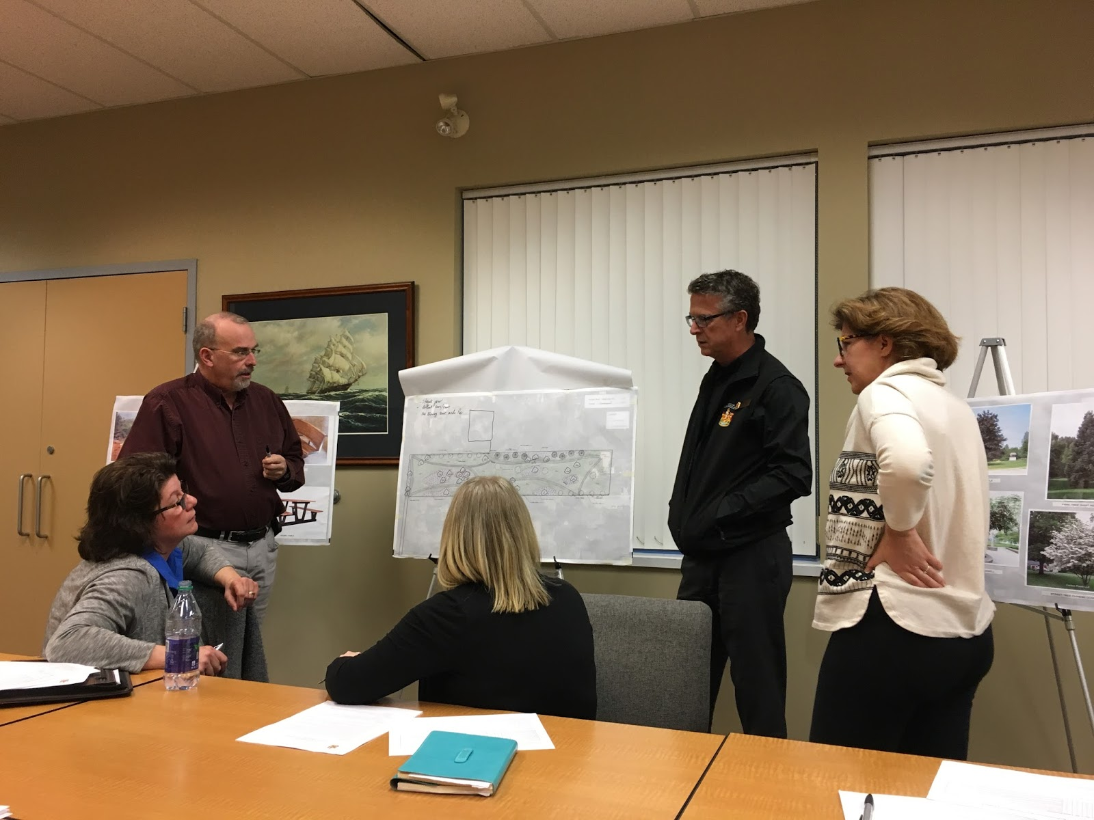
Complaints About Employees

Slide 30

Complaints about Employees
What to do
Follow Protocols
Won’t be able to Resolve Immediately

Slide 31

What to do After the Audit

Slide 32
Take a deep breath – That was stressful!

Slide 33
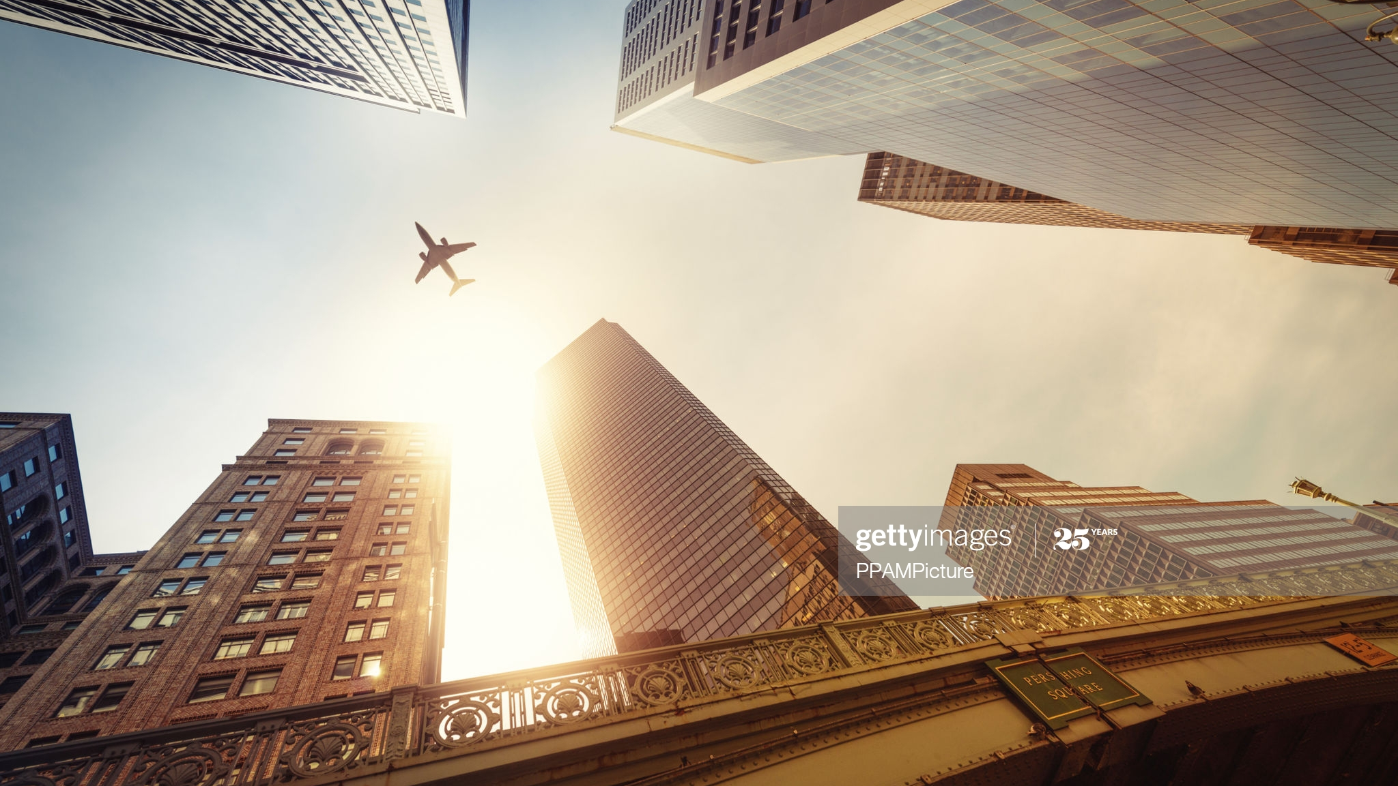
Report to Executive Authority
Go Back to Providing Great Service!

Slide 34
Case Law

Slide 35
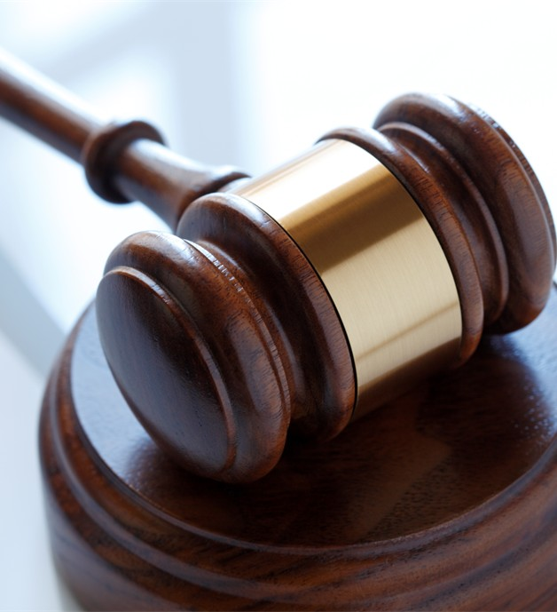
Glik v. Cunniffe
United States Court of Appeals for the First Circuit held that a private citizen has the right to record video and audio of police carrying out their duties in a public place
Court also noted that the right to film public officials was subject to reasonable limitations with respect to the time, place and manner in which the recording was conducted

Slide 36
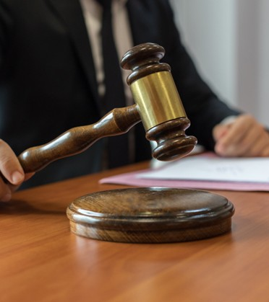
Fields v. City of Philadelphia
People have the right to gather news from any legal source about the way government operates
Can record police in public, performing job
Don’t seize electronic devices without legal cause

Slide 37
Time, Place and Manner Restrictions
Numerous court cases, most notably the case of Glik v. Cunniffe, have also ruled that filming protections are subject to time, place, and manner restrictions, including in the majority of public buildings. Limitations include, but are not limited to, trespassing on public or private property, entering an established crime scene (whether marked or unmarked by crime scene tape or other methods), or materially interfering with police activities
The United States Supreme Court case of Grayned v. City of Rockford (1972) clarifies and defines the parameters of time, place, and manner restrictions and is often cited when removing First Amendment auditors who are in violation of its guidelines. Conversely, it is also cited when protecting First Amendment auditors who are acting within its parameters

Slide 38
Police: Handling a First Amendment Audit - Today's Tip from Lexipol

Slide 39
Thank You!
Michael W. Tupper
Iowa Communities Assurance Pool
Law Enforcement Risk Control Specialist
mike@icapiowa.com
641.777.3259

